Slide 1
Matrices - Operations
INVERSE OF A MATRIX
Consider a scalar k. The inverse is the reciprocal or division of 1 by the scalar.
Example:
k=7 the inverse of k or k⁻¹ = 1/k = 1/7
Division of matrices is not defined since there may be AB = AC while B = C
Instead matrix inversion is used.
The inverse of a square matrix, A, if it exists, is the unique matrix A⁻¹ where:
AA⁻¹ = A⁻¹ A = I

Slide 2
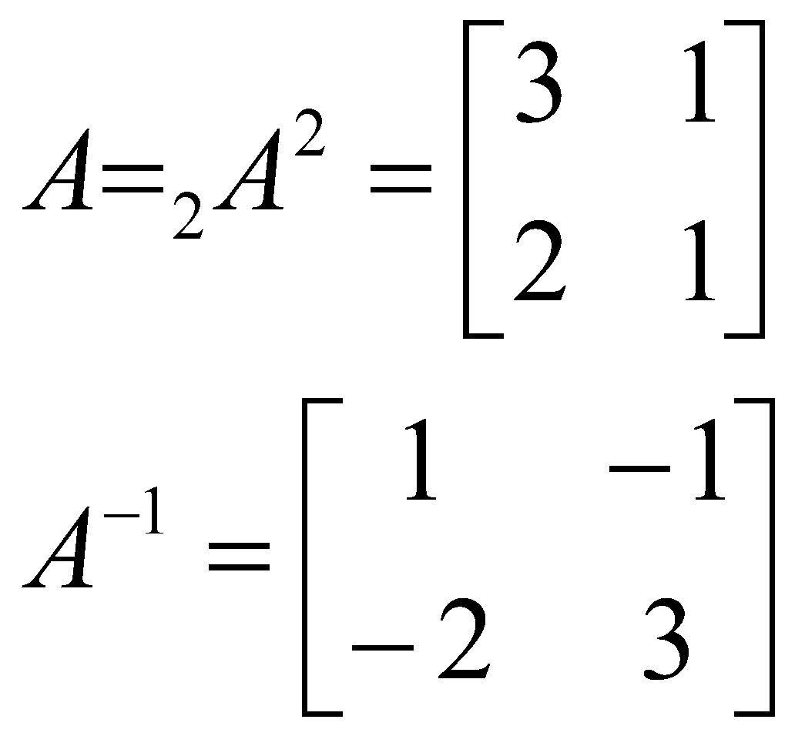
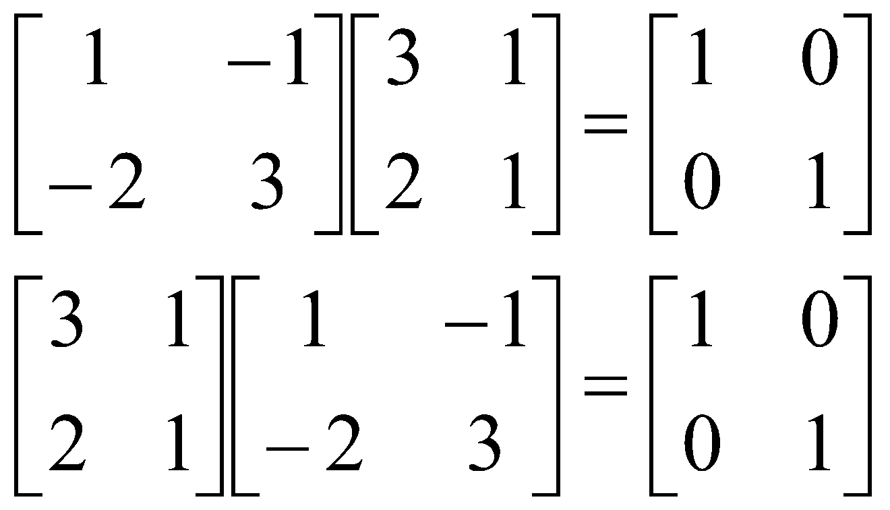
Matrices - Operations
Example:
Because:

Slide 3
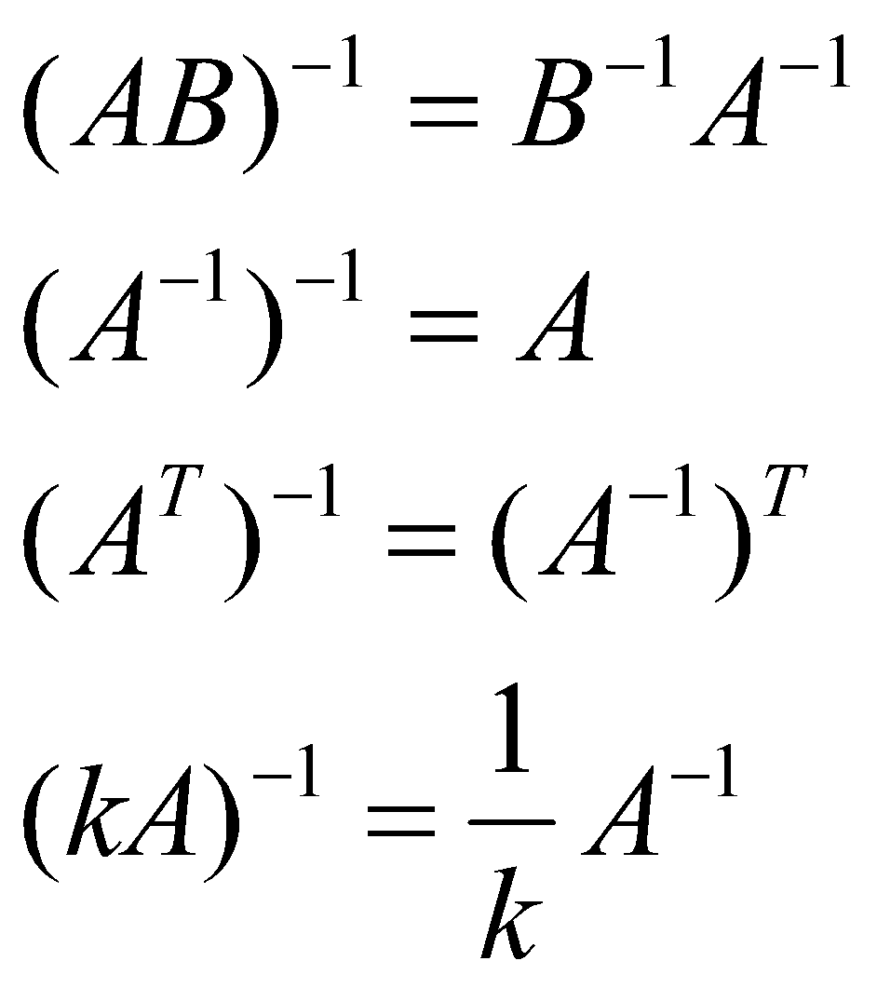
Matrices - Operations
Properties of the inverse:
A square matrix that has an inverse is called a nonsingular matrix
A matrix that does not have an inverse is called a singular matrix
Square matrices have inverses except when the determinant is zero
When the determinant of a matrix is zero the matrix is singular

Slide 4
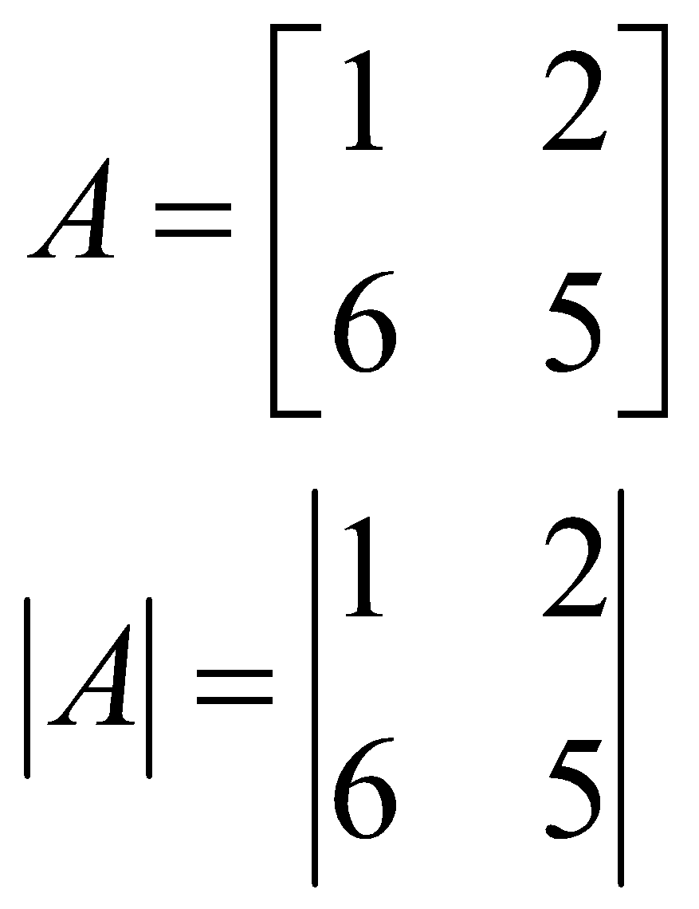
Matrices - Operations
DETERMINANT OF A MATRIX
To compute the inverse of a matrix, the determinant is required
Each square matrix A has a unit scalar value called the determinant of A, denoted by det A or |A|
If
then

Slide 5
Matrices - Operations
If A = [A] is a single element (1x1), then the determinant is defined as the value of the element
Then |A| =det A = a₁₁
If A is (n x n), its determinant may be defined in terms of order (n-1) or less.

Slide 6
Matrices - Operations
MINORS
If A is an n x n matrix and one row and one column are deleted, the resulting matrix is an (n-1) x (n-1) submatrix of A.
The determinant of such a submatrix is called a minor of A and is designated by m_{ij} , where i and j correspond to the deleted
row and column, respectively.
m_{ij} is the minor of the element a_{ij} in A.

Slide 7
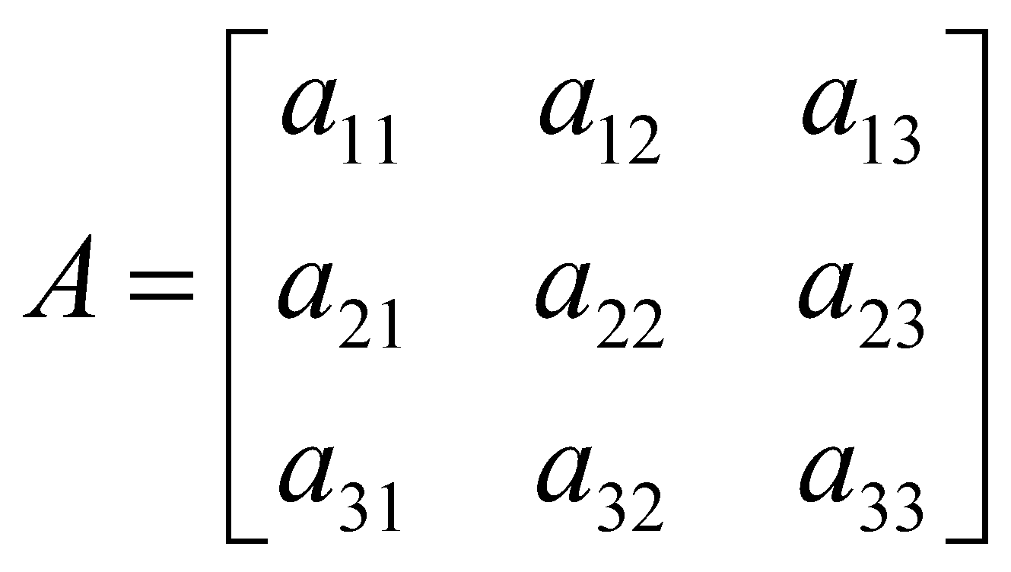
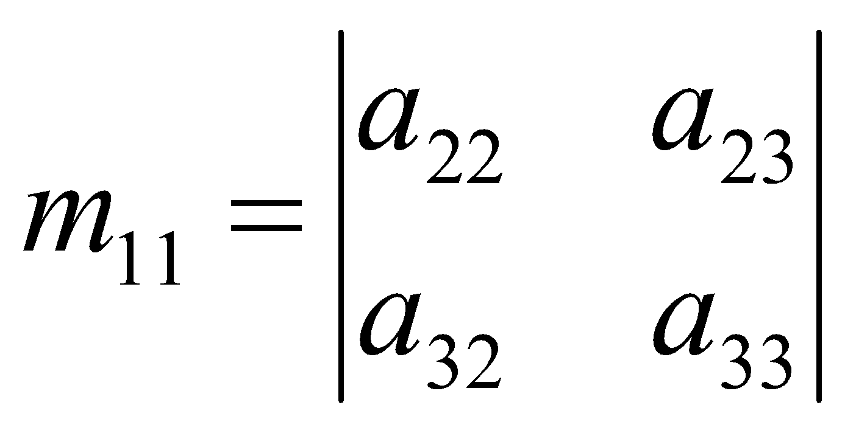
Matrices - Operations
eg.
Each element in A has a minor
Delete first row and column from A .
The determinant of the remaining 2 x 2 submatrix is the minor of a₁₁

Slide 8
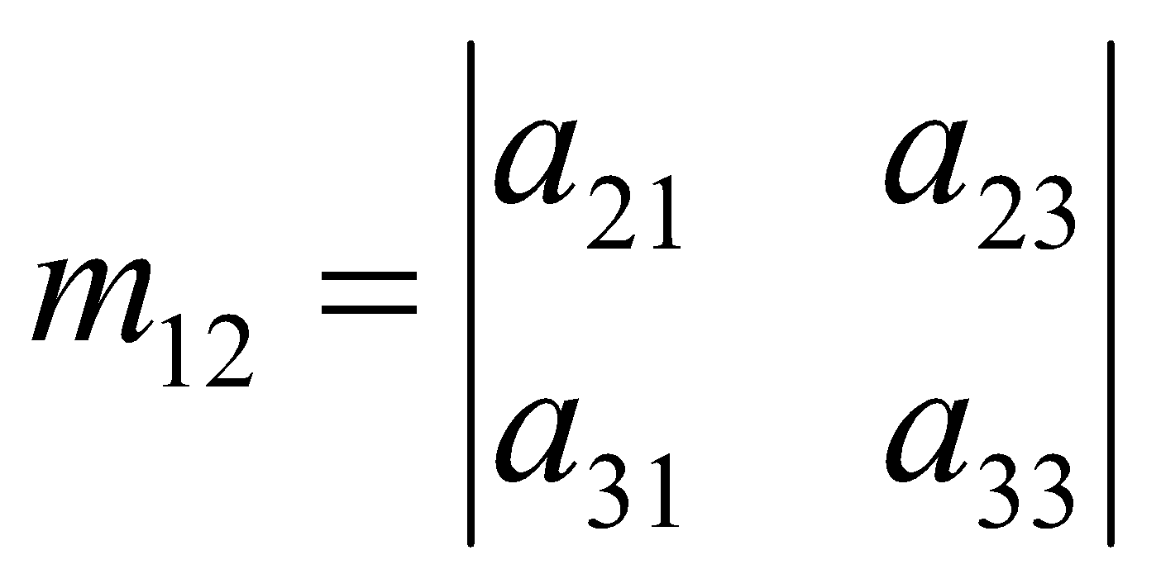
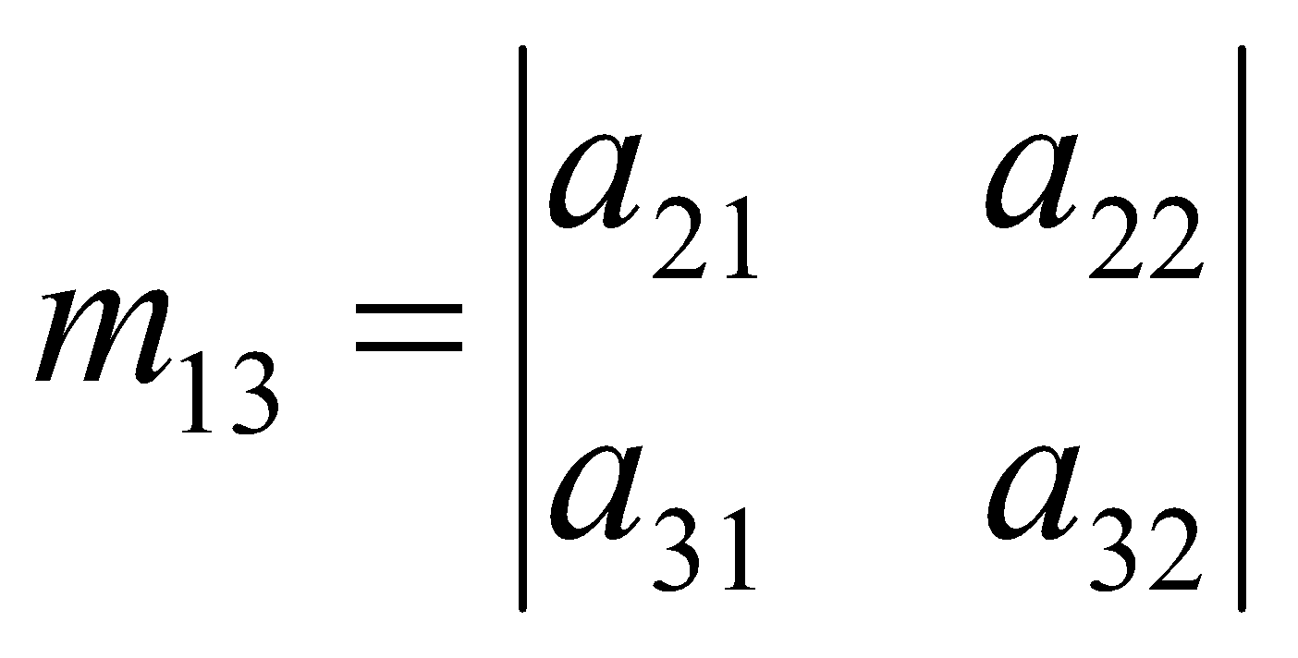
Matrices - Operations
Therefore the minor of a₁₂ is:
And the minor for a₁₃ is:

Slide 9
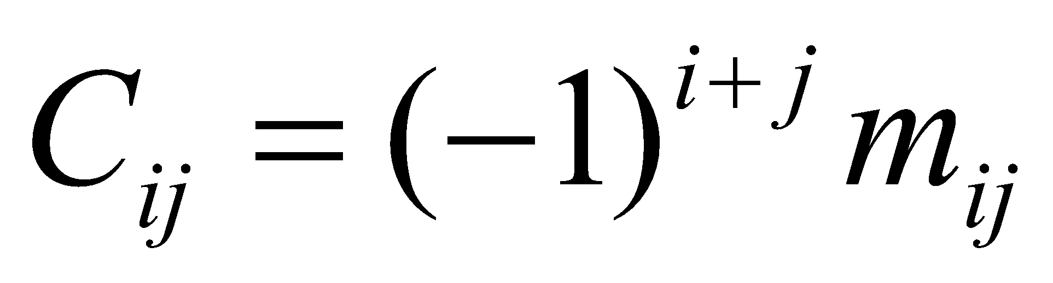
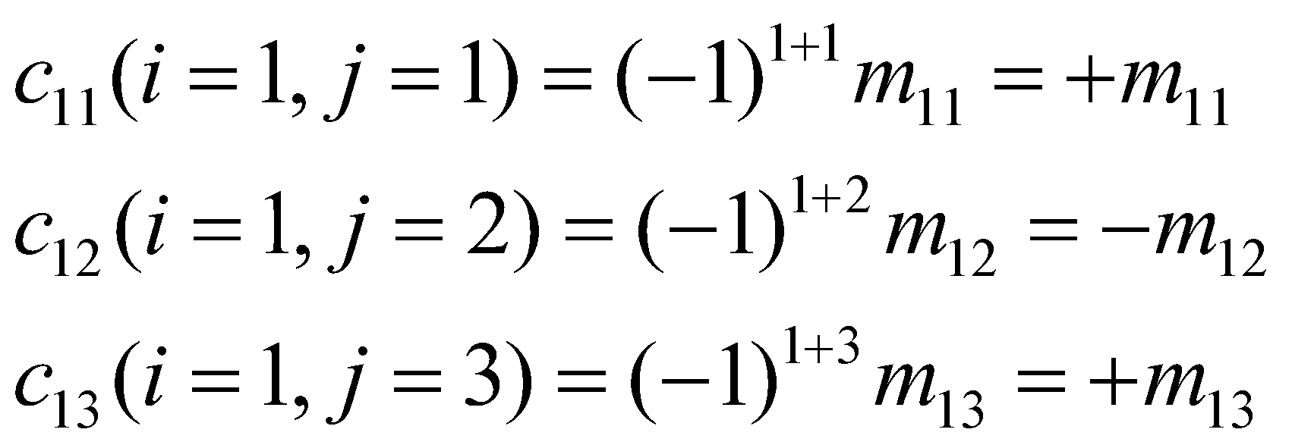
Matrices - Operations
COFACTORS
The cofactor C_{ij} of an element a_{ij} is defined as:
When the sum of a row number i and column j is even, c_{ij} = m_{ij} and when i+j is odd, c_{ij} =-m_{ij}

Slide 10
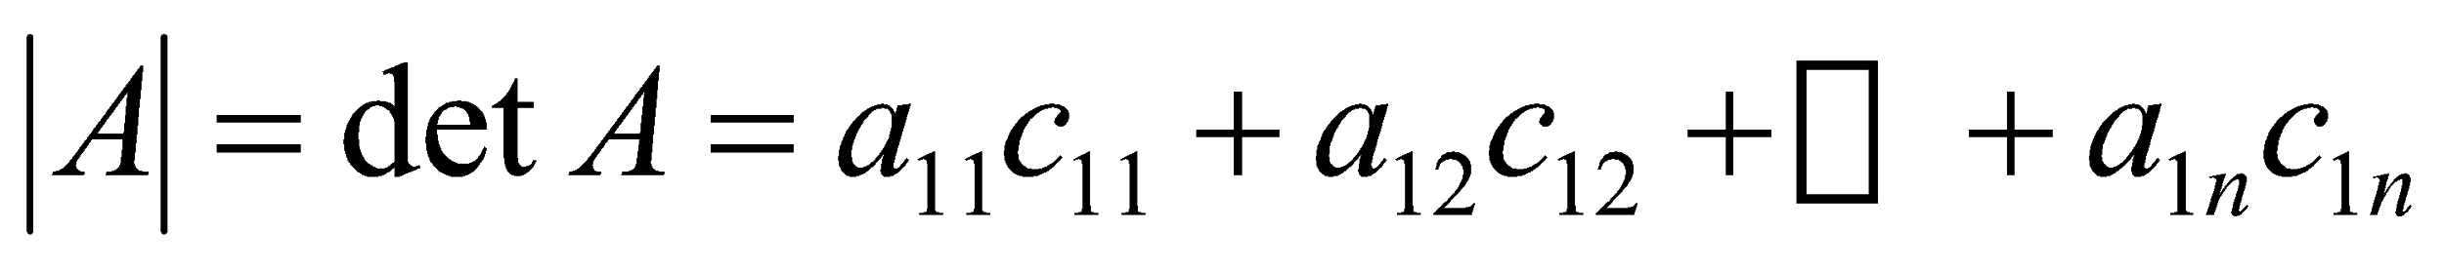
Matrices - Operations
DETERMINANTS CONTINUED
The determinant of an n x n matrix A can now be defined as
The determinant of A is therefore the sum of the products of the elements of the first row of A and their corresponding cofactors.
(It is possible to define |A| in terms of any other row or column but for simplicity, the first row only is used)

Slide 11
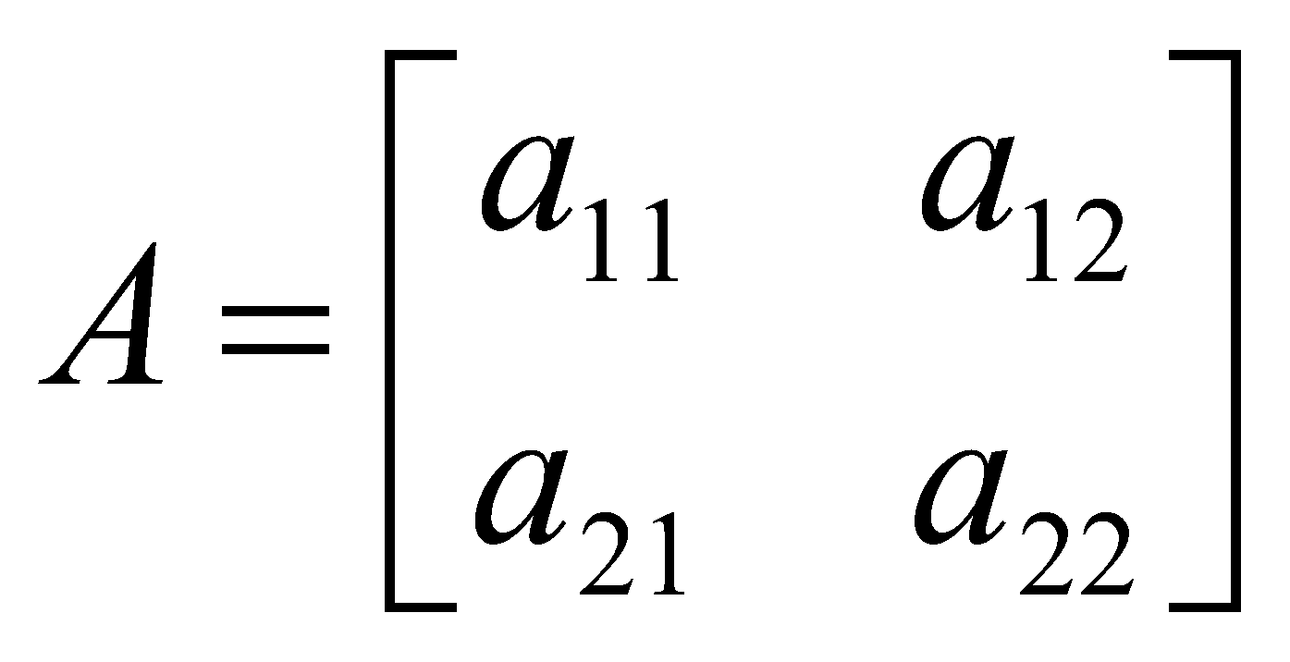
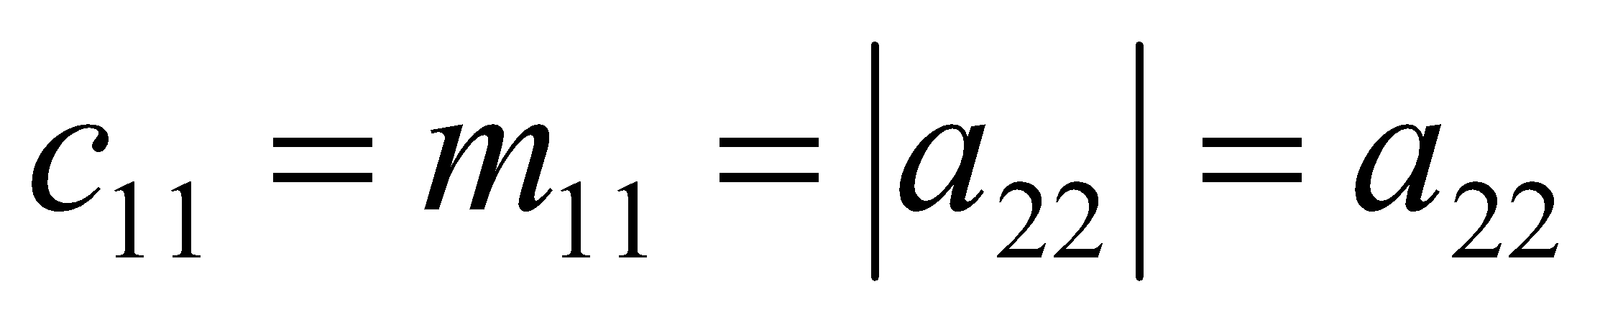
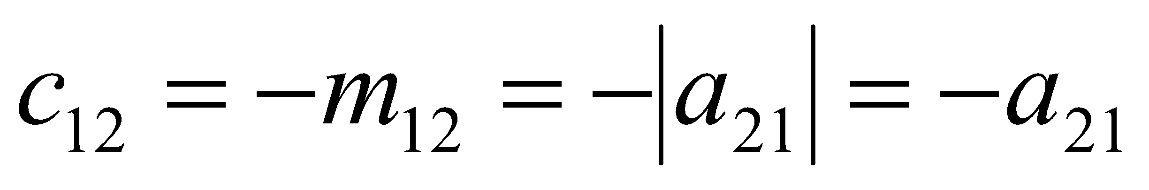
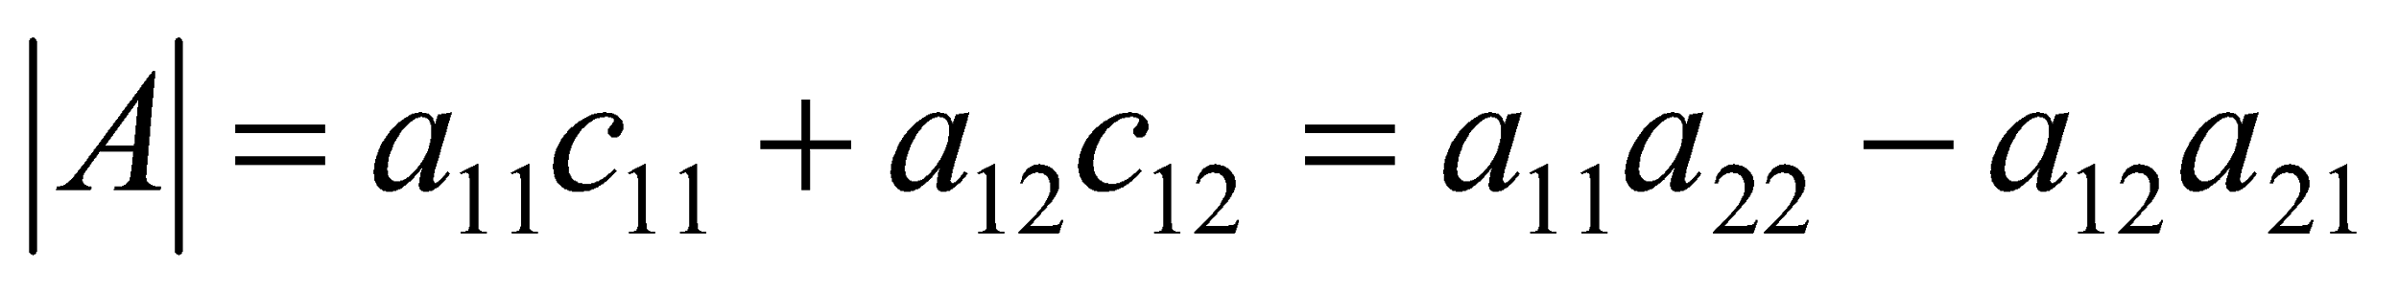
Matrices - Operations
Therefore the 2 x 2 matrix :
Has cofactors :
And:
And the determinant of A is:

Slide 12
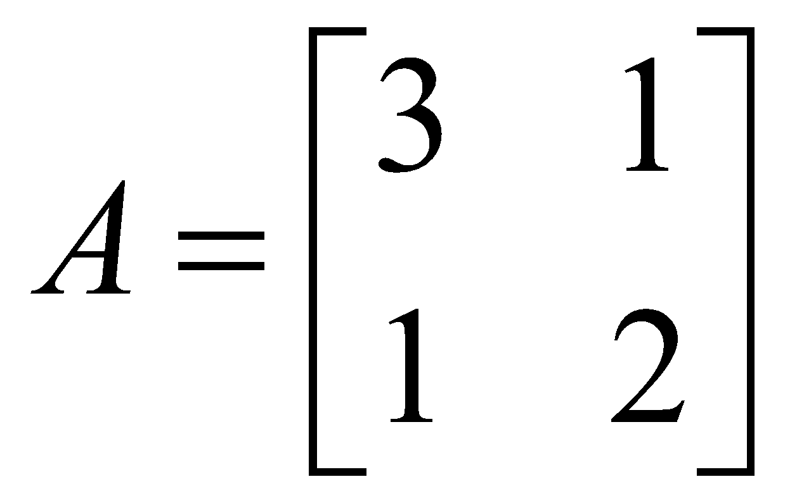
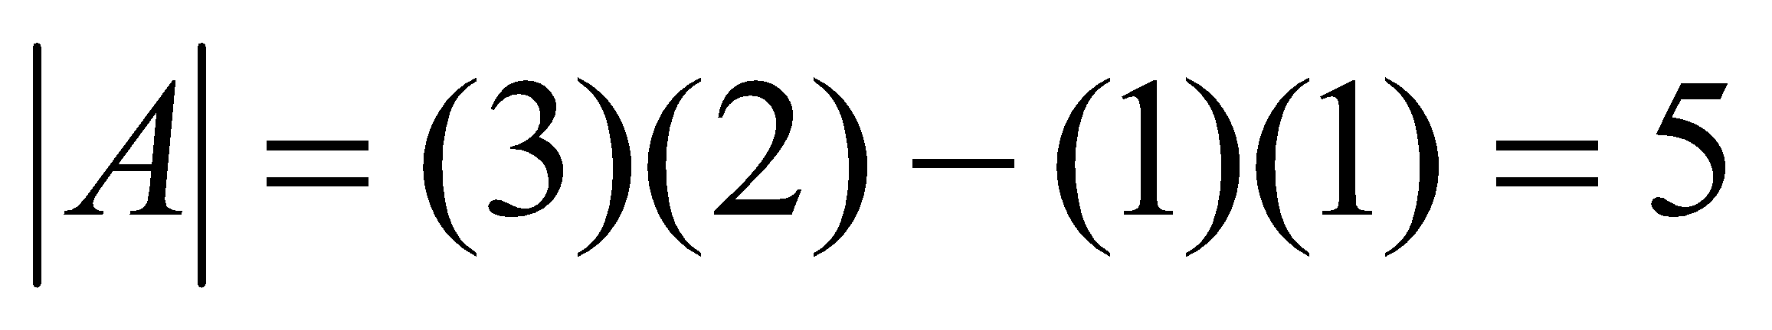
Matrices - Operations
Example 1:

Slide 13
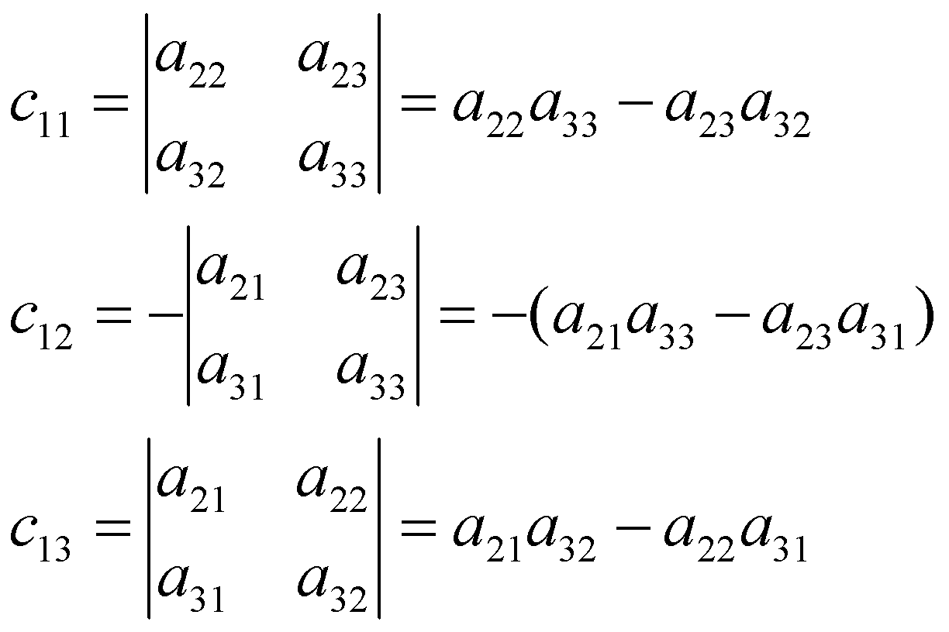
Matrices - Operations
For a 3 x 3 matrix:
The cofactors of the first row are:

Slide 14
Matrices - Operations
The determinant of a matrix A is:
Which by substituting for the cofactors in this case is:

Slide 15
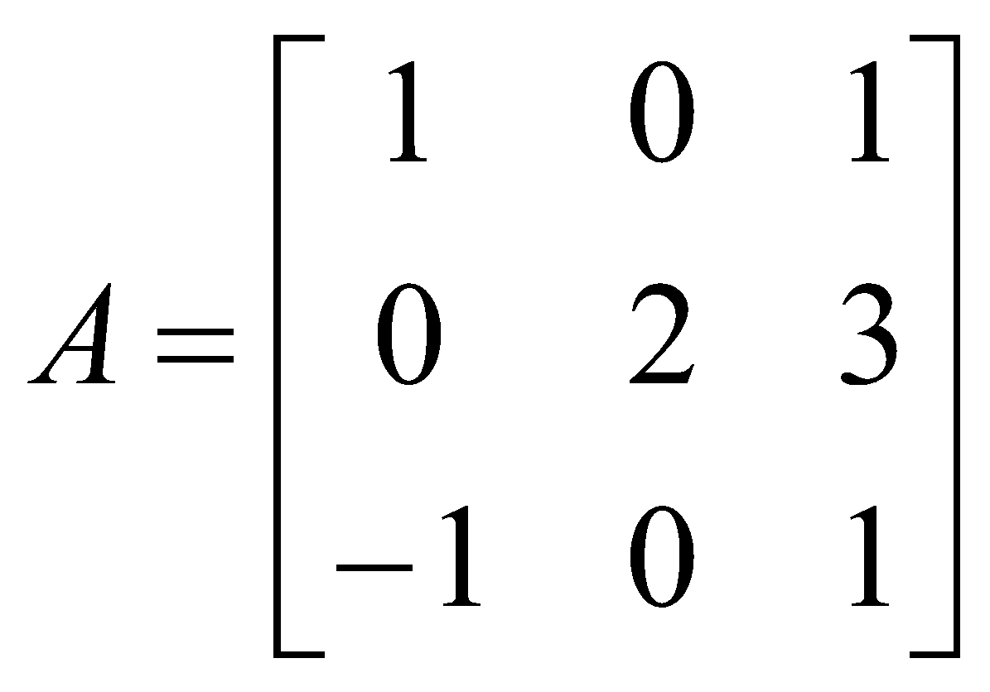
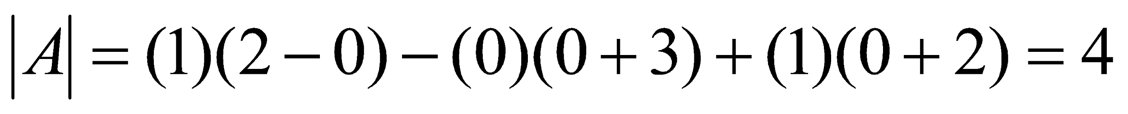
Matrices - Operations
Example 2:

Slide 16
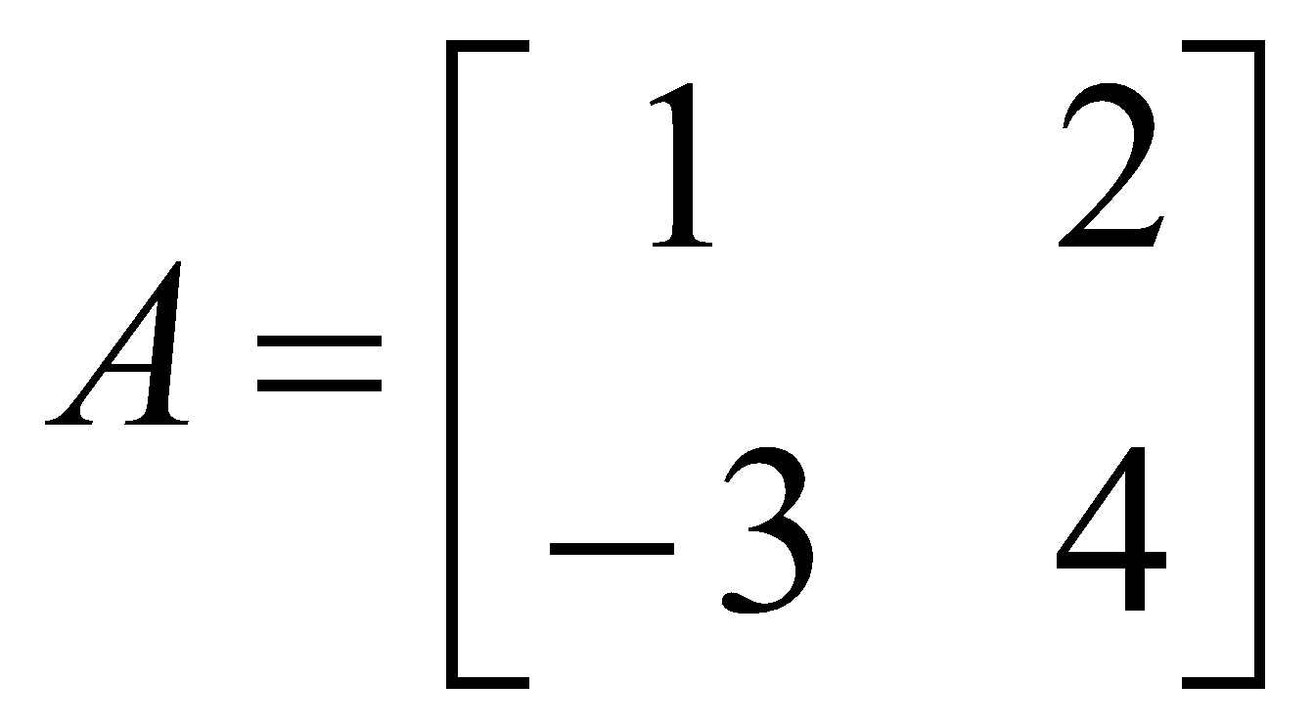
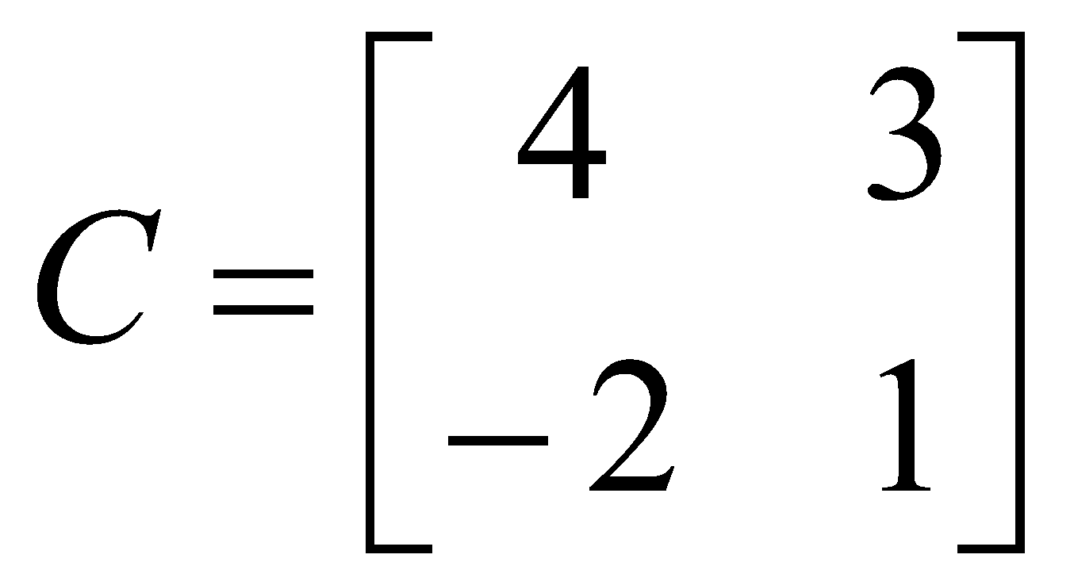
Matrices - Operations
ADJOINT MATRICES
A cofactor matrix C of a matrix A is the square matrix of the same order as A in which each element a_{ij} is replaced by its cofactor c_{ij} .
Example:
If
The cofactor C of A is

Slide 17

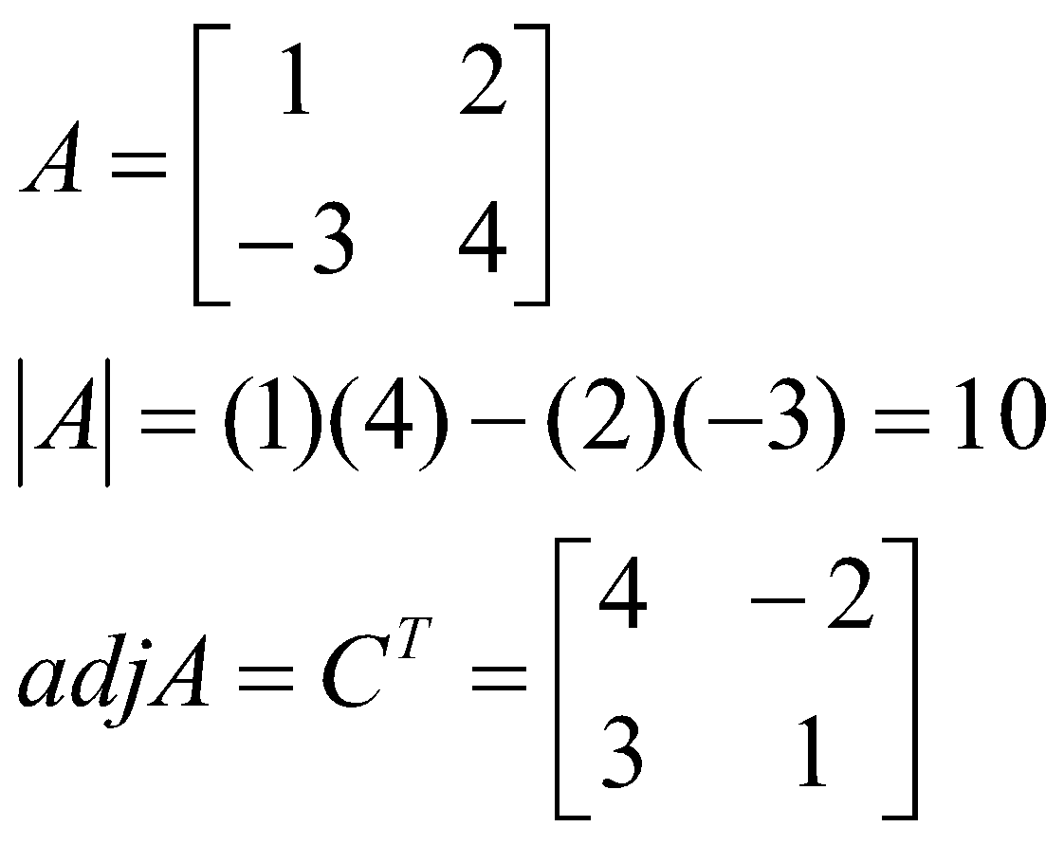
Matrices - Operations
The adjoint matrix of A, denoted by adj A, is the transpose of its cofactor matrix
It can be shown that:
A(adj A) = (adjA) A = |A| I
Example:

Slide 18
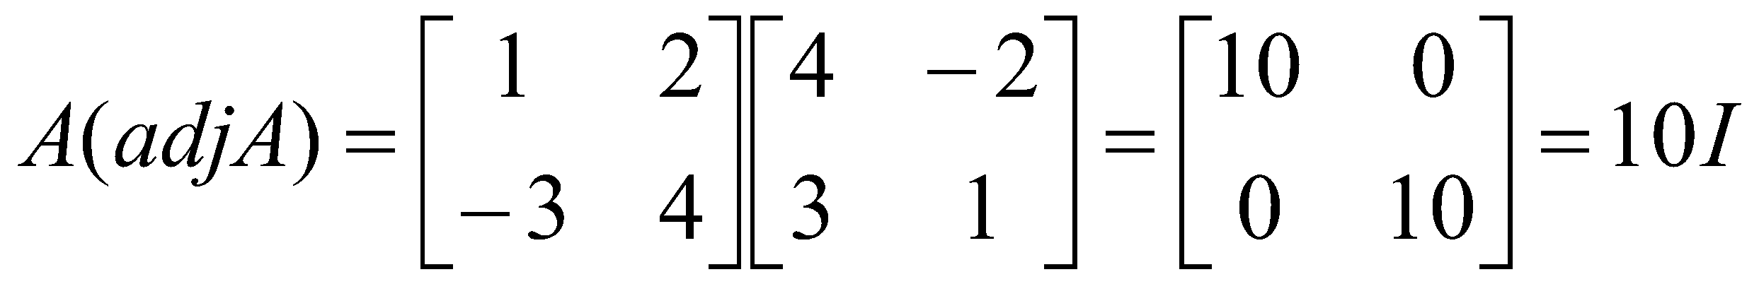
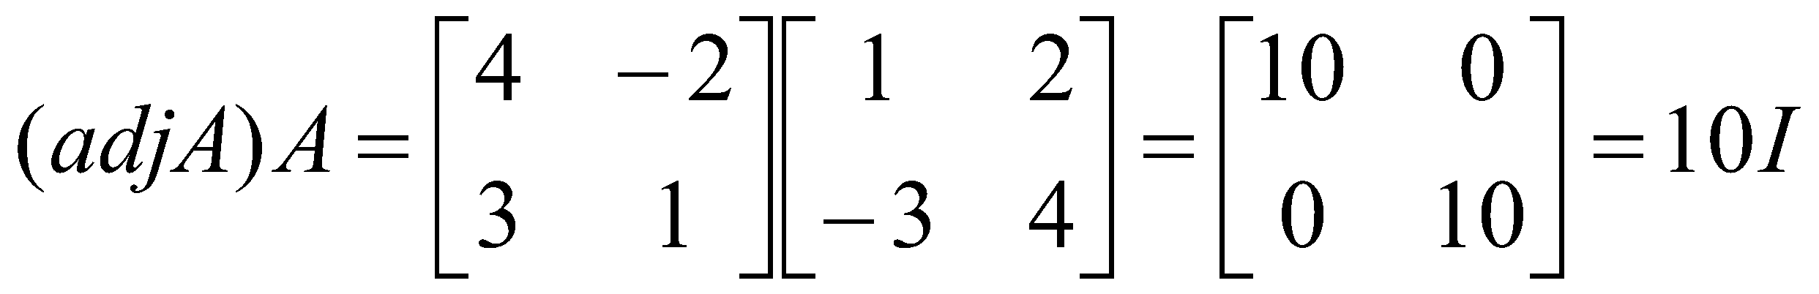
Matrices - Operations

Slide 19
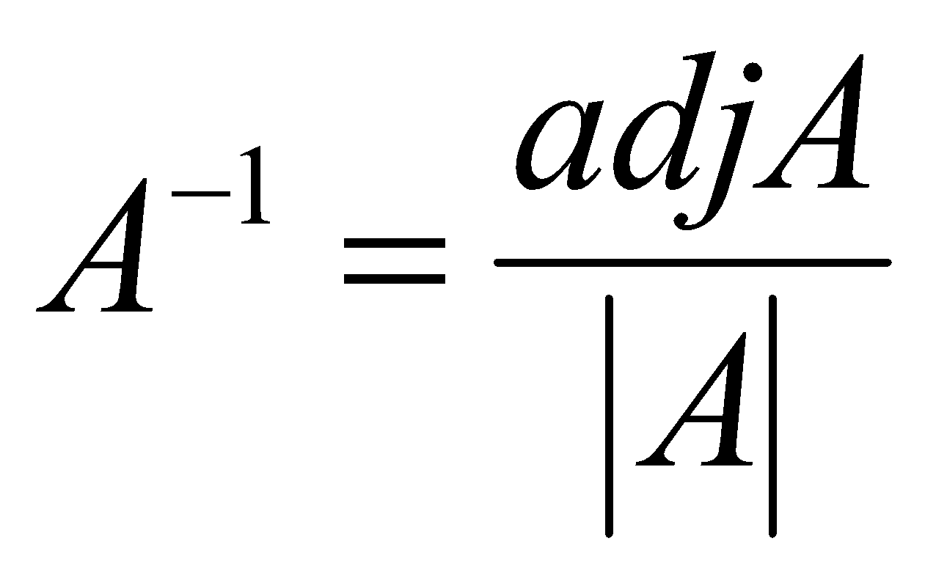
Matrices - Operations
USING THE ADJOINT MATRIX IN MATRIX INVERSION
Since
AA⁻¹ = A⁻¹ A = I
and
A(adj A) = (adjA) A = |A| I
then

Slide 20
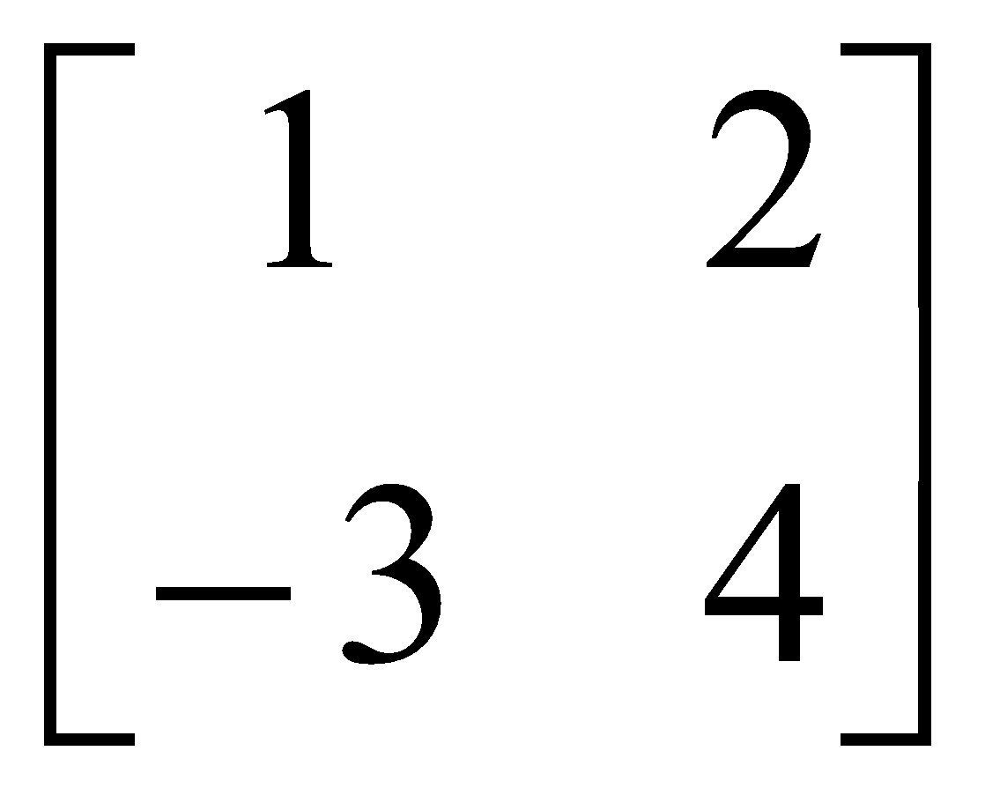
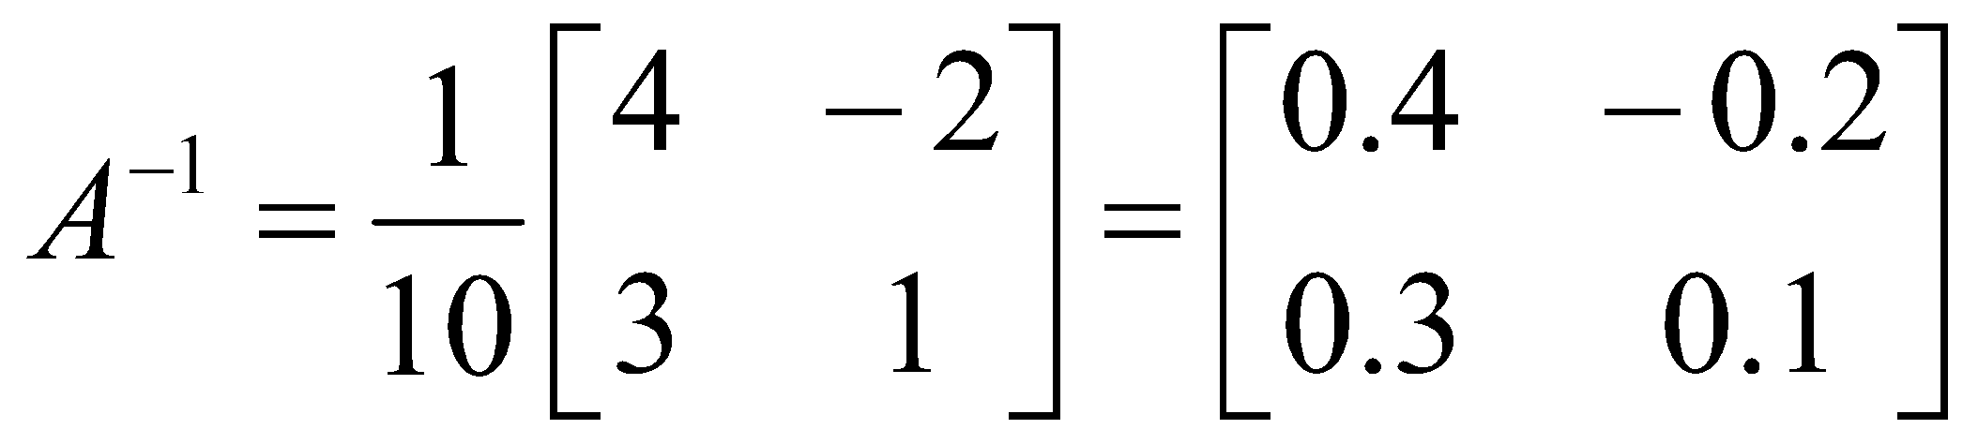
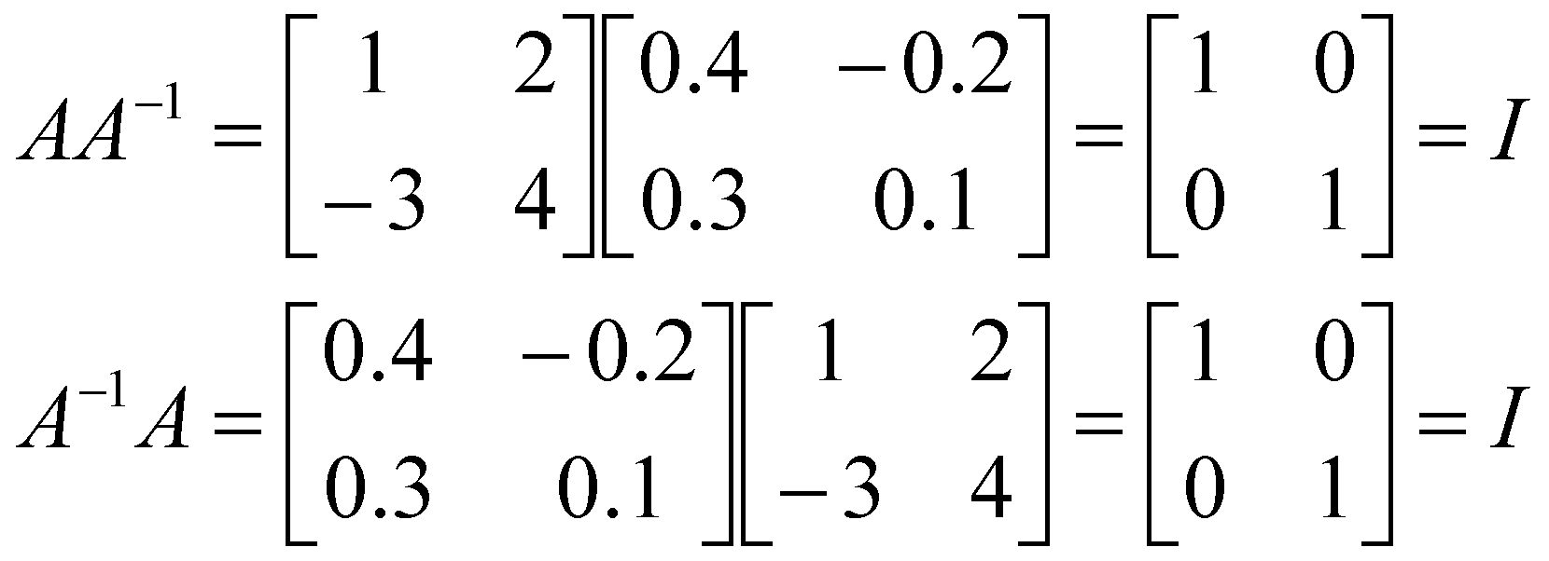
Matrices - Operations
Example
A =
To check
AA⁻¹ = A⁻¹ A = I

Slide 21
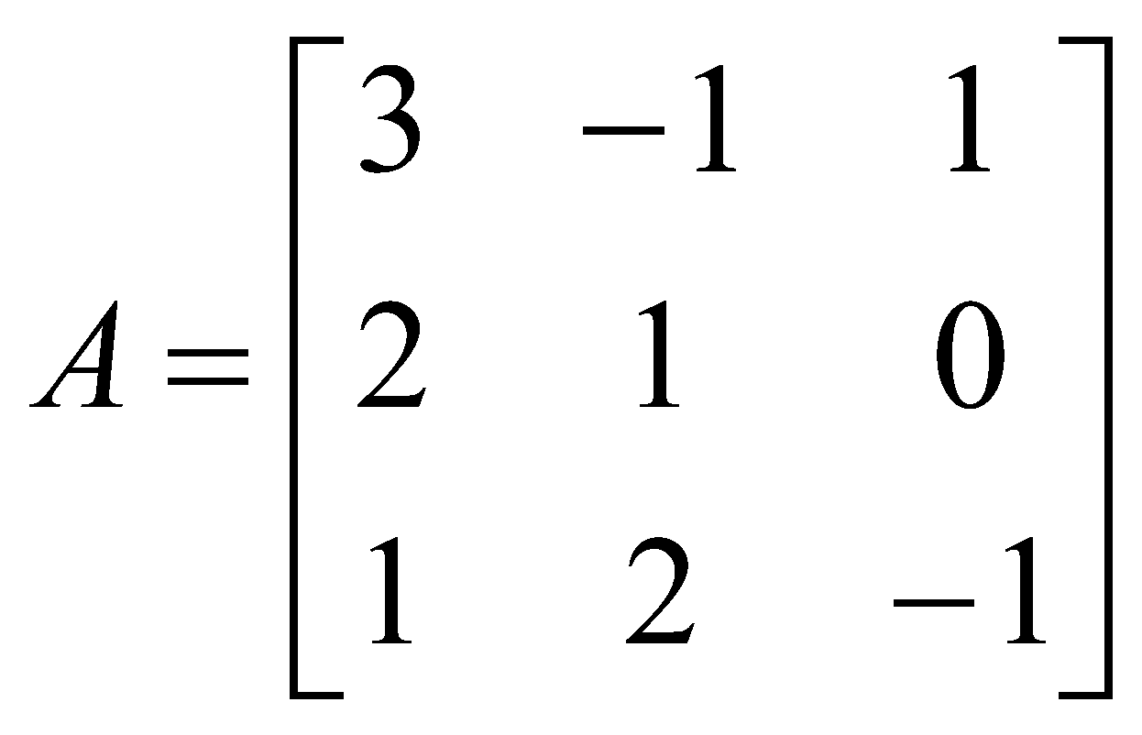
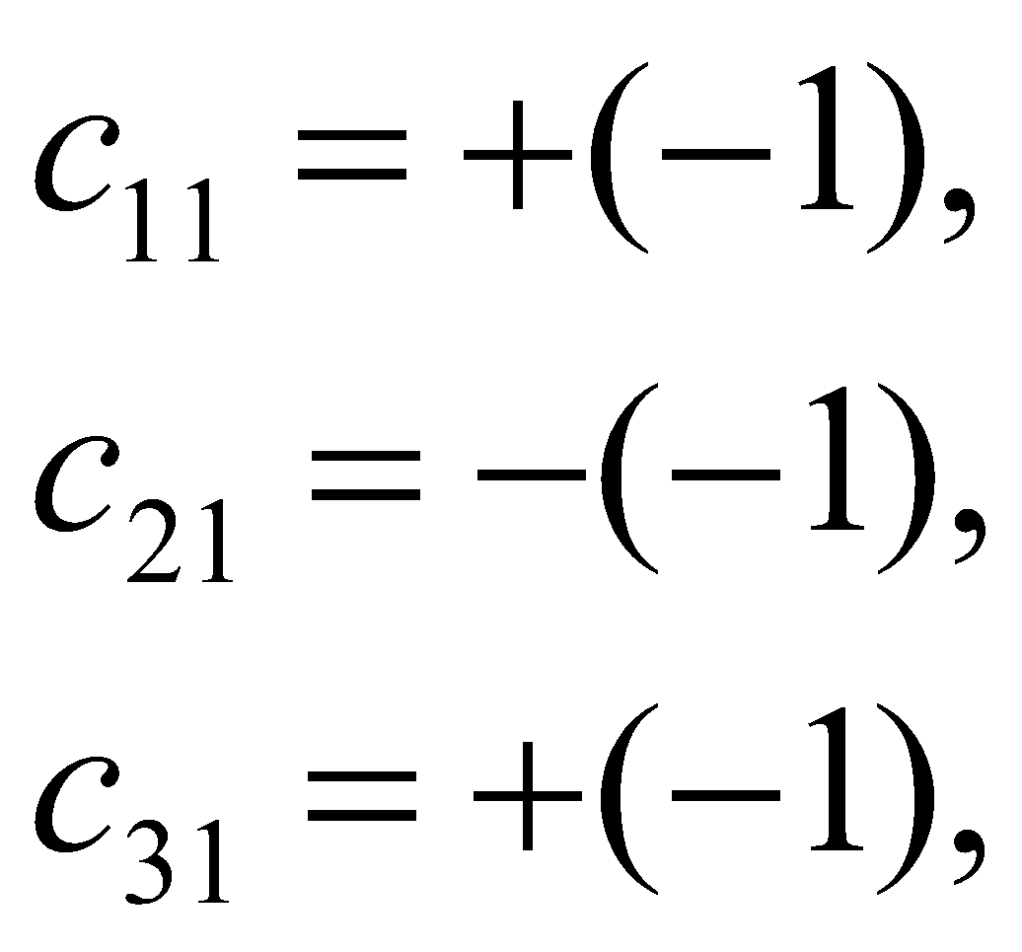
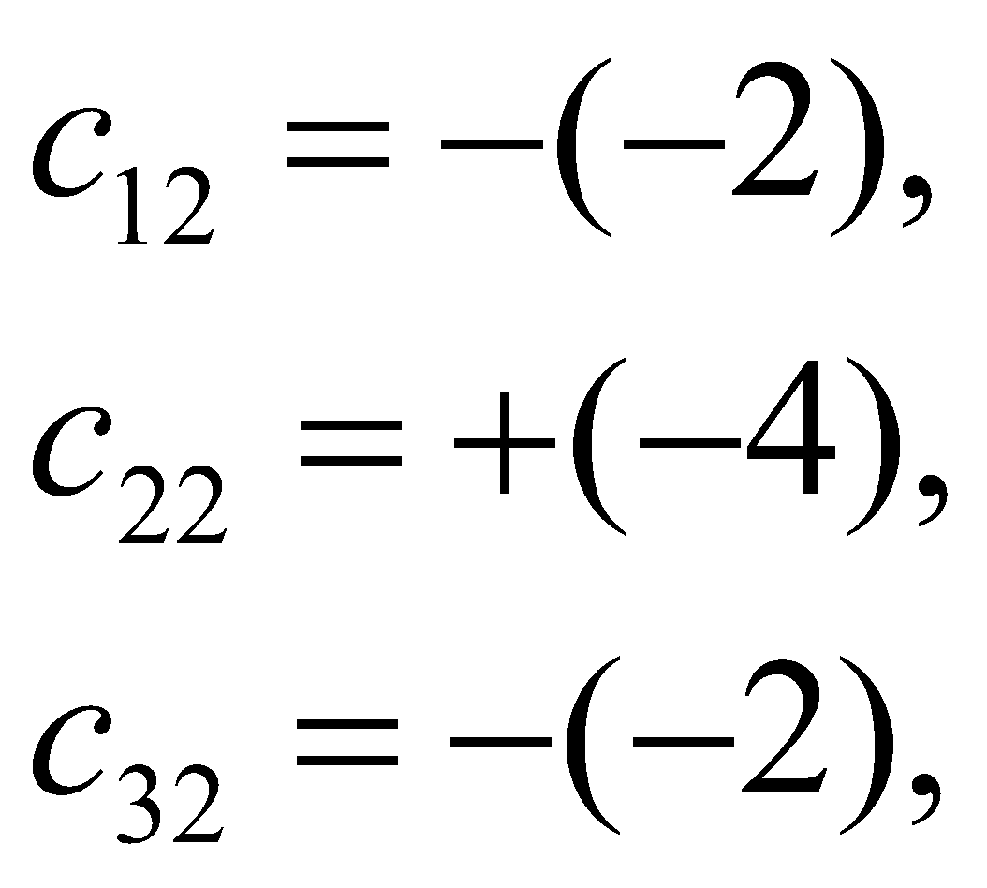
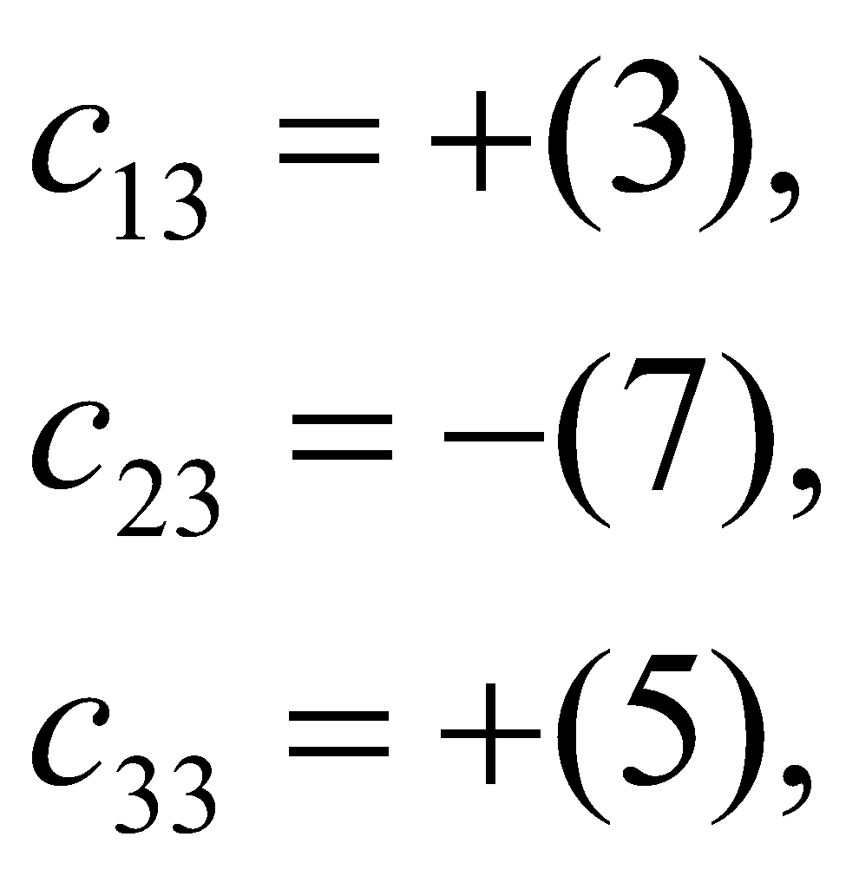
Matrices - Operations
Example 2
The determinant of A is
|A| = (3)(-1-0)-(-1)(-2-0)+(1)(4-1) = -2
The elements of the cofactor matrix are

Slide 22
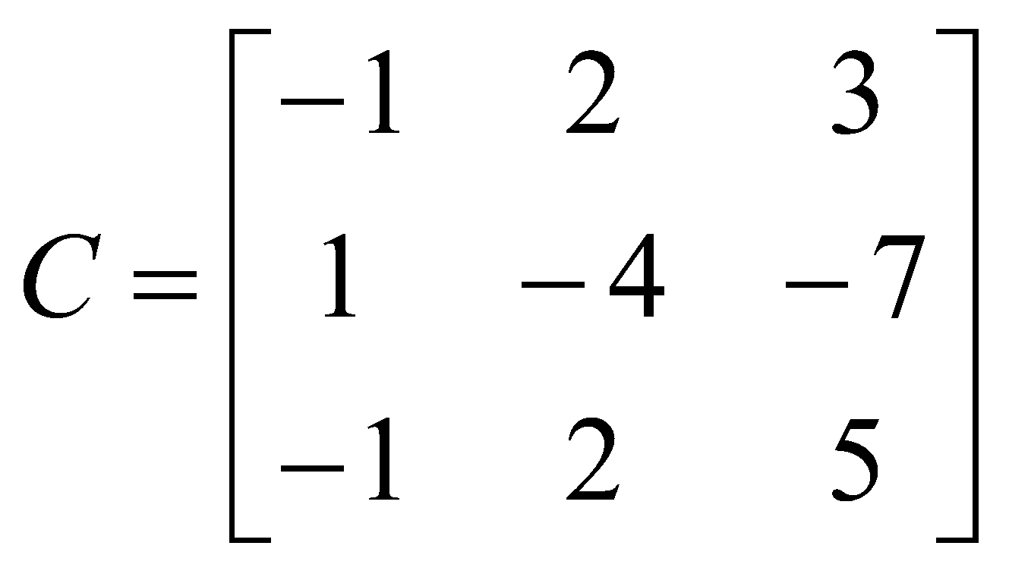
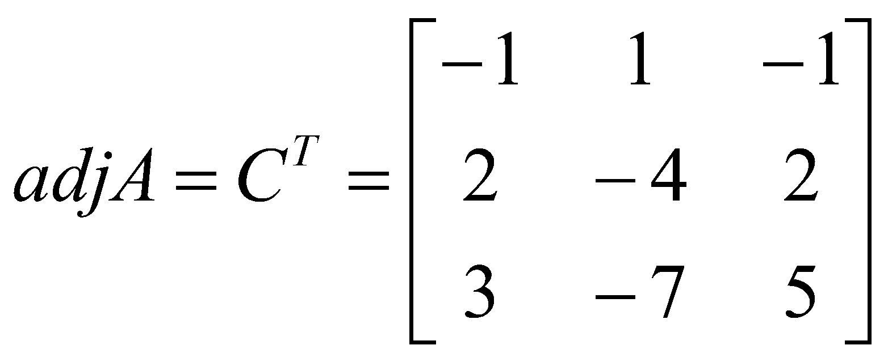
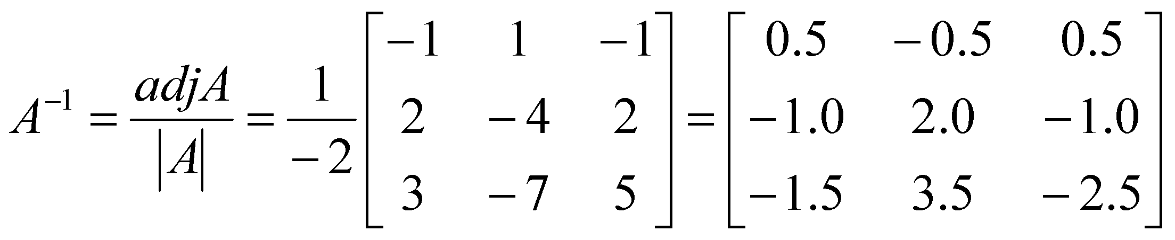
Matrices - Operations
The cofactor matrix is therefore
so
and

Slide 23
Matrices - Operations
The result can be checked using
AA⁻¹ = A⁻¹ A = I
The determinant of a matrix must not be zero for the inverse to exist as there will not be a solution
Nonsingular matrices have non-zero determinants
Singular matrices have zero determinants

Slide 24
Matrix Inversion
Simple 2 x 2 case

Slide 25
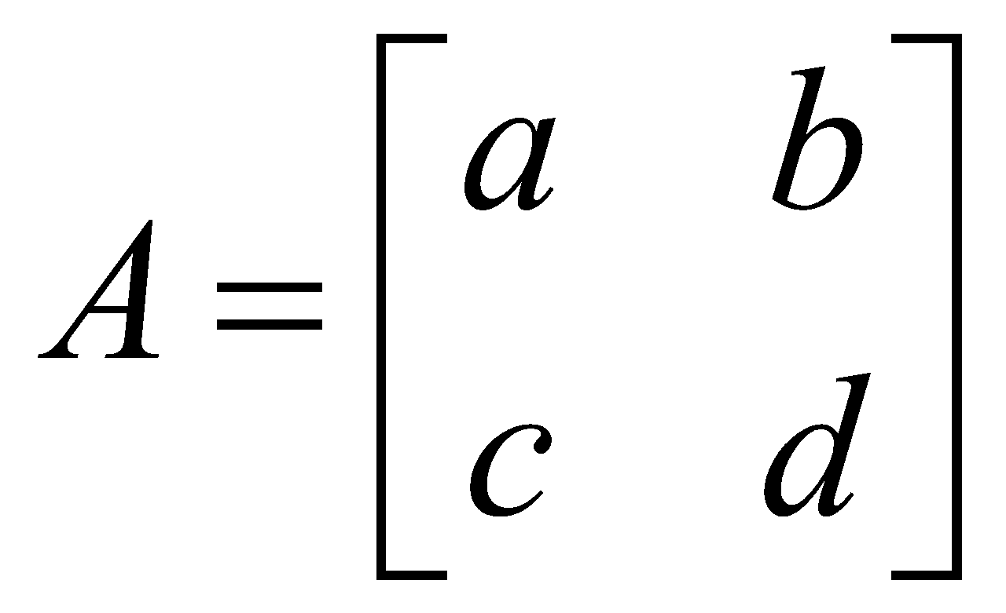
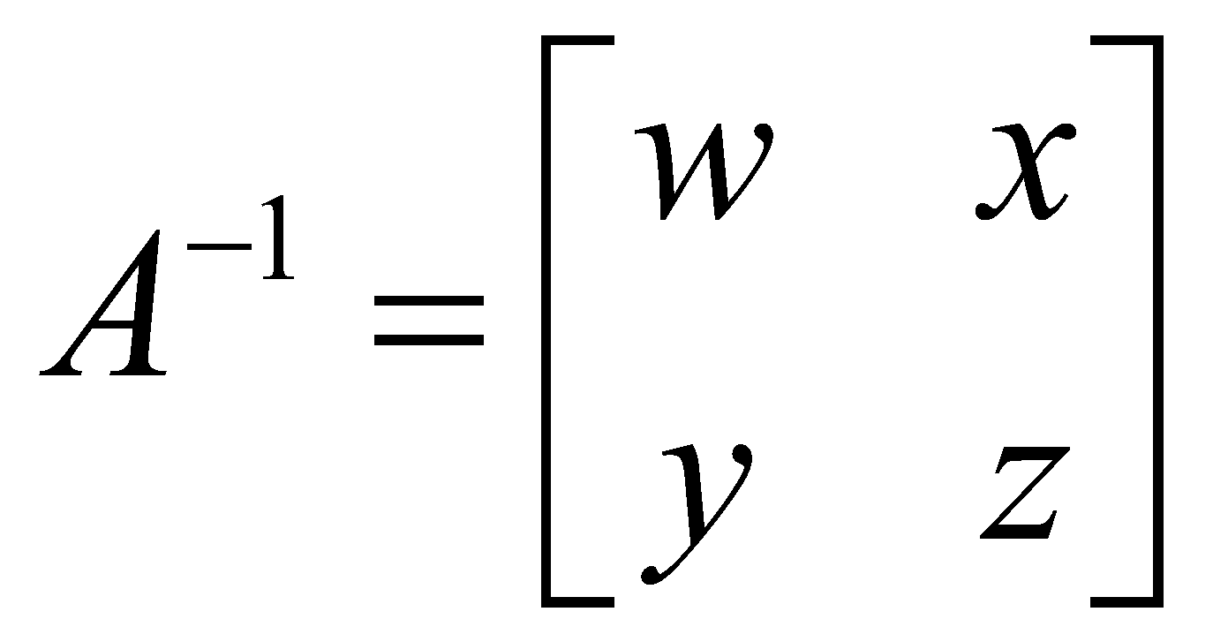
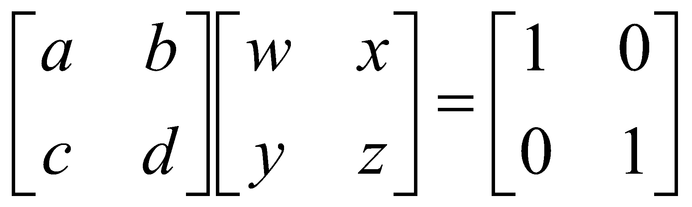
Simple 2 x 2 case
Let
and
Since it is known that
A A⁻¹ = I
then

Slide 26
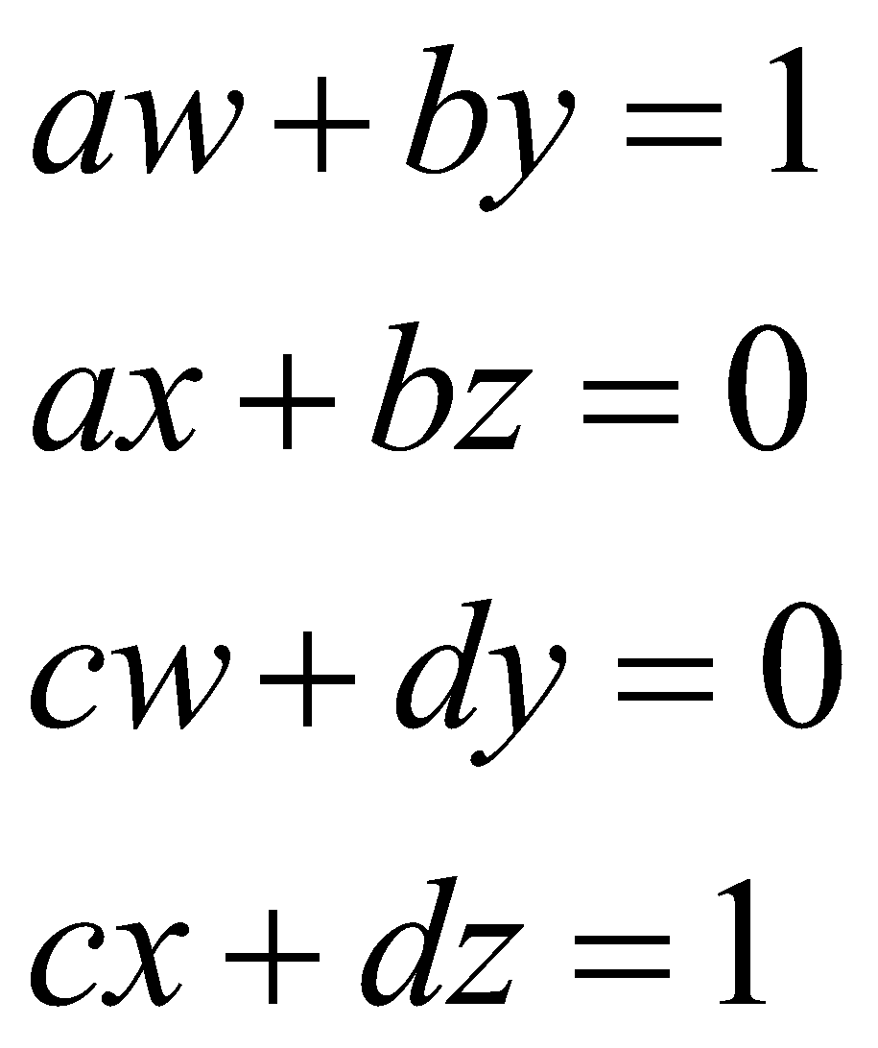
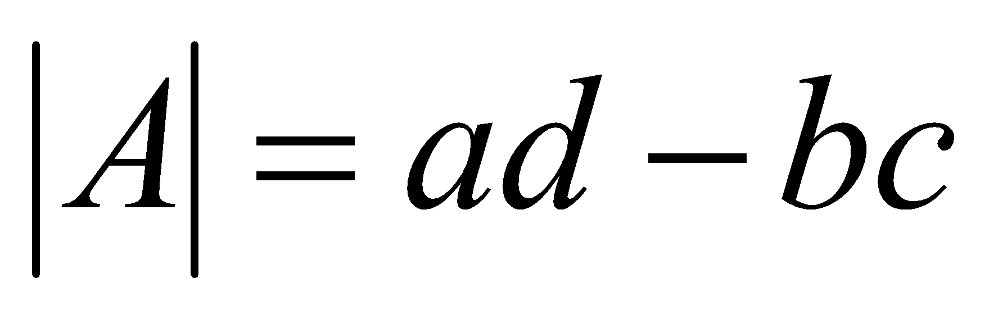
Simple 2 x 2 case
Multiplying gives
It can simply be shown that

Slide 27
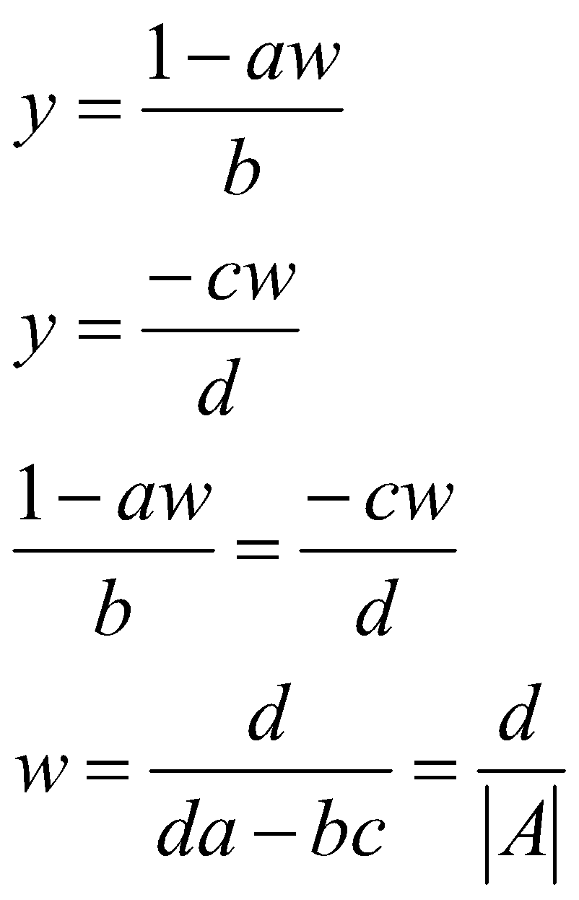
Simple 2 x 2 case
thus

Slide 28
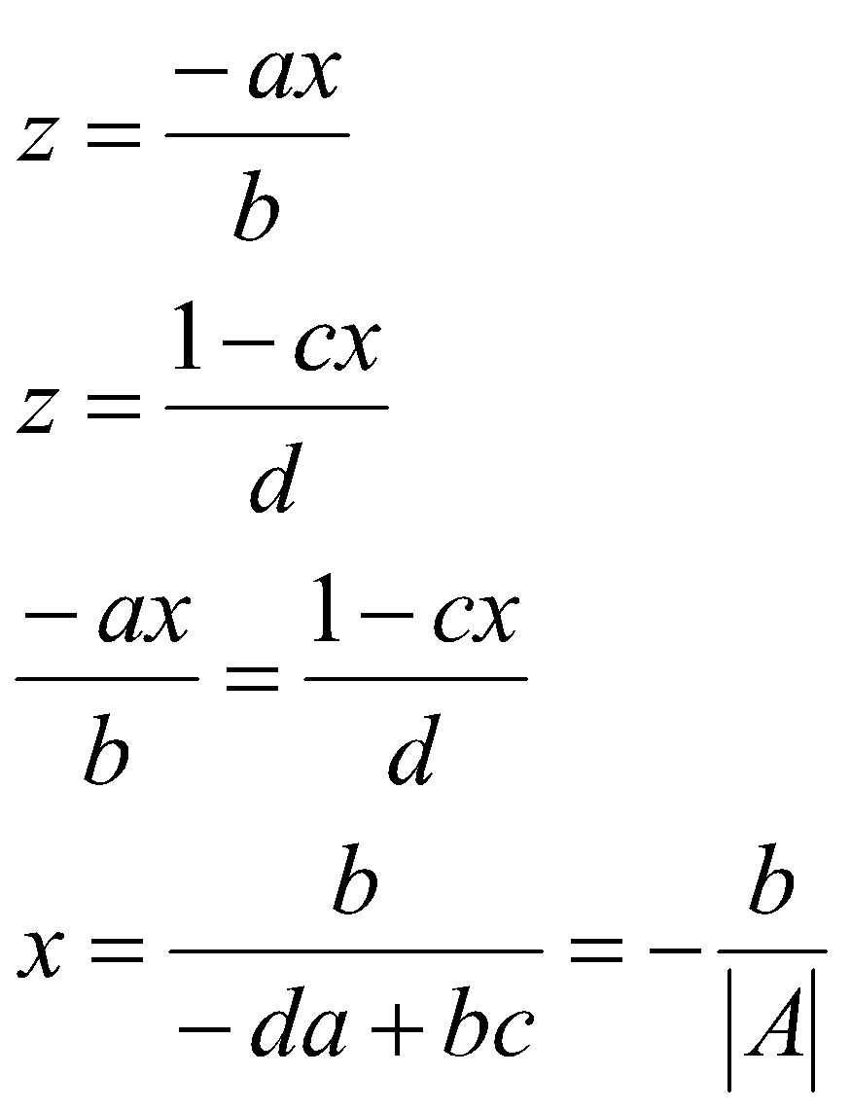
Simple 2 x 2 case

Slide 29
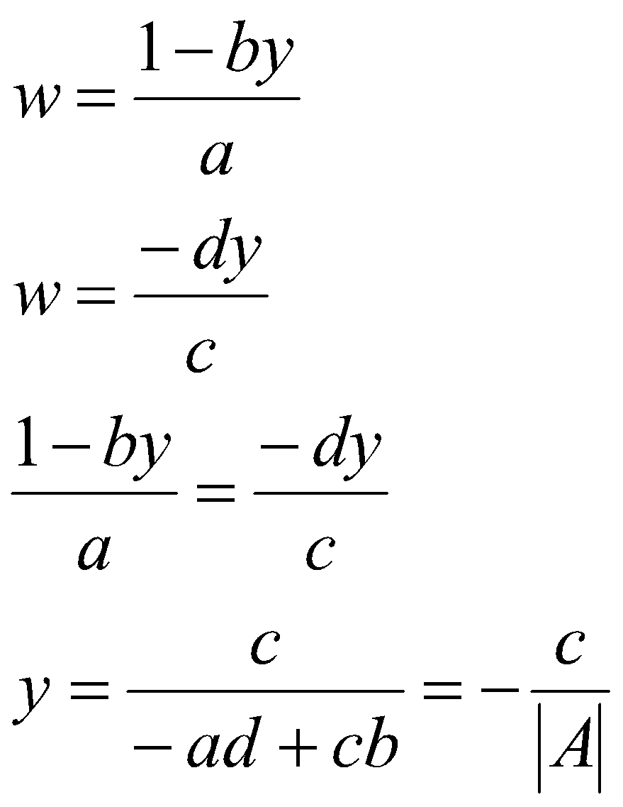
Simple 2 x 2 case

Slide 30
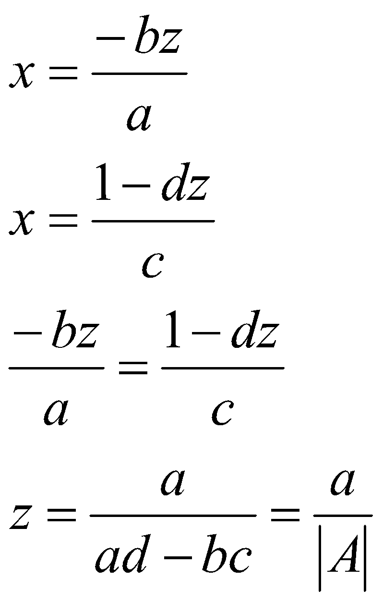
Simple 2 x 2 case

Slide 31
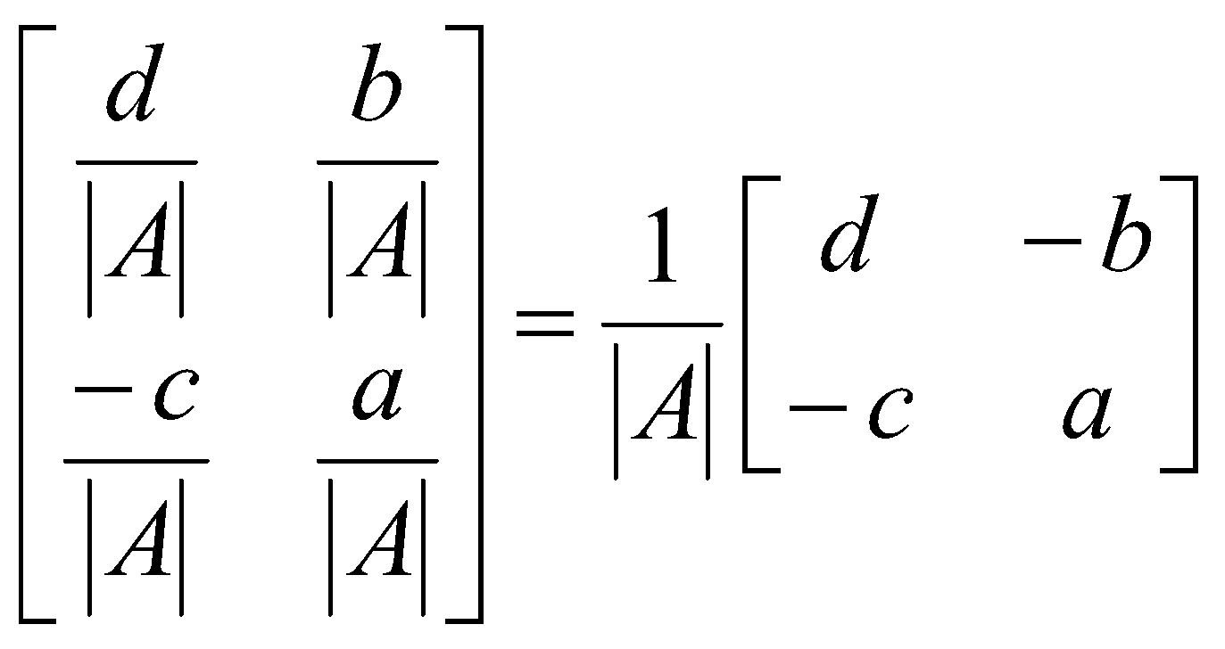
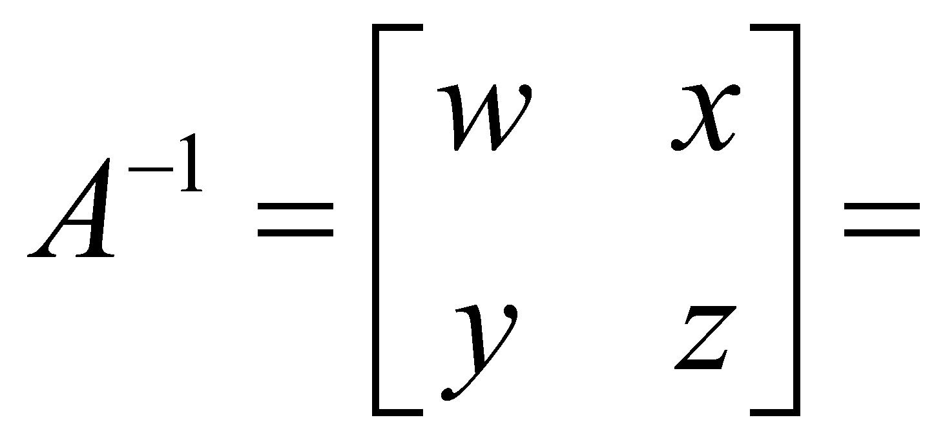
Simple 2 x 2 case
So that for a 2 x 2 matrix the inverse can be constructed in a simple fashion as
Exchange elements of main diagonal
Change sign in elements off main diagonal
Divide resulting matrix by the determinant

Slide 32
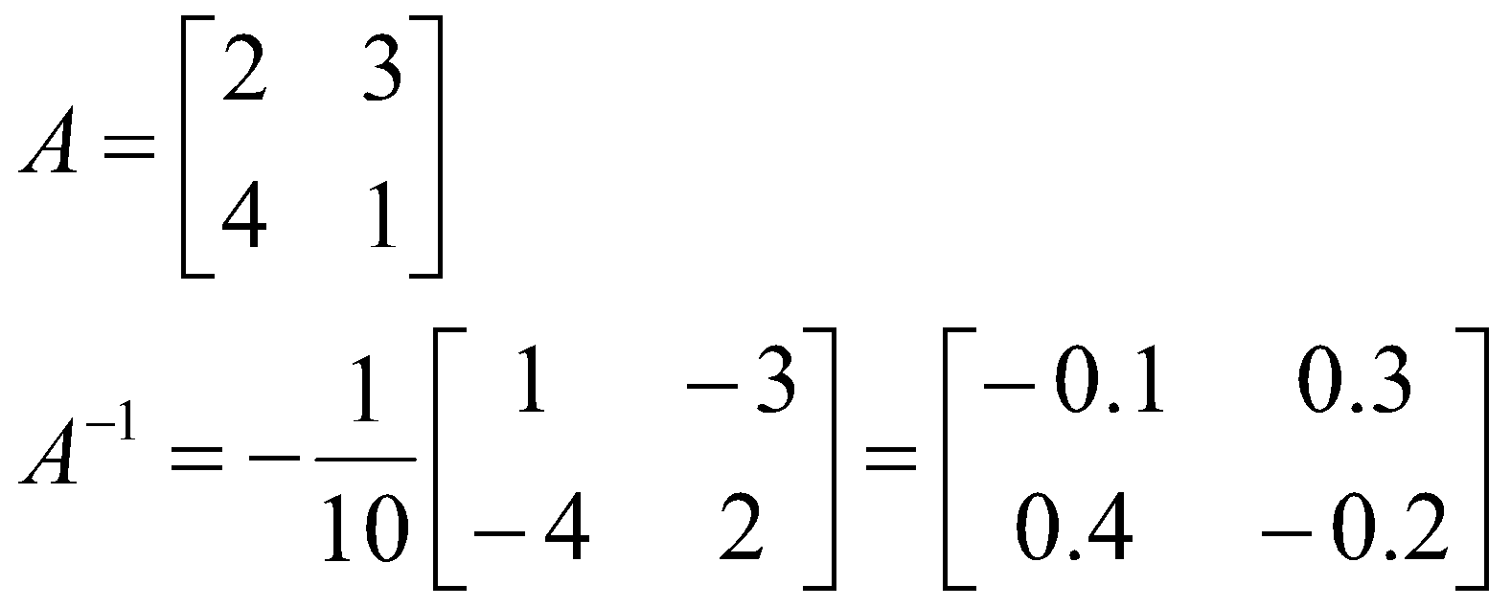
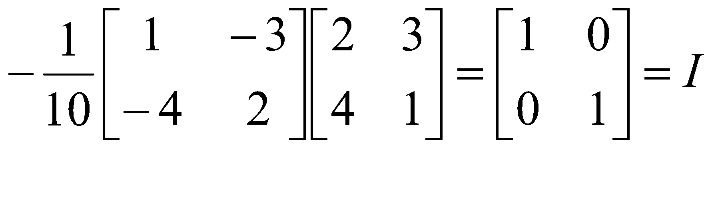
Simple 2 x 2 case
Example
Check inverse
A⁻¹ A=I

Slide 33
Matrices and Linear Equations
Linear Equations

Slide 34
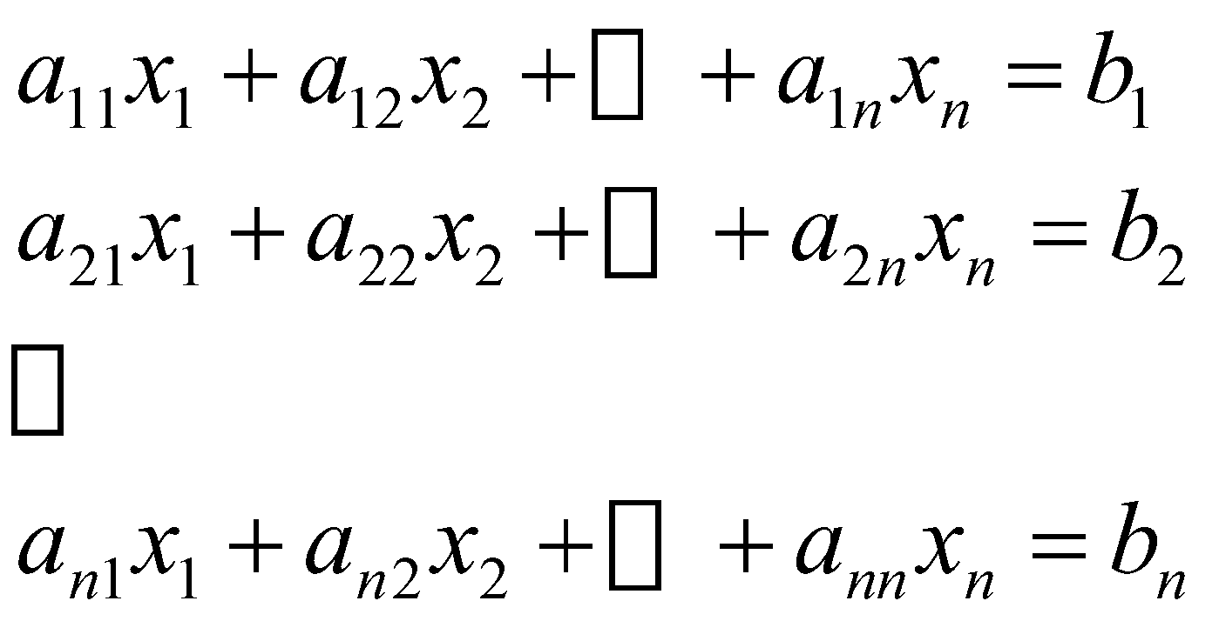
Linear Equations
Linear equations are common and important for survey problems
Matrices can be used to express these linear equations and aid in the computation of unknown values
Example
n equations in n unknowns, the a_{ij} are numerical coefficients, the b_{i} are constants and the x_{j} are unknowns

Slide 35


Linear Equations
The equations may be expressed in the form
AX = B
where
and
n x n
n x 1
n x 1
Number of unknowns = number of equations = n

Slide 36
Linear Equations
If the determinant is nonzero, the equation can be solved to produce n numerical values for x that satisfy all the simultaneous equations
To solve, premultiply both sides of the equation by A⁻¹ which exists because |A| = 0
A⁻¹ AX = A⁻¹ B
Now since
A⁻¹ A = I
We get
X = A⁻¹ B
So if the inverse of the coefficient matrix is found, the unknowns, X would be determined

Slide 37


Linear Equations
Example
The equations can be expressed as

Slide 38


Linear Equations
When A⁻¹ is computed the equation becomes
Therefore

Slide 39

Linear Equations
The values for the unknowns should be checked by substitution back into the initial equations

