Slide 1
Welcome to
Azure course for DevOps engineering practice

Slide 2


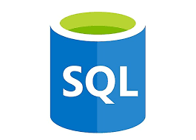



Agenda
Introduction to course
Level 2 – PaaS, SaaS design and blue green migration:
    Web apps
    Traffic manager
    Azure SQL Service
    Automation account for blue green pattern.
    Infrastructure logging with azure services

Slide 3
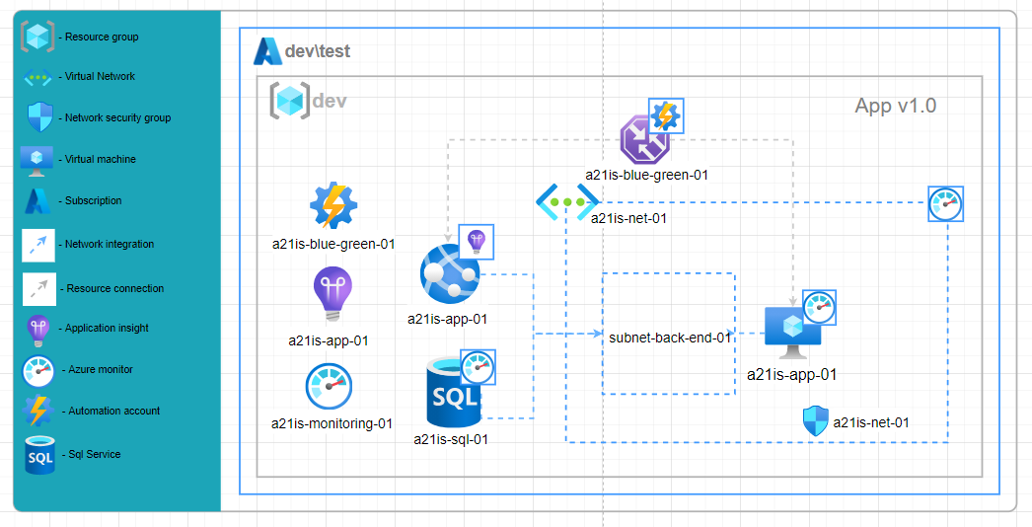
PaaS, SaaS design and blue green migration
Requirement
Your customer decided to migrate an application workload from IaaS to PaaS\SaaS platform to minimize
amount of management.
You need to provide:
simple and cost-effective design
migration plan for production workload with minimal downtime
Goal
Learn popular PaaS and SaaS services.
Design blue-green deployment for platform migration.
Deal with azure monitoring platform

Slide 4

Azure Web apps
Azure App Service (or WebApp)
It is a Microsoft PaaS solution that allows you to host web apps, mobile back ends, and RESTful APIs in the programming language of your choice without managing infrastructure.
Automatically patches and maintains the OS and language frameworks
Multiple languages and frameworks - ASP.NET, ASP.NET Core, Java, Ruby, Node.js, PHP, or Python.
Containerization and Docker Windows or Linux containers
DevOps optimization - Integration with Azure DevOps, GitHub, BitBucket, Docker Hub, or Azure Container Registry.
Global scale with high availability - Scale up or out manually or automatically.

Slide 5
Azure Web apps
Security and compliance - App Service is ISO, SOC, and PCI compliant. Authenticate users with Azure Active Directory, Google, Facebook, Twitter, or Microsoft account. Create IP address restrictions and manage service identities.
Visual Studio and Visual Studio Code integration - Dedicated tools in Visual Studio and Visual Studio Code streamline the work of creating, deploying, and debugging.
API and mobile features - App Service provides turn-key CORS support for RESTful API scenarios, and simplifies mobile app scenarios by enabling authentication, offline data sync, push notifications, and more.
Blue-Green deployment

Slide 6

App Service overview
App service plan
Host platform for app services
App service
Host platform for applications
Auto-scaling
Price tier
Diagnostic center
App settings
CORS
IIS configuration
DNS and SSL
Diagnostic center

Slide 7
App Service overview
App settings
CORS
IIS configuration
DNS and SSL
Diagnostic center
Local MySql server
WebJobs
Backups
Terminal
SSL + Azure Key Vault

Slide 8
App Service overview
App settings
CORS
IIS configuration
DNS and SSL
Diagnostic center
Local MySql server
WebJobs
Backups
Terminal
SSL + Azure Key Vault
Network integration
Deployment slots
Kudu
IP Restriction
Outbound Ips
Deployment slots

Slide 9

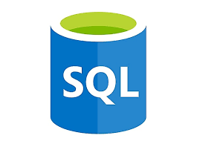
App service
Deployment slot
Scaling adding instances to live and non-live app services
Live and non-live app services contains the same feature
Non-live app service consume resources
Application does not receive traffic on non-live slot but application jobs are still running
dns: issoftwebapp.azurewebsites.net
name: issoftwebapp
CNAME: mysite.issoft.com
Instance: live
dns: issoftwebapp-staging.azurewebsites.net
name: staging
Instance: non-live
Application on non-live slot may still process some jobs and affect release

Slide 10


Create:
App service plan
App service
Review:
App service plan configuration
App service configuration
Kudu interface
Swap strategy

Slide 11
Use case
Application release strategy
Release 0.1
Release 0.2
Issue detected
Release 0.2
Start non-live slot (for apps without graceful shutdown)
Deploy application to non-live slot
Validate changes on non-live slot
Swap slots
Stop non-live slot
QA
Slot: non-live
Release: 0.2
Slot: live
Release: 0.1
Clients
Swap
Rollback to release 0.1
Swap slots
Slot: live
Release: 0.2
Slot: non-live
Release: 0.1

Slide 12


Use case
Customer wants to host java applications on azure app services. Application use SQL which is deployed on azure virtual machine. Design solution.
Virtual Network integration
CORS policy – control request header
Network security group:
  Allow connection from app service outbound IPs
App service app settings – variable storage
App service auto-scaling
Application insight - monitoring
Issoft.azurewebsites.net
10.20.30.40

Slide 13
Use case
Customer applications can write logs only to file system. The log files will overload the app service plan by storage capacity. You need to design log rotation.
Issoft.azurewebsites.net
/home/site/wwwroot/Jobs/triggered/scheduler.cron
/Rotate-Log.ps1
/home/site/wwwroot/index.html
/home/site/LogFile/app.log
/app.2021.10.22.log

Slide 14
Traffic manager

Slide 15




Traffic manager
Application gateway
7
Traffic Manager works at the DNS level. It uses DNS responses to direct end-user traffic to globally distributed endpoints. Clients then connect to those endpoints directly.
Traffic Manager is resilient to failure, including the failure of an entire Azure region.
6
5
Load balancer
4
OSI Model
https://mydns.com
3
2
https://anydns.com
MS guarantee that DNS queries will receive a valid response from at least one of our Azure Traffic Manager name server clusters at least 99.99% of the time.
1

Slide 16
Traffic Manager has several routing policies:
Geographic: Use this method if you want to direct users to specific endpoints based on the geo locations where they are connecting from.
MultiValue: Use this method when you want to return multiple IPV4 or IPV6 endpoints. Works with external IPV4, IPV6 endpoints only.
Subnet: Use this method when you want to return an endpoint for a specific set of IPV4 range.

Slide 17
Traffic Manager has several routing policies:
Performance: Use this method when your endpoints are deployed in different geographic locations, and you want to use the one with the lowest latency.
Priority: Use this method when you want to select an endpoint which has highest priority and is available.
Weighted: Use this method when you want to distribute traffic across a set of endpoints as per the weights provided.

Slide 18
Create:
Traffic manager
Review:
Traffic manager configuration

Slide 19
Azure SQL

Slide 20
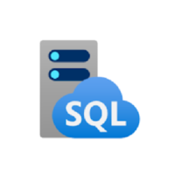
Azure SQL services
Database-as-a-service (DBaaS)
Azure SQL Database
Azure SQL Managed Instance
T-SQL difference (vendor lock)
Support less features that Azure SQL managed instance
Supports database migration from on-premises with minimal to no database change.
Almost 100% capabilities with SQL Server VM
At the end - Platform-as-a-Service (PaaS)

Slide 21
Azure SQL database
Features
Azure SQL database is a family of managed, secure, and intelligent products that use the SQL Server database engine in the Azure cloud.
Virtual core (vCore)-based billing model
DTU based billing model
ElasticPool for cost optimization
Backup out of box
Network integration
Encryption
Firewall
Azure AD authentication
Usage insight
Geo-Replication

Slide 22
Azure SQL database
Azure SQL database
Billing model
Virtual core (vCore)-based
DTU based
Control and transparency of individual resource consumption
  Provisioned – scale fixed number of resources:
  CPU
  Memory
  Storage
  Serverless – auto-scaling compute and billing for compute used per second
Fixed set of resources is assigned to the database or elastic pool via performance tiers

Slide 23
Azure SQL database
Azure SQL database
ElasticPool
Azure SQL Database elastic pools are a simple, cost-effective solution for managing and scaling multiple databases that have varying and unpredictable usage demands.
Works for multiple databases with non-overlapping nature of utilization
DTU
Databases
A
B
C
40 DTU

Slide 24
Create:
Azure SQL database
Review:
Azure SQL database configuration

Slide 25
Use case.
Customer wants to use Azure SQL database. There are several application which use database only for read operations and several application use read\write applications. The access to database should be secure. The design should cover a disaster recovery plan.
Geo-replication
Read only operations are pointed to geo-copy
Encryption
Azure point-in-time backup
Auto-scaling
Azure AD authentication
Type: Secondary database
Operation: Read
Type: Primary database
Operation: Read\Write

Slide 26
Azure monitor

Slide 27
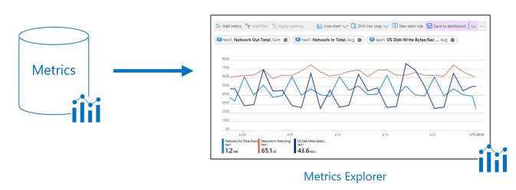


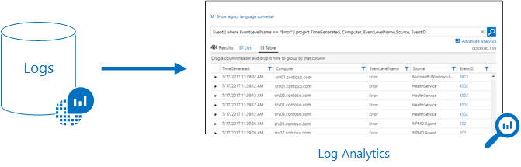
Azure monitor
Every resource in azure provides metrics
…
Most of the resources can be connected to Log Analytics

Slide 28

Azure monitor
Detect and diagnose issues across applications and dependencies with Application Insights.
Correlate infrastructure issues with azure insights agents.
Drill into monitoring data with Log Analytics for troubleshooting and deep diagnostics.
Support operations at scale with smart alerts and automated actions.
Create visualizations with Azure dashboards and workbooks.
Collect data from monitored resources using Azure Monitor Metrics.
Notes:
Open and show - https://docs.microsoft.com/en-us/azure/azure-monitor/monitor-reference

Slide 29
Azure monitor
Alerts proactively notify you when issues are found with your infrastructure or application using your monitoring data in Azure Monitor.
You can alert on metrics and logs:
  Metric values
  Log search queries
  Activity log events
  Health of the underlying Azure platform
  Tests for website availability
Manage alerts
New
Issue detected
Acknowledged
Issue reviewed
Closed
Issue resolved

Slide 30


Azure monitor
Automated actions
Out of box scaling
Scale action for azure resources
Custom flow
Azure automation account with web hook to run custom scenarios
…
…

Slide 31

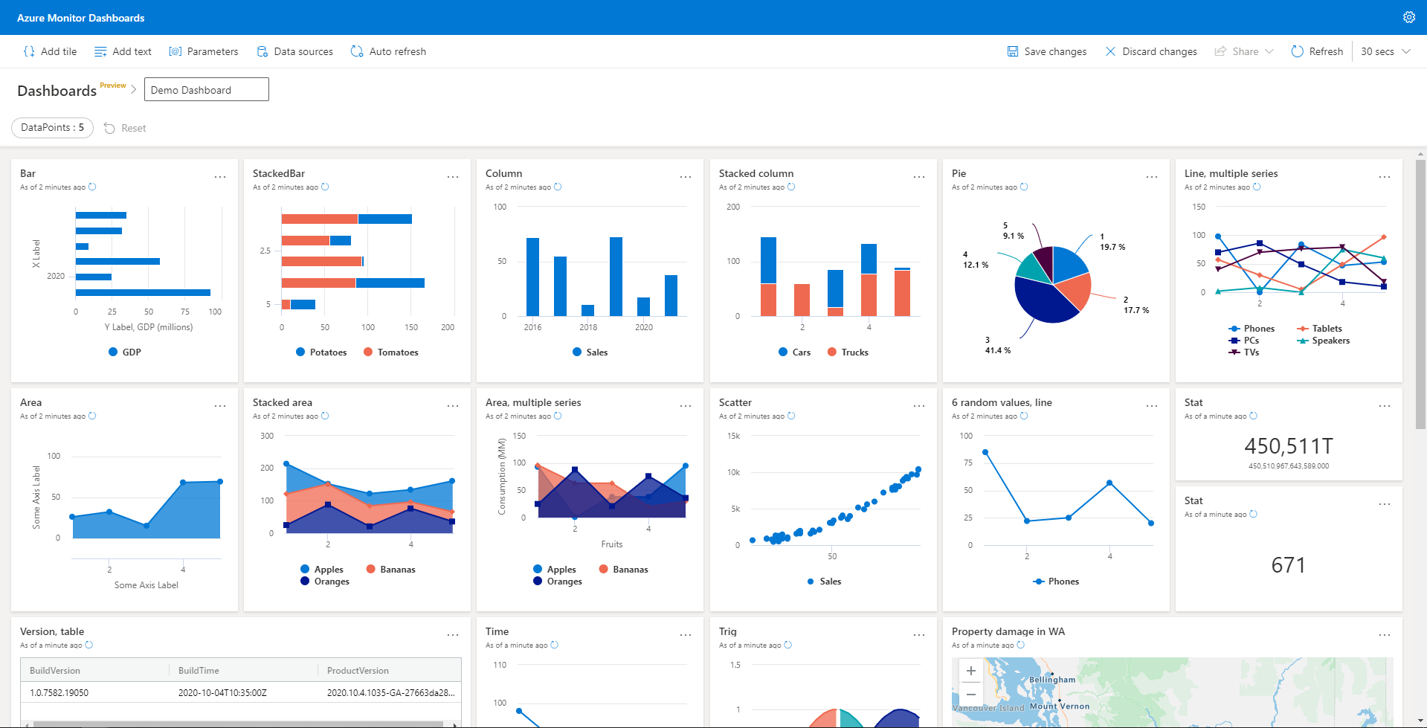
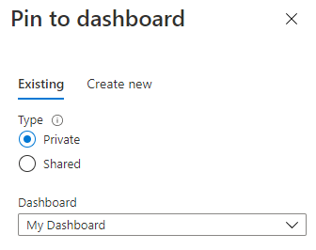
Azure Dashboard
Dashboards are a focused and organized view of your cloud resources in the Azure portal

Slide 32
Application insight

Slide 33

Application insight
Application Insights is an extensible Application Performance Management (APM) service for:
detect performance anomalies
application analytics
diagnose issues and to understand what users actually do with your app

Slide 34
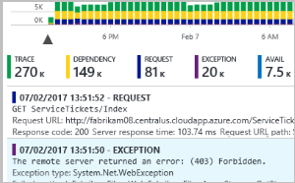
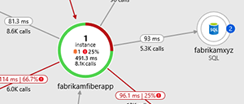
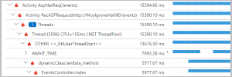
Application insight
Request rates, response times, and failure rates
Dependency rates, response times, and failure rates - Find out whether external services are slowing you down.
Exceptions - stack trace and related requests of server and browser exceptions.
Page views and load performance - reported by your users' browsers.
AJAX calls from web pages - rates, response times, and failure rates.
User and session counts.
Performance counters from your Windows or Linux server machines, such as CPU, memory, and network usage.
Custom events and metrics
Service map
Performance trace
Request review

Slide 35
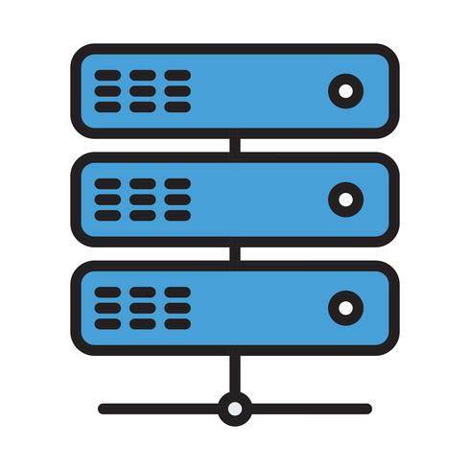

Application insight
App Service - install ApplicationInsightsAgent
Virtual Machine and scale set - install Application Insights agent
On-premises servers - install Status Monitor V2 powershell module
Code integration – integrate library to your code
Every provider has it own number of metrics and supported languages

Slide 36
Create:
Application insight
Review:
Configuration
App Service integration
Metrics
Azure monitor
Azure dashboard

Slide 37
Automation account

Slide 38


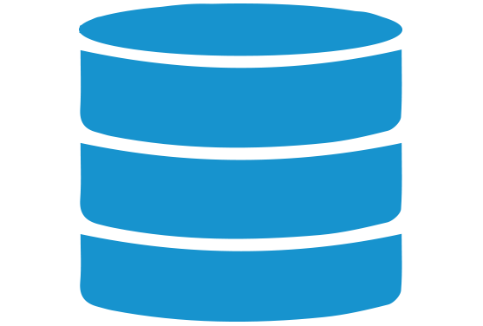

Automation account
Azure automation account - place for automation scripts and infrastructure orchestration
Supports native integration with the PowerShell Gallery and ability to import custom modules
Support python
Provides configuration storage
Trigger Automation operations at predefined times
Modules
Credentials
Variables
Connections
Certificates
Schedules
Python 2 and 3 packages

Slide 39
Automation account
Azure agents
Default mode
All scripts will be executed on azure agents
Hybrid Runbook Worker
Connect on-premiss or azure virtual machine with azure agent
More flexible debug of the scripts
Ability to manage virtual machine updates from automation account
Azure AD-based authentication

Slide 40
Automation account
Use cases
Schedule tasks
Stop VMs or services at night and turn on during the day, weekly or monthly recurring maintenance workflows.
Cost saving
Scale up and scale down dev\test resources
Maintenance
Implement custom logic to rotate files of storage account or VM, etc…
Webhook
Create webhook and manage alerts

Slide 41
Automation account
Powershell module
Az.Automation
Get-AzAutomationCredential
Get-AzAutomationCertificate
Get-AzAutomationVariable
…

Slide 42
Create:
Automation account
Runbook for app service migration
Review:
Configuration

Slide 43
Thank you for your time and join to our course

