Slide 1

Calendar
Group Member:
Wei Shan N13745493
Dong Li N14180637
Lien-Jung Chang N13362262

Slide 2

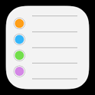
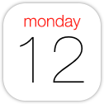
The reason to design the calendar
Reminders has drawbacks
Reducing the conflicts between schedule and reminders list
Straightforward events to deal
with
Notes:
it’s inconvenient to switch app between reminders and calendars
if user want to check whether he has free time on specific time

Slide 3

The functions that Calendar provide
User-friendly manipulation
Concise interface design
Communication with Parse and iCalendar
Providing reminder for specific
event
Providing check button for
reminders list

Slide 4
Target audience
Our target audience is those who want to make their own schedule in an efficient way

Slide 5
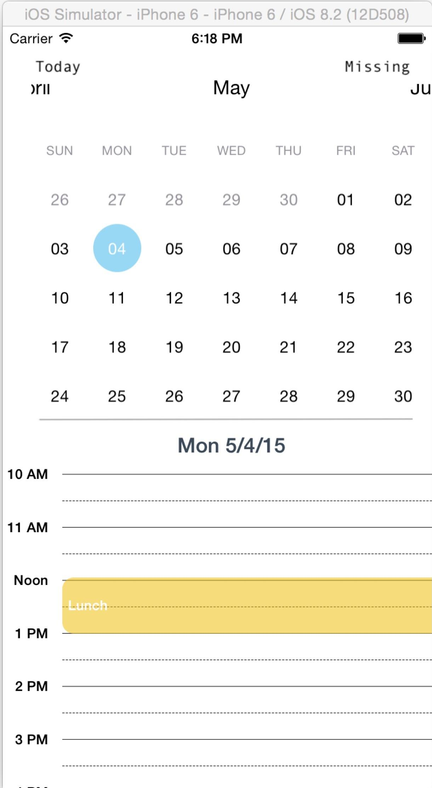
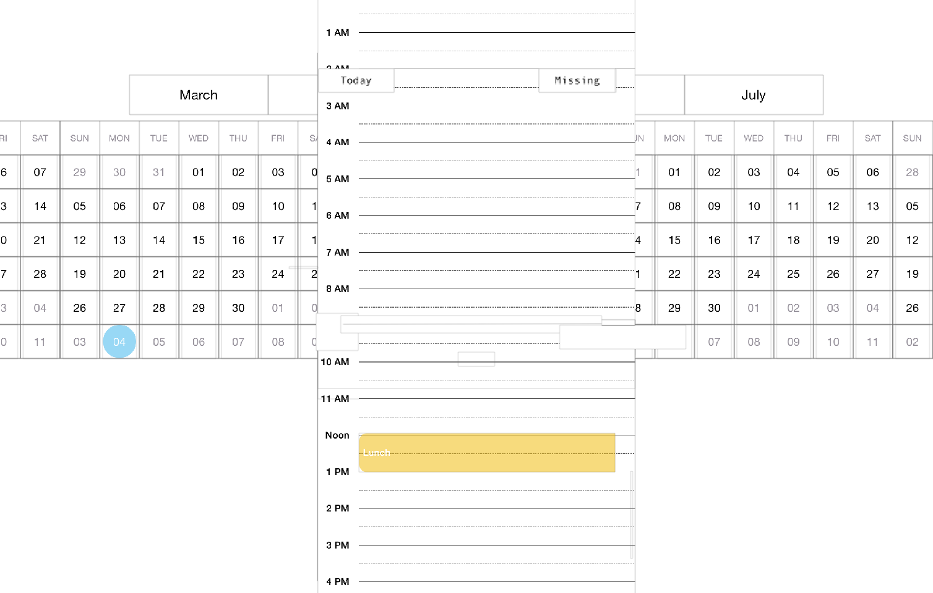
Design

Slide 6
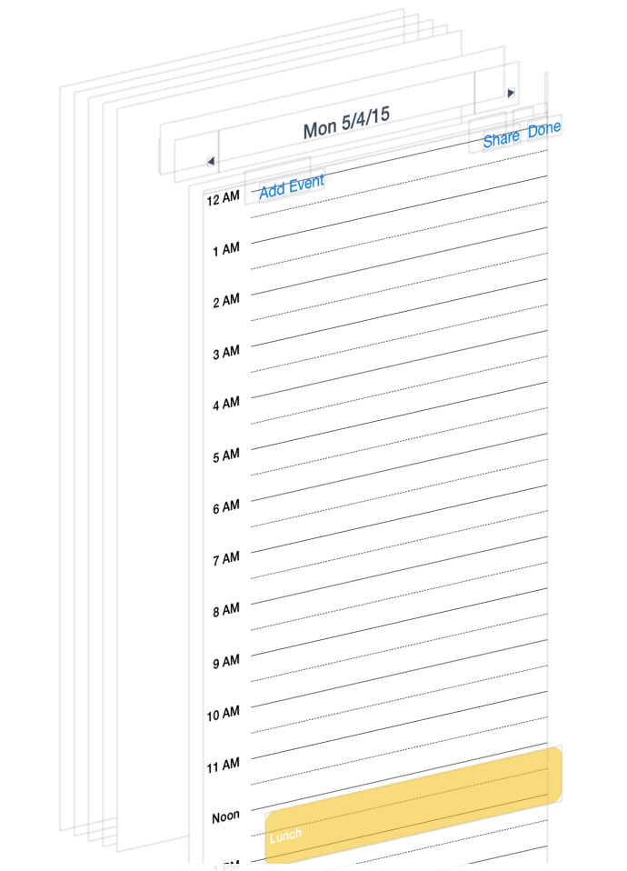
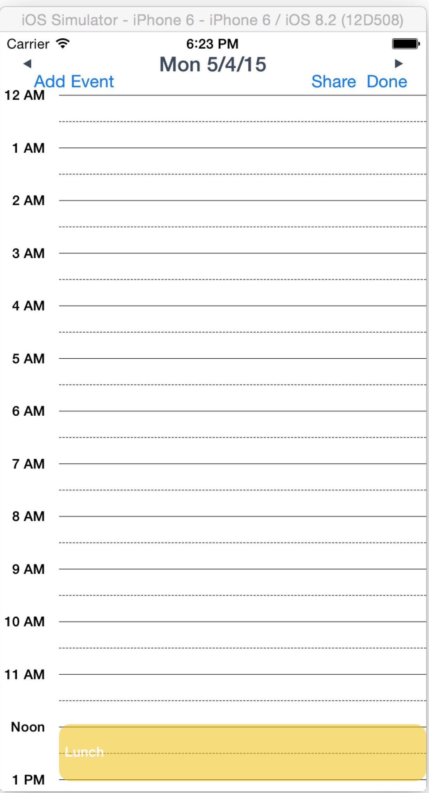
Design

Slide 7
Application Architecture
Parse
MADayView
JTCalendar
NHCalenderActivity

Slide 8
The problem we had met

Slide 9
Future prospects
Design for other devices and operating system

Slide 10
Q&A

Slide 11
THE END

