Slide 1


Cryptocurrency Market Analysis
Yashraj Patil

Slide 2

Problems in the Crypto Market
The cryptocurrency market is highly volatile and fragmented, making it difficult for investors to track consistent trends.
Prices fluctuate drastically across coins, exchanges, and timeframes, creating uncertainty in decision-making.
Lack of clarity on top gainers/losers and market dominance makes it challenging to identify short term opportunities.
Investors struggle to interpret how market cap, trading volume, and liquidity influence performance.
With thousands of tokens listed, filtering out noise to focus on meaningful assets is a major challenge.
Objectives of the EDA Project
Conduct an exploratory analysis of CoinGecko market data to uncover patterns, anomalies, and trends in crypto pricing and trading activity.
Identify top gainers and losers across multiple time horizons (24h, 7d, etc.) using mirrored visualizations for clarity.
Compare market capitalization vs. trading volume to highlight liquidity and investor interest.
Examine the dominance of major coins (BTC, ETH, stablecoins) and their influence on the overall market.
Assess volatility and correlations between leading cryptocurrencies to understand risk and diversification potential.

Slide 3

Web Scraping
How It Works:
The scraper sends a request to the website.
It retrieves the HTML content of the page.
Specific elements (e.g., product names, prices, ratings) are parsed and extracted.
The cleaned data is stored in structured formats like spreadsheets, CSV files, or Pandas Data Frames.
Web scraping is the automated process of extracting data from websites using code instead of manual copy-paste. With Python libraries like Requests and Beautiful Soup, you can collect structured information such as prices, product details, reviews, or news articles directly from web pages.
Why It’s Useful:
Market research & trend analysis – track competitor strategies and industry shifts.
Price monitoring – compare product prices across platforms in real time.
Lead generation – collect contact details or business listings at scale.
Content aggregation – gather news, reviews, or social media posts for analysis.
Data-driven insights – fuel analytics, dashboards, and machine learning models.

Slide 4
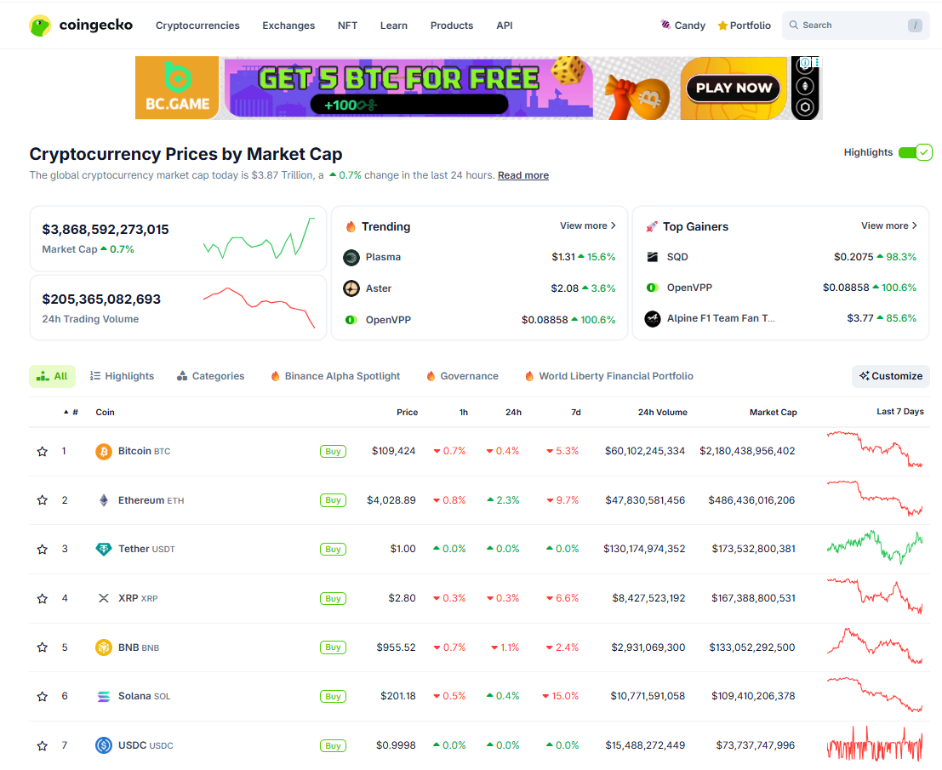
Interface of the Website

Slide 5
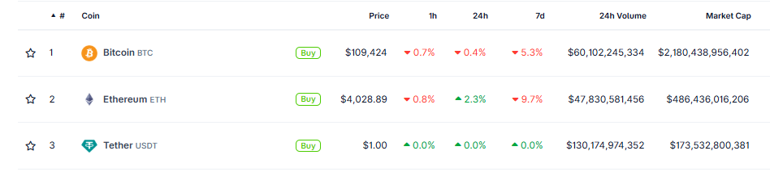

Extracting Data From The Table
Extracted the details from the table like symbol,coin_name,coin_price,price_change_per_24h,volume_24h,market_cap

Slide 6
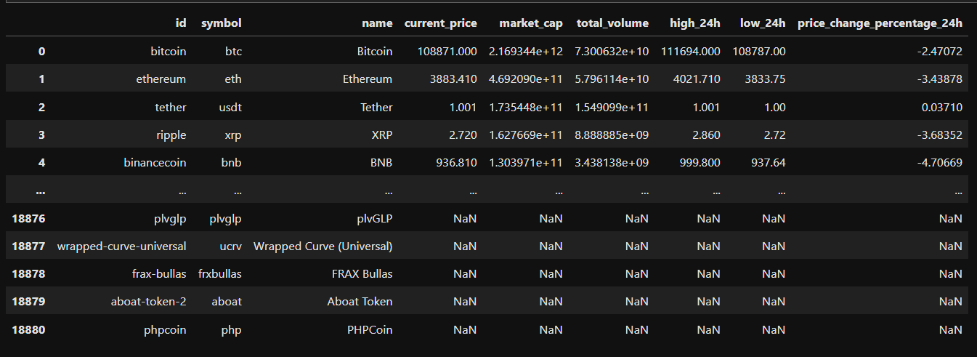
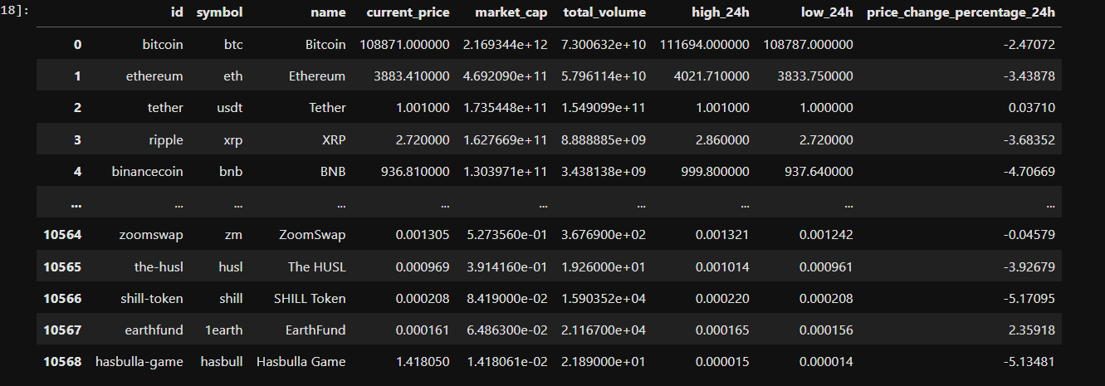
Data Cleaning
Before Cleaning:
The original dataset contained several data quality issues such as noisy entries, inconsistent data types, duplicate records, and missing values. These problems made the raw data unreliable for analysis.
To address this, I performed a series of data cleaning steps to ensure accuracy, consistency, and usability:
Removed irrelevant columns and extraneous characters to streamline the dataset.
Handled missing values through imputation or removal, depending on context.
Eliminated duplicate records to avoid bias and redundancy.
Converted columns to appropriate data types (e.g., numeric, categorical, datetime) for consistency and proper analysis.
Standardized formats and labels to maintain uniformity across the dataset.
After Cleaning:

Slide 7

Data Visualization
Data visualization is the practice of representing information and data in a graphical or pictorial format — like charts, graphs, maps, or dashboards — so that patterns, trends, and insights become easier to see and understand.
Simplifies complexity: Turns large, messy datasets into clear visuals.
Reveals hidden patterns: Helps uncover correlations, anomalies, and trends not obvious in raw tables.
Speeds up decision-making: Visuals are processed faster by the brain than text or numbers.
Improves communication: Makes insights accessible to both technical and non-technical audiences.
Supports storytelling: Guides viewers step by step toward conclusions.
Univariate (1 variable)
Focus: Distribution & frequency
Examples: Histogram, Bar chart, Box plot
Bivariate (2 variables)
Focus: Relationships & comparisons
Examples: Scatter plot, Line chart, Grouped bar chart
Multivariate (3+ variables)
Focus: Interactions & combined effects
Examples: Heatmap, Bubble chart, Pair plot

Slide 8
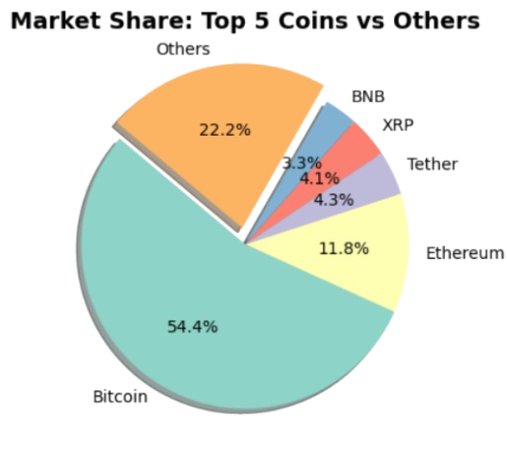
Bivariate Analysis
Numerical Vs Categorical
How much of the total cryptocurrency market capitalization is dominated by the top 5 coins versus all other coins combined?
The Bitcoin dominates the market share by holding 54.4% followed by Ethereum with 11.8% hold
While Other coins hold just 22.2% market share
The pie chart demonstrates that the crypto market is highly concentrated, with the top 5 coins holding the lion’s share of market capitalization, while the rest of the market is fragmented and relatively small.

Slide 9
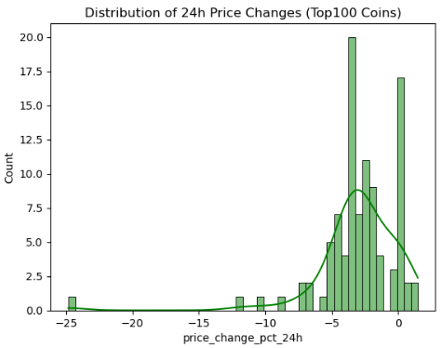
Bivariate Analysis
Numerical VS Numerical
What is the overall distribution of daily returns across the top cryptocurrencies, and does the market show a bias toward gains or losses in the short term?
The longer right tail indicates that while losses are common, a few coins achieved large positive spikes, reflecting speculative rallies
The KDE curve smooths the distribution, confirming that downward moves dominate, but extreme upward moves are possible — a mascot of crypto volatility
The distribution is skewed to the right, meaning most coins had negative returns, while fewer coins experienced strong positive gains.
The peak around –5% shows that many coins lost roughly this amount in the last 24 hours.

Slide 10
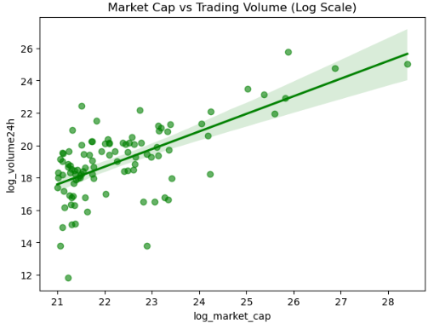
Bivariate Analysis
Numerical VS Numerical
What is the relationship between a cryptocurrency’s market capitalization and its trading volume, and does a larger market cap generally correspond to higher trading activity?
Market cap is a strong predictor of liquidity, but outliers exist where coins punch above or below their weight in terms of trading activity
The regression line reinforces the trend: as market cap increases, trading volume also increases.
Larger market cap coins (e.g., Bitcoin, Ethereum) tend to have higher trading volumes, confirming that dominant coins are also the most liquid.- Smaller-cap coins are more scattered, with some showing relatively high trading activity despite lower market caps indicating speculative interest.

Slide 11
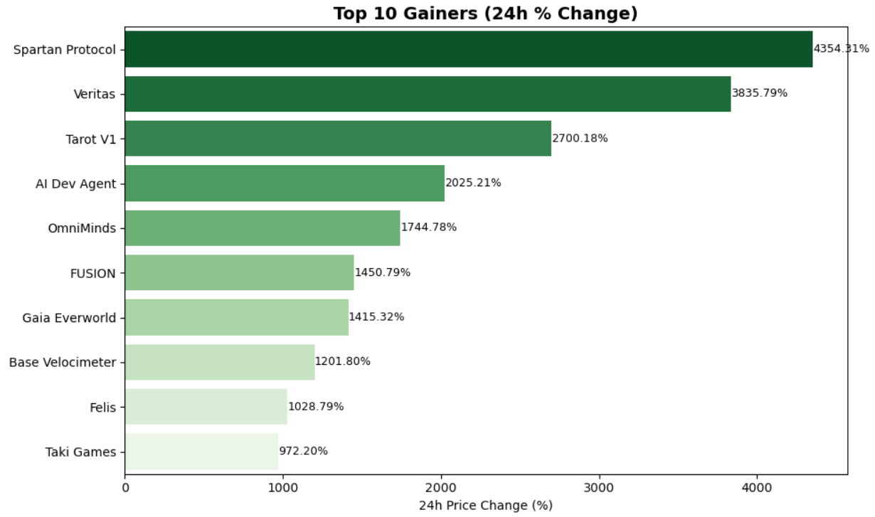
Bivariate Analysis
Numerical Vs Categorical
Which cryptocurrencies recorded the highest percentage gains in the last 24 hours, and what does this reveal about short‑term market dynamics?
Such extreme gains are often linked to low‑cap tokens, where small inflows of capital can cause outsized price jumps.
While these tokens offer huge upside potential, they also carry high downside risk, as such spikes are rarely sustainable.
Massive spikes: Coins like Spartan Protocol (+4500%) and Veritas (+3800%) show extraordinary one‑day surges, far beyond typical market movements

Slide 12
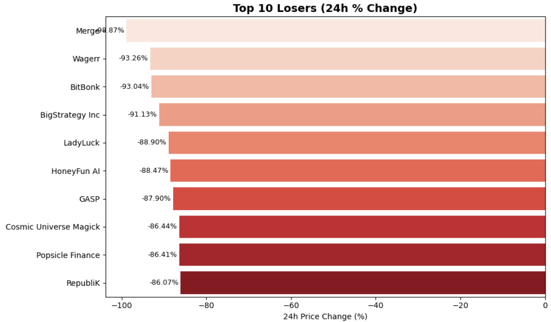
Bivariate Analysis
Numerical Vs Categorical
Which cryptocurrencies recorded the largest percentage losses in the last 24 hours, and what does this reveal about short‑term risks and vulnerabilities in the market?
Such steep declines are usually linked to low‑cap or thinly traded tokens, where small sell‑offs can trigger massive price crashes.
These results reinforce that while some coins can deliver huge short‑term gains, others can just as quickly wipe out most of their value making diversification and risk management critical
Severe declines: Tokens like Merge (–94.9%), Wagerr (–93.3%), and BitBonk (–93.0%) lost nearly all of their value in just one day, showing the extreme downside risk in smaller or speculative coins.

Slide 13
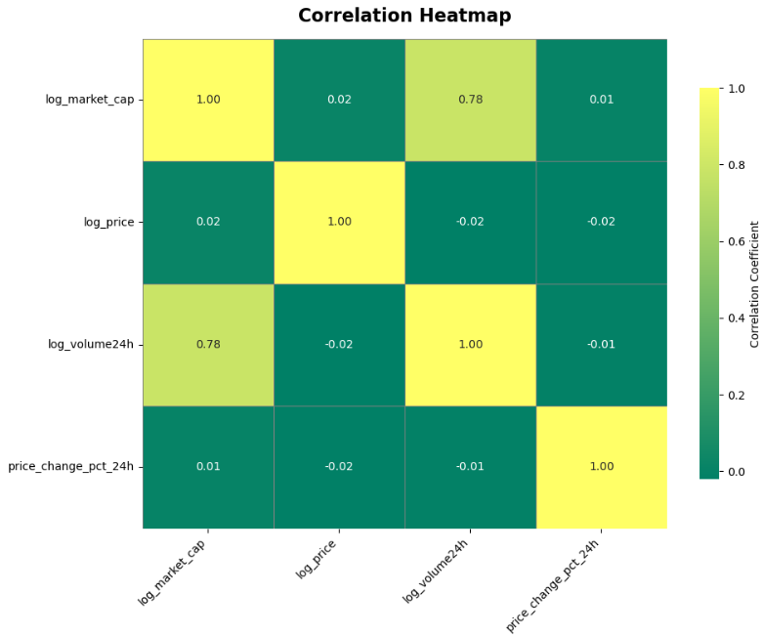
Multivariate Analysis
How strongly are the key numerical features in the cryptocurrency dataset correlated with each other, and what patterns emerge from these relationships?
High positive correlations (close to +1) indicate features that move together e.g., market_cap and trading_volume often show strong positive correlation, meaning larger coins tend to trade more.
High negative correlations (close to -1) suggest inverse relationships e.g., a coin’s stability (low volatility) might negatively correlate with its daily price swings.
Near-zero correlations imply independence i.e. features that don’t influence each other directly

Slide 14
Conclusion
The crypto market shows high volatility, with most assets experiencing modest daily losses and a few extreme outliers driving large gains or crashes.
Distribution analysis reveals a bias toward negative returns, but with occasional sharp upward spikes — a hallmark of speculative rallies.
Ranking analysis (Top Gainers/Losers) highlights the extremes, showing how a handful of tokens dominate short‑term performance.
Scatter analysis (Market Cap vs Volume) confirms that larger coins tend to have higher liquidity, reinforcing the link between size and trading activity.
Correlation analysis shows strong ties between market cap and trading volume, while daily price changes remain largely independent of size or price level.
Overall, the findings emphasize both the risks and opportunities in crypto, underscoring the need for data‑driven decision‑making.

Slide 15



Thank You
Crypto Markets Are Dominated By Volatility And Outliers So Data‑driven Analysis Is The Only Way To Separate Noise From Opportunity

