Slide 1
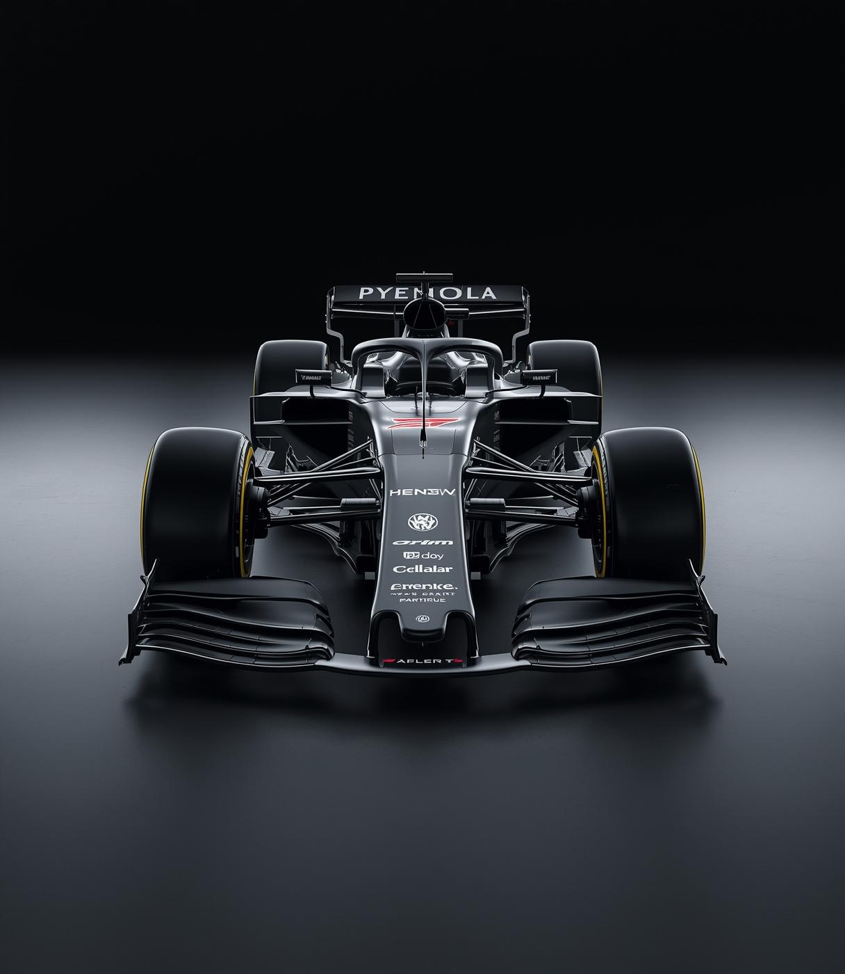
Formula 1
Stats Explorer
ISTE 240 – Web and Mobile, Spring 2026,
Team Members:
Izhan Akhtar, 421009836
Om Singh, 751006630
Adil Nurmagambetov, 415002457

Slide 2
Project Idea & Problem
Intuitive Formula 1 Statistics Platform
Formula 1 statistics and race data are spread across many different websites, making it difficult for fans to quickly find reliable and organized information
Fans want a simple, centralized platform where they can view driver standings, race results, and team performance in one place
Our application solves this by storing structured Formula 1 data in a database and presenting it through clean tables and dashboards
The system focuses on clarity, ease of use, and fast navigation rather than complex analytics

Slide 3
Core Features
What the Platform Offers
Driver Standings
Team Rankings
Race Results
Users can easily view current driver standings, helping them track performance and understand the competitive landscape of Formula 1 racing throughout the season.
Our platform provides comprehensive team rankings, allowing users to analyze team performance and strategies as they compete for the championship title across various races.
Users can browse through detailed race results by season, offering insights into race outcomes, driver performances, and historical data to enhance the overall viewing experience.

Slide 4
Technologies & Design
Key Components and Approach
Frontend Stack
Backend Framework
Database Management
The frontend utilizes HTML, CSS, and JavaScript combined with Bootstrap to create a responsive user interface. This ensures optimal accessibility across various devices while maintaining a clean aesthetic.
A robust backend is powered by Java Spring Boot implementing REST APIs and MVC architecture, ensuring efficient data management and seamless interactions between the frontend and backend systems.
Data is managed using MySQL with JPA/Hibernate for efficient database operations. This setup facilitates structured data handling, enhancing the application's performance and scalability for future expansions.

Slide 5
UI/UX Design
User Interface & Experience Strategy
The interface will use a clean, motorsport-inspired color scheme and layout to match the Formula 1 theme while maintaining strong readability
A dashboard-style homepage will provide users with quick access to standings, race results, and key statistics without overwhelming the screen
The website will be fully responsive, ensuring smooth usability across desktop, tablet, and mobile devices
Navigation will be simple and consistent, with clear sections for Drivers, Teams, Races, and Dashboard to minimize user confusion

Slide 6
Thank You!
Any Questions?

