Slide 1
MIND: In-Network Memory Management for Disaggregated Data Centers
Seung-seob Lee, Yanpeng Yu, Yupeng Tang,
Anurag Khandelwal, Lin Zhong, Abhishek Bhattacharjee
Yale University
SOSP 21
2021.11.26 presented by GZ

Slide 2
Resource Disggregation
CPU
MEM
GPU
CPU
MEM
GPU
CPU
MEM
GPU
[servers]

Slide 3
Resource Disggregation
CPU
CPU
CPU
CPU
MEM
GPU
Network
CPU
MEM
GPU
CPU
MEM
GPU
MEM
MEM
MEM
GPU
GPU
GPU
[servers]
disaggregated blades
Benefits of resource disaggregation
* High resource utilization
* Easy to manage
* Elastic scalability

Slide 4
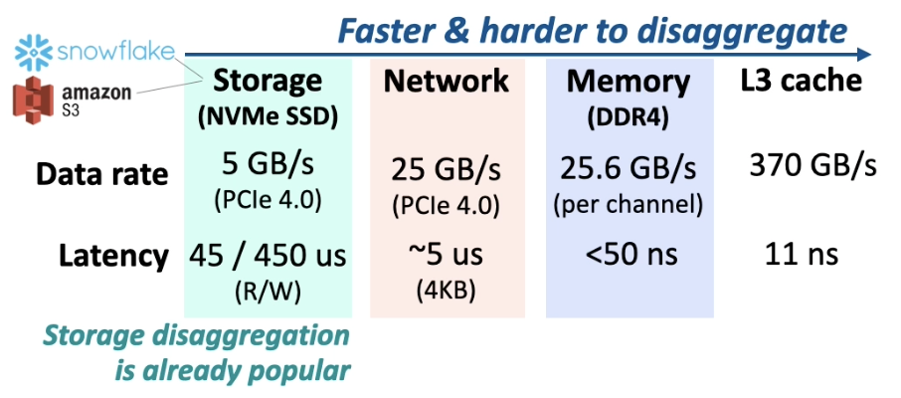
Memory Disaggregation
• Need for memory disaggregation
• Timely problem
Low utilization
(as low as 30%)
Unbalanced Usage
(>70% of the time in clusters)
Energy Consumption
(up to 46% of avg. system)

Slide 5
Memory Disaggregated Goals
Performace(CPU <-> Memory)
high throughput & low latency
Transparent elasticity
flexible resource allocation

Slide 6
Existing Approaches
Distributed shared memory (DSM)
Recent disaggregated memory schemes
DSM
Ideal
Transparent elasticity
Recent Disagg.
Performance

Slide 7
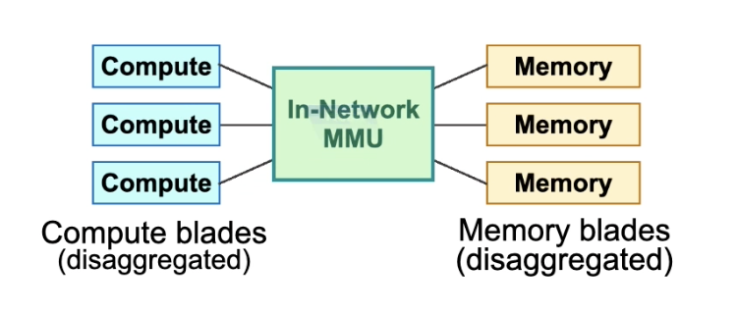
Key Insight : In-network memory management
Central location: global view & processing directly in the data path

Slide 8
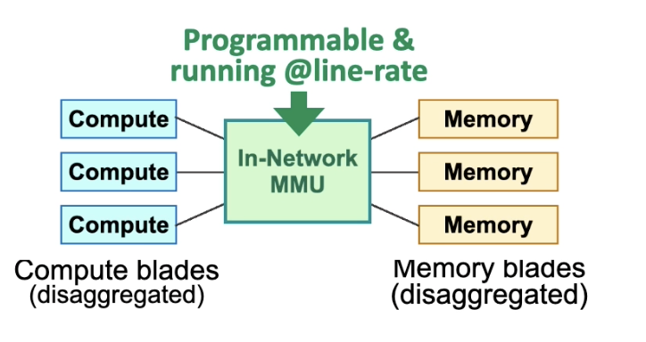
Key Insight : In-network memory management
Central location: global view & processing directly in the data path
Programming switching ASIC: flexible processing at line rate

Slide 9
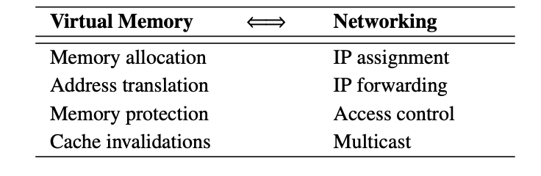
Key Insight : In-network memory management
Central location: global view & processing directly in the data path
Programming switching ASIC: flexible processing at line rate
Similarity between network functions and memory management

Slide 10
MIND: In-network Memory management
CPU
Programable switch
Memory
Read, 0X1000
Control plane
CPU
Data plane
CPU
Memory

Slide 11
MIND: In-network Memory management
CPU
Programable switch
Memory
Read, 0X1000
Control plane
CPU
Address translation:
where is the data?
Data plane
CPU
Memory

Slide 12
MIND: In-network Memory management
CPU
Programable switch
Memory
Read, 0X1000
Control plane
CPU
Address translation:
where is the data?
Data plane
CPU
Memory protection
Is this access permitted or valid?
Memory

Slide 13
MIND: In-network Memory management
Cache coherency protocol:
How to keep data synchronized?
CPU
Programable switch
Memory
Read, 0X1000
Control plane
CPU
Address translation:
where is the data?
Data plane
CPU
Memory protection
Is this access permitted or valid?
Memory

Slide 14
Challenges in Building In-network MMU
Limited resources
Limited size of in-network memory
Tens of MB → not sufficient to store metadata in a traditional way
Limited computation capability
Switching ASIC → not sufficient to directly port traditional MMU functions

Slide 15
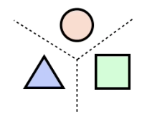
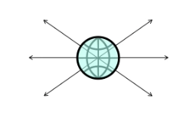
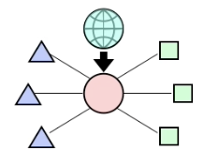
Three Principle of system Design
P1-Decouple memory managemnet functionalities
P2-Leverage global view of network
P3-Exploit network-centric hardware primitives

Slide 16
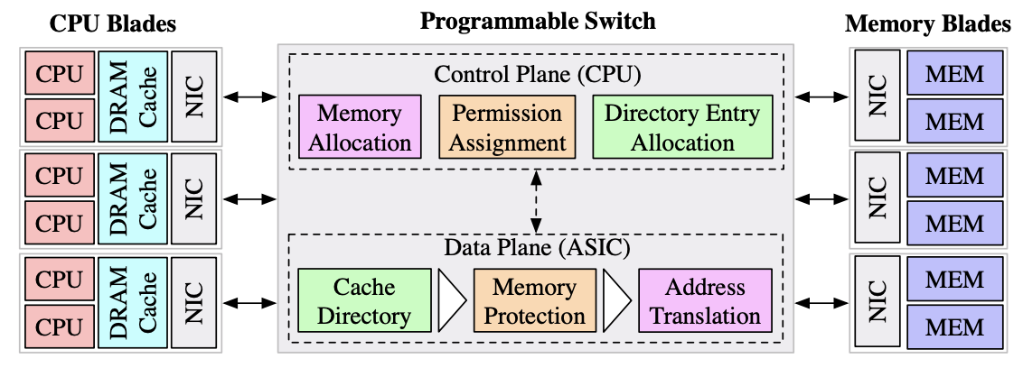
MIND overview: challenges and solutions

Slide 17
MIND overview: challenges and solutions
Control plane
CPU
CPU
decoupling address translation and protection
translation blade-based & protection vma-based
use range partitions not page-based
use single virtual address space for all processes
Local DRAM as cache
Memory allocation
Permission assignment
Directory entry allocation
NIC
4KB page: too many entries
Huge page: load balancing&memory fragmentation
MEM
MEM
MEM
MEM
NIC
Data plane
NIC
CPU
CPU
Cache directory
Memory protection
Address translation
CPU
CPU
CPU
CPU
Local DRAM as cache
Local DRAM as cache
Local DRAM as cache
NIC
NIC
NIC
Programmable switch

Slide 18
MIND overview: challenges and solutions
Control plane
CPU
CPU
Memory allocation
VMA-granularity protection
Local DRAM as cache
Permission assignment
Directory entry allocation
leverage TCAM-based parallel range matches in programmable switch ASIC to support <PDID, vma> match
NIC
MEM
MEM
4KB page: too many entries
Huge page: inflexiable protection
MEM
MEM
NIC
Data plane
NIC
CPU
CPU
Cache directory
Memory protection
Address translation
CPU
CPU
CPU
CPU
Local DRAM as cache
Local DRAM as cache
Local DRAM as cache
NIC
NIC
NIC
Programmable switch

Slide 19
MIND overview: challenges and solutions
Control plane
CPU
CPU
Access granularity
Coherence granularity
-> Dynamic resizing
Local DRAM as cache
Memory allocation
Permission assignment
Directory entry allocation
NIC
use multicast in switch to send
invalidate messages
MEM
MEM
MEM
MEM
NIC
Small cache line: too many entries
Large cache line: false sharing
Data plane
NIC
CPU
CPU
Cache directory
Memory protection
Address translation
CPU
CPU
CPU
CPU
Local DRAM as cache
Local DRAM as cache
Local DRAM as cache
NIC
NIC
NIC
Programmable switch

Slide 20
MIND overview: challenges and solutions
New memory allocation
Control plane
CPU
CPU
Local DRAM as cache
Memory allocation
Permission assignment
Directory entry allocation
NIC
MEM
MEM
MEM
MEM
NIC
Data plane
NIC
CPU
CPU
Cache directory
Memory protection
Address translation
CPU
CPU
CPU
CPU
Local DRAM as cache
Local DRAM as cache
Local DRAM as cache
NIC
NIC
NIC
Programmable switch

Slide 21
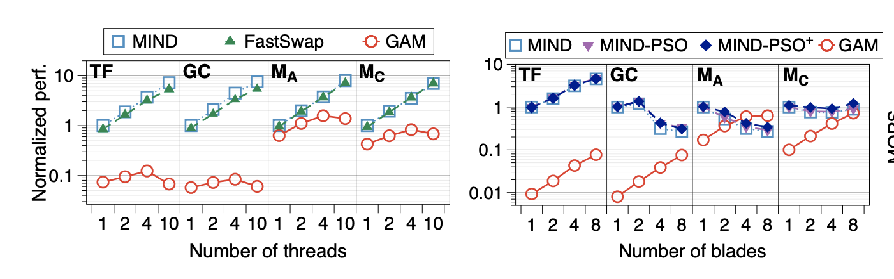
Performance evaluation
DSM
MIND
Transparent elasticity
Recent Disagg.
Performance

Slide 22
Conclusion and summary
Trade-off between resource elasticity and performance in memory disaggregation
Designed MIND, an in-network MMU by leveraging programmable network
prototype of MIND can match the performance of prior proposals and provide transparent elasticity

