Slide 1

NVAlloc: Rethinking Heap Metadata Management in Persistent Memory Allocators
ASPLOS 22
Zhi Guo
2022.10.14

Slide 2
Persistent Memory Allocator
Fundamental building block for developing high-performance applications on PMEM.
Middleware that provides recoverable and fine–grained user-level heap memory management.
Application
malloc/free
Persistent Memory Allocator
ralloc, PMDK, Makalu, nvm_malloc, PAllocator
File Mapping
OS
Identify and Set Up
Persistent Memory

Slide 3
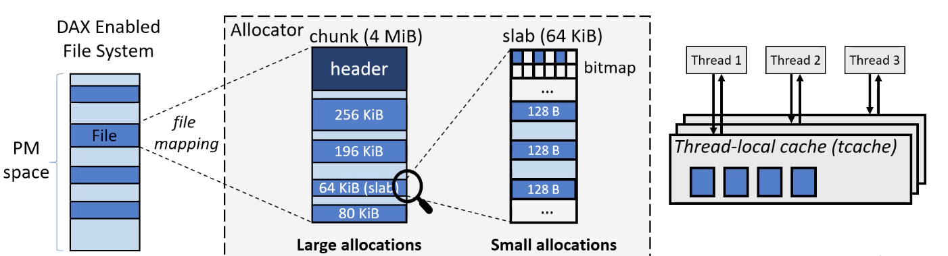
Persistent Heap Memory Management
Existing persistent memory allocators inherit mature designs from volatile memory allocators
Large allocations(e.g., >16KB) are served by large memory regions in chunks.
Small allocations(e.g., < 16KB) are served by small memory regions in slabs.
They use thread-local cache (or tcache) to reduce lock contention in small allocations.

Slide 4
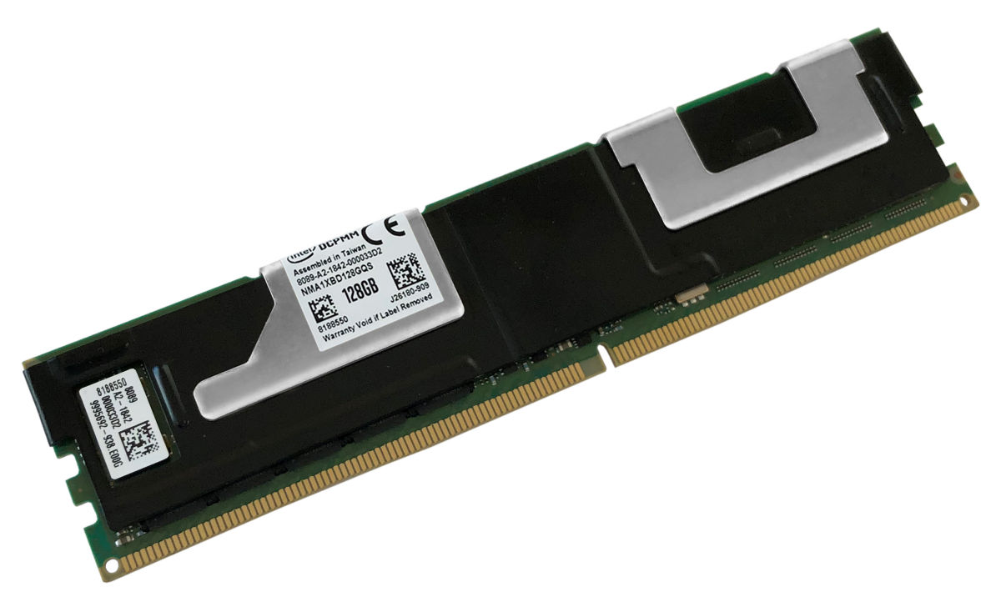
Characteristics of Real PMEM Hardware
Better sequential access performance than random
Repeated cache line flush(reflush) latency is 8x higher.
Existing allocators are not aware of these PMEM characteristics

Slide 5
Objectives
Heap Metadata management
Issues
Cache Line Reflush
Small Random Access
Static Slab Fragmantation
Designs
Interleaved Mapping
Log-structured Bookkeeping
Slab
Morphing
NVAlloc

Slide 6
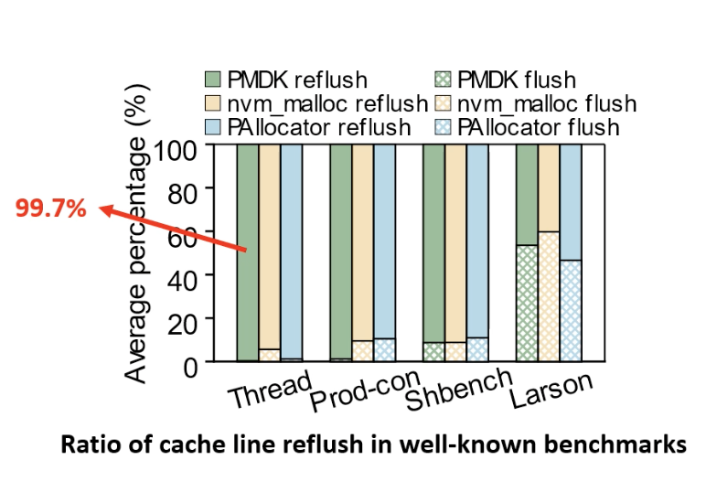
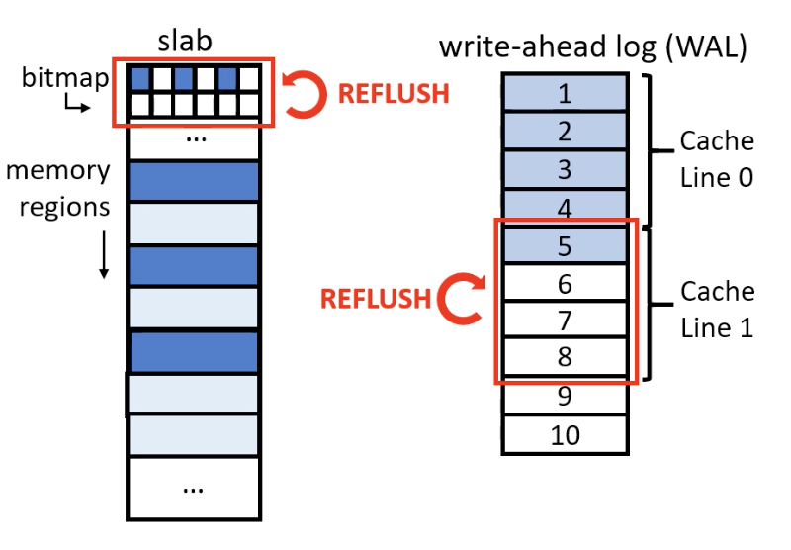
Observation 1: Cache Line Reflush Frequently Happens in Small Allocations
Reflush frequently happens for repeated updates of densely placed small metadata(bitmap, WALs).

Slide 7
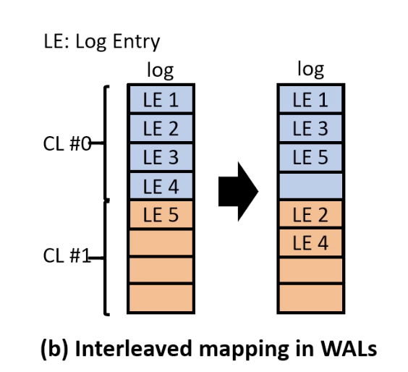
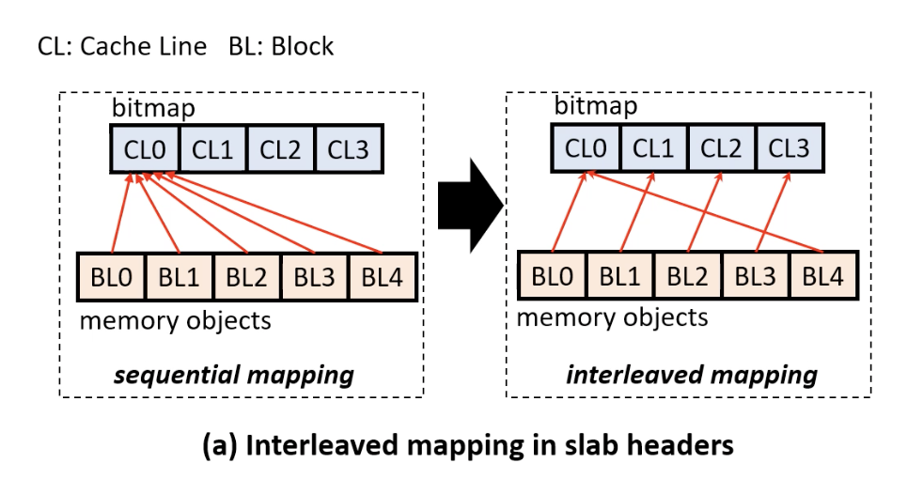
Optimization 1: Interleaved Mapping
Key insight: the metadata of consecutive objects do not need to be consecutive.

Slide 8
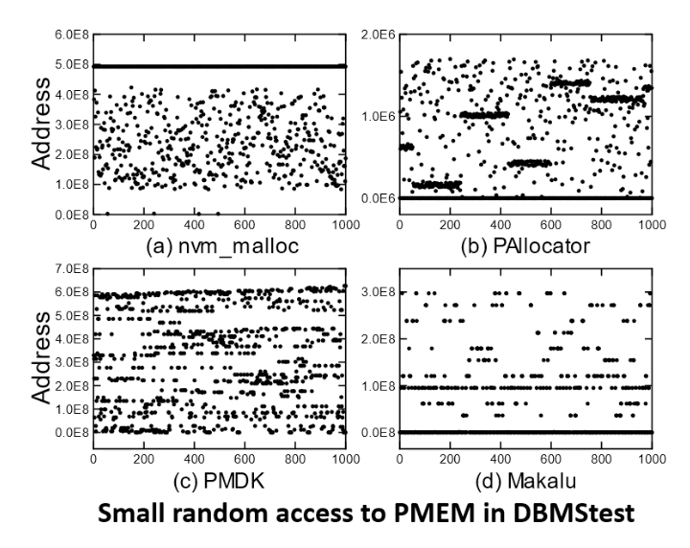
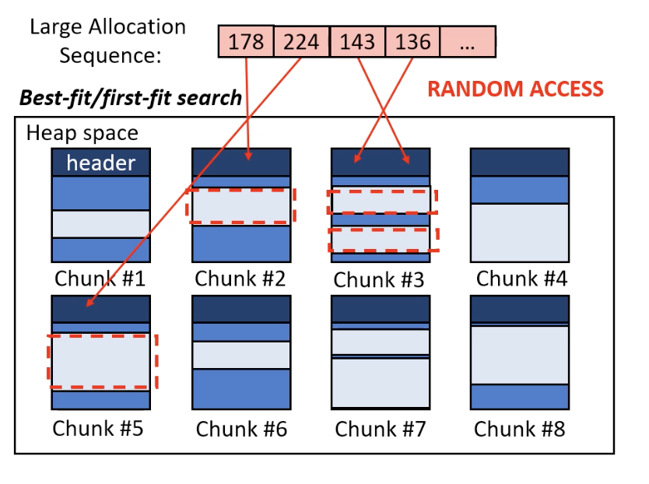
Observation 2: Small Random Access Frequently Happens in Large Allocations
The allocation algorithms (e.g., best-fit) and in-place bookkeeping modification causes small random access

Slide 9
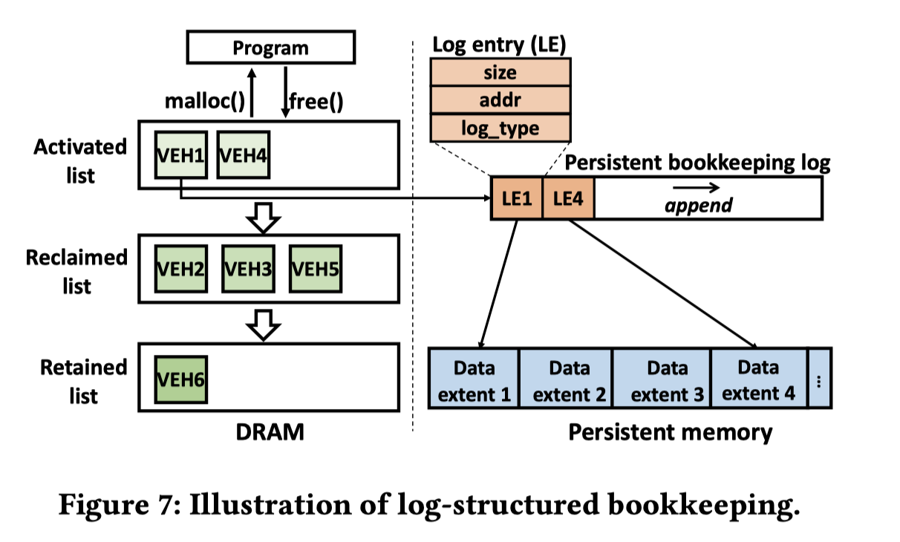
Optimization 2: Log-structured Bookkeeping
NVAlloc decouples large allocation metadata into volatile indexes and persistent log-structured bookkeeping.

Slide 10
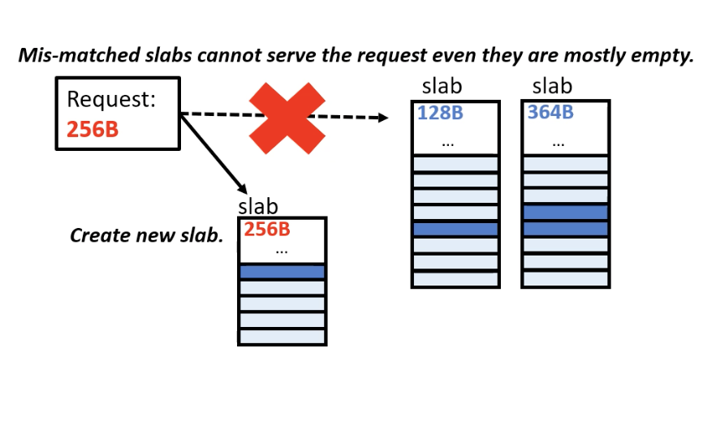
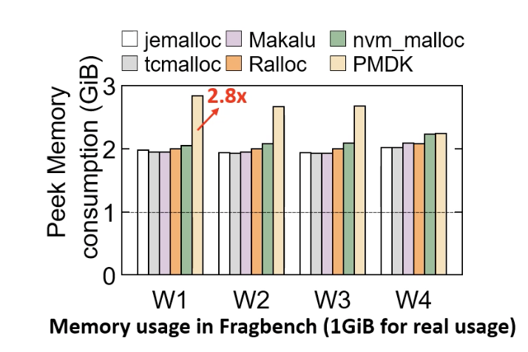
Observation 3: Persistent Memory Fragmentation in Small Allocations
Fragmentation cannot be eliminated by restarting the system for PMEM
Static slab segregation causes fragmentation under varying allocation pattern.

Slide 11
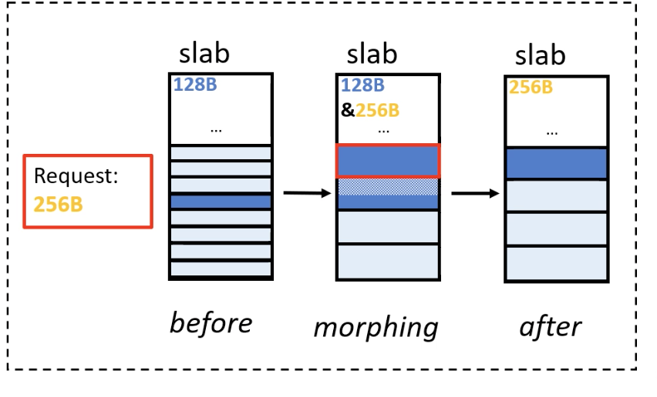
Optimization 3: Slab Morphing
NVAlloc allows a slab of low memory usage to be transformed to a slab of another size class using slab morphing.
During the transformation, the slab may store two types of data blocks of different sizes.
Challengs:
Correctness of indexing two types of blociks in one slab.
Minimize the overhead.

Slide 12
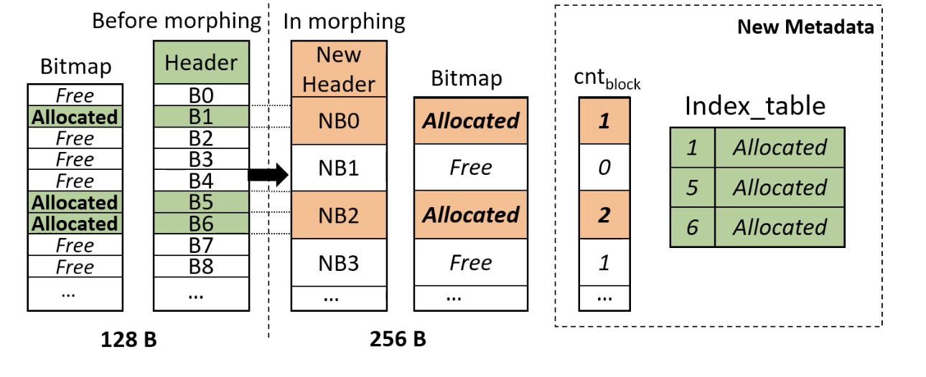
Optimization 3: Slab Morphing
The release of old blocks (e.g., B0) has a low cost because the are small in number.
The allocation and release of new blocks have no extra overhead because only the bitmap is used in the process.

Slide 13
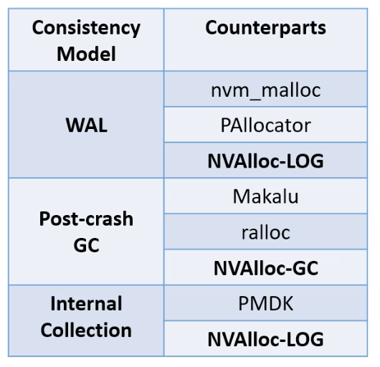
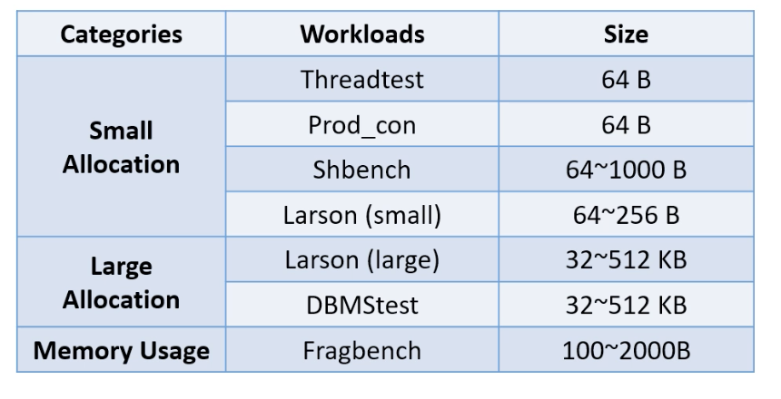
Evaluation Setup
Platform
CPU: Intel Xeon Gold 5218R
DRAM: 4*16 GB 2666 Mhz
PMEM: 2*128 GB Intel Optane DCPMMs
Workloads
Compared Allocators

Slide 14
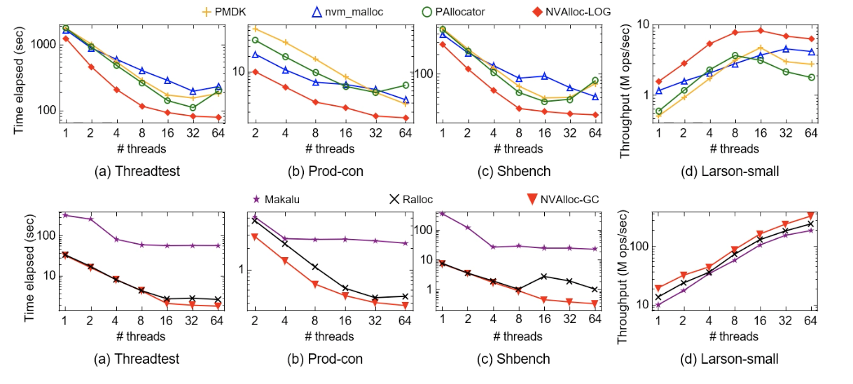
Performance Results: Small Allocation
For small allocation, NVAlloc outperforms existing allocators by up to 6.4x and 3x in average

Slide 15
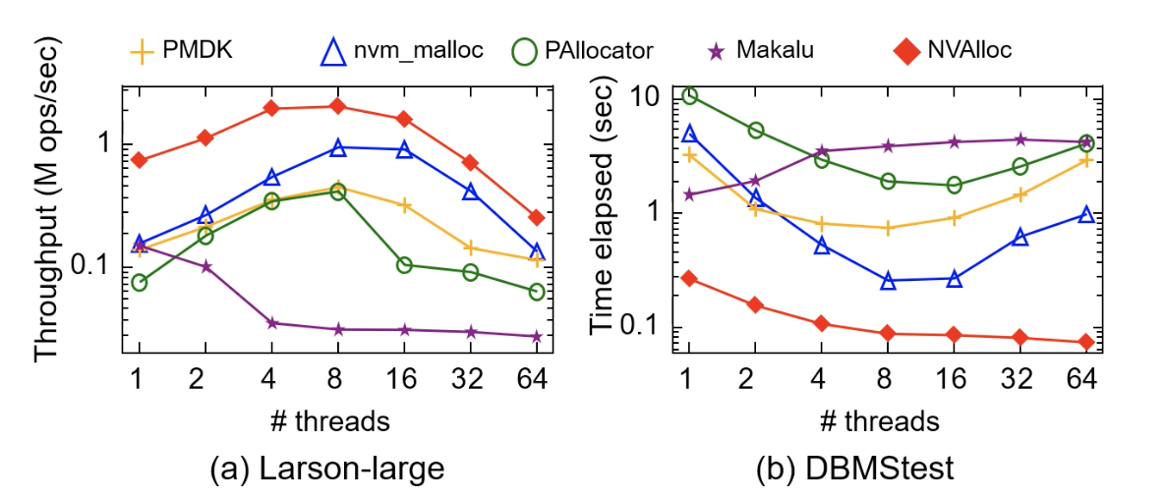
Performance Results: Large Allocation
For large allocation, NVAlloc outperforms existing allocators by up to 57x and 5x in average

Slide 16
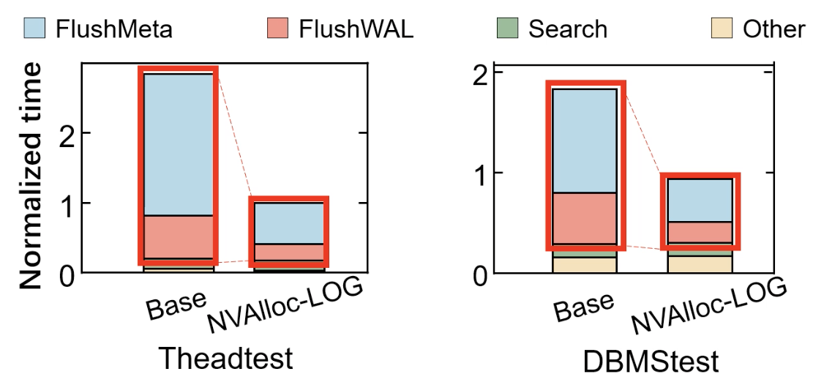
Performance Breakdown
The performance improvement is mainly due to the reduction of the flush time.
For small allocation, the cache line reflushes are eliminated.
For large allocation, the small random flushes to PMEM are eliminated.

Slide 17
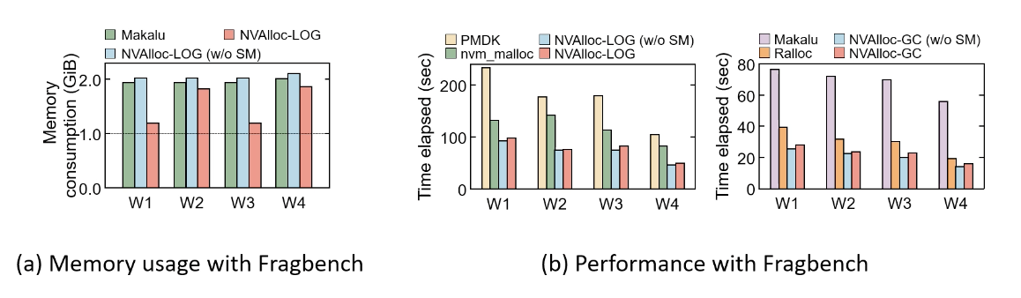
Performance Results: Memory Usage
NVAlloc reduces memory usage by up to 57.8% with performance overhead less then 5%.

Slide 18
Summary
NVAlloc addresses performance and memory usage issues in existing persistent memory allocators.
Interleaved mapping => cache line repeated flush.
Log-structured bookkeeping => small random access.
Slab morphing => static slab fragmentation.
NVAlloc significantly speeds up small and large allocations and reduces memory usage.

Slide 19
Title

