Slide 1

DiLOS: Adding Performance to Paging-based Memory Disaggregation
Wonsup Yoon, Jinyoung Oh, Jisu Ok, Sue Moon, Youngjin Kwon
KAIST APSys 21
Presented by Zhi Guo
2022.09.29

Slide 2
Resource Disggregation
CPU
MEM
GPU
CPU
MEM
GPU
CPU
MEM
GPU
[servers]

Slide 3
Resource Disggregation
CPU
CPU
CPU
CPU
MEM
GPU
Network
CPU
MEM
GPU
CPU
MEM
GPU
MEM
MEM
MEM
GPU
GPU
GPU
[servers]
disaggregated blades
Benefits of resource disaggregation
* High resource utilization
* Easy to manage
* Elastic scalability

Slide 4
Memory Disaggregation
Two node(CPU node and Memory node)
Memory in CPU node works as cache.

Slide 5
Memory Disaggregation (SOTA)
Kernel based
Fastswap
explicit page fault, the OS fetches remote page to local in response to the page fault.
Library based
AIFM
check whether an object is in local or remote memory when dereferencing its pointer.

Slide 6
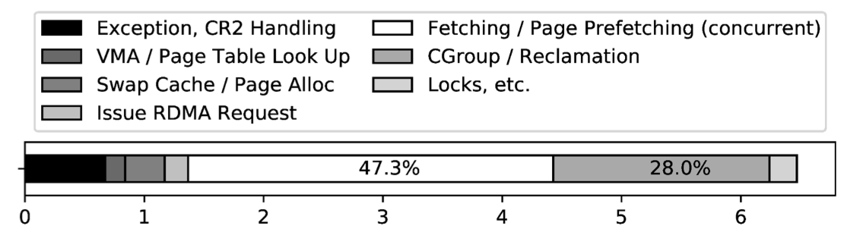
Memory Disaggregation (SOTA)
Kernel based
Fastswap
Expensive page fault
Library based
AIFM
Lack of compatibility

Slide 7
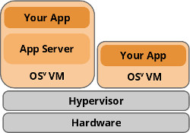
Unikernel
Unikernel:
LibOS
process and kernel running together
Ring-0 mode
Eliminate kernel-user mode switching

Slide 8
Dis-mem with Unikernel
Insights
Why Unikernel matches Dis-mem
OS serves one application in both scenario
Performance improvement
Avoid mode-switching when page fault
Use application semantics

Slide 9
DiLOS Design
Fast page fault handler
Prefetcher
Page manager
Communication over RDMA

Slide 10
Fast page fault handler
Unified page table
Use bits in PTE to distinguish local page and remote page
Asynchronous network requests
Do permission checks and page reclaims, after the network request

Slide 11
Prefetcher
Bypass swap cache
DiLOS cuts down on page faults during prefetching via skipping the swap cache.
Hit tracker
Use access bit in page table.
Notes:
The swap cache is a core data structure in Linux’s swap system.It stores all prefetched pages and provides statistical information.
The swap cache design incurs a large number of minor page faults, limiting overall performance.

Slide 12
App-aware Prefetching Guide
Why Unikernel is APP-aware?
Upcall/downcall is much more faster.
DiLOS App-aware prefetching procedure
DiLOS Provide upcall/downcall interfaces for prefetching guide.
During fetching, page fault handler issues an event with the faulting address and statistics to the guide.
The guide uses application semantic to inform the prefetcher what data to prefetch.
Notes:
a Linux upcall latency to invoke a user-level handler takes 2-3 𝜇 seconds whereas a single page fault takes 3-4 𝜇 seconds. In unikernels, on the other hand, the costs of system calls and upcalls are the same as function calls

Slide 13
Page Manager
Cleaner
Write dirty pages to memory node.
Reclaimer
Evict the least recently cleaned and not-accessed pages. (LRU)

Slide 14
Communication over RDMA
RDMA
RDMA is the SOTA communication channel for memory disaggregation.
Unikernel OSv doesn’t support RDMA.
DiLOS’s RDMA driver
Borrow VMM-bypass’s concept, reusing VMM’s control path and bypassing VMM in data path

Slide 15
Implementation
DiLOS is built on top of Osv.
CLOC
DiLOS: 5085
OSv: 576
QEMU: 880

Slide 16
Evaluation
Compare with AIFM(library based), Fastswap(kernel based)
Testbed
Computing node:
Intel E5-2670 v3, DDR4 RAM(110G), Mellanox CX556A EDR/100GbE card.
Memory node:
Intel E5-2670 v3, DDR4 RAM(440G), Mellanox CX556A EDR/100GbE card.

Slide 17
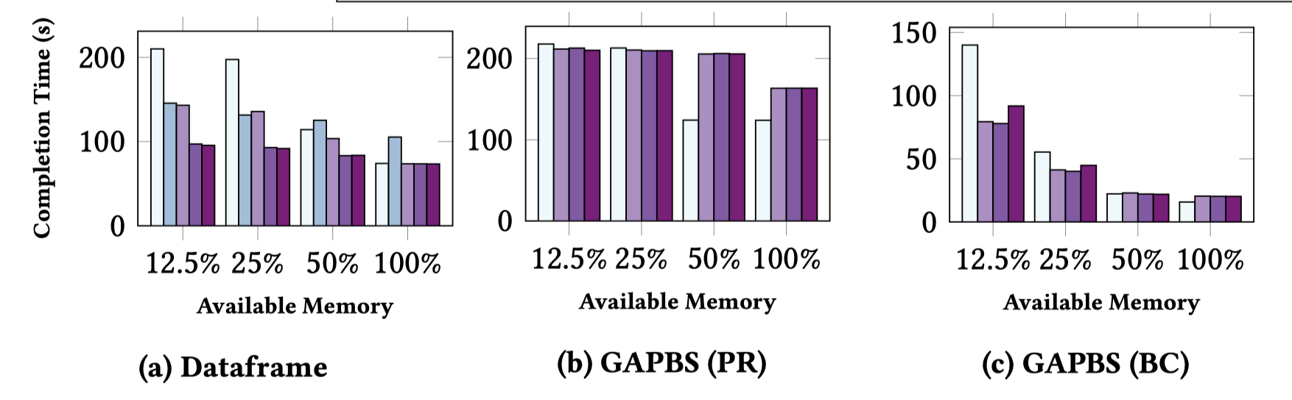
Evaluation
Notes:
DiLOS 默认比aifm好，这是因为AIFM 每次访问指针都需要在软件层进行解引用
在Datafram(数据处理benchmark）中，DiLOS比fastswap表现更好, 特别是在local memory很小时184%
图计算benchmark 中，在50% 100%时，DiLOS表现要比fastswap差，作者说这是因为Osv里面的同步（锁）扩展性不好，

Slide 18
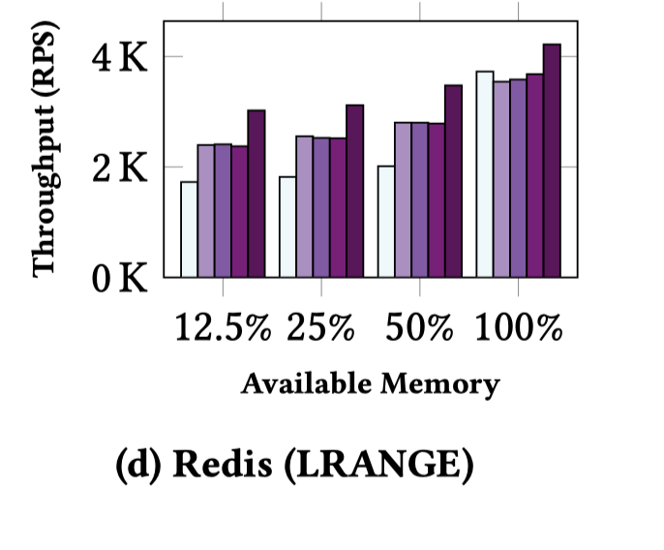
Evaluation

Slide 19
Conclusion
This paper claims unikernels are a promising platform for memory disaggregation.
This paper introduces DiLOS, it demonstrates superior performance than SOTA work（52% vs AIFM, 120% vs fastswap).

