Slide 1
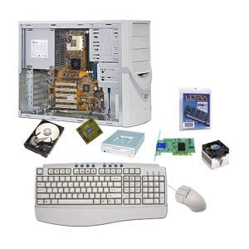
Computer Parts
There are many parts that work together to make a computer work.

Slide 2
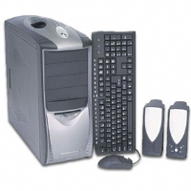
Hardware
Physical parts of the computer, including processor and memory chips, input/output devices, tapes, disks, modems, cable, etc.

Slide 3
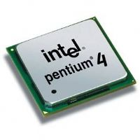
CPU
The Central Processing Unit

Slide 4
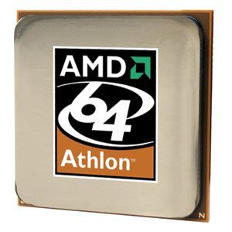
Processor
The CPU – The chip or chips that interpret and execute program instructions and manage the functions of input, output, and storage devices.

Slide 5
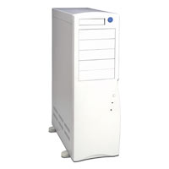
Computer Case
Contains the major components of the computer. It helps protect them.

Slide 6
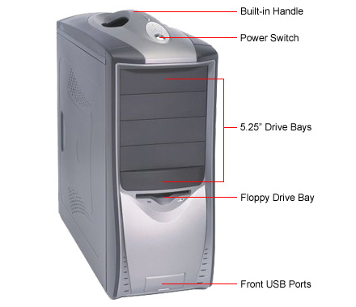
Front of the Computer Case

Slide 7
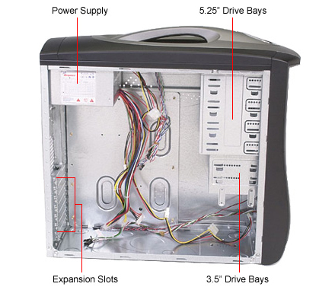
Inside the Computer Case

Slide 8
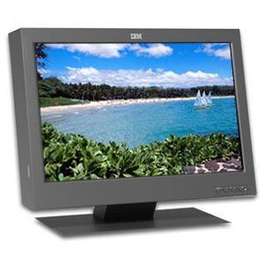
Monitor
A display screen to provide “output” to the user. It is where you view the information your are working on.

Slide 9
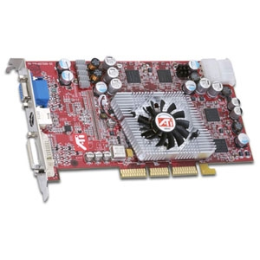
Video Card
Connects the computer to the monitor. It is a circuit board attached to the motherboard that contains the memory and other circuitry necessary to send information to the monitor for display on screen.

Slide 10
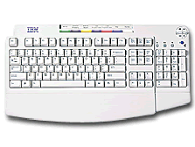
Keyboard
Used to enter information into the computer and for giving commands.

Slide 11
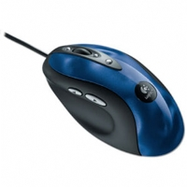
Mouse
An input device operated by rolling its ball across a flat surface. The mouse is used to control the on-screen pointer by pointing and clicking, double-clicking, or dragging objects on the screen.

Slide 12
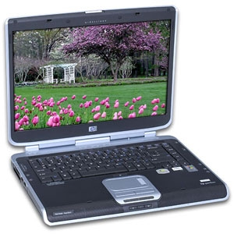
Touchpad
A pressure-sensitive and motion sensitive device used in place of a mouse.

Slide 13
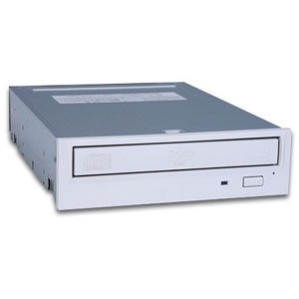
CD Rom Drive
The drive that plays CDs and reads data that has been stored on the CD.

Slide 14
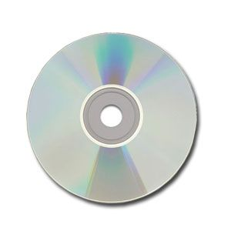
CD
Compact Disk – A type of optical storage device.

Slide 15
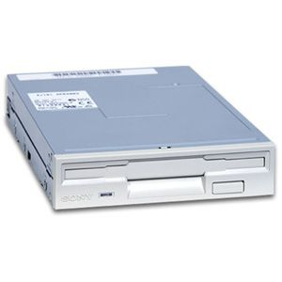
Floppy Disk Drive
A device that holds a removable floppy disk when in use; read/write heads read and write data to the diskette.

Slide 16
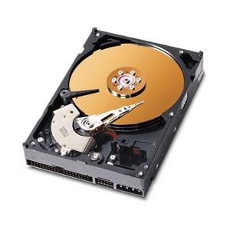
Hard Disk
Magnetic storage device in the computer.

Slide 17
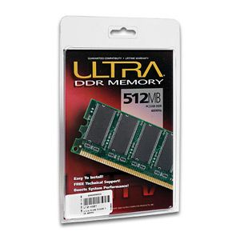
RAM
Random Access Memory
RAM is a computer’s temporary memory, which exists as chips on the motherboard near the CPU. It stores data or programs while they are being used and requires power.

Slide 18
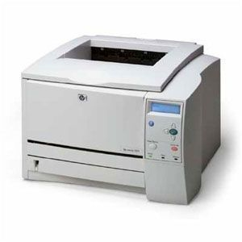
Printer
An output device that produces a hard copy on paper. It gives information to the user in printed form.

Slide 19
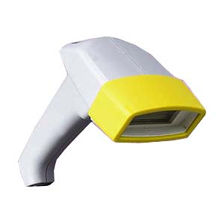
Barcode Reader
An input device that converts a pattern of printed bars into a number that a computer can read. They are often used by businesses to quickly input price and product information.

Slide 20
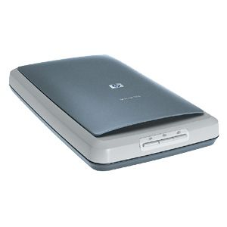
Scanner
A device that allows pictures to be placed into a computer.

Slide 21
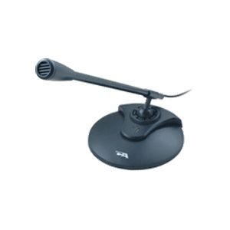
Microphone
Allows the user to record sounds as input to their computer.

Slide 22
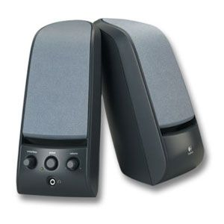
Speakers
Used to generate or reproduce voice, music, and other sounds.

Slide 23
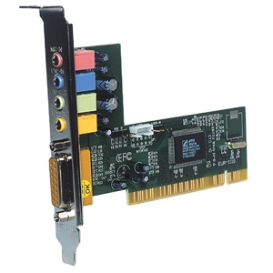
Sound Card
Connects the speakers and microphone to the computer.

Slide 24
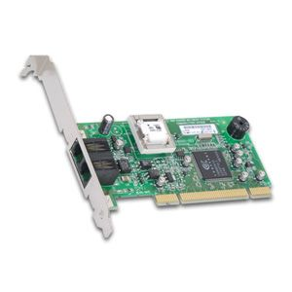
Modem
The place where the computer is connected to the phone line.

Slide 25
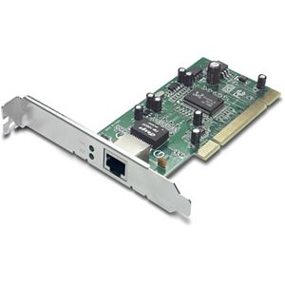
Network Card
A circuit board that connects the computer to the rest of the network usually using special cables.

Slide 26
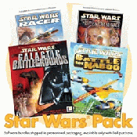
Software
Programs that tell the computer what to do. It provides instructions that the CPU will need to carry out.

Slide 27
DOS
Disk Operating System
This software connects the hardware with the programs you want to run.
MS-DOS:
Microsoft DOS (Disk Operating System) is a command line user interface. MS-DOS 1.0 was released in 1981 for IBM computers.

Slide 28
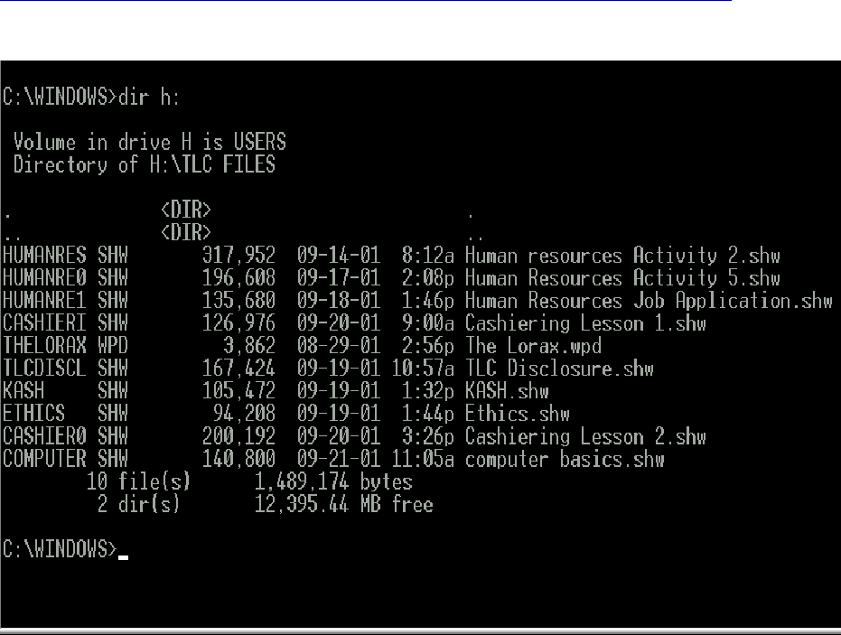
Example of MS-DOS

Slide 29
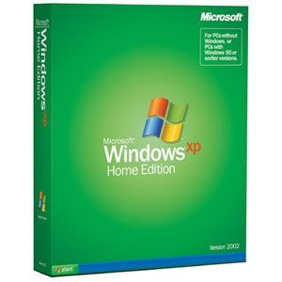
Windows
A family of operating systems developed and produced by Microsoft Corp. It provides a software graphical user interface (GUI) used on IBM and compatible computers.

Slide 30
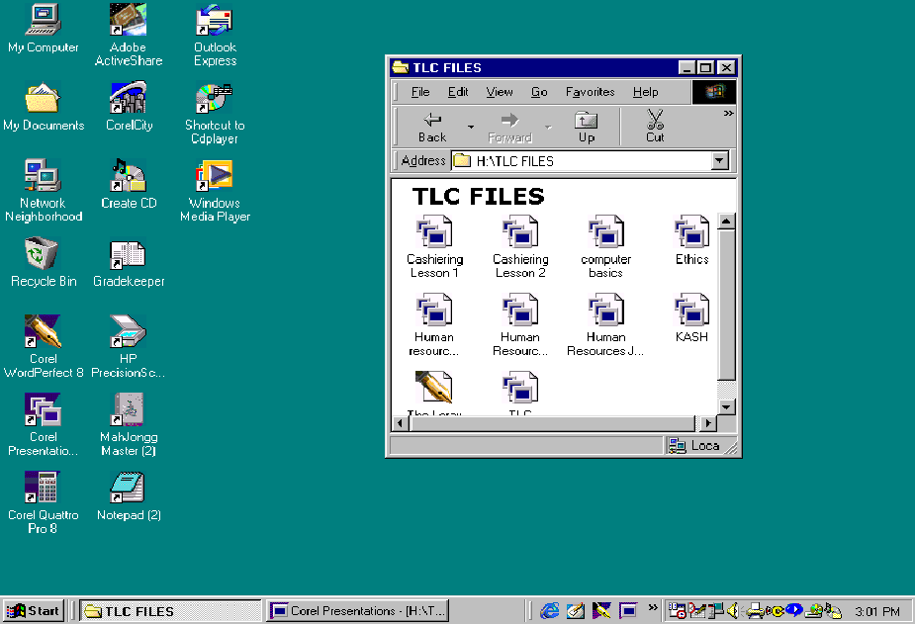
Example of Windows (GUI)

