Slide 1
Cybersecurity

Slide 2
Network Security
Network security comprises authentication and encryption
Authentication is typically accomplished through a username and password
Other forms of authentication are digital certificates, smart cards, and biometrics

Slide 3
Administrator Account
User provides password for default administrator account
Default administrator account name should be changed to better secure network
Ability to delete or rename the administrator account varies according to operating system

Slide 4
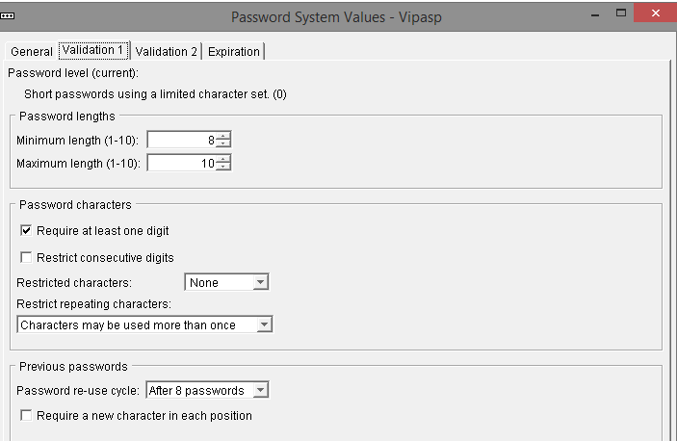
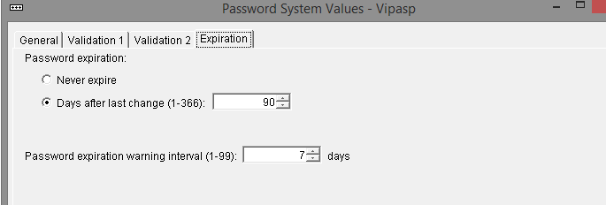
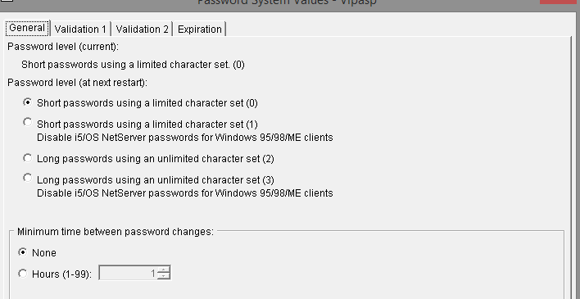
Setting Password Criteria (admin)

Slide 5
User Account Passwords
To make passwords more secure administrators should:
Set defaults for password histories, age, and length
Educate users about poor and secure passwords

Slide 6
Poor Passwords
Poor passwords contain:
Words that are found in a dictionary
Names familiar to the password owner
Keyboard patterns
Social security numbers
Secure passwords are less vulnerable to hashing techniques

Slide 7
Wired Equivalent Privacy (WEP)
First attempt use encryption to secure the data transferred across a wireless network
Algorithm not complex and can be easily cracked
A VPN can add to the security set in place by WEP

Slide 8
Wi-Fi Protected Access (WPA)
Developed by the Wi-Fi organization to overcome the vulnerabilities of WEP
Compatible with 802.11 devices
Wi-Fi Protected Access 2 (WPA2) is an enhanced version of WPA
WPA2 is compatible with the 802.11i standard

Slide 9
Denial of Service (DoS)
One of the most common attacks on a server
Can overload a server to the point that it crashes or is not able to complete a legitimate user request

Slide 10
Trojan Horse
Example: Free download that contains malicious code
That code could contain virus, worm, or backdoor
Example: Can imitate legitimate logon screen
When user logs on, name and password are sent to unauthorized user

Slide 11
E-mail Attachments
Source of most commonly encountered viruses
Malicious code can be programmed into attachment
When recipient opens attachment, malicious program is activated

Slide 12
Social Engineering
Relies on the gullibility of a network user and his or her respect for authority

Slide 13
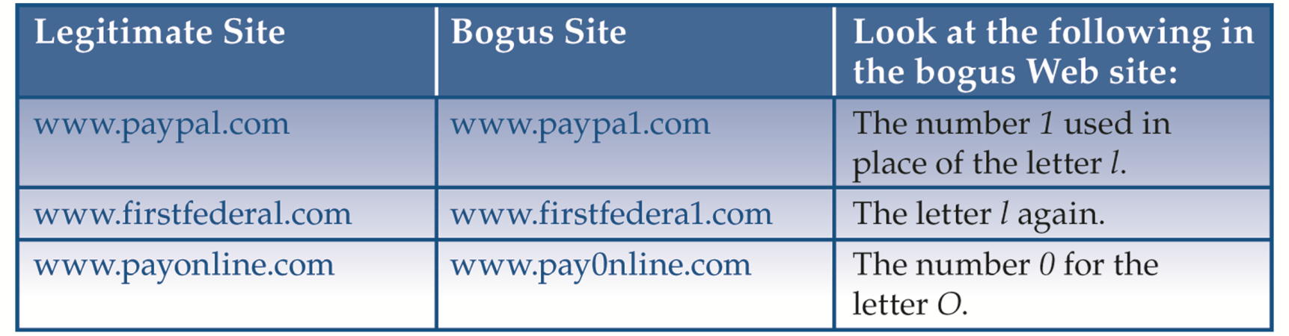
Phishing
E-mail can appear as if it’s from a legitimate company, such as a credit card company
E-mail requests user’s personal information, such as social security number or bank account PIN
Phony web sites that look authentic, but have slightly different domain names

Slide 14
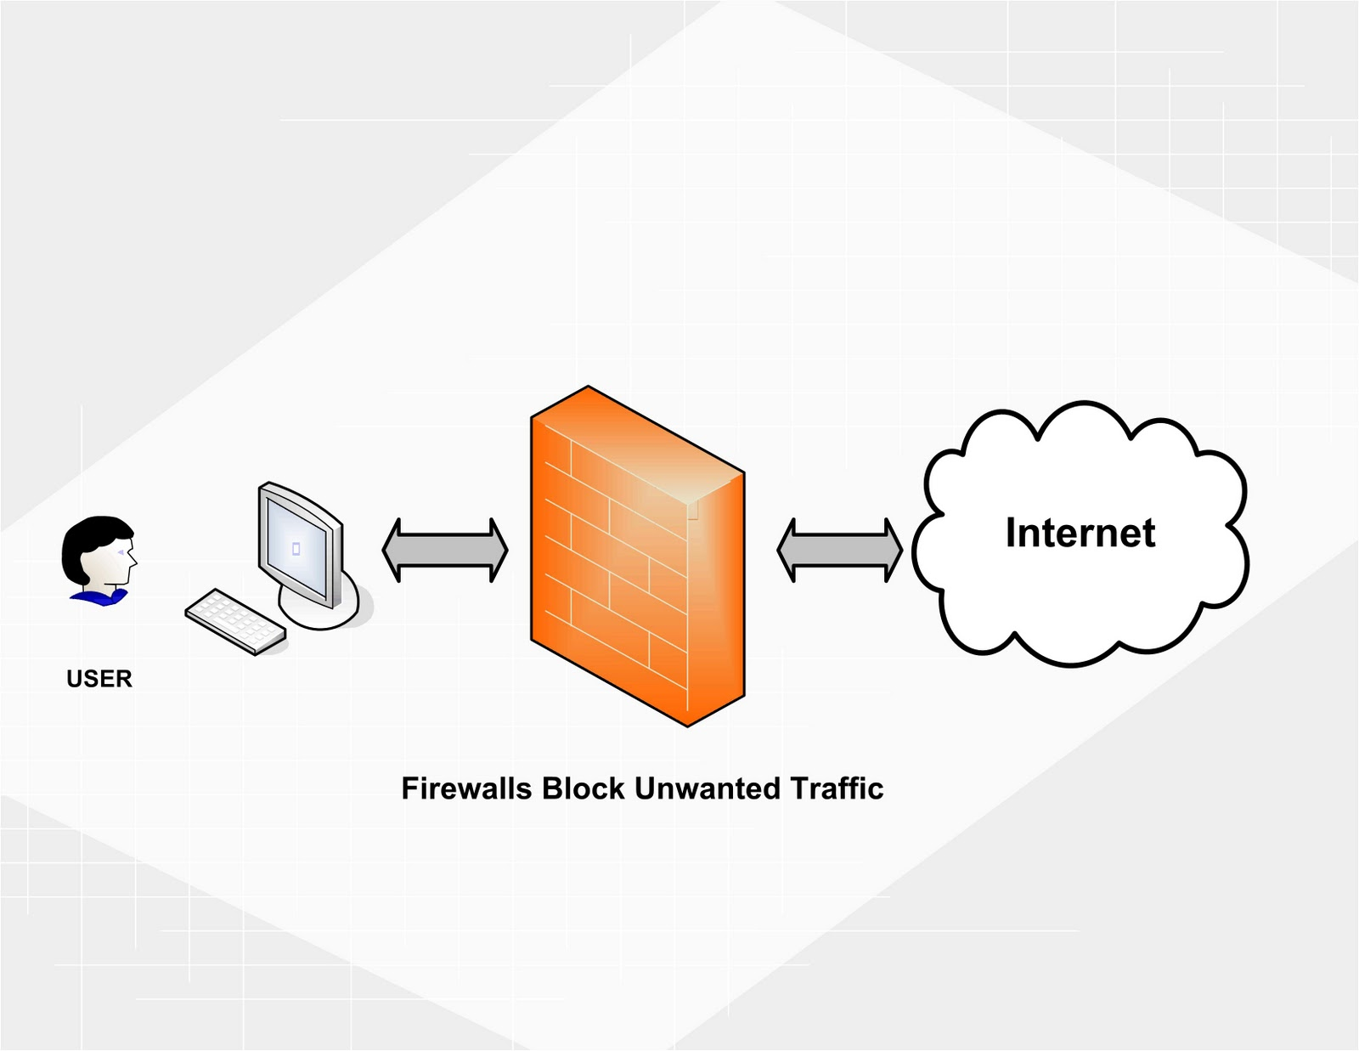
Firewall
Can consist of hardware, software, or a combination
Servers, routers, and PCs may be used
Designed to filter inbound and outbound flow of network packets based on factors such as
IP address
Port number
Software application
Packet contents
Protocol

Slide 15
What is a Firewall?
A layer of security between your home network and the Internet. Since a router or modem is the main connection from a home network to the Internet, a firewall is often packaged with those devices.
Firewalls are a combination of hardware and software. The hardware part gives firewalls excellent performance, while the software part allows firewalls to be tailored to your specific needs.

Slide 16
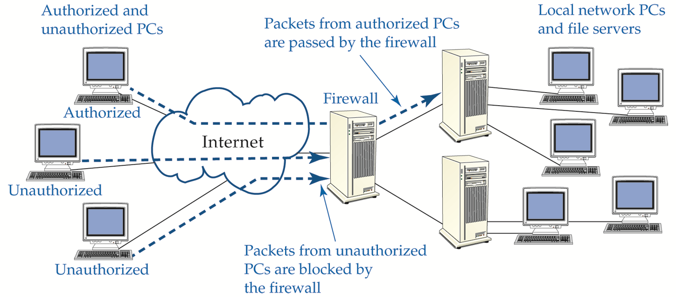
Firewall Example

Slide 17
What is a Firewall?
Some applications outside a network require manually changing your firewall to allow them access. Examples of these applications include online games, VPN, and Voice-Over-IP.
A firewall does not secure against every kind of data and attack. (still need to run a virus-checker on all your computers.)
Other products such as Windows and macOS create software firewalls. These can cause network problems, because they are trying to apply different security to your network, which other firewalls will not accept. May need to disable conflicting firewalls.
Firewall features vary by model - newer and more expensive products have more advanced features. Firewall features are described in a product's datasheet, and their configuration information is found in the manuals.
The term firewall is often used to describe the part of a network that is protected by a firewall, as in the phrase behind the firewall. Parts of a network that are outside the firewall are more vulnerable to attack.

Slide 18
Network Address Translation (NAT)
Allows unregistered private network addresses to communicate with legally registered IP addresses
Advantages
Hides internal IP addresses, thus providing security
Eliminates need for multiple registered IP addresses
Allows multiple ISDN (Integrated Services for Digital Network) connections to be combined into one Internet connection

Slide 19
Media Access Control (MAC) Filtering
To configure MAC filtering, administrator creates an Access Control List (ACL)
ACL is located on Wireless Access Point (WAP)
ACL contains list of MAC addresses belonging to authorized wireless network devices

Slide 20
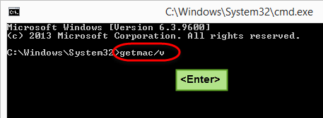
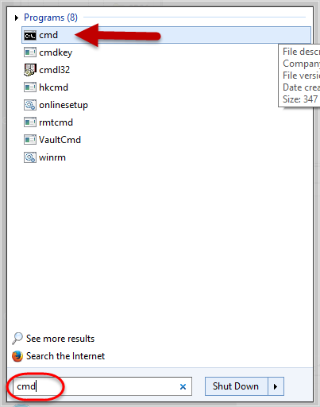
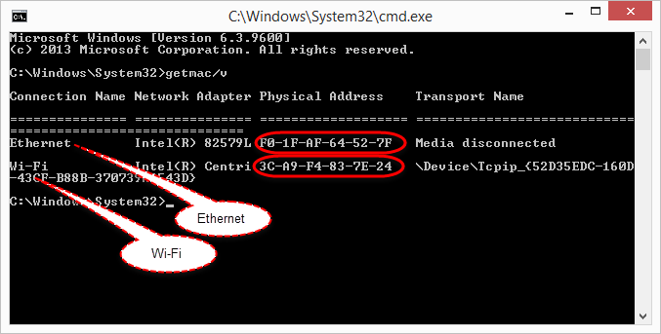
Find your MAC Address
3
2
4
1

Slide 21
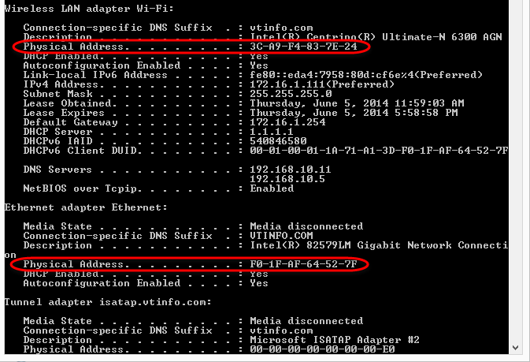
Also: ipconfig /all

Slide 22
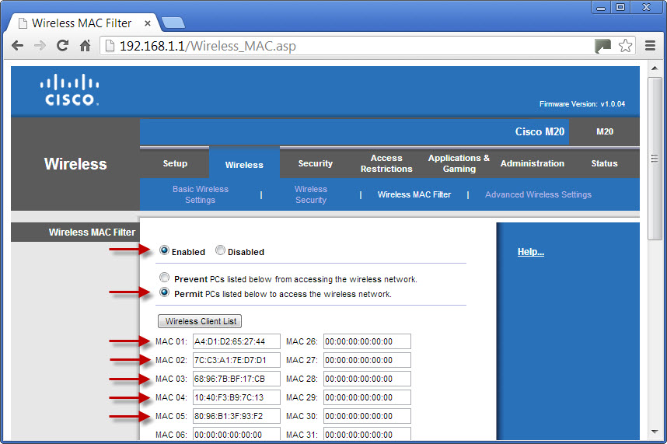
CISCO Router MAC Filter Setup

