Slide 1
Operating Systems

Slide 2
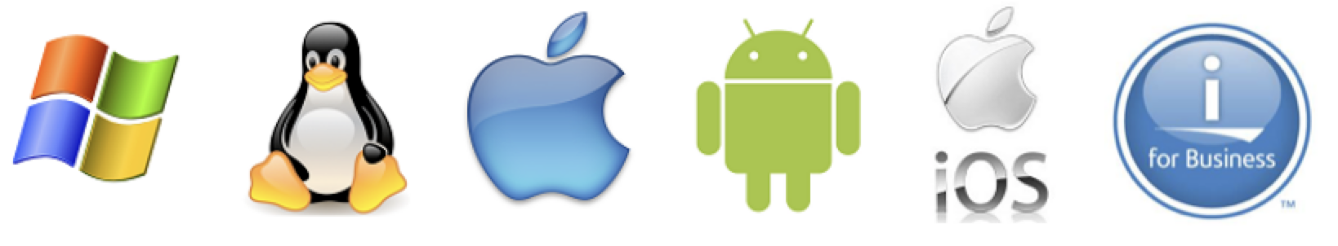
Operating Systems
Definition: the main program in a computer that controls the way the computer works and makes it possible for other programs to function.
Consists of software that:
Controls the use of computer hardware and software resources
Enables user interaction via applications
Gives direct access to various functions outside of applications (such as copying/deleting files)
Updates the OS itself

Slide 3
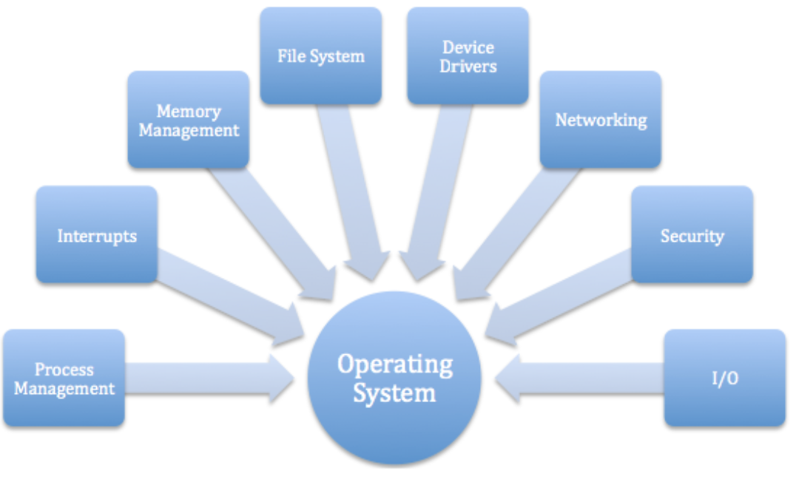
Operating System Functions
Gives applications easy but “safe” access to hardware (safe meaning it performs the desired actions without crashing the system)
Manages sharing of data and security
Enables use of resources, such as memory, storage, and networking

Slide 4
Operating Systems
The biggest and fastest computer in the world is of no use if it cannot efficiently provide beneficial services to its users.
Users see the computer through their application programs. These programs are ultimately executed by computer hardware.
System software, in the form of operating systems and middleware, is the glue that holds everything together.
The evolution of operating systems has paralleled the evolution of computer hardware.
As hardware became more powerful, operating systems allowed people to more easily manage the power of the machine.

Slide 5
Operating Systems
In the 1960s, hardware has become powerful enough to accommodate multiprogramming, the concurrent execution of more than one task.
Multiprogramming is achieved by allocating each process a given portion of CPU time (a timeslice).
Interactive multiprogramming systems were called timesharing systems.
When a process is taken from the CPU and replaced by another, we say that a context switch has occurred.

Slide 6
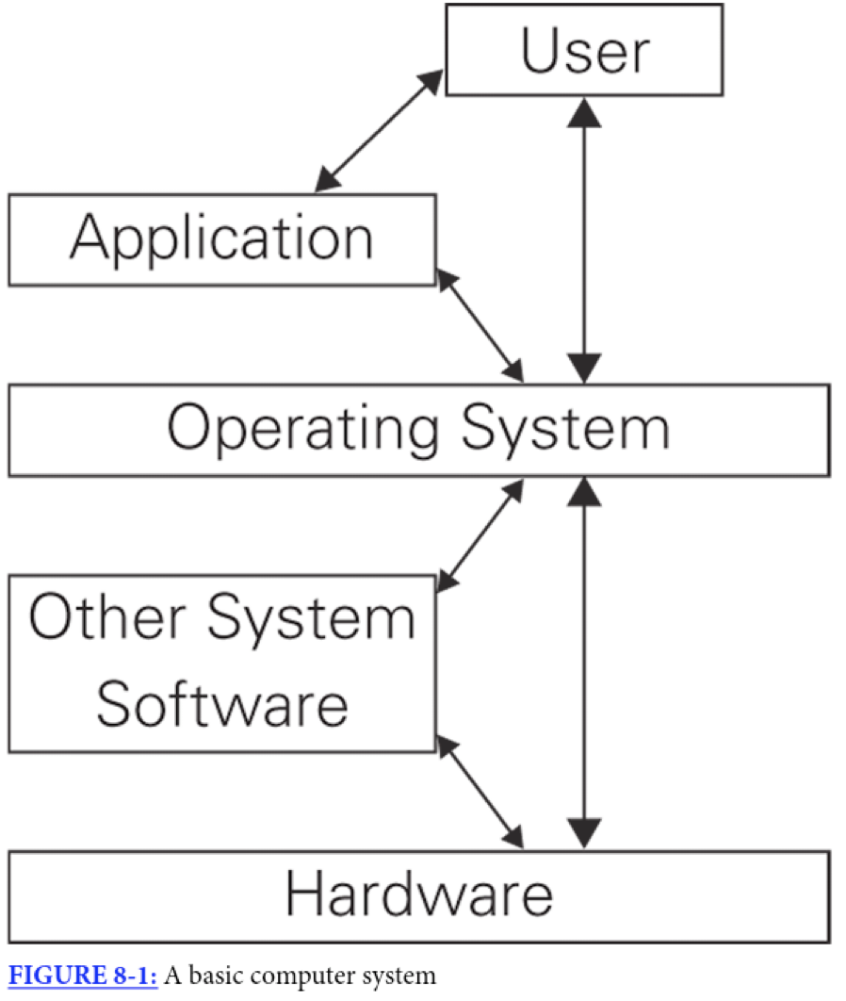
Operating Layers
Users: input data, require steps to be executed, save data or generate output
Application: responds to requests such as saving a file by passing it along to the OS
OS layer: (“other system software” = e.g. device drivers - software that assists the OS)
Hardware: the physical computer. Kernel performs/controls the actions on the hardware.

Slide 7
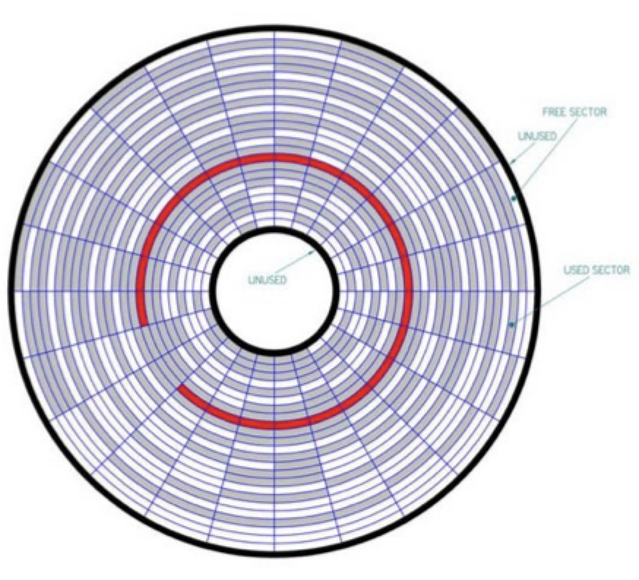
File Systems
Different schemes of organizing and storing files on a storage device
FAT32 (File Allocation Table)
NTFS (New Technology File System)
HFS+ (Hierarchical File System)
APFS (Apple File System)
ext4:
Journaling file system for Linux
Fourth extended filesystem

Slide 8
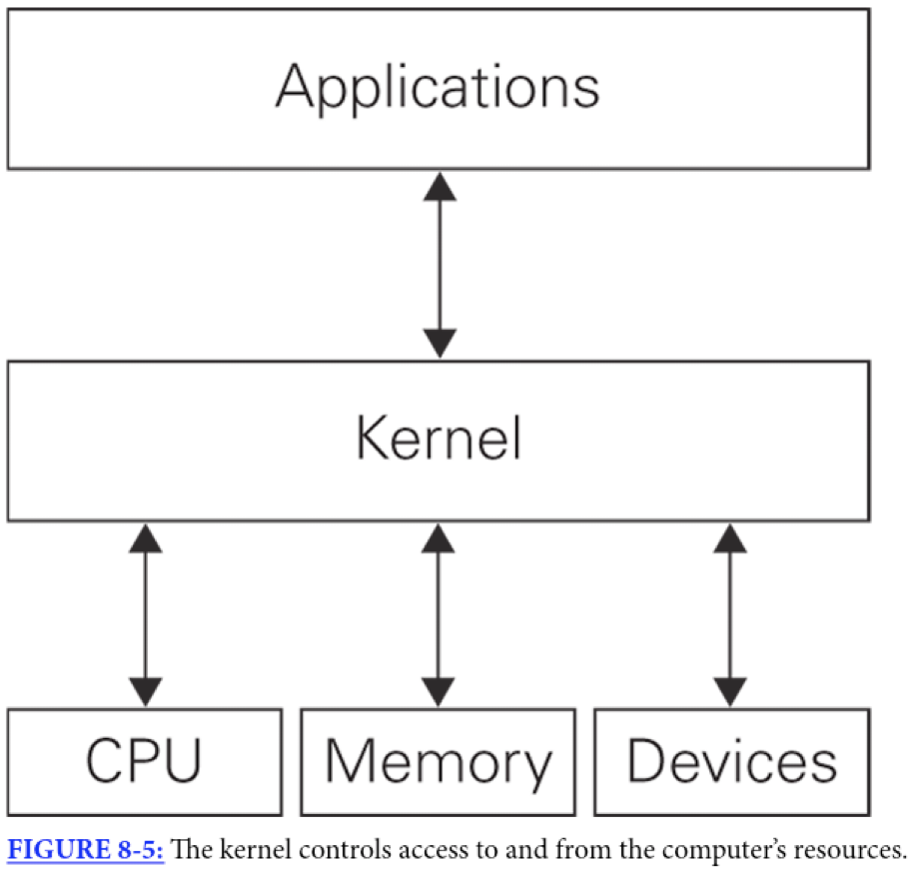
The Kernel
Two operating system components are crucial: kernel and the system programs
Kernel is software that oversees and exerts basic control for a computer’s hardware, memory access, central processing unit (CPU), storage devices and file systems
As the core of the operating system, the kernel performs scheduling, synchronization, memory management, interrupt handling and it provides security and protection
Provides the necessary interface for applications to use the computer’s hardware

Slide 9
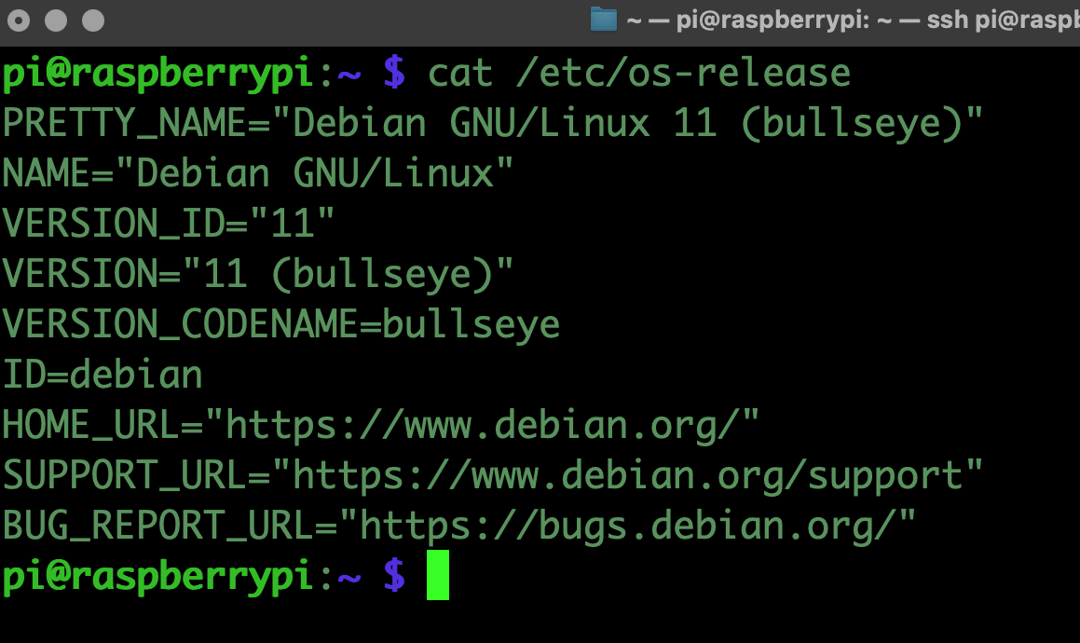
Command Line Interface
Operating systems have a powerful utility that allows commands to be entered and executed on the command line
This Command Line Interface provides the user with access to operating system functions
All major operating systems have a command line interface:
Windows Command Prompt / PowerShell
macOS Terminal
Unix Terminal
Linux Terminal

Slide 10
Command Line Interface
Operating systems have a powerful utility that allows commands to be entered and executed on the command line
This Command Line Interface provides the user with access to operating system functions
All major operating systems have a command line interface:
Windows Command Prompt / PowerShell
macOS Terminal
Unix Terminal
Linux Terminal

Slide 11
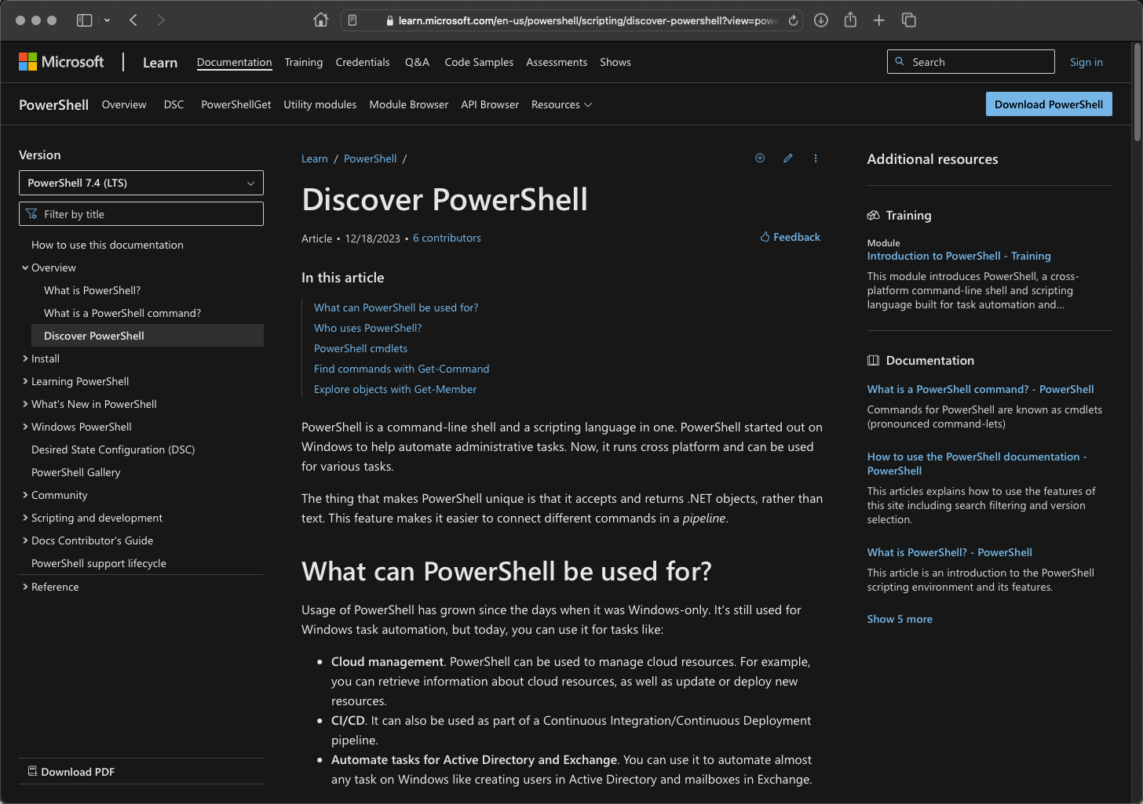
PowerShell
https://learn.microsoft.com/en-us/powershell/scripting/discover-powershell?view=powershell-7.4

Slide 12
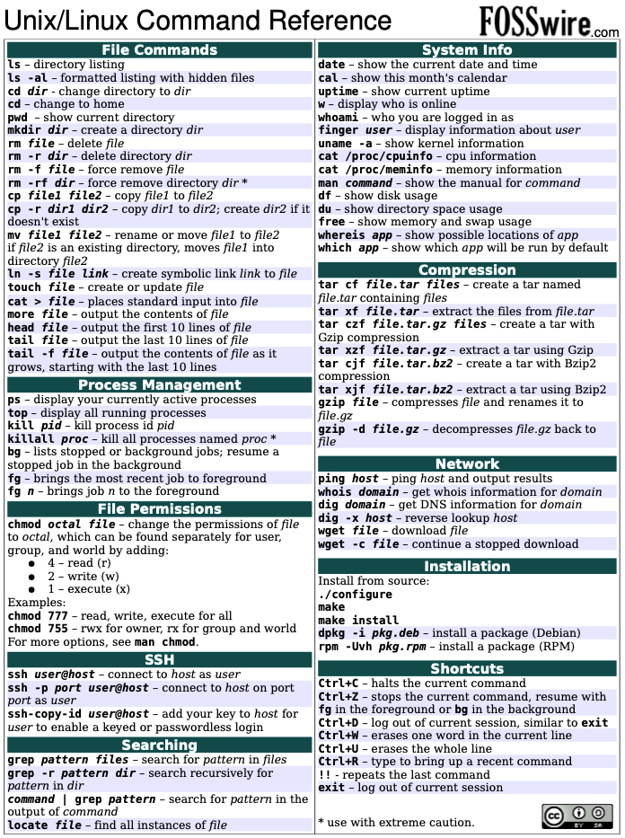
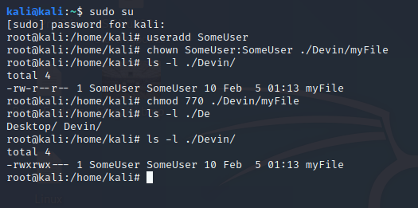
Terminal Commands (macOS, Unix, Linux)

