Slide 1
Virtualization & Cloud Computing

Slide 2
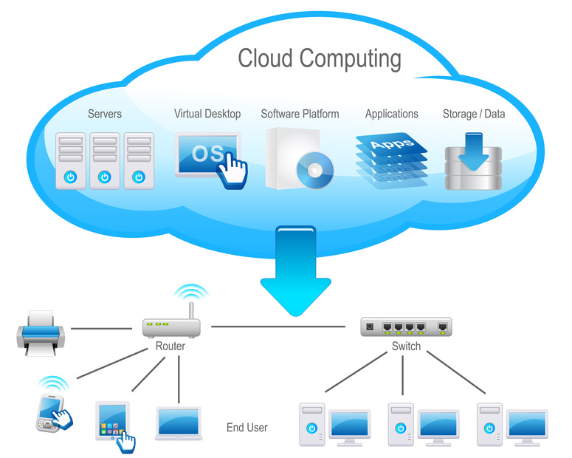
Cloud Computing

Slide 3
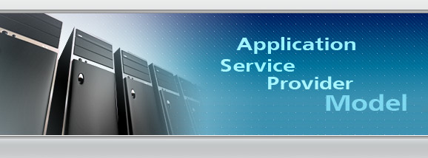
ASP Model

Slide 4
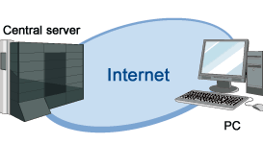
Infrastructure as a Service

