Slide 1
Computer Hardware

Slide 2
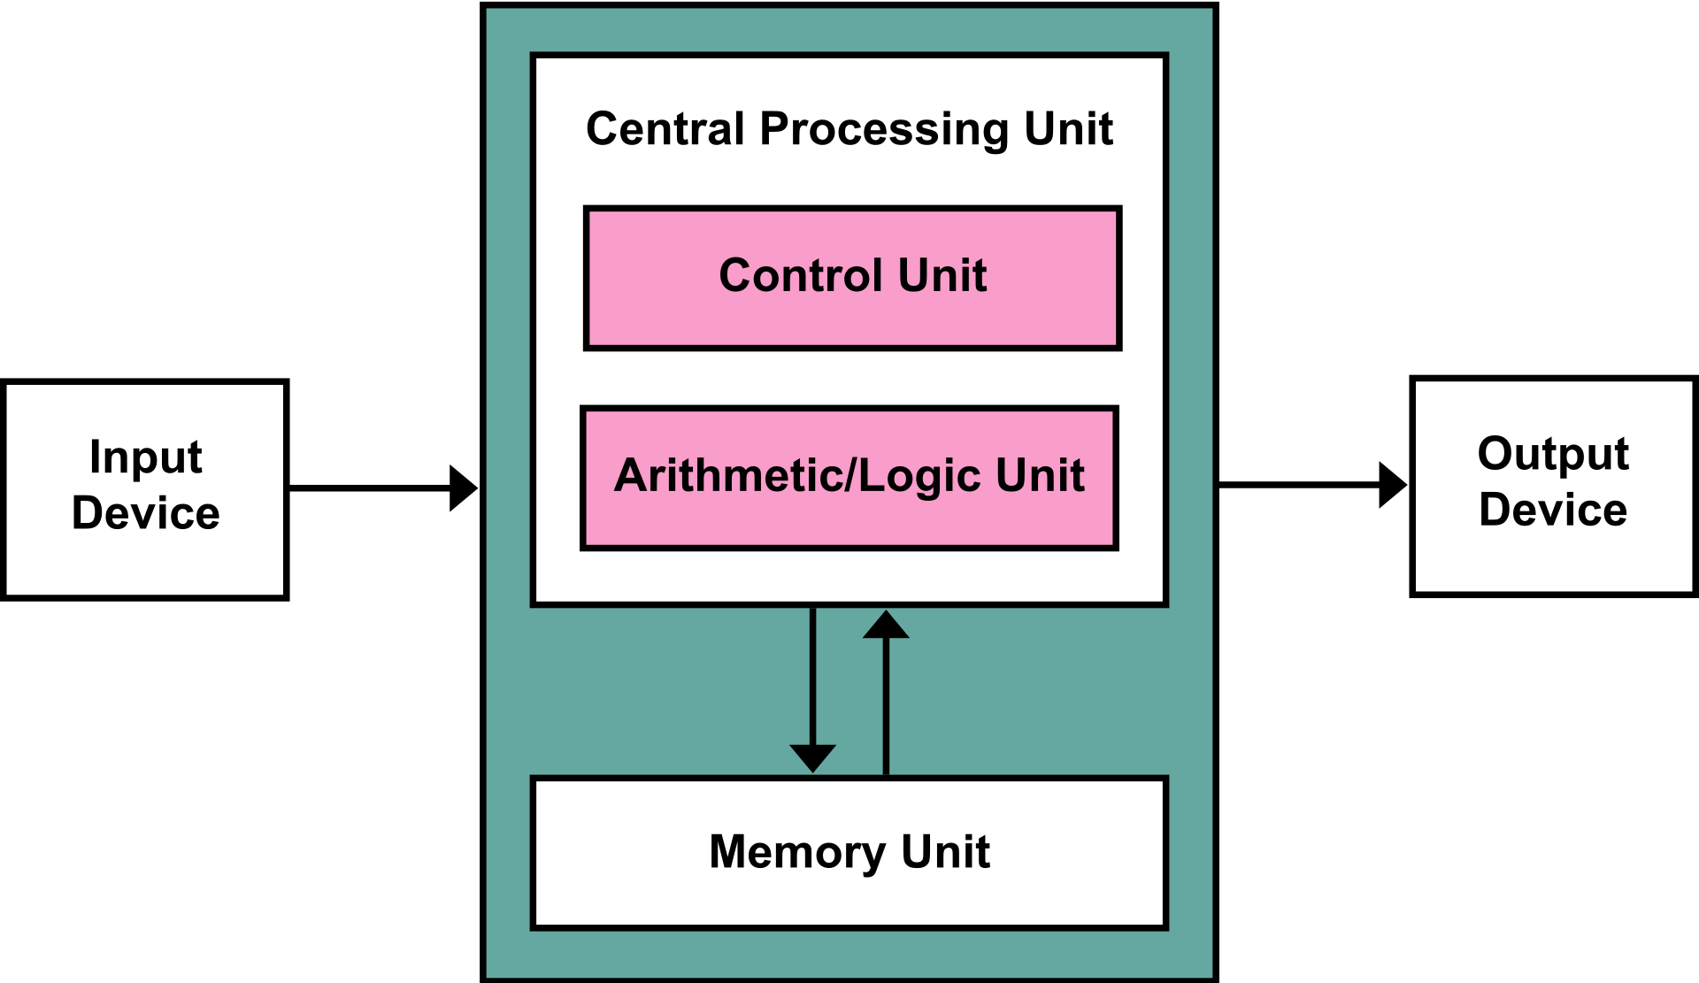
Von Neumann architecture
A design architecture for an electronic digital computer with these components:
A processing unit with both an arithmetic logic unit and processor registers
A control unit that includes an instruction register and a program counter
Memory that stores data and instructions
External mass storage
Input and output mechanisms

Slide 3
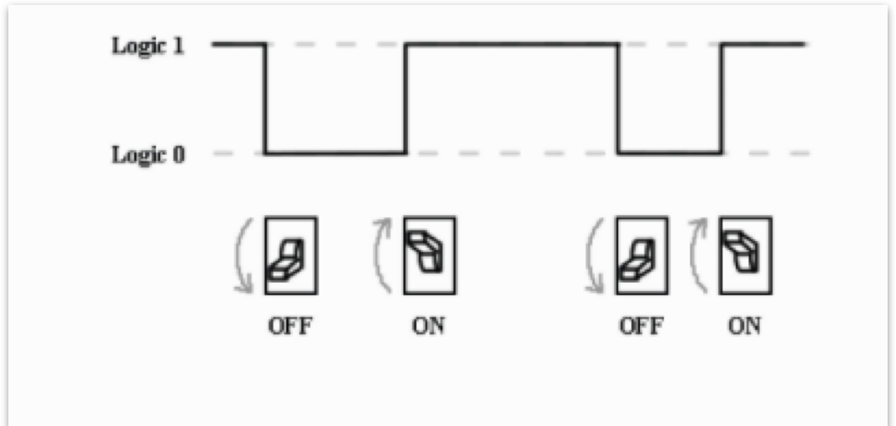
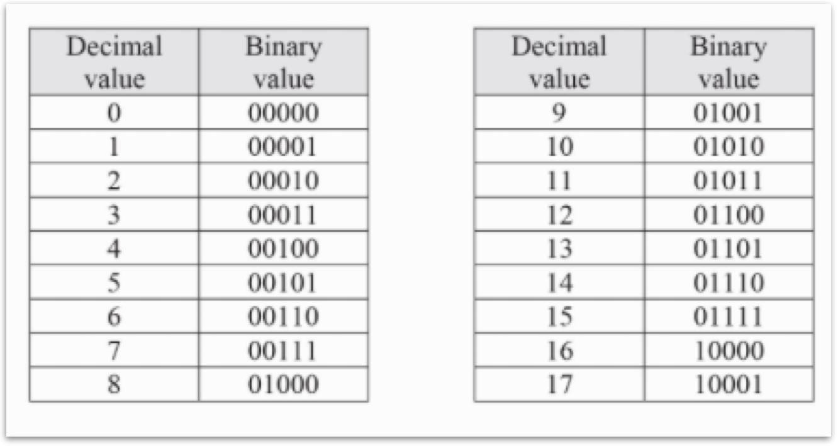
Representing Data Digitally
Electrical signals
Lots of switches!
“on” or “off” states
Binary: 0’s and 1’s

Slide 4
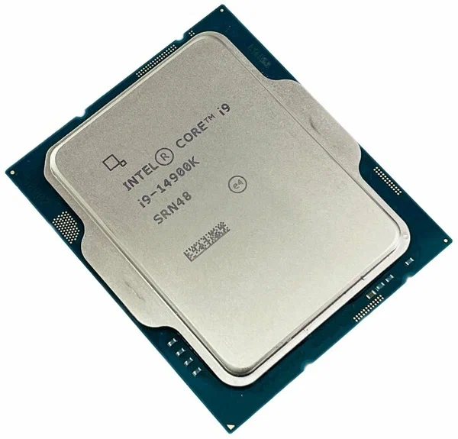
Processor
Also called CPU: Central Processing Unit
This is the primary “brain” of the computer. It is responsible for carrying out the logic and arithmetic operations described in computer programs.
Operation: The fundamental operation of (most) CPUs is to execute a sequence of stored instructions that is called a program.

Slide 5
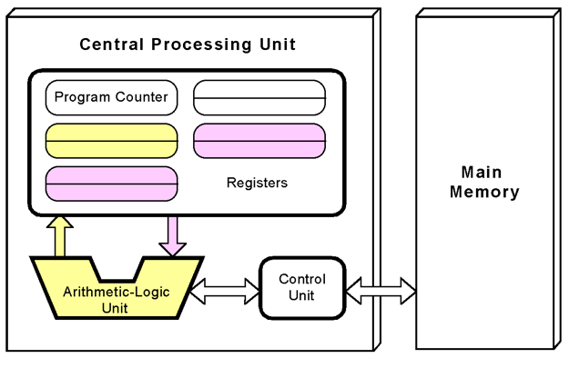
Processor
CPUs follow the fetch, decode and execute steps in their operation, which are collectively known as the instruction cycle.
After the execution of an instruction, the entire process repeats, with the next instruction cycle normally fetching the next-in-sequence instruction

Slide 6
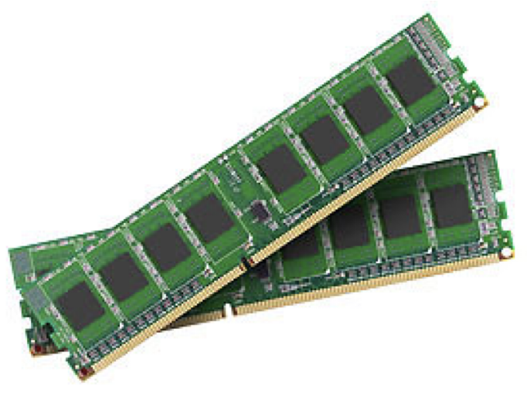
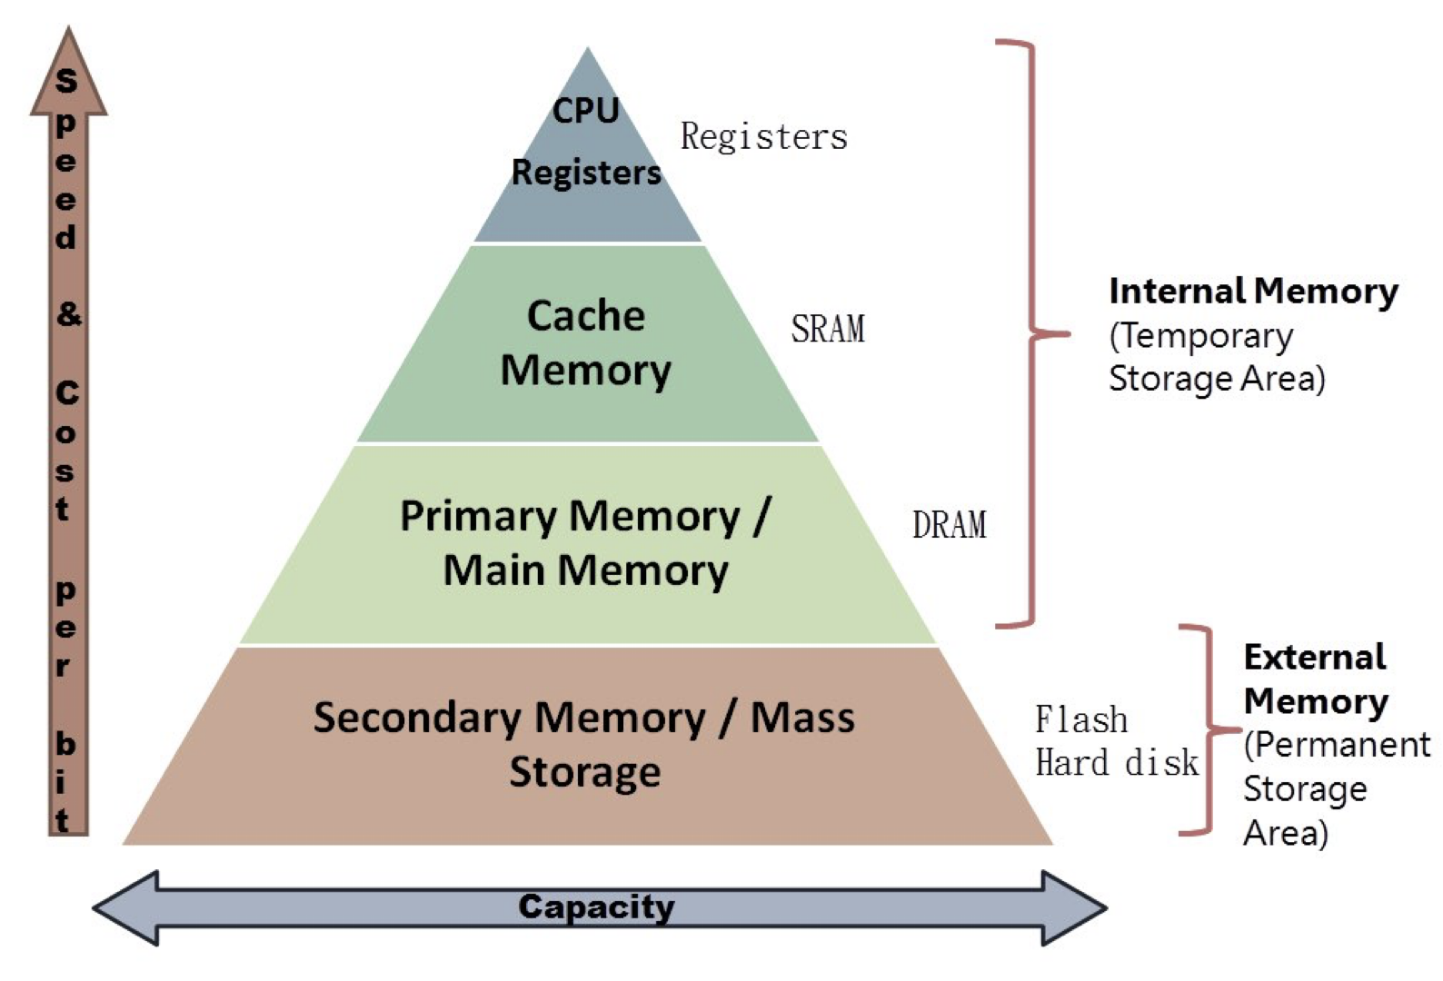
Memory
Modern computers have many different types of memory.
Performance, Capacity, and Cost are all factors that computer designers need to consider when selecting how much of a particular memory should be used at each level of the design.
Memory is classified by whether it is volatile or non-volatile.
Volatile memory: does not retain binary state when power to the circuit is lost
Non-Volatile storage: for internal mass storage, this is the solid-state or hard disk that stores data and instructions for longer periods and when the power is cycled. Capacity and cost (per byte) are favorable, but access times are quite slow.

Slide 7
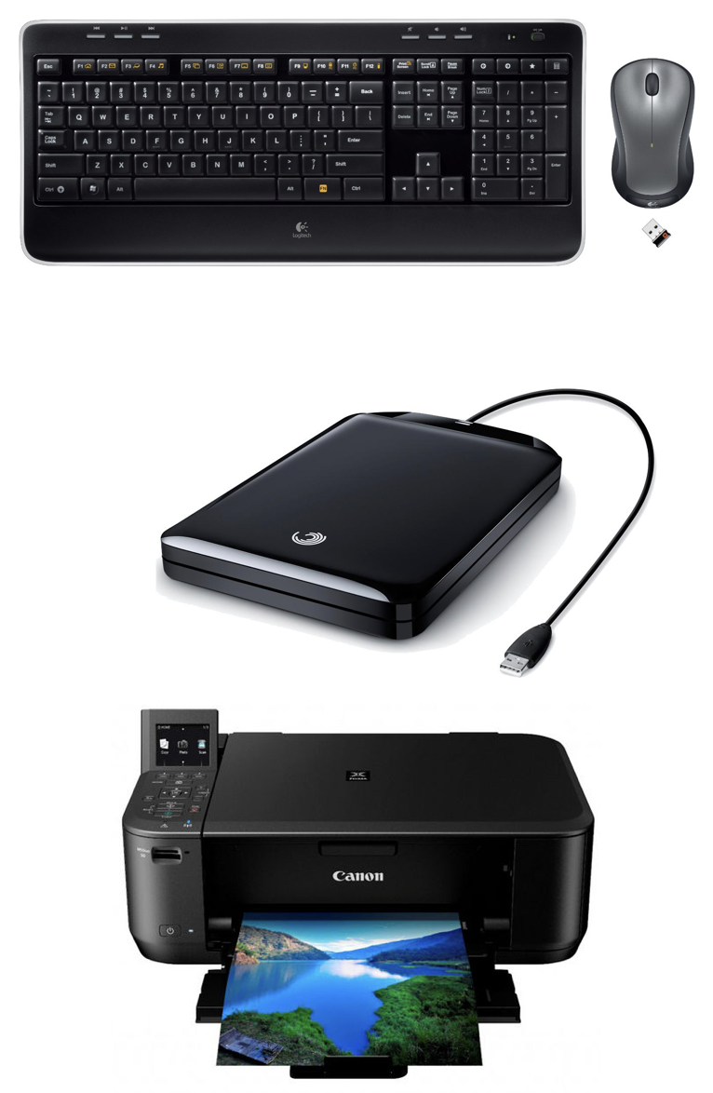
Peripheral Devices
Audio: Speaker, microphone, sound card, MIDI
Communications: Modem, network adapter, Wi-Fi, Human interface: Mouse, keyboard, trackpad
Image: Webcam, scanner
Printer: Laser printer, inkjet, and CNC (Computer Numerical Control) used in automating machinery.
Mass storage: USB flash drive, memory card reader, digital audio player digital camera, external hard drive
USB hub: Controls connected USB devices that are connected to the hub
Video: Webcam, surveillance cameras, consumer and professional video cameras and so on

