Slide 1
Hardware and Networking Troubleshooting

Slide 2
How Networks Work
Network Troubleshooting

Slide 3
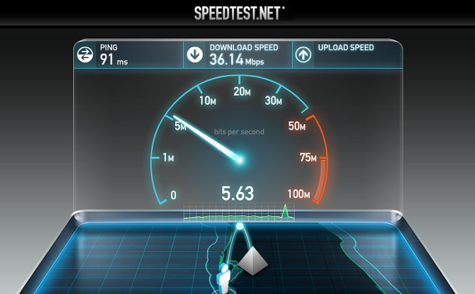
Check your Speed
http://www.speedtest.net

Slide 4
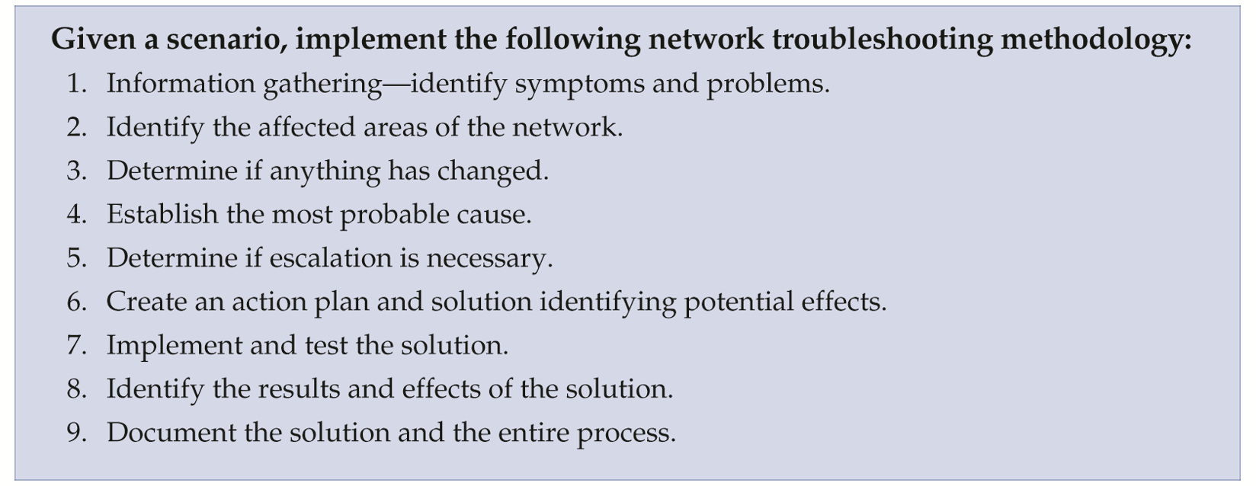
Troubleshooting Methodology

Slide 5
TCP/IP Troubleshooting Utilities
TCP/IP Utility | Function | When to Use
netstat | Displays current TCP/IP and port statistics | To determine network problems, monitor connections, and check for open ports
nbtstat | Displays NetBIOS over TCP statistics | To see a list of computers currently connected to the network
ping | Sends a packet from one host to another and then echoes a return reply | To quickly check the state of network media between two hosts
tracert or traceroute | Sends a packet from one host to another and gathers statistics and information along the way | To troubleshoot the path to a distant destination
arp | Maps the host MAC address to the host IP address | To verify IP address and MAC address assignments
nslookup | Resolves domain names to IP addresses | To find information about domain names and IP addresses

Slide 6
Pros and Cons
Advantages | Disadvantages
Share software, data, equipment, and communications quickly, easily, and inexpensively | Losing access to files Need additional personnel
Secure data | Vulnerability to hackers, viruses, and disgruntled workers

