Slide 1
Single cell integration
Pasha Mazin pm19@sanger.ac.uk
March 2023

Slide 2
The plan
Batch effect: what is it?
Single cell representation
Feature space
Embedding
KNN
What does integration mean?
Main integration approaches
Quality metrics
Label transfer

Slide 3
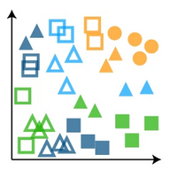
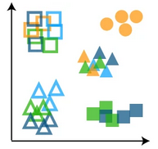
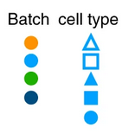
“Batch” effect - unwanted (technical or biological) signal in the data
Technical
Technologies
Protoloc versions
Experimental conditions (laboratory, pearson performing experiment, etc)
Pipeline/annotation versions
Biological
Donor
Species
Organs
Cellular compositions
integration

Slide 4
Single cell data representation
Embedding (low dim space)
Graph k-nearest neighbors (KNN)
Feature space
cells
Clustering
Umap
Label transfer
etc
features
dimension 3
dimension 2
dimension 1
N features ~ 1e4-1e5
Genes, peaks, proteins, etc
N dimensions ~ 50-200
PC, latent space
Computed based on features

Slide 5
Integration options
There are 49 integration method as of Nov 2020 (likely much more now).
Integration methods need as input:
Count or log-normalized matrix
Batch (and maybe other covariates) information
Some (scANVI) can use cell type annotation
There are some options in data pre-processing
Use highly variable genes (HGV) or full gene set
Scale (per batch)/no scale
Output
Corrected feature matrix
Common embedding
Common graph
Combination of above

Slide 6
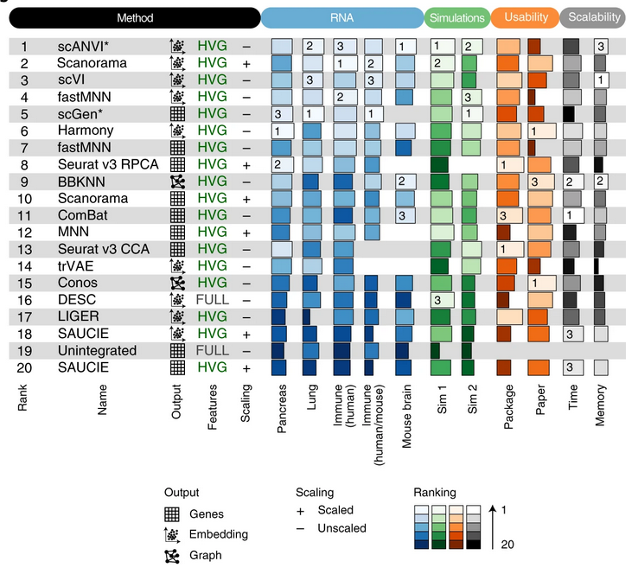
The overall scores for the best performing method, preprocessing and output combinations on each task as well as their usability and scalability. Methods that failed to run for a particular task were assigned the unintegrated ranking for that task. An asterisk after the method name (scANVI and scGen) indicates that, in addition, cell identity information was passed to this method. For ComBat and MNN, usability and scalability scores corresponding to the Python implementation of the methods are reported (Scanpy and mnnpy, respectively).

Slide 7
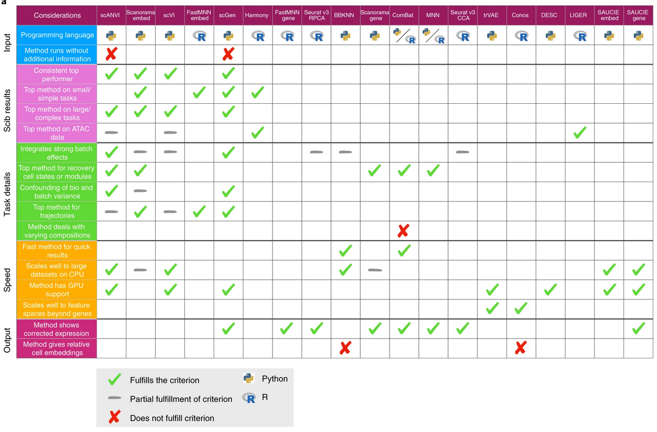

Slide 8
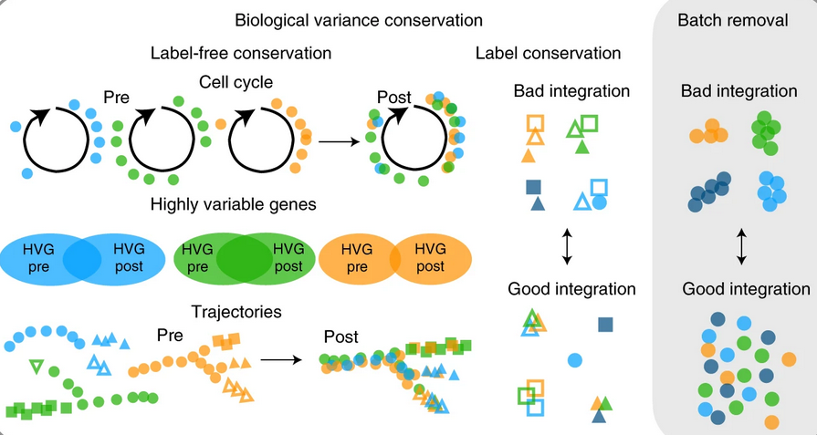
Metrics. All in [0,1] scale, where 1 means good integration.

Slide 9
Metrics summary
Metric name | Purpose | Input | Needs cell type labels
principal component regression | removal of batch effects | embedding | no
ASW batch | removal of batch effects | embedding | yes
graph connectivity | removal of batch effects | graph | yes
graph iLISI | removal of batch effects | graph | no
kBET | removal of batch effects | graph | no
NMI | label conservation | clustering | yes
ARI | label conservation | clustering | yes
ASW label | label conservation | embedding | yes
graph cLISI | label conservation | graph | yes
isolated label F1 | label conservation | clustering | yes
isolated label ASW | label conservation | embedding | yes
cell-cycle (CC) conservation | conservation of biological variance | embedding | no
HVG conservation | conservation of biological variance | features | no
trajectory conservation | conservation of biological variance | graph | yes/no (performed per cluster) Needs per-batch trajectories ahead

Slide 10


Batch effect removal
Principal component regression (weightes sum of batch-to-PC R²)
graph connectivity mean (across all cell types) proportion of cell in the largest connected component in cell type subgraph
cLISI - neighborhood heterogeneity

Slide 11



Label conservations
Similarity between pre-existed cell type annotation and optimal (max NMI) clustering for integrated dataset.
NMI
ARI
ASW - average silhouette width
Celltypes
Batches within celltypes
cLISI - neighborhood homogeneity
isolated label F1 and ASW - how good cell types present in subset of batches separates from other cell types.
Consider all cell pairs; a - both cells are in same cluster in both clusterings, b - cells are in different clusters in both clusterings. A+b+c+d - total number of pairs.
b is a mean distance within cluster (to ith)
a is a mean distance to the closest cluster

Slide 12
Conclusion
Shut up and use Scanorama

Slide 13
Conclusion
Shut up and use Scanorama (or scVI (or scANVI (or Harmony if scATAC (or bbknn²)))))
¹ Very slow on large datasets according to my experience.
² Very fast

Slide 14
Links
The presentation is based on the benchmarking paper: https://www.nature.com/articles/s41592-021-01336-8
The deposited all benchmarking datasets here: https://doi.org/10.6084/m9.figshare.12420968
The made scib package with integration methods wrappers and metrics implementations: https://github.com/theislab/scib
An there is a web site with benchmarking results: https://theislab.github.io/scib-reproducibility/

