Slide 1
CAPSTONE PROJECT
Designing RushMore Pizzeria's
Enterprise Database System
From a fragile orders.json file to a cloud-native, analytics-ready PostgreSQL platform
Data Engineering • Cloud Deployment • Database Programming • Analytics

Slide 2
The Problem: orders.json Can't Keep Up
As RushMore grew to multiple locations, the simple JSON file system became a business bottleneck.
!
Slow at scale
X
No concurrency
Reading/writing one flat file gets slower as order history grows.
Multiple cashiers can't safely write to the same file at once.
#
No analytics
~
Data corruption risk
Impossible to query 'top customers' or 'busiest hour' from raw JSON.
A crash mid-write can silently corrupt the entire order history.
2

Slide 3
Objective & Scope
1
2
3
4
Model
Deploy
Populate
Analyze
Design a normalized (3NF) relational schema for stores, customers, menu, and orders.
Provision a managed PostgreSQL instance on Azure and connect via pgAdmin.
Generate 10,000+ rows of realistic, masked data with Python + Faker.
Answer 5 core business questions with SQL and a connected BI tool.
3

Slide 4
Architecture Overview
pgAdmin
schema deploy +
row-count QA
populate.py
Azure PostgreSQL
Python + Faker
+ psycopg2
Flexible Server
rushmore_db
Power BI
Top 10 customers,
business analytics
One Postgres instance in the cloud acts as the single source of truth for the seeding script, schema tooling, and every downstream analytics client.
4

Slide 5
Database Schema — 7 Normalized Tables
Stores
Customers
Ingredients
Menu_Items
Physical pizzeria locations
PII for registered customers
Master raw-ingredient stock list
Product catalog (+ price)
Menu_Item_Ingredients
Orders
Order_Items
Junction: recipe per item
One row per transaction
One row per order line item
Blue mark = core spec table • Coral mark = added to complete the model (see next slide)
5

Slide 6
Design Decisions Beyond the Spec
The brief's 5 tables couldn't support analytics on their own — three additions closed the gaps.
Menu_Items.price
Order totals and line items need a price source; without it, revenue can't be calculated at all.
Menu_Item_Ingredients
A junction table for the many-to-many between recipes and ingredients — required for proper 3NF.
Order_Items
Referenced by volume targets ('~15,000+ items') but never defined; models one order's line items.
6

Slide 7
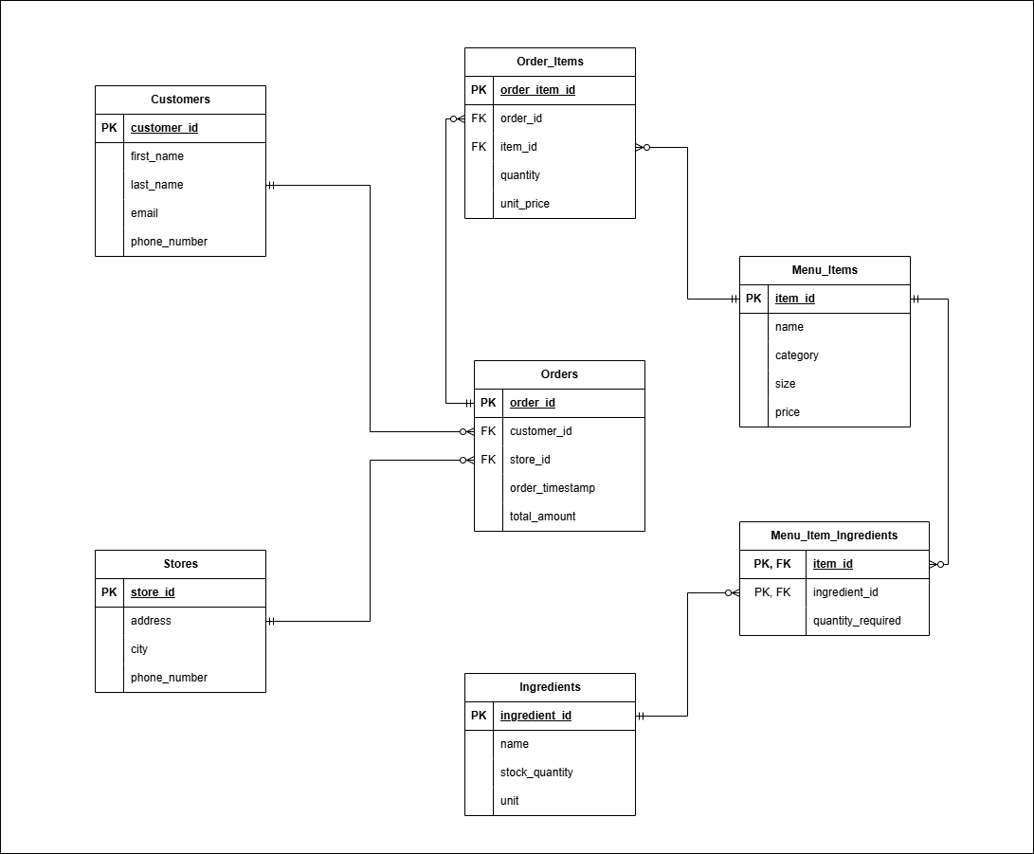
Entity-Relationship Diagram (ERD)
6

Slide 8
Cloud Deployment — Azure Flexible Server
1
2
3
4
5
Create resource
Basics & auth
Networking
Create database
Connect
Databases → Azure Database for PostgreSQL Flexible Server
Server name, region, admin username/password
Public access + firewall rule for current IP
rushmore_db created inside the server
pgAdmin, SSL mode = Require, port 5432
7

Slide 9
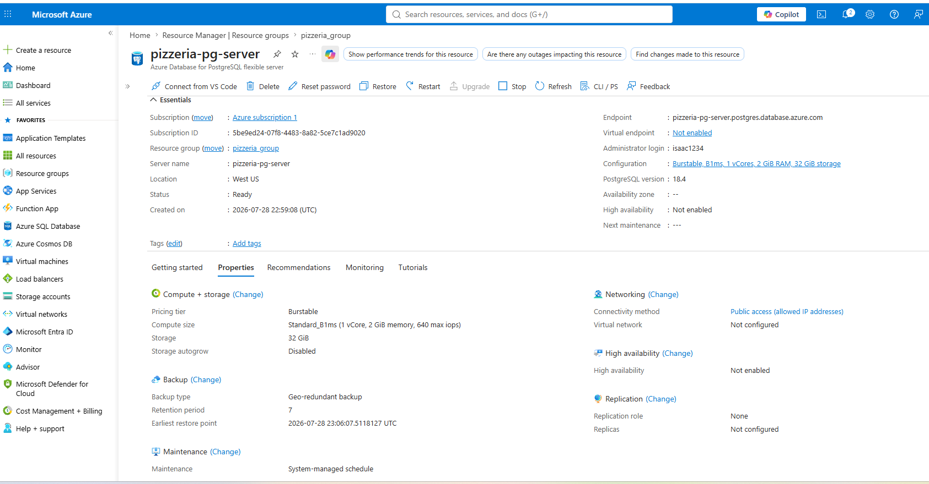
Cloud Deployment
6

Slide 10
Data Population Engine
Faker generates realistic PII (names, emails, phones, addresses) that masks what real customer data would look like — no real customer is ever touched.
execute_values()
Batches thousands of rows into one round trip instead of row-by-row inserts
returning id
Captures auto-generated IDs so child tables can reference the right parent
Insert order
Stores → Ingredients → Menu_Items → Customers, then Orders, then Order_Items
Price snapshot
Order_Items.unit_price is copied from the menu at order time, not looked up live
8

Slide 11
Final Verified Row Counts
Confirmed with SELECT COUNT(*) in pgAdmin — not the misleading 'last 100 rows' grid view.
4
1,200
45
25
Stores
Customers
Ingredients
Menu Items
9

Slide 12
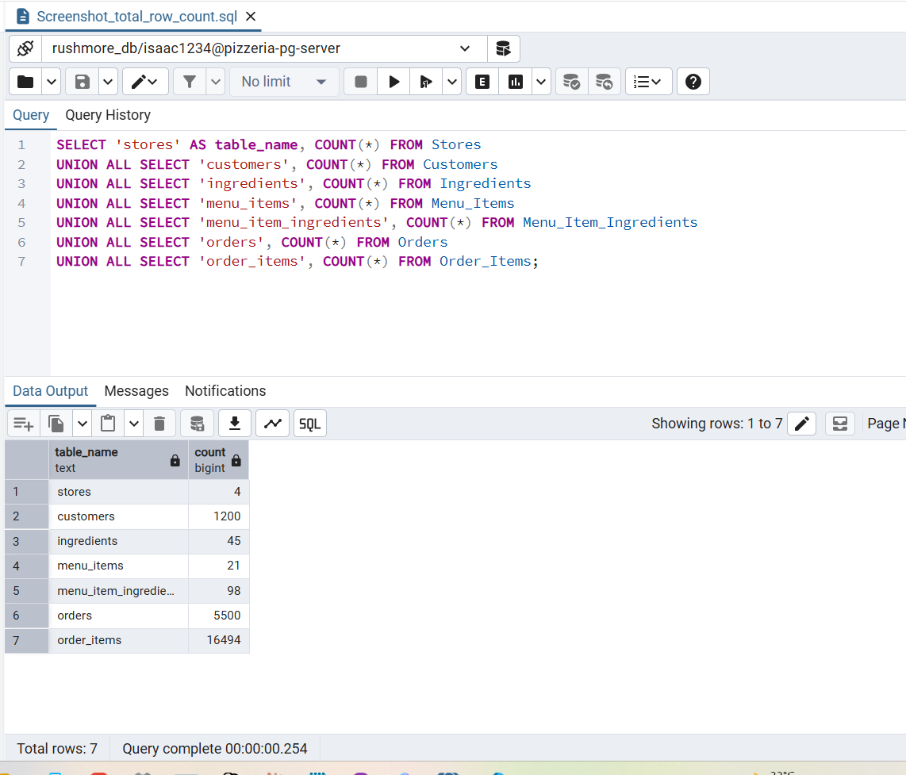
Row Count – Post faker script
6

Slide 13
Challenges — Objective Interpretation
More +
More +
More +
More +
Stores
Customers
Ingredients
Menu Items
!
10

Slide 14
Challenges — Cloud Setup & Connectivity
Wrong region chosen
!
First server was deployed in a region far from me, adding real latency. Fixed by redeploying in a region close to home.
password authentication failed
!
A trailing space in the .env password, invisible until printed with repr(). Fixed by stripping and re-verifying the credential.
!
relation "stores" does not exist
populate.py ran before schema.sql was deployed. Fixed by running the schema first and verifying it in information_schema.tables.
!
10

Slide 15
Challenges — Runtime & Tooling
Duplicate key on re-run
»
A prior partial run left old rows behind. Fixed with TRUNCATE ... RESTART IDENTITY CASCADE before re-running.
Stale kernel TypeError
»
An edited function stayed outdated in the Vscode's memory. Fixed by switching from .ipynb to a plain .py script.
Row count looked short (1,101 vs. 1,200)
»
pgAdmin's "last rows" grid isn't a total-count view. Fixed by confirming the true total with SELECT COUNT(*).
»
11

Slide 16
Analytics — 5 Business Questions
1
Total sales revenue per store
2
Top 10 most valuable customers by total spending
3
Most popular menu item by quantity sold, across all stores
4
Average order value
5
Busiest hours of the day for orders
12

Slide 18
Lessons Learned
Planning tables on paper isn't enough — actually trying to answer real questions with the data shows you what's missing.
Most "connection failed" errors aren't really about your code. They're usually a typo in the password, a missing security setting, or the wrong database.
Notebooks are great for testing things step by step, but they can quietly hold onto old code. If something breaks for no reason, restart it and run everything fresh.
Don't trust what you see on screen at a glance — always double check the real number with a simple COUNT query before believing it.
Thank you

