Slide 1

MCA Major Project Mid Term Evaluation
COURIER SERVICE SYSTEM
( A uberization of courier service… )
Under the guidance of
Ms. Divya Sharma
Department of Computer Applications
Faculty of Science, Technology and Architecture
Manipal University Jaipur
By
Aman Agrawal
23FS20MCA0079
2023-25

Slide 2
Introduction
Couriers have fast emerged as one of the most convenient and affordable modes of goods delivery in which we pick , we ship , we deliver.
This system provides good courier services, courier delivery services, parcel delivery , International courier services , domestic courier services, import and exports.
Couriers are usually more expensive than usual mail services.
Sending the courier across the internet and no need to visit anywhere.
This model showcases the integration of cutting-edge tools and Methodologies, employing technologies such as Html , CSS , JavaScript and PHP.

Slide 3
Motivation
The main objectives of courier management Service –
Deliver products to customers :-
Low prices
Safe delivery
Fast delivery
Low startup costs.
Complete flexibility.
Advertise cheaply through internet.
Guarantee your future security.

Slide 4
Process Model
Requirement Analysis:
• Understand user needs and define system requirements (functional and non-functional).
• Define core features: user registration, search, booking, payment, and itinerary management.
System Design:
• Design the frontend wireframes and UI components.
• Create database schema for managing user accounts, travel services, bookings, and payments.
Development:
Frontend: Build responsive and interactive pages using HTML, CSS, and JavaScript.
Backend: Develop server-side scripts using PHP (with XAMPP as the local server).
Database: Set up and manage the MySQL database to store travel-related data.

Slide 5
Process Model
Integration : Integrate the frontend with the backend to enable functionality such as search, booking, and payments.
Testing and Debugging : Conduct unit testing, integration testing, and user acceptance testing to ensure functionality and performance.
Deployment and Maintenance : Deploy the system locally on XAMPP or on a live server and maintain for updates and troubleshooting.

Slide 6

Software and Hardware Requirements
Software Requirements:
Platform : Web & Android
Frontend: HTML, CSS, and JavaScript
Backend: PHP, MYSQL
Web Server : XAMPP (My SQL & PHP)
Development tools : Android Studio & Notepad++
Hardware Requirements:
Processor: Minimum Intel i3 or higher
RAM: 4GB (Minimum)
Storage: 20GB Hard Disk Space

Slide 7
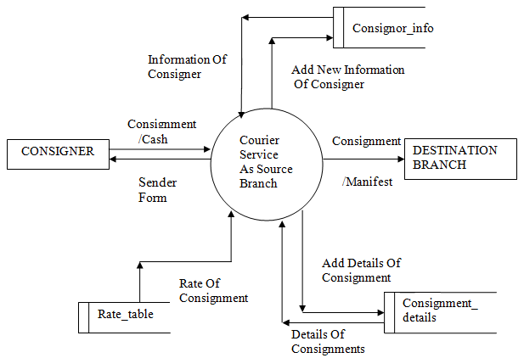
Manage Couriers: Admin processes courier details such as types, dimensions, and descriptions. The couriers are prepared for future booking and delivery processes. Book Courier: Customers provide courier details (destination, size, and type) to book the service. Booking information is sent to the courier system for processing. Track Delivery: Customers can monitor their courier's status in real time using the system. Delivery updates include the current location and expected time of arrival. Delivery Process: Couriers are assigned to delivery personnel. Delivery details like destination, barcodes, and receiver information are updated in the system. Customer Interaction: Customers provide input such as booking requests, payments, and contact information. The system responds with booking confirmations, tracking updates, and delivery completion status. System Outputs: Notifications about the courier's status and delivery are sent to the customer. Delivery details are logged for administrative purposes.
Data Flow Diagram ( DFD )

Slide 8
Conclusion
A successful courier management system website achieves the following:
• Improved Efficiency: Automation of key processes like booking, tracking, and billing reduces manual work, minimizes errors, and speeds up operations.
• Enhanced Customer Experience: Real-time tracking, online booking, and proactive notifications empower customers with greater control and transparency over their shipments, leading to increased satisfaction.
• Cost Reduction: Optimized routes, efficient resource allocation, and reduced administrative overhead contribute to significant cost savings.
• Increased Revenue: Improved service quality, wider reach through online presence, and enhanced customer satisfaction can attract more customers and drive revenue growth.

Slide 9
Future Scope
The use of this System for the better services and faster processing.
The application is very useful and easy to use.
Courier facility in India is very cheaper and maximum charges but we can send the courier to destination in minimum charges.
More time will be Save.
Improved Customer Satisfaction.
Optimized routes, reduced fuel consumption, and contribute to lower costs.

