Slide 1
WorkWise
A Project Management Tool for Engineers

Slide 2
Project Description
WorkWise is a cutting-edge project management tool designed to empower engineering teams. Built with React and Node, this comprehensive solution provides a user friendly, efficient, and flexible environment for teams to plan, track, and manage their projects effectively.

Slide 3
Features
Project Dashboard
Task Management
Gain an overview of your projects in one centralized dashboard. Track project progress at a glance.
Break down projects into WorkItems. Assign Workitems to team members, set priorities, and track status changes in realtime.

Slide 4
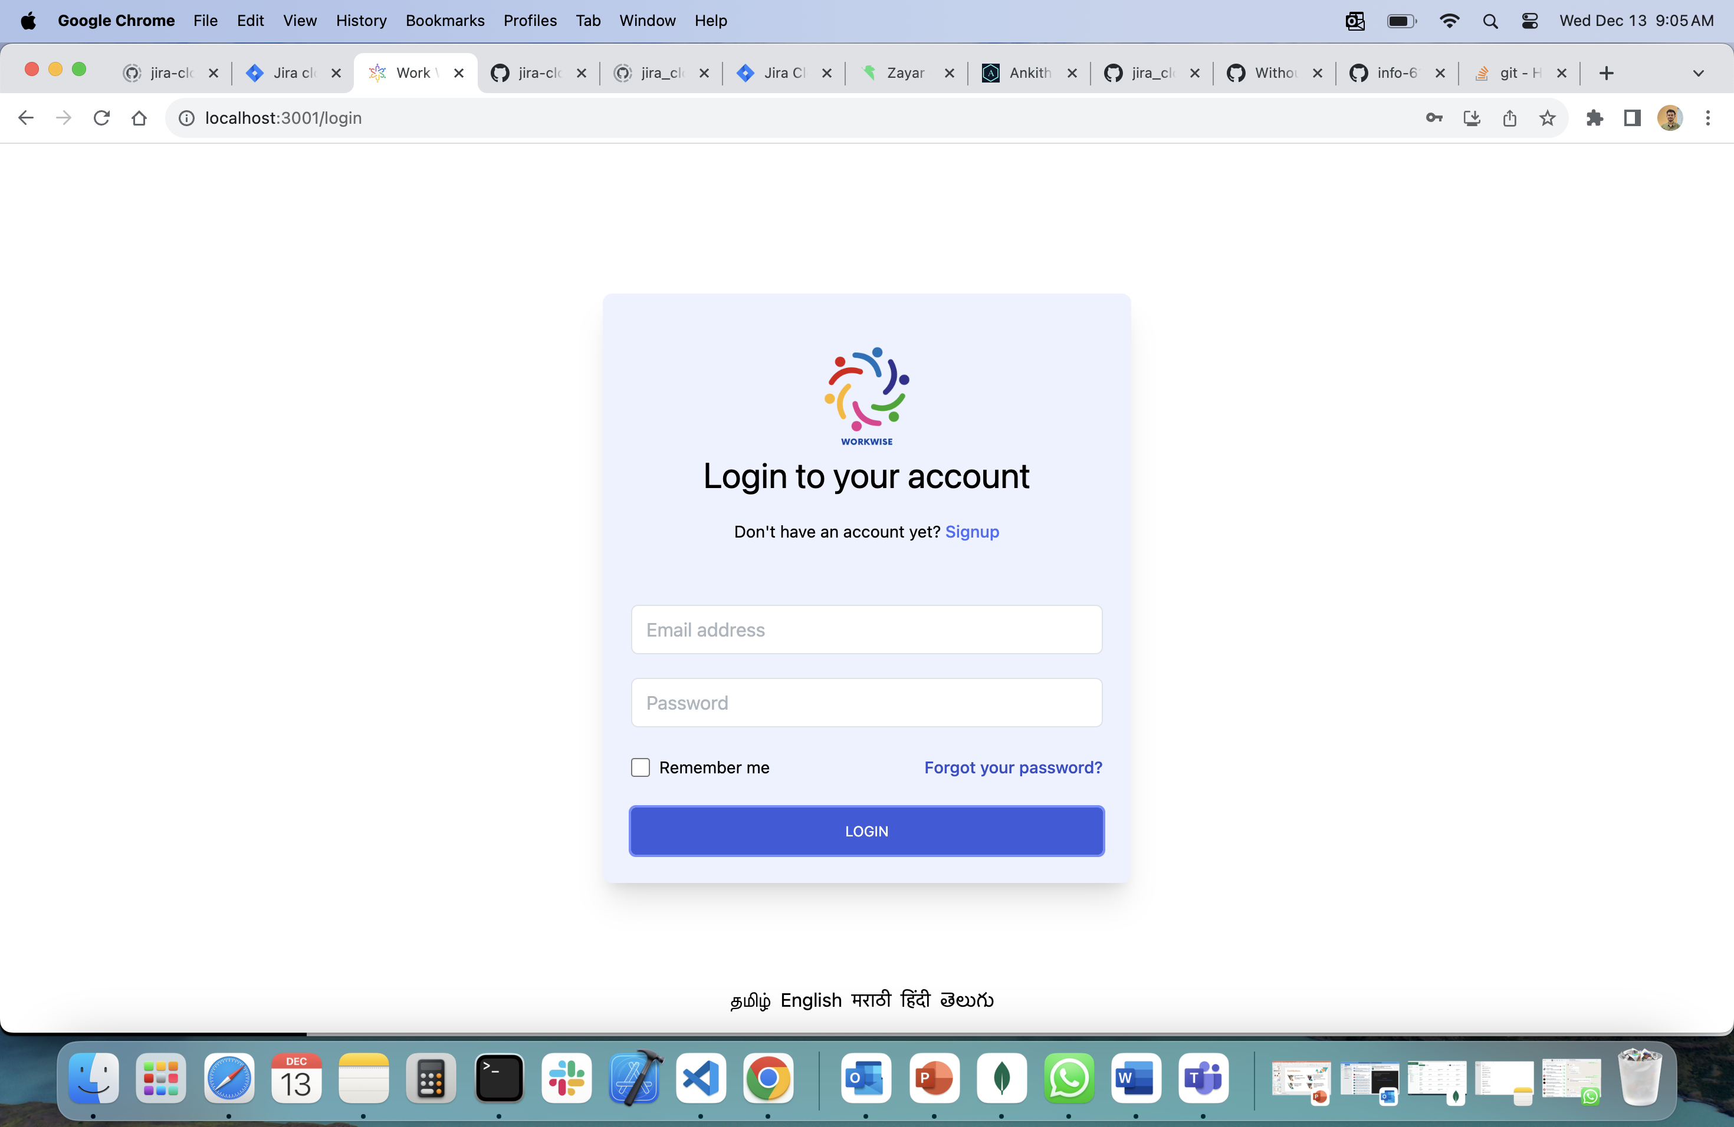
Login Page

Slide 5
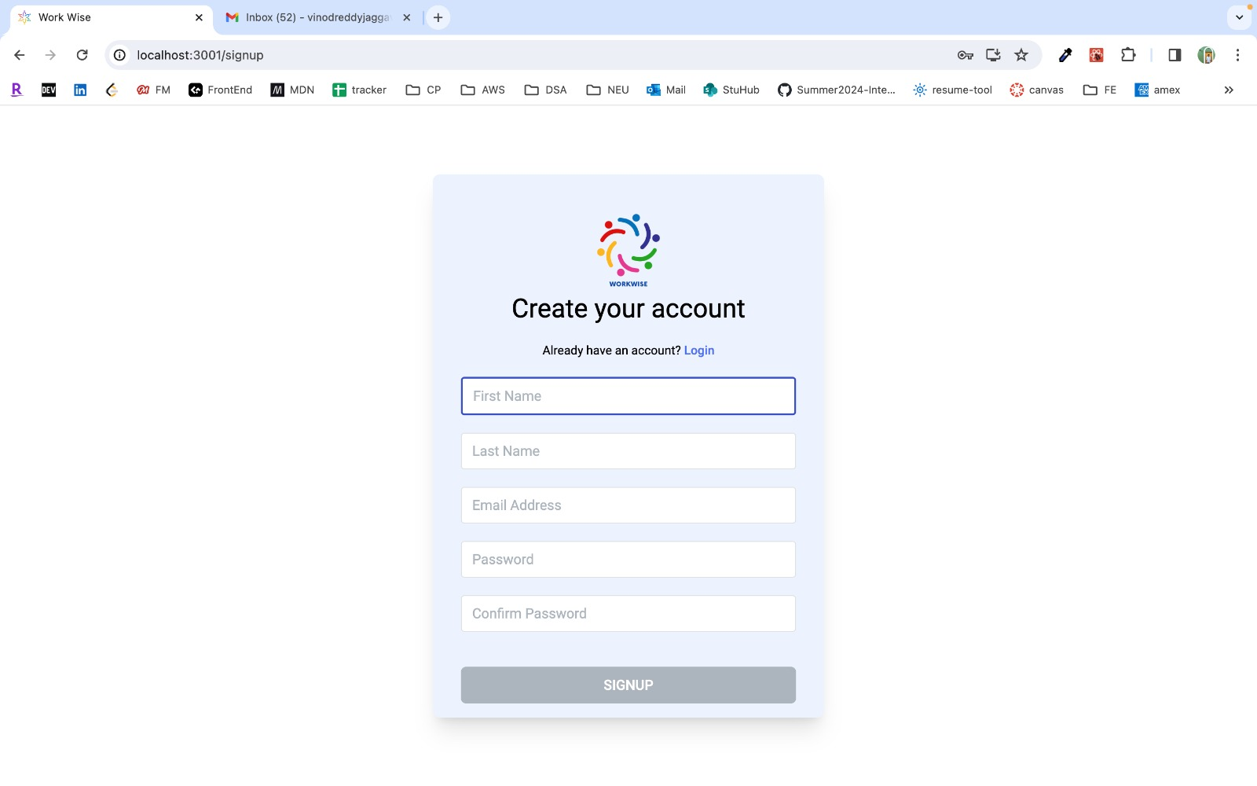
SignUp Page

Slide 6
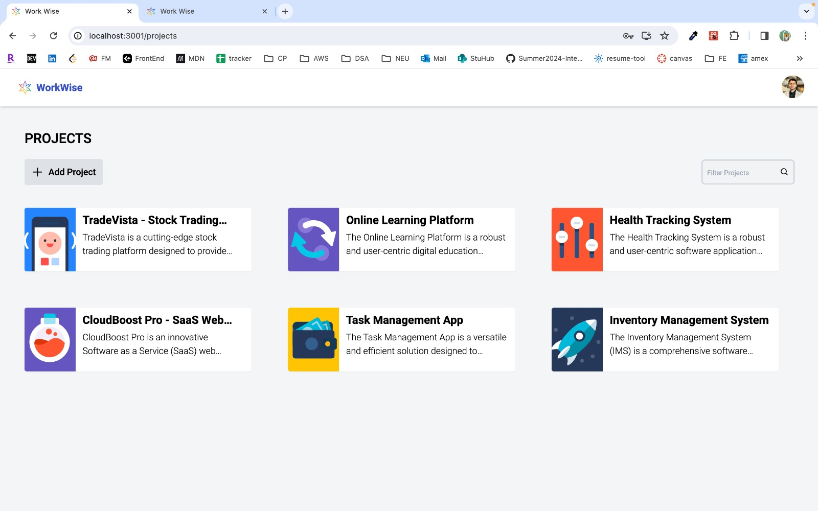
Add a Project

Slide 7
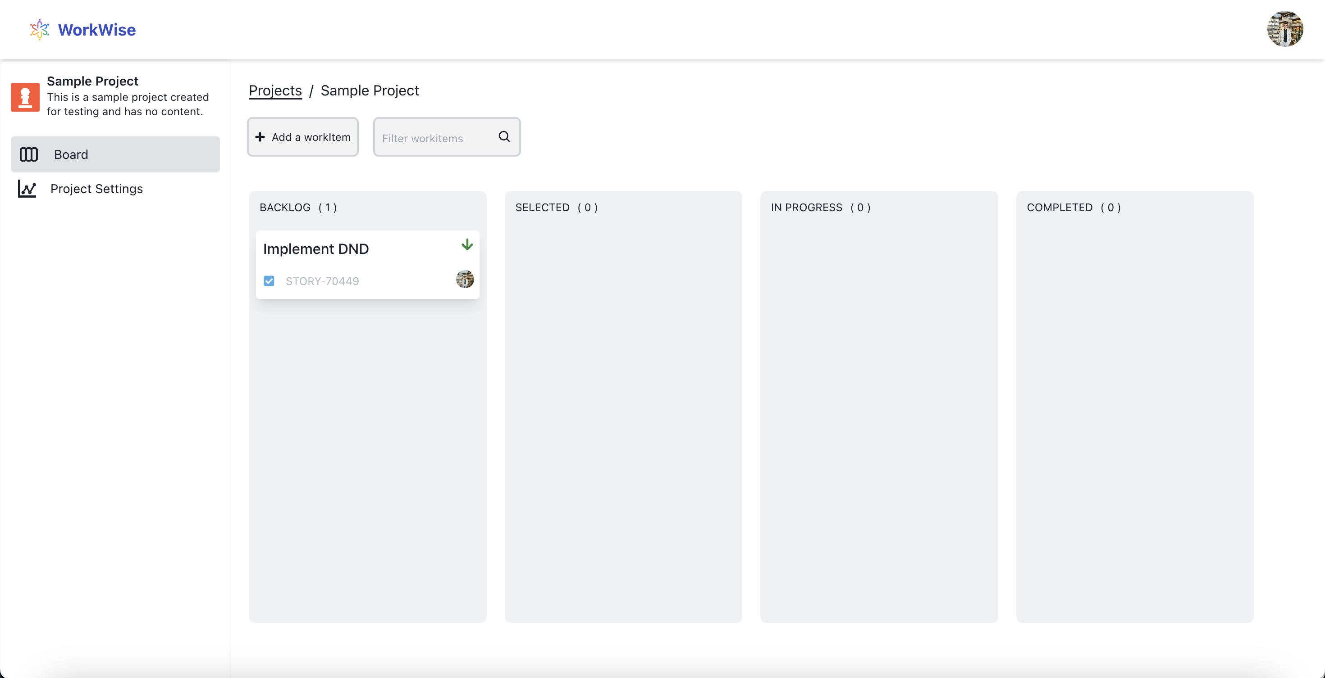
Kanban Board

Slide 8
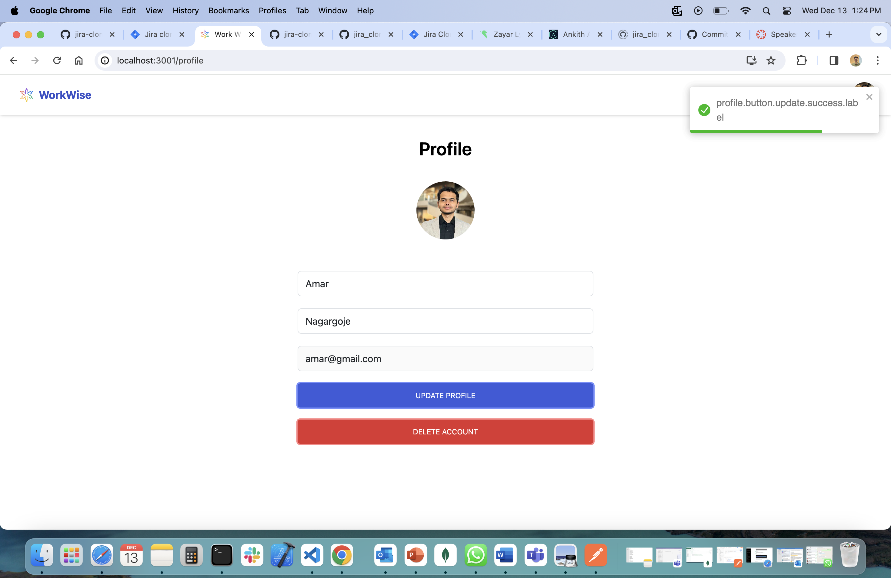
Profile Page

Slide 9
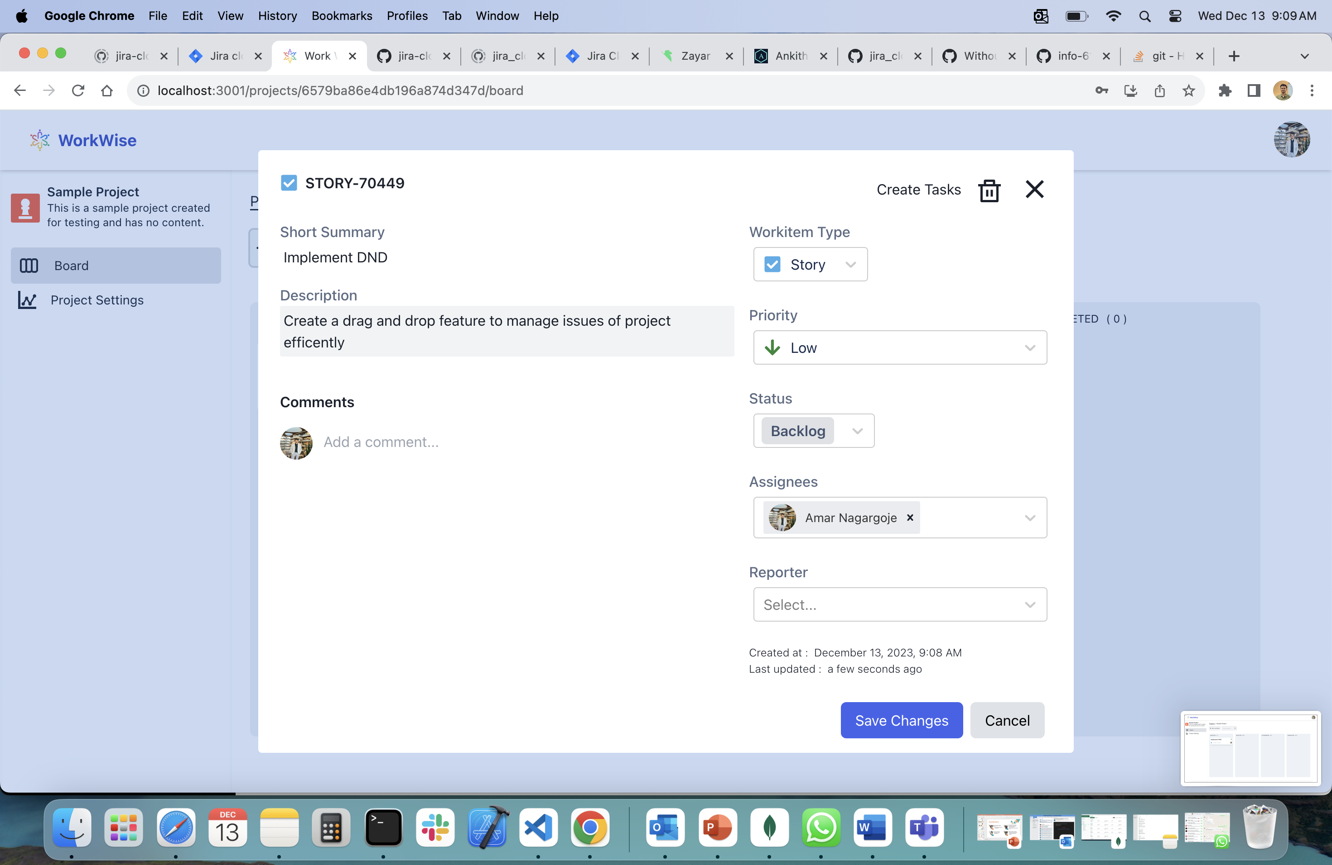
Create Work Item

Slide 10
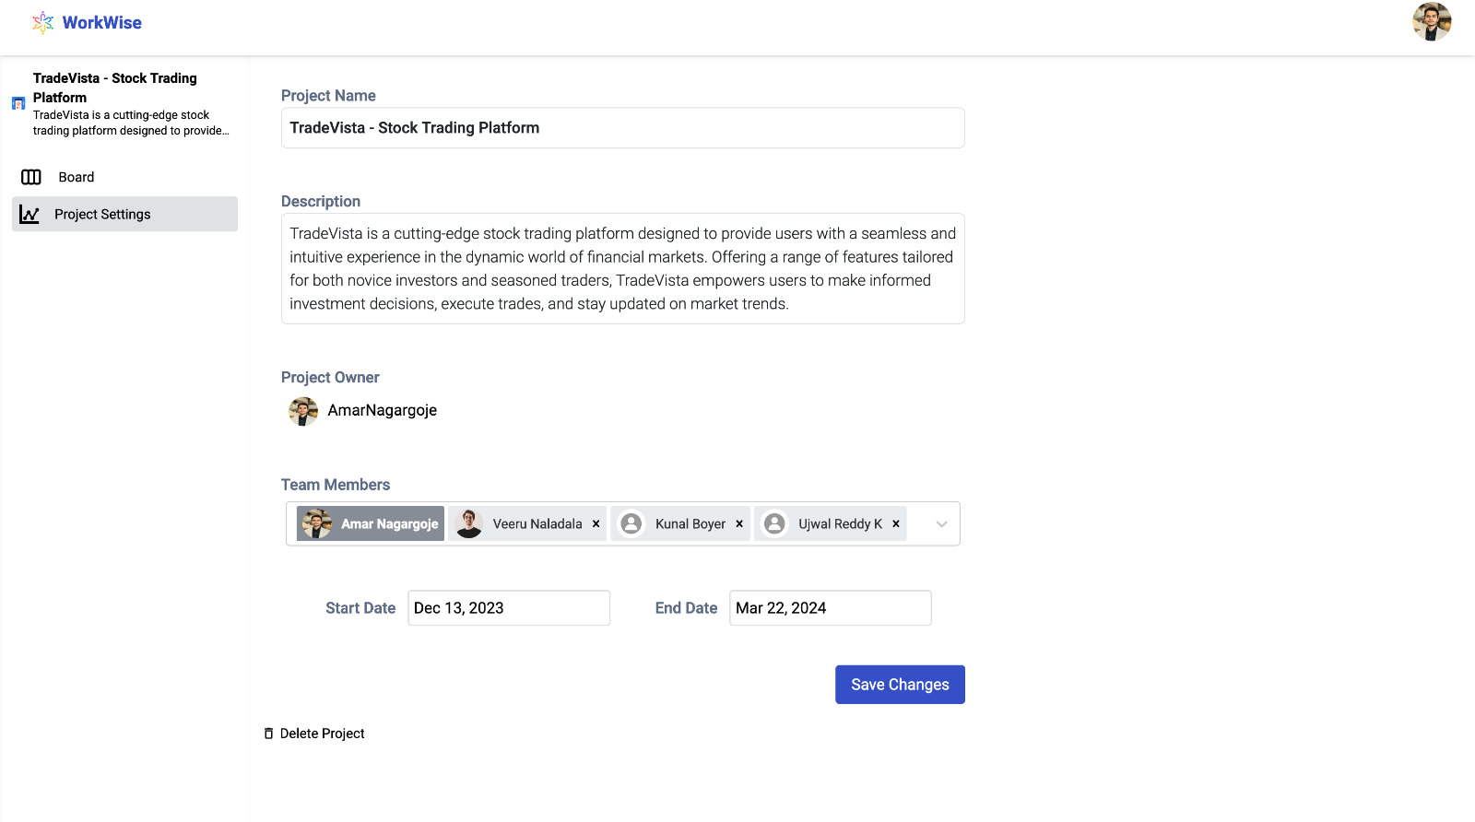
Project Settings Page

Slide 11
Meet our team
Sai Vinod Reddy Jaggavarapu
Amar Nagargoje
Kunal Bhoyar
Ujwal Reddy Kotla

Slide 12
Summary
In conclusion, WorkWise isn't just a project management tool; it's a dynamic solution that empowers engineering teams to collaborate seamlessly, visualize workflows effectively, and ultimately deliver successful projects.

Slide 13
Thank you

