Slide 1

DATA ANALYSIS WITH NOTEBOOKS*: A Tutorial**
*Not that kind of notebook
**Understanding techniques for data curve fitting. Some maths is involved***
***don’t panicTM.
Akash Bhattacharya
abhattacharya03@beckman.com
Notes:
AI-generated content may be incorrect. ---

Slide 2
What, why, how
This tutorial will give you an intro to basic data analysis using online tools
Data analysis is an increasingly important part of many jobs, especially with the advent of AI
You will learn how to use online tools like Github and Colab
You will walk away with a (hopefully) new skill set which you can leverage in your job and grow

Slide 3
Getting Started
Motivation: when you have some data to analyze, but:
You need something beyond Excel
You don’t want to spend $$$ on expensive proprietary software
IT doesn’t want you to install software without approval
In this tutorial:
You will learn how to analyze data using a web-based tool called Jupyter / Python notebook
This will be driven by a case study where you will fit a dataset about housing price vs floor size to a model
Prerequisites:
Chrome browser, updated and current
Google account (se a throwaway account if you like)

Slide 4
What will you learn here
Basics
High level intro to data analysis
Intro to interactive coding tools
Intro to Google Colab
Case Example using housing data
Step by step tutorial
Get your data and notebook from Github
Load notebook into Google Colab
Run notebook cell-by-cell
Resources
Data is available here:
https://github.com/iab149/BasicDataAnalysis/tree/main This is a public repository on Github Download Housing_data.xlsx to local disk. Also download the notebook quadratic_fit_gui.ipynb
You will run the notebook on Google Colab
https://colab.research.google.com/

Slide 5
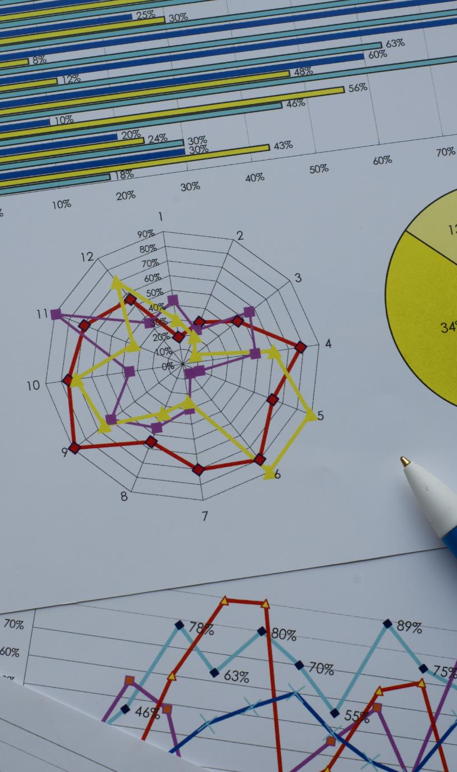
What is Data Analysis?
Definition of Data Analysis
Data analysis involves inspecting, cleaning, and modeling data to extract useful information and patterns.
Applications Across Domains
Data analysis supports decision making in research, business intelligence, engineering, and healthcare sectors.
Analytical Techniques
Statistical and computational methods help reveal trends, test hypotheses, and guide informed decisions.
Contextual Example
The tutorial focuses on identifying Gaussian-shaped peaks in data from spectroscopy and signal processing.
Notes:
Data analysis is the process of inspecting, cleaning, and modeling data to discover useful information. It plays a crucial role in various domains such as scientific research, business intelligence, engineering, and healthcare. The primary goal of data analysis is to extract meaningful patterns from noisy or complex datasets. By applying statistical and computational techniques, analysts can uncover trends, test hypotheses, and make informed decisions. In the context of this tutorial, data analysis is used to identify and quantify Gaussian-shaped peaks in user-uploaded datasets, which is a common task in fields like spectroscopy and signal processing.

Slide 6
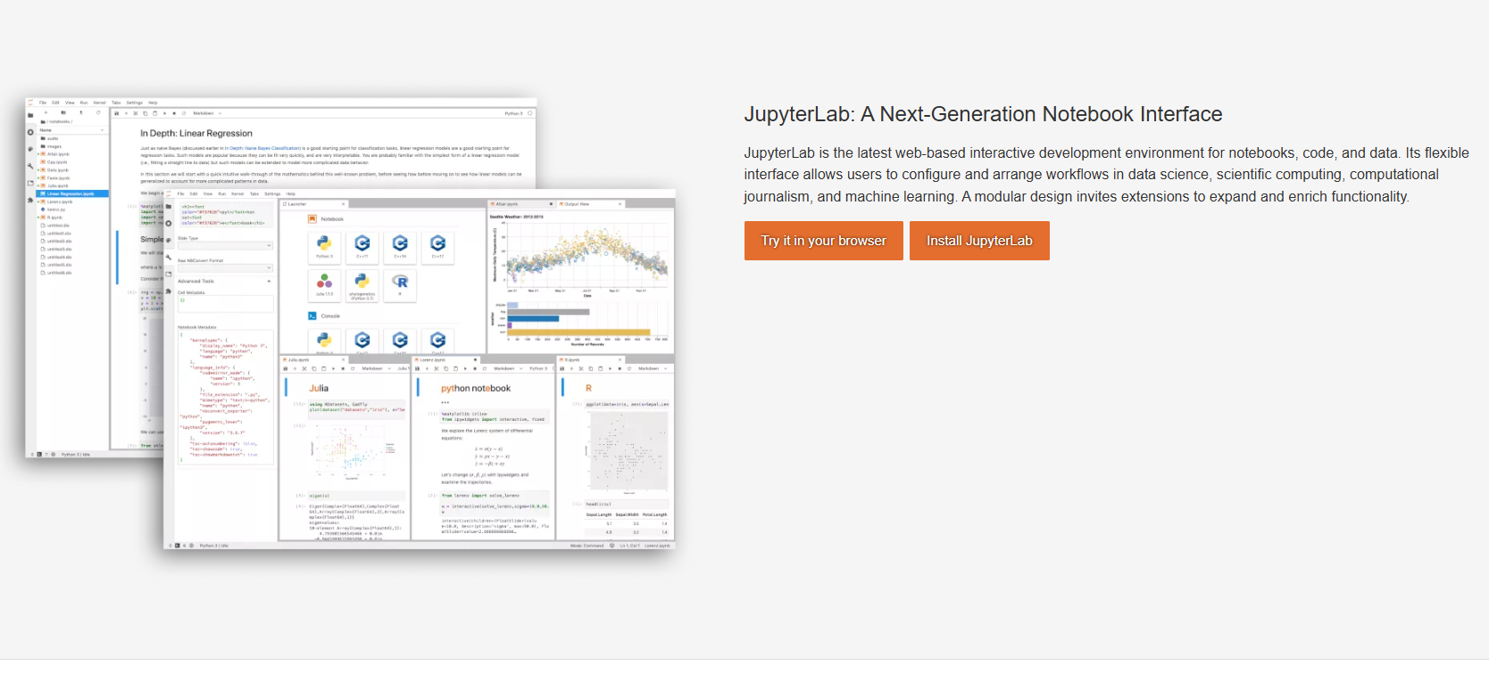
Jupyter Notebooks
Interactive Coding Environment
Jupyter Notebooks integrate executable code, rich text, and visualizations in one interactive document.
Multi-language Support
Supports multiple programming languages, with Python being widely used for data science and research.
Educational and Research Tool
Ideal for teaching and prototyping, allowing users to document workflow alongside code and visuals.
Gaussian Fitting Tutorial
Demonstrates Gaussian fitting process with explanations and visual outputs using Jupyter Notebook.
Notes:
Jupyter Notebooks are interactive coding environments that combine executable code, rich text, and visualizations in a single document. They are widely used in education, data science, and research due to their modular and user-friendly interface. Notebooks support multiple programming languages, including Python, and allow users to document their workflow alongside the code. This makes them ideal for teaching and prototyping. In this tutorial, the Gaussian fitting process is demonstrated using a Jupyter Notebook, enabling learners to follow along with explanations and visual outputs.

Slide 7
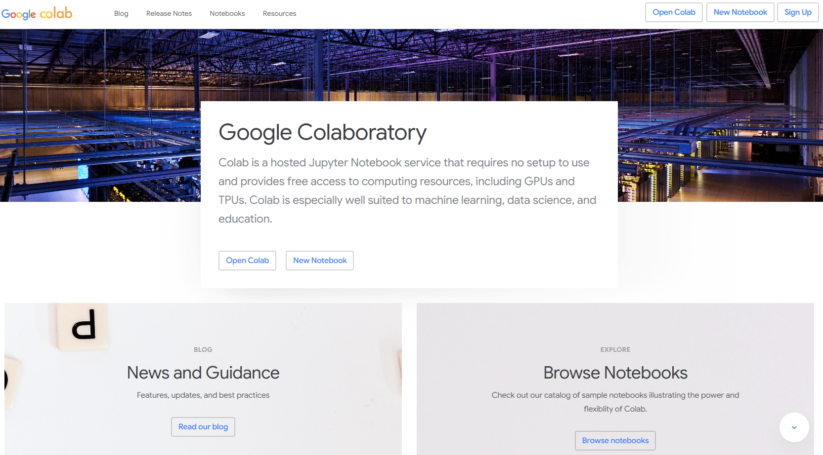
Google Colab
Cloud-Based Platform
Google Colab enables users to run Jupyter Notebooks online without local installation, enhancing accessibility.
Collaborative Features
Multiple users can collaborate on the same notebook simultaneously, boosting teamwork and productivity.
Integration with Google Drive
Seamless integration with Google Drive allows easy file management and data uploads within Colab notebooks.
Interactive Data Analysis
Users can run notebooks like Gaussian fitting interactively and upload their own data for analysis.
Notes:
Google Colab is a free cloud-based platform that provides access to Jupyter Notebooks without the need for local installation. Users can write and execute Python code directly in their browser, making it highly accessible and convenient. Colab supports collaboration, allowing multiple users to work on the same notebook simultaneously. It also integrates with Google Drive for easy file management. In this tutorial, learners are encouraged to use Google Colab to run the Gaussian fitting notebook, upload their own data, and explore the analysis interactively.

Slide 8
Fitting data: the basic steps
Notes:
Understanding the Gaussian Curve

Slide 9
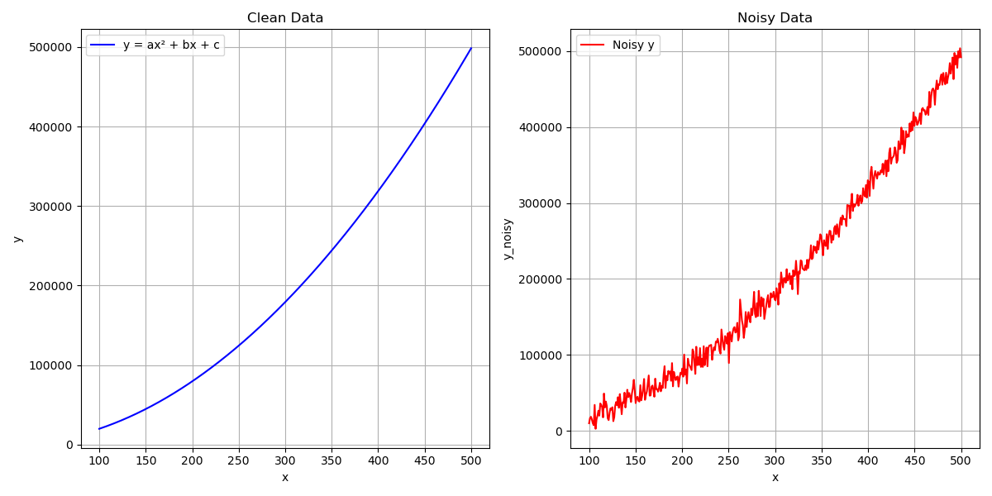
The steps
Plot your raw data
Try to fit it to a basic quadratic equation: y = a*x² + b*x + c Get fit values and statistics

Slide 10
Conclusion
Notes:
Summary and Next Steps

Slide 11
Why is this important?
You need to analyze some data:
Budget friendly: use a notebook for FREE
IT friendly (ish): no need to download
Your client / collaborator / cat needs to analyze some data and they have asked for your help
Comment your notebook to explain every step (this is MUCH easier and visually better than commenting code)
Send them your notebook
Bask in the warm glow of having helped a fellow scientist in need
Notes:
This tutorial demonstrates how to perform Gaussian fitting on user-uploaded data using Jupyter Notebooks and Google Colab. Key takeaways include understanding the structure of Gaussian functions, setting up fitting routines, and interpreting results. Learners are encouraged to apply these techniques to their own datasets and explore advanced topics such as baseline correction and peak detection. The interactive nature of notebooks makes it easy to experiment and refine analyses, fostering deeper understanding and skill development.

