Slide 1






New STS Recruitment Request Form
How
Why
When
Who
What
IPA-Ghana Staff Retreat
Retreat Venue
January 15 – 17, 2019

Slide 2
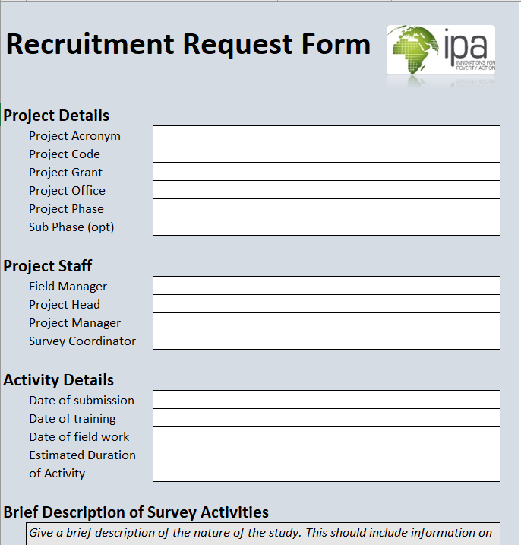
Redesigned Short-Term Staff Recruitment
How
Why
What
When
Who

Slide 3
Why is this necessary?
Current form is cumbersome and more difficult >> New form is structured in a much simpler way with guideline to each section
Automatization/Standardization for Selection of internal candidates by SCs
Automatization means quick response rates from SCs for internal recruitment request
How
Why
When
Who
What

Slide 4
Who will use this form?
Project Staff: STS Recruitment Request (Internal Only)
SC: Automatic Short-listing of Internal Candidates using form as an input to Stata program
How
Why
When
Who
What

Slide 5

Live Demo
How
Why
When
Who
What

Slide 6



Timelines?
JAN
FEB
MAR
1
2
3
How
Why
When
Who
What
BETA
PILOT
FINAL
Launch Beta Version
Pilot Beta Version on Some Projects
Finalize and Launch

Slide 7


Slide 8


