Slide 1



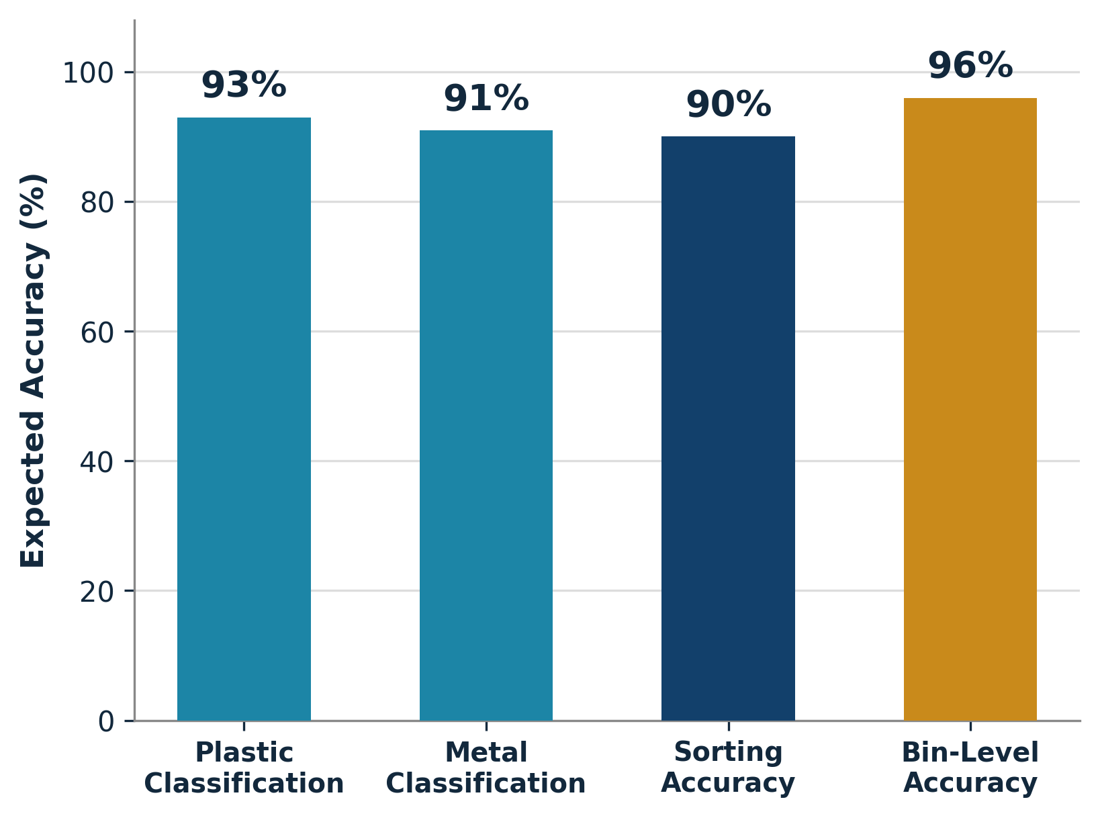
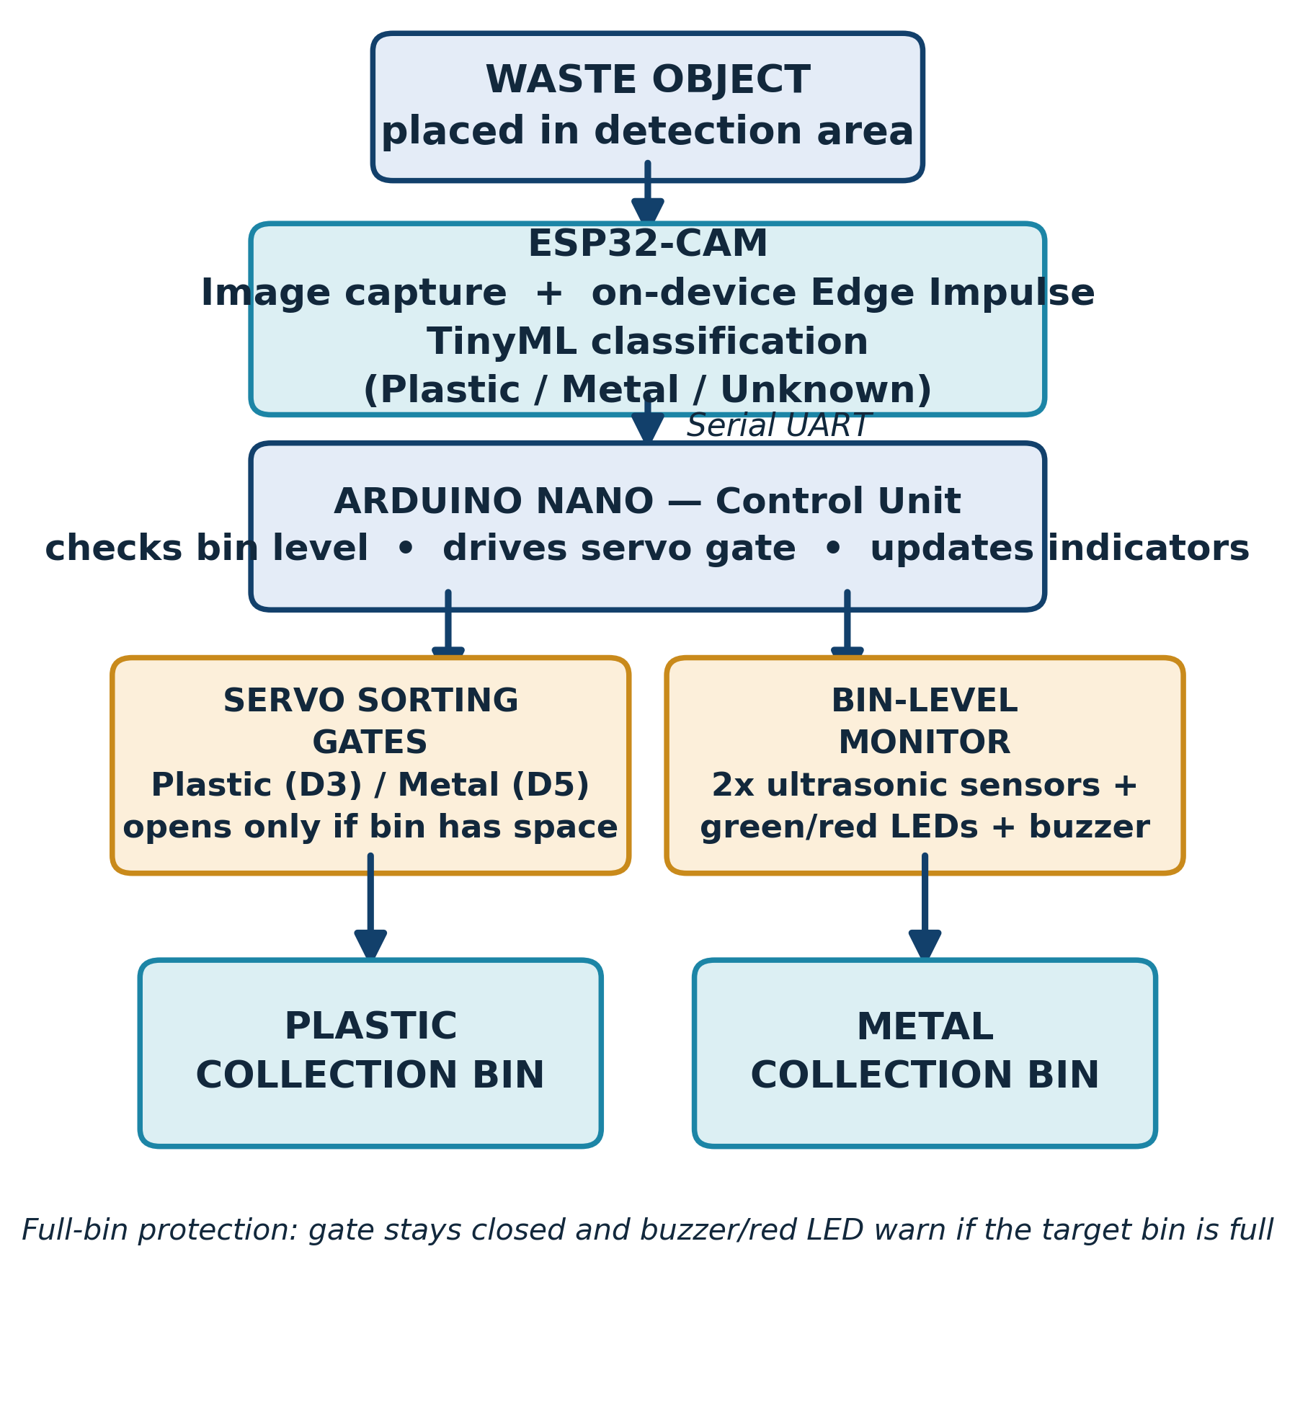
EDGE AI-BASED PLASTIC BOTTLE AND METAL CAN DETECTION AND AUTOMATIC WASTE SEGREGATION SYSTEM
Department of Computer Engineering, Faculty of Engineering,
Ahmadu Bello University Zaria, Kaduna State, Nigeria
Student Names: Mohammed Adamu Abubakar, Ibrahim Abdulkadir Supervised by: [Supervisor's Name]
Abstract
Improper waste segregation contributes significantly to environmental pollution and reduced recycling efficiency. This project presents an Edge AI-based system that automatically detects and segregates plastic bottles and metal cans using Tiny Machine Learning (TinyML). An ESP32-CAM captures real-time images of waste items and classifies them as plastic, metal, or unknown using a lightweight Edge Impulse-trained model that runs entirely on-device, with no cloud dependency. The classification result is sent via serial communication to an Arduino Nano, which drives two servo motors to direct the waste into the correct compartment. Two ultrasonic sensors continuously monitor bin fill levels, while LED indicators and a buzzer alert users when a compartment is full. The result is a low-cost, low-latency, and scalable waste-sorting solution suitable for smart cities, schools, and offices.
Introduction
Methodology
Result
Rapid urbanization and population growth have driven a sharp rise in municipal solid waste. Manual sorting is slow, labour-intensive, and exposes workers to health hazards.
TinyML now allows real-time AI inference directly on low-power microcontrollers, removing the need for cloud servers or expensive computing hardware.
This project designs an embedded AI system that identifies plastic bottles and metal cans in real time and automatically sorts them, with live bin-level monitoring.
Objectives:
• Classify plastic and metal waste using TinyML
• Real-time image acquisition via ESP32-CAM
• Automate sorting using servo-controlled gates
• Monitor bin levels with ultrasonic sensors
• Evaluate accuracy and response time
How it works
The ESP32-CAM captures each waste image and runs an on-device Edge Impulse TinyML model to classify it as Plastic, Metal, or Unknown. The result is sent by serial UART to an Arduino Nano, which checks the target bin's capacity via ultrasonic sensors before opening the matching servo gate. LEDs and a buzzer give real-time status feedback.
Expected performance
Full experimental results are still being collected. Figures below are preliminary targets based on comparable Edge Impulse waste-classification deployments and will be confirmed during system testing.
Average response time: ~1.8 s per item
Confidence threshold: 70–80%
System testing covers:
• Classification accuracy per class
• Sorting accuracy (correct bin)
• Bin-level detection accuracy
• Servo response time
• False-classification rate
Potential for Product Commercialization
• Deployable in smart cities, schools, offices, and residential estates
• Low-cost components make affordable mass production possible
• No cloud/internet dependency reduces running cost
• Easily scalable to more waste categories (paper, glass, e-waste)
• Potential partnership with recycling and waste-management firms
Innovation and Creativity
Combines on-device TinyML inference, automated servo-based sorting, and real-time bin-level monitoring in a single low-power embedded platform — removing cloud dependency while keeping hardware cost and response latency low. The modular ESP32-CAM / Arduino Nano architecture makes it easy to extend the system to new waste categories or additional sensors.
Conclusion
The developed Edge AI-based waste segregation system shows that low-power embedded devices can reliably classify and automatically sort plastic and metal waste in real time, without cloud computing. By integrating TinyML classification, servo-based sorting, and ultrasonic bin monitoring, the system offers a practical, low-cost, and scalable solution for improving recycling efficiency in homes, schools, and smart-city waste-management infrastructure.
References
Kaza, S. et al. (2018). What a Waste 2.0. World Bank. | Guerrero, L.A. et al. (2013). Solid waste management challenges for cities in developing countries. Waste Management, 33(1). | Warden, P. & Situnayake, D. (2019). TinyML. O'Reilly. | Szeliski, R. (2022). Computer Vision: Algorithms and Applications.
Acknowledgement
Future Work
We sincerely thank our supervisor for the guidance and support given throughout this project, and the Department of Computer Engineering, ABU Zaria, for the technical resources provided.
Future work includes expanding classification to more waste categories (paper, glass, e-waste), adding IoT connectivity for remote bin monitoring, and a solar-powered outdoor version.

