Slide 1
Clinical Prediction On readmission after Changing-Medication for Diabetic Patients.
ABDULLAH ALLUHIDAN
FINAL-PROJECT HAP-780

Slide 2
OUTLINE:
INTRODUCTION
DATA SOURCE
DATA VARIABLES
DATA PRE-PROCESSING
DATA PROCESSING
CONCLUSION

Slide 3
INTRODUCTION:
Diabetes is a series health condition that cause higher than normal blood sugar levels .
More than 30 million child and adults has been diagnosed with Diabetes.
Diabetes has several types like: Diabetes type1, Diabetes type2, Gestational diabetes.

Slide 4

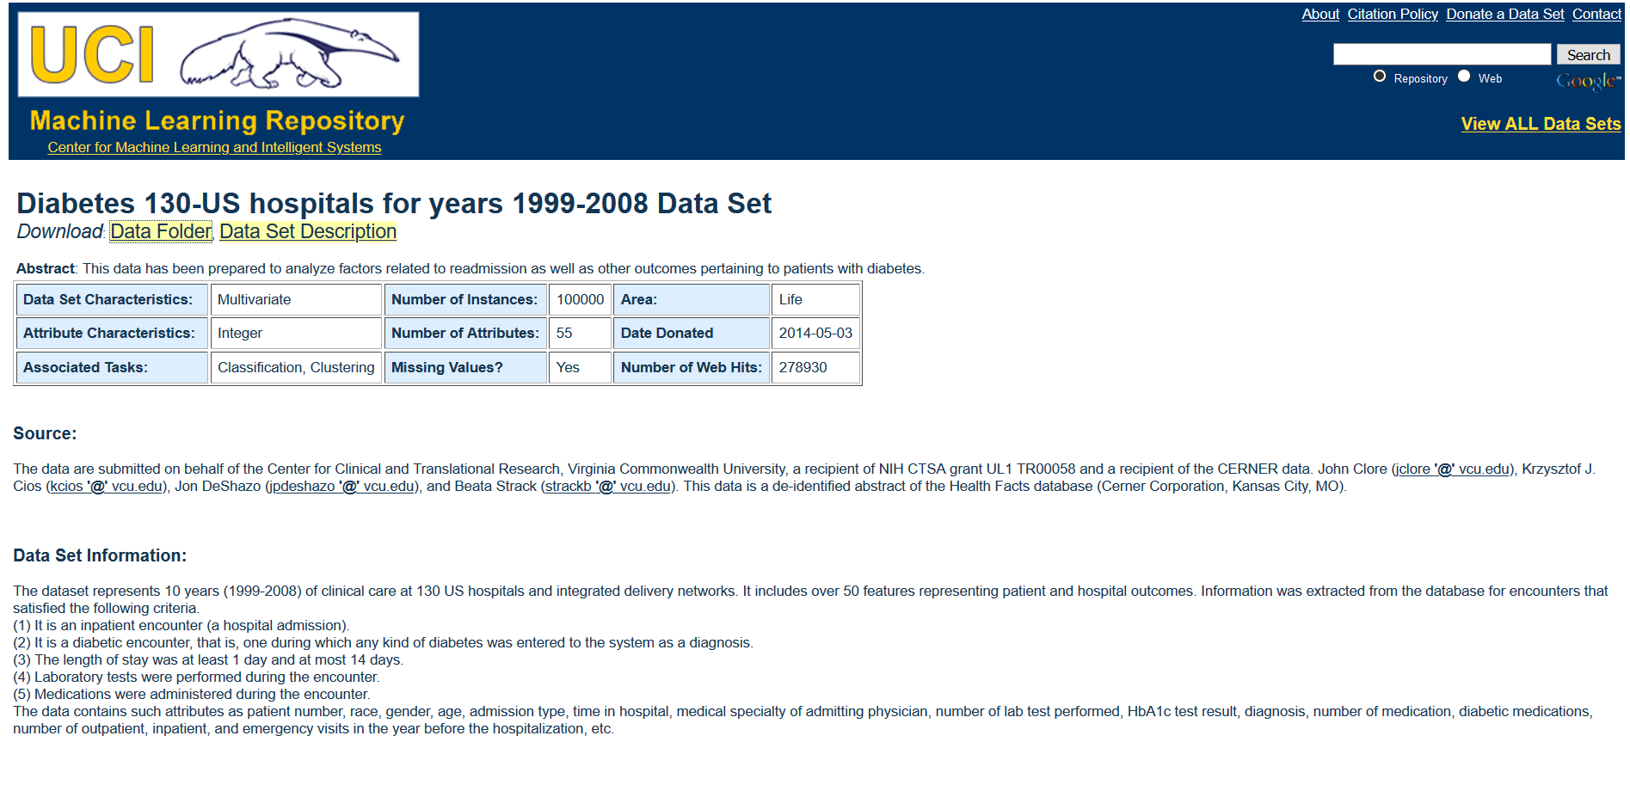
DATA SOURCE:
was extracted from UCI and it is done on behalf of the Center for Clinical and Translational Research, Virginia Commonwealth University, a recipient of NIH CTSA grant UL1 TR00058 and a recipient of the CERNER data.
dataset represents 10 years (1999-2008) of clinical care at 130 US hospitals and integrated delivery networks. It includes over 50 features representing patient and hospital outcomes.

Slide 5
DATA VARIABLES:
patient number, race, gender, weight, age, admission type, time in hospital, medical specialty of admitting physician, number of lab test performed, HbA1c test result, diagnosis, number of medications, diabetic medications, number of outpatients, inpatient, and emergency visits in the year before the hospitalization.
Data contain 101,767 patients

Slide 6
Data attributes:
Race (African-American , Asian, Other, Hispanic, Caucasian,?)
Gender (Male, Female)
Age ([0-10], [10-20], [20-30],[30-40],[40-50],[50-60],[60-70],[70-80],[80-90],[90-100])
Admission (1- Emergency. 2-Urgent. 3-Elective. 4-Newborn. 5-Trauma-Center. 7 and 8 –Missing Value.)

Slide 7
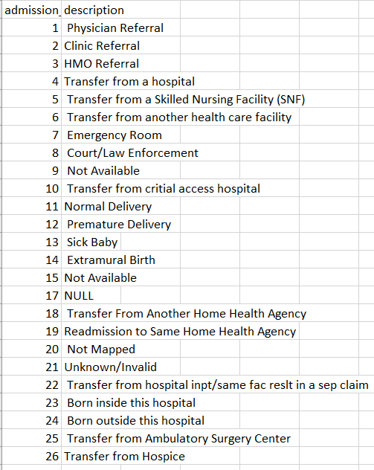
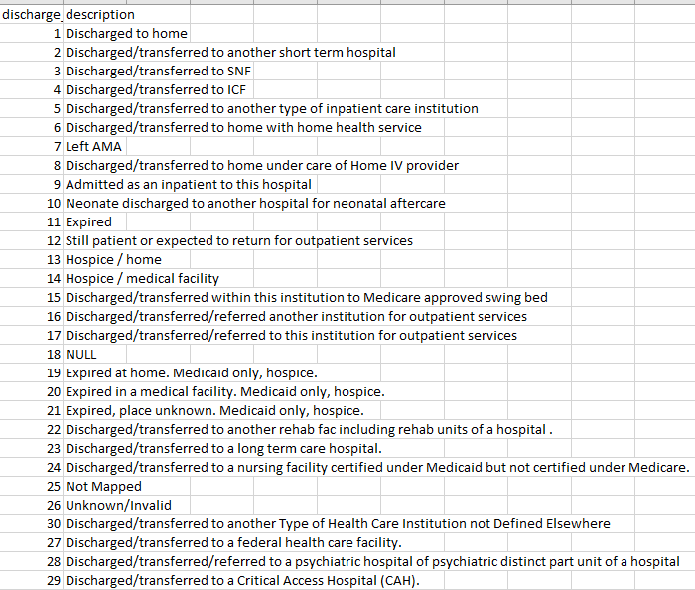
Data attributes:

Slide 8
SUMMRIZE SOME IMPORTANT attributes:
Variables | N
GENDER:
Female | 26,130
Male | 25,177
AGE:
30-60 | 32,884
60 and Above | 18,363
RACE:
Caucasian | 37,927
African-American | 11,011
Other | 850
Asian | 391
Hispanic | 1,068
ADMISSION TYPE:
Emergency | 29,501
Urgent | 10,616
Elective | 11,120
Newborn | 5
Trauma-Center | 5
MEDICATION:
insulin | 27,167
metformin | 10,915
repaglinide | 735
Change_Medication:
change | 23,405
Didn’t change | 27,842
DIABETES-MEDICIATION:
Yes | 39,603
No | 11,644
READMISSION:
Yes | 23,226
No | 28,021

Slide 9
Data attributes:
Some Medications (insulin, tolazamide > (Steady, Up, Down, No).
Change Medications (No ,Ch)
Diabetes_MED (Yes, No)
Readmitted (>30 , <30, No)
The final dataset patients is 23,406

Slide 10
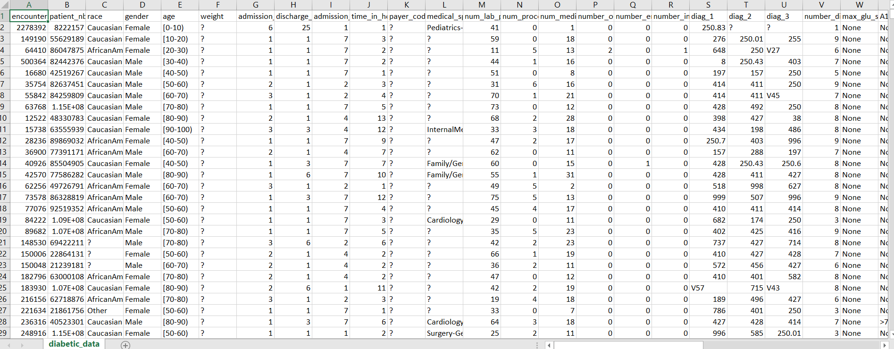
Data Pre-processing:

Slide 11
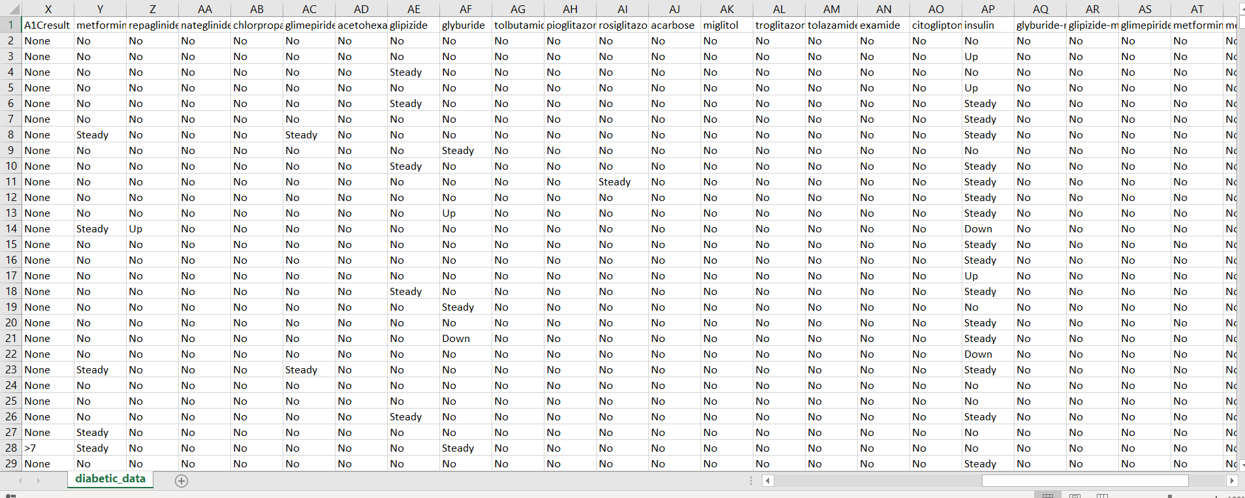
Data pre-processing:

Slide 12
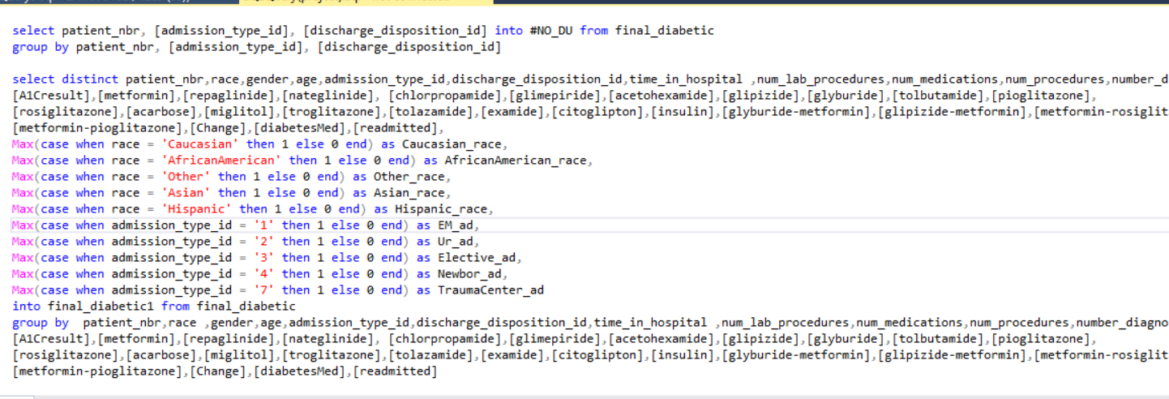
Data preprocessing:

Slide 13
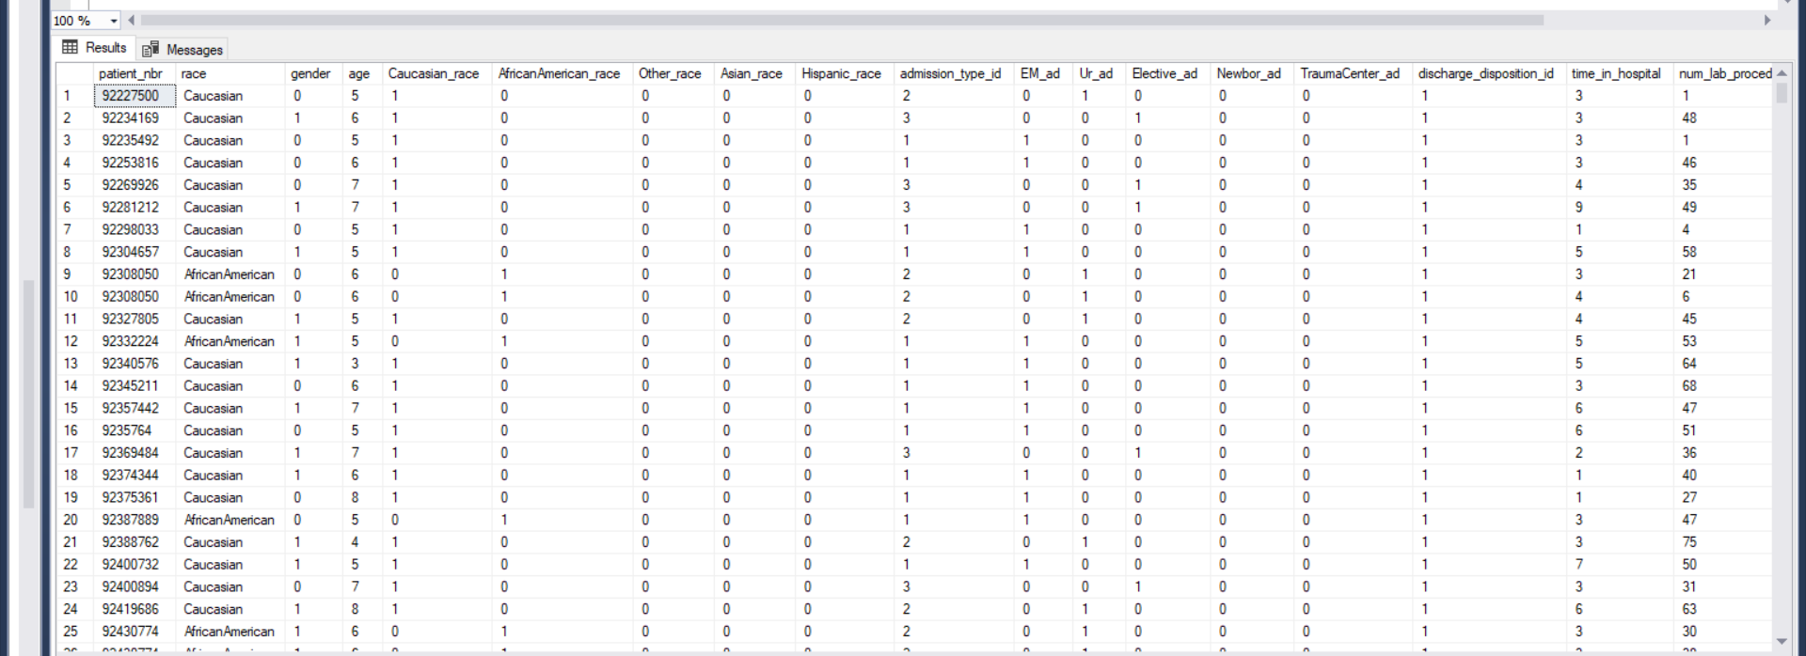
Data pre-processing

Slide 14
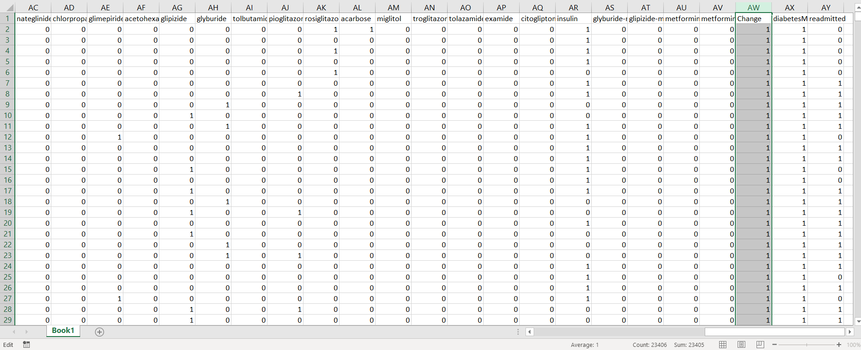
Data pre-processsing

Slide 15
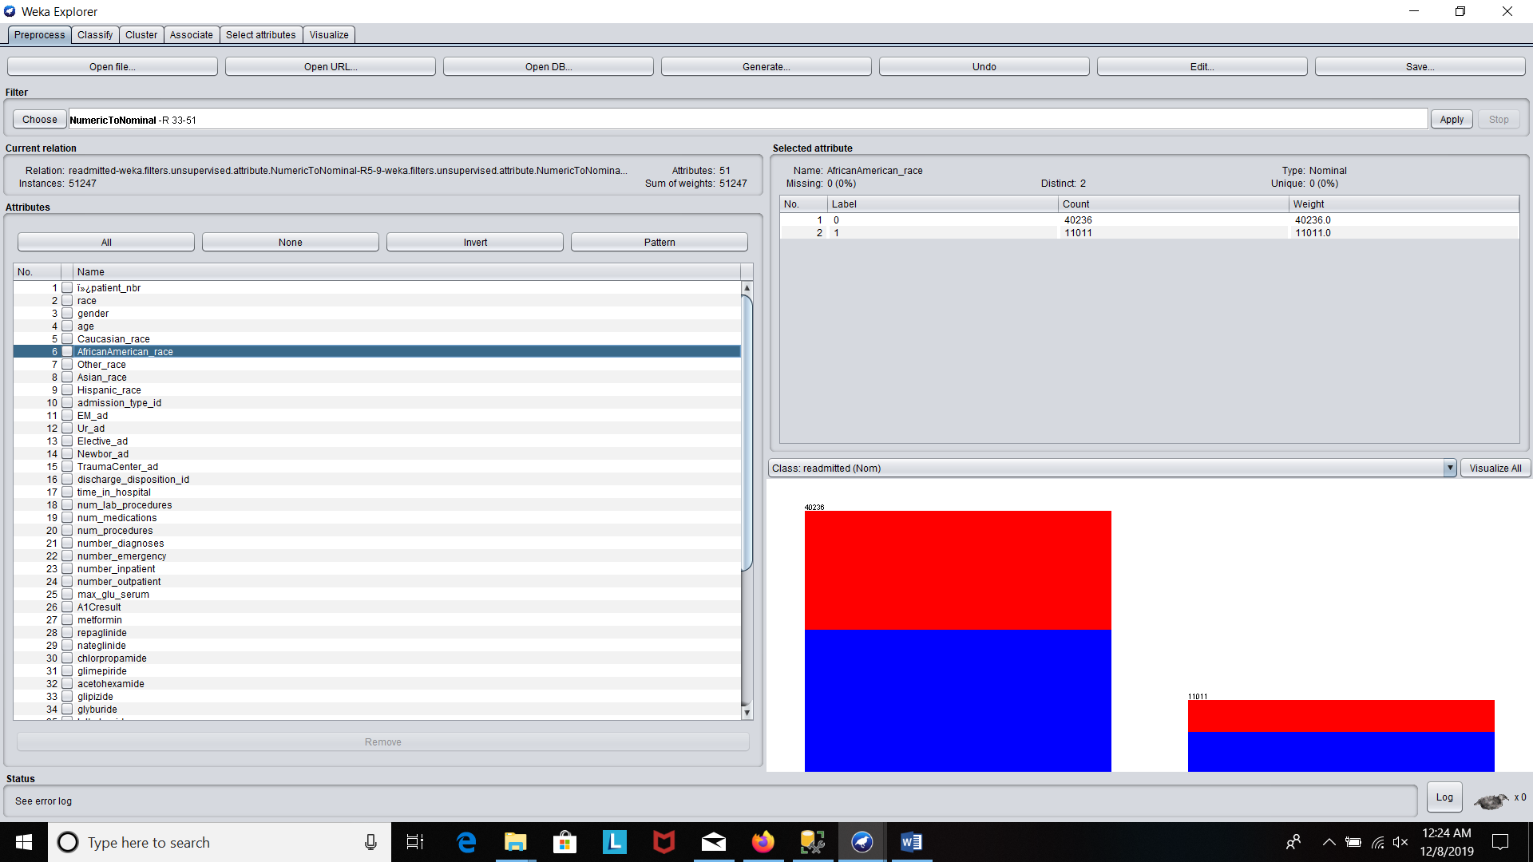
Data processing:

Slide 16
Summarizing The Models Results:
MODEL | ROC | Incorrectly classified instance | Weighted Avg. Precision | Weighted Avg. TP Rate | Weighted Avg. FP Rate | Weighted Avg. PRC Area | Recall Not Readmitted | Recall readmitted
Naïve Bayes | 0.657 | 40.24% | 0.633 | 0.598 | 0.435 | 0.657 | 0.894 | 0.268
Logistic | 0.662 | 37.45% | 0.629 | 0.625 | 0.390 | 0.629 | 0.769 | 0.466
J48 | 0.581 | 41.74% | 0.582 | 0.583 | 0.421 | 0.555 | 0.612 | 0.549

Slide 17
Conclusion:
The aim was to build a model to predict readmission after changing the medication for the diabetic patients .
The only limitation was Weight missing values almost 97%.

Slide 18
REFERNCes:
https://archive.ics.uci.edu/ml/datasets/diabetes+130-us+hospitals+for+years+1999-2008#
https://www.researchgate.net/profile/Srideivanai_Nagarajan/publication/281213698_Design_and_Implementation_of_Expert_Clinical_System_for_Diagnosing_Diabetes_Using_Data_Mining_Techniques/links/5606c94708aeb5718ff75f4b.pdf
https://bmcmedinformdecismak.biomedcentral.com/articles/10.1186/1472-6947-9-28
https://www.diabetes.co.uk/diabetes_lada.html
https://www.diabetes.co.uk/diabetes_mody.html
https://www.niddk.nih.gov/health-information/diabetes/overview/what-is-diabetes

