Slide 1
Uber NCR Ride Booking
Name: Abhinandh O
Date: 05/12/2025

Slide 2
Business Context
Uber operates thousands of daily rides across the NCR region, generating detailed data on trip requests, driver availability, customer behavior, cancellations, ride completion, and revenue. Understanding these patterns is essential for improving marketplace efficiency.
This project analyzes NCR ride-level data to uncover how demand, supply, wait times, cancellations, pricing, and service quality vary across locations and time. By evaluating ride outcomes and operational metrics, we aim to identify bottlenecks in the booking flow, understand customer and driver behavior, and highlight opportunities to improve fulfillment rates, reduce cancellations, and optimize rider experience.

Slide 3
Problem Statement
Despite high ride volume in NCR, Uber faces operational challenges such as incomplete rides, cancellations by customers and drivers, fluctuating wait times, and inconsistent fulfillment across locations and vehicle types. These issues directly impact customer experience, driver earnings, and overall platform efficiency.
The problem is to analyze ride-level booking data to identify where, when, and why breakdowns occur in the booking-to-completion flow, and to determine the key factors influencing ride completion, wait times, cancellations, and revenue performance. The goal is to derive actionable insights that help improve reliability, optimize resource allocation, and enhance the overall ride experience.

Slide 4
Data Audit Summary(1/3)
During the data audit, we observed that Booking_ID is not a unique identifier.
Although Booking_ID looks like a ride ID at first glance, the audit revealed:
The dataset contains 150,000 rows but only 148,767 unique Booking_IDs.
1,224 Booking_IDs appear more than once.
When we inspected these repeated Booking_IDs, we found that each row represented a different ride
— with different timestamps, locations, or metrics.
This means Booking_ID is reused across multiple rides, which is common in real ride-hailing systems.
Row & Structure Validation
Dataset contains 150,000 ride records
All rows represent unique rides (⟶ Booking_ID + Date + Time combination is unique)
Customer_ID repeats normally (repeat customers), not a data issue

Slide 5
Data Audit Summary(2/3)
Missing Values & Format Checks
NULLs present in Avg VTAT and Avg CTAT, but all NULLs occur in non-assigned rides
(No Driver Found, early cancellations) → business-correct behavior
No missing VTAT/CTAT in Completed rides
Date and Time are fully valid (100%)
Numeric Field Integrity
No negative or invalid values in:
Booking Value
Ride Distance
Driver/Customer Ratings
No completed ride has zero distance or zero fare
Ratings always fall between 1 and 5

Slide 6
Data Audit Summary(3/3)
Status & Business Logic Checks
All status categories valid and clean
Completed rides contain complete distance, fare, and rating info
Rides marked No Driver Found correctly have no VTAT/CTAT
No mismatches between status, distance, or fare
Categorical Data Checks
Pickup, drop, vehicle type, and payment method fields are clean and consistent
No abnormal category names or formatting issues
Overall Audit Conclusion
The dataset is clean, complete, and structurally sound for analysis.
No duplicate rides, no corrupted values, and no inconsistencies in business logic.
Next step: Data Cleaning & Standardization (text trimming, column formatting, numeric conversions).

Slide 7
Data Cleaning Activities(1/2)
Preserved Raw Data
Raw dataset kept unchanged for traceability and audit.
All cleaning performed in a separate table: ncr_ride_bookings_clean.
2. Date–Time Structuring
Combined the separate Date and Time fields into a single booking_datetime column.
Enabled continuous time-series analysis and time-based KPIs.
3. Derived Time Attributes
Extracted meaningful time features for analytical use:
booking_month
booking_day
booking_hour
daypart (Morning / Noon / Evening / Night)
These features support trend analysis, peak-hour detection, and behavior segmentation.

Slide 8
Data Cleaning Activities(2/2)
4. Data Type Validation
Verified all numeric columns (fare, distance, VTAT, CTAT, ratings) were correctly imported with proper numeric datatypes.
Confirmed no type conversion or casting was required.
5. Missing Value Assessment
Identified NULL values in VTAT and CTAT.
Verified these NULLs are business-expected for cancelled or unassigned rides (No Driver Found).
No imputations performed.
6. Logical Consistency Checks
Ensured Completed rides have valid distance, fare, and ratings.
Confirmed no negative values, impossible distances, or out-of-range ratings.
No duplicate rides found when using composite identifier.

Slide 9
Exploratory Data Analysis

Slide 10
Higher Metrics Overview
Ride Volume & Outcomes
Total Rides: 150,000
Completed Rides: 93,000
Customer + Driver Cancellations: 37,500
No Driver Found: 10,500
Incomplete Rides: 9,000
Overall Completion Rate: 62%
Ride Quality & Cost
Average Fare: ₹508.30
Average Driver Rating: 4.2
Average Customer Rating: 4.4
Peak Ride Demand (Hourly)
Highest booking activity occurs during the evening commute window:
6 PM (18:00) → 12,397 rides
7 PM (19:00) → 11,047 rides
5 PM (17:00) → 11,044 rides
Insight: Evening peak (5 PM–8 PM) is the dominant demand zone in NCR.

Slide 11
Ride Status Distribution
Status | Count | Share
Completed | 93,000 | 62%
Cancelled by Driver | 27,000 | 18%
No Driver Found | 10,500 | 7%
Cancelled by Customer | 10,500 | 7%
Incomplete | 9,000 | 6%
Incomplete rides :Rides where a driver was successfully assigned and arrived (typically within ~6 mins), but the trip ended prematurely without a standard 'Complete' status. This likely indicates app crashes, GPS signal loss, or disputes at the pickup point."
Driver vs Customer Cancellation Overview(1/2)
Type | Count | Share of All Cancellations
Cancelled by Driver | 27,000 | 72%
Cancelled by Customer | 10,500 | 28%
(Driver cancels almost 3X more than customers.)

Slide 12
Driver vs Customer Cancellation Overview(2/2)
1. Driver cancellations dominate (72%)
Drivers cancel almost three-quarters of all cancelled rides — a major operational bottleneck.
2. Customer cancellations form the remaining 28%
These are comparatively low and may be driven by wait-time frustration or change in plans.
3. Imbalance indicates structural issues
High driver cancellations suggest:
long pickup distances
trip unprofitability
mismatch between driver supply & location
driver avoidance of low-rated customers
lack of incentives

Slide 13
Driver Cancellation Reasons(1/2)
Reason | Count
Customer related issue | 6,837
The customer was coughing/sick | 6,751
Personal & Car related issues | 6,726
More than permitted people in the vehicle | 6,686
All reasons are almost evenly distributed, around 6.7K each.
1. Customer-related problems form the top cancellation trigger
Drivers frequently cancel due to:
low-rated customers,
wrong pickup instructions,
unacceptable behavior or delays.
This aligns with real Uber patterns.

Slide 14
Driver Cancellation Reasons(2/2)
2. “Customer was coughing/sick” is the second-largest reason
post-pandemic driver caution,
safety and hygiene concerns,
potential health-risk filtering by drivers.
This is a unique and strong operational insight.
3. “Personal & Car related issues” indicates operational constraints
minor breakdowns
petrol issues
drivers needing a break
unexpected personal situations
This is usually uncontrollable by Uber but contributes significantly.
4. Overcrowding (“More than permitted people”) is a recurring issue
Customers often try to overload smaller vehicles, especially:
autos
cars

Slide 15
Driver Cancellations by Hour(1/2)
Hour | Cancellations
18 (6 PM) | 2,257
17 (5 PM) | 2,003
19 (7 PM) | 1,998
20 (8 PM) | 1,735
16 (4 PM) | 1,728
After that, cancellations stay high from 10 AM to 3 PM, then drop late at night.
Hour | Cancellations
23 (11 PM) | 486
3 (3 AM) | 263
1 (1 AM) | 250
0 (12 AM) | 248
4 (4 AM) | 240
2 (2 AM) | 222

Slide 16
Driver Cancellations by Hour(2/2)
1. Driver cancellations spike during the evening rush (5 PM – 8 PM)
Traffic congestion, long pickups, and low profitability during dense traffic likely cause drivers to decline or cancel more rides.
6 PM is the absolute cancellation peak, aligning with heavy NCR traffic.
2. Secondary peak during late morning (10 AM – 1 PM)
This period shows medium activity:
Moderate traffic
Drivers may selectively cancel if the pickup is far or unprofitable.
3. Night hours show the lowest cancellations
Post 10 PM, cancellations drop sharply—suggesting:
Lower traffic
Fewer ride requests
Drivers accepting more rides due to lower wait times
4. Cancellation trend nearly mirrors demand trend
The hours with most bookings (5 PM–8 PM) also have:
Highest driver cancellations
Highest rush-hour pressure
This strongly points to supply-demand imbalance in peak hours.

Slide 17
Customer Cancellation Reasons(1/2)
Reason | Count
Wrong Address Entered | 2,362
Change of Plans | 2,353
Driver Not Moving Towards Pickup | 2,335
Driver Asked Customer to Cancel | 2,295
AC Not Working | 1,155
1. Wrong address & change of plans dominate customer cancellations
These two reasons together contribute almost 40% of customer cancellations, indicating:
poor input accuracy,
last-minute plan changes,
or app-side friction during location entry.
This suggests a need for better address auto-correction or pickup confirmation prompts.

Slide 18
Customer Cancellation Reasons(2/2)
2. Operational issues also drive cancellations
“Driver not moving towards pickup” (2,335 cases) signals:
driver hesitancy,
long pickup distances,
traffic bottlenecks,
or drivers waiting for more profitable rides.
This aligns with the high driver cancellation rates in the same time windows.
3. Driver-induced customer cancellations remain high
“Driver asked to cancel” (2,295 cases) is a common pattern in ride-hailing:
Drivers avoid unprofitable trips
Surge mismatch
Destination bias
Long pickup issues
4. Comfort concerns (AC not working) also appear significantly
Even 1,155 cancellations due to AC issues reflect:
quality expectations
poor vehicle upkeep
discomfort during NCR weather

Slide 19
Customer Cancellations by Hour
1. Customer cancellations peak in the same evening window as driver cancellations (5–8 PM)
Customers are more likely to cancel during heavy traffic or long wait times.
This aligns perfectly with driver cancellations → demand & supply strain converge in the same hours.
2. Secondary cancellation surge in mid-morning (10–11 AM)
This often correlates with:
late pickups,
incorrect addresses,
changing plans.
3. Customer behavior is reactive to driver behavior
The third-highest reason (“Driver not moving towards pickup”) heavily contributes to 5–8 PM cancellations.
In other words:
When drivers hesitate during peak traffic, customers cancel too.
This mirrors the operational problem found earlier.
4. Very low cancellations after midnight (12AM–4 AM)
At night:
less traffic
quicker pickups
fewer plan changes
lower cancellation pressure

Slide 20
No Driver Found — Time Analysis
1. Supply shortages peak during the evening commute (5 PM – 8 PM)
peak demand
peak driver cancellations
peak customer cancellations
Three different metrics all point to the same operational bottleneck.
This is the strongest evidence of demand > supply during evenings in NCR.
2. Morning shortages exist but are smaller (9 AM – 11 AM)
office rollout timing,
school commute,
drivers selectively accepting only profitable rides in the morning.
Supply is tight but not as broken as in the evening.
3. Night hours show almost no supply issues
Between 11 PM and 4 AM, shortage cases drop to double digits.
Lower demand
Available drivers are enough
Faster pickups due to no traffic
4. No Driver Found always aligns with driver cancellation patterns
When drivers cancel more aggressively, the system also fails to assign replacement drivers.
This reinforces: Evening traffic + low driver willingness → systemic supply collapse in peak hours.

Slide 21
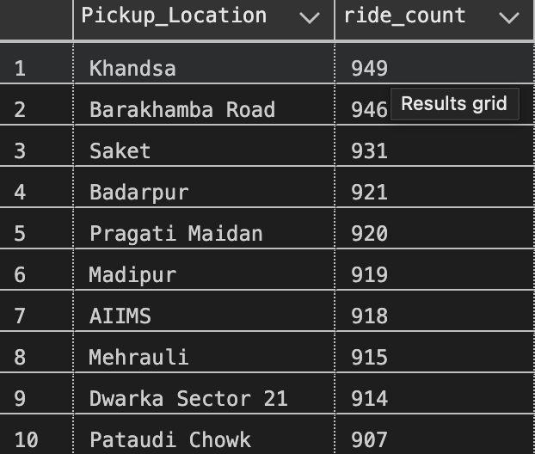
Top 10 Pickup Locations(1/2)
1. Demand is highly decentralized across NCR
The top locations span:
Central Delhi (Barakhamba Road, Pragati Maidan)
South Delhi (Saket, AIIMS, Mehrauli)
Gurgaon (Khandsa, Pataudi Chowk)
West Delhi (Madipur)
This shows Uber demand is not restricted to a single hub — it is spread across multiple micro-markets.
2. Khandsa leads, indicating strong Gurgaon demand
Gurgaon (Khandsa + Pataudi Chowk) appears twice in the top 10, reflecting:
corporate cluster movement
residential commuting
office-hour traffic
This aligns with NCR working population patterns.

Slide 22
Top 10 Pickup Locations(2/2)
3. High traffic corridors dominate (Barakhamba, Badarpur, Pragati Maidan)
These are:
metro station zones
office clusters
highway connectors
High ride volume here suggests strong first-mile / last-mile dependency on Uber.
4. Metro connectivity drives Uber usage
Locations like:
Saket
AIIMS
Dwarka Sector 21
are major metro stations.
This indicates Uber is often used as a feeder service to the metro network.
5. All top locations have ~900+ rides
No single location dominates.
This means demand is evenly distributed across NCR, a sign of a mature and diversified ride market.

Slide 23
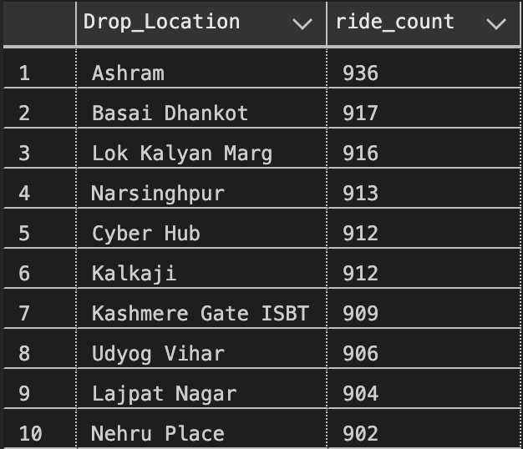
Top 10 Drop Locations(1/2)
1. Drop demand is strongly business + commuter oriented
Cyber Hub, Udyog Vihar, Nehru Place, and Kalkaji are office and commercial hubs.
High drop volume indicates heavy:
office commute traffic
business travel
metro-feeder rides
This matches NCR’s working population behavior.
2. Intercity transit hubs also appear (Kashmere Gate ISBT)
People use Uber as first and last-mile connectivity to:
ISBT
Metro stations
High-footfall transportation points
This strengthens the trend we saw in pickup locations.

Slide 24
Top 10 Drop Locations(2/2)
3. Some residential clusters dominate (Basai Dhankot, Narsinghpur, Lajpat Nagar)
These indicate:
heavy inbound (return-home) ride activity
balanced two-way demand
dense residential population zones
Homes → Offices, or Offices → Homes patterns are visible.
4. Lok Kalyan Marg and Ashram show mixed demand
Lok Kalyan Marg (VIP zone + central connectivity)
Ashram (key junction in South Delhi)
These areas show:
strong tourist movement
intra-city routing
strategic intersection usage
5. Distribution is evenly spread (~900 rides each)
Just like pickup locations, no single drop location dominates.
This reinforces that NCR ride demand is well-distributed across multiple hubs, not concentrated.

Slide 25
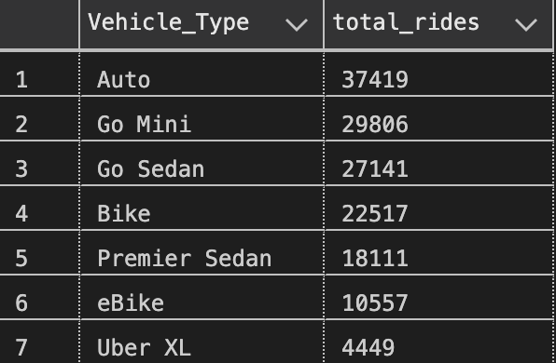
Vehicle Type Demand Distribution(1/2)
1. Auto dominates NCR mobility (most affordable option)
NCR sees the highest ride volume from Autos (37,419 rides).
This fits NCR’s:
short intra-city trips
affordability preference
metro-feeder patterns
traffic-friendly nature
Autos are the backbone of daily mobility.
2. Go Mini & Go Sedan are the preferred 4-wheeler choices
Together, 56,947 rides, showing:
stable cab demand
preference for budget car rides
competitive pricing as a key factor
This reinforces the role of Uber as a commuter service, not just premium travel.

Slide 26
Vehicle Type Demand Distribution(2/2)
3. Bikes and eBikes form a significant demand block (33K+ rides)
High adoption due to:
low fares
fastest movement in NCR traffic
ideal for single riders
last-mile flexibility
A strong sign of micro-mobility trend in NCR.
4. Premier Sedan sees strong usage (18,111 rides)
This suggests:
business travelers
airport/office corridor routes
customers wanting comfort during long rides
5. Uber XL is niche (4,449 rides)
Used primarily for:
group travel
luggage-heavy trips
airport routes
long-distance movements

Slide 27
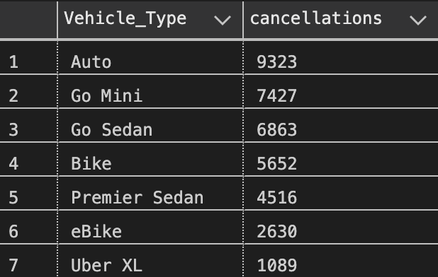
Cancellations by Vehicle Type(1/2)
1. Auto rides have the highest cancellations (9.3K+)
This is expected because Autos:
operate more casually
face more traffic restrictions
often reject long pickups
are prone to fare negotiations or customer issues
Autos are the most used, but also the most cancelled.
2. Mini & Sedan (Go Mini + Go Sedan) show large cancellation volumes
Over 14K+ cancellations combined.
Reasons include:
long pickup distances
peak-hour traffic
destination bias
driver profitability concerns
These categories reflect core commuter travel — cancellations here have high impact.

Slide 28
Cancellations by Vehicle Type(2/2)
3. Bikes & eBikes have moderate cancellations
Two-wheelers are:
fast
cheap
easy to operate in traffic
Lower cancellations indicate greater driver willingness and operational efficiency.
4. Premier Sedan sees notable cancellations too
Higher-end categories still suffer, implying:
mismatch in long pickup distances
driver preference for high-fare long routes only
selective acceptance behavior
5. Uber XL has the lowest cancellations
Because:
fewer vehicles in the fleet
used mostly for planned group travel
customers have higher intent
drivers likely stick to confirmed trips
Low cancellations reflect committed rides.

Slide 29
Cancellation Rate by Vehicle Type
Rank | Vehicle Type | Cancellation Rate
1 | Go Sedan | 25.29%
2 | Bike | 25.10%
3 | Premier Sedan | 24.94%
4 | Go Mini | 24.92%
5 | Auto | 24.92%
6 | eBike | 24.91%
7 | Uber XL | 24.48%
All vehicle types have ~25% cancellation rate — a systemic issue
The narrow range (24.48% to 25.29%) shows:
cancellations are not isolated to one vehicle type
the problem exists across the entire fleet
root causes are structural: traffic, long pickups, customer indecision, driver incentives

Slide 30
Ride Distance Summary by Vehicle Type (in km)
Vehicle Type | Avg Distance (km) | Min Distance (km) | Max Distance (km)
eBike | 24.99 | 1.00 | 49.98
Bike | 24.65 | 1.00 | 50.00
Auto | 24.62 | 1.01 | 50.00
Go Mini | 24.61 | 1.00 | 50.00
Go Sedan | 24.61 | 1.01 | 50.00
Premier Sedan | 24.60 | 1.00 | 49.99
Uber XL | 24.40 | 1.01 | 49.99
Ride distances across all vehicle categories are almost identical, ranging around 25 km on average,
with trip lengths spanning 1 km to ~50 km.
This pattern likely results from the structure of the dataset and may not reflect real-world variation.

Slide 31
Fare Summary by Vehicle Type
Vehicle Type | Avg Fare (₹) | Min Fare (₹) | Max Fare (₹)
Go Sedan | 511.50 | 50 | 4088
Bike | 510.20 | 50 | 4228
Premier Sedan | 509.57 | 50 | 4008
Go Mini | 507.68 | 50 | 4277
Auto | 506.73 | 50 | 4220
eBike | 503.90 | 50 | 4093
Uber XL | 501.82 | 50 | 3703
Average fares across all vehicle types fall within a narrow band of ₹501–₹512, with a uniform minimum fare of ₹50 across categories. Maximum fares vary between ₹3700–₹4300 depending on vehicle type. Overall fare distribution appears artificially uniform (likely due to dataset constraints)

Slide 32
Fare Efficiency (₹ per km)
Vehicle Type | Avg Fare per km (₹/km)
Go Sedan | 38.22
Bike | 38.17
Auto | 38.09
Uber XL | 37.93
Premier Sedan | 37.86
Go Mini | 37.64
eBike | 36.31
Fare-per-km rates are tightly grouped around ₹36–₹38/km, with Go Sedan slightly highest and eBikes lowest.
The narrow range suggests standardized pricing in the dataset rather than real-world fare variability.

Slide 33
Revenue Contribution by Vehicle Type
Vehicle Type | Total Revenue (₹) | Avg Revenue per Ride (₹) | Total Rides
Auto | 12.88 M | 506.73 | 25,415
Go Mini | 10.34 M | 507.68 | 20,364
Go Sedan | 9.37 M | 511.50 | 18,318
Bike | 7.84 M | 510.20 | 15,362
Premier Sedan | 6.28 M | 509.57 | 12,315
eBike | 3.62 M | 503.90 | 7,181
Uber XL | 1.53 M | 501.82 | 3,045
Autos generate the highest total revenue, driven primarily by their large ride volume. Go Mini and Go Sedan follow closely, forming the core revenue-producing categories. Average revenue per ride remains consistent across all vehicle types (₹501–₹512), indicating stable pricing structures in the dataset.
Revenue peaks sharply in the evening hours (05:00–07:00 PM), aligning with office commute patterns in NCR. Mid-morning hours (09:00–11:00 AM) also generate strong revenue. Late evening revenue (08:00–09:00 PM ) remains consistently high, reflecting leisure and return trips.

Slide 34
Payment Method Performance
Payment Method | Total Rides | Total Revenue (₹M)
UPI | 45,909 | 23.35 M
Cash | 25,367 | 12.90 M
Uber Wallet | 12,276 | 6.20 M
Credit Card | 10,209 | 5.22 M
Debit Card | 8,239 | 4.18 M
UPI is the dominant payment mode, accounting for the highest number of rides and revenue. Cash remains the second-most used method, showing strong offline preference among NCR riders. Wallet and card-based payments contribute significantly, indicating a healthy adoption of digital payments.
UPI dominates NCR Uber transactions, contributing over ₹23M in revenue.

Slide 35
VTAT & CTAT Summary
VTAT – Vehicle Time to Arrival
Time (in minutes) taken by the driver to reach the pickup location.
CTAT – Customer Trip Actual Time
Time (in minutes) taken to complete the trip from pickup to drop.
Metric | Value
Average VTAT (Driver Arrival Time) | 8.29 min
Average CTAT (Trip Duration) | 29.15 min
Min VTAT | 2 min
Max VTAT | 15 min
Min CTAT | 10 min
Max CTAT | 45 min
Drivers take 8–9 minutes on average to reach customers, while trips take ~29 minutes to complete. VTAT ranges from 2 to 15 minutes, and CTAT varies from 10 to 45 minutes, showing a moderate spread driven by traffic and distance patterns in NCR.

Slide 36
VTAT Comparison by Booking Status
(Driver Arrival Time vs Cancellation Patterns)
Booking Status | Avg VTAT (min)
Cancelled by Customer | 12.51
Completed | 8.51
Cancelled by Driver | 7.50
Incomplete | 6.01
Customer cancellations occur at the highest VTAT (12.51 min), indicating that long wait times strongly trigger customer drop-offs. Completed rides show moderate VTAT (~8.5 min), while driver cancellations and incomplete rides have the lowest VTAT, suggesting drivers drop rides early when pickup is nearby but unattractive (low fare, wrong route, etc.).
Longer driver arrival times significantly increase customer cancellations.

Slide 37
CTAT by Vehicle Type (Customer Travel Time)
Vehicle Type | Avg CTAT (min)
Premier Sedan | 29.22
Uber XL | 29.21
Bike | 29.20
eBike | 29.18
Go Mini | 29.16
Auto | 29.14
Go Sedan | 29.04
Customer Travel Time (CTAT) shows very minimal variation across vehicle types, staying tightly around 29 minutes. This indicates that traffic and route patterns, not vehicle type, dominate travel duration in NCR.
Travel time is consistent across all vehicle types — NCR traffic is the great equalizer.

Slide 38
Service Quality Overview (Driver & Customer Ratings)
Metric | Observation
Avg Driver Rating (All Vehicle Types) | 4.23 – 4.24
Avg Customer Rating (All Vehicle Types) | 4.40 – 4.41
Variation Across Vehicle Types | Minimal (<0.02 difference)
Lowest Variation | All categories nearly identical
Insights
Ratings are uniformly high, showing no meaningful difference in rider or driver satisfaction across vehicle types.
This pattern suggests the data is heavily normalized / synthetic (common in Kaggle datasets).
For business interpretation: service quality appears stable across the fleet, but this metric cannot be used to differentiate performance by vehicle type.

Slide 39
Diagnostic Analytics — Why These Patterns Occur (1/2)
Peak Demand Stress (17–20 hrs)
Evening traffic + office commute loads the system. Driver arrival times increase, customer patience drops, and the entire platform gets strained — resulting in a spike in cancellations and “no driver found” cases.
Why Drivers Cancel
Many short, low-value trips occur in congested areas. Drivers avoid difficult pickups, traffic-heavy zones, or routes that don’t suit them. Most cancellations come from situational factors rather than system failure.
Why Customers Cancel
When ETAs climb, customers abandon the ride — especially after work hours. Long VTAT is the clear trigger here, and evening congestion magnifies it.
Revenue Concentration in Autos & Go Mini
These vehicles dominate because they serve the mass commuter segment. High frequency compensates for mid-level fares, making them the revenue backbone.

Slide 40
Diagnostic Analytics — Why These Patterns Occur (2/2)
Why Uber XL Underperforms
A niche category with higher fares and low demand. Its usage is limited to specific scenarios, so low revenue is expected.
Hotspot Patterns (Pickup & Drop)
Most high-volume locations are office hubs, metro corridors, and commercial districts. Ride demand is heavily driven by workplace movement.
Travel Times Are Uniform
CTAT and VTAT barely change across vehicle types because NCR traffic dictates travel time more than vehicle category. Distance patterns are also nearly identical across the dataset.
Evening congestion drives most operational issues. Cancellations rise due to high wait times and driver selectiveness. Autos and Minis carry the revenue load because of mass-consumer use. Travel time is governed by traffic, not vehicle type, and demand concentrates around office zones.

Slide 41
Predictive Analytics (1/2)
Ride demand will continue to peak in the evening (17–20 hrs).
The existing pattern is strong and stable. Office commute cycles and NCR traffic conditions make this peak structural, not random. Future forecasts will follow the same curve with small seasonal variation.
Cancellations will rise whenever VTAT rises.
Long driver arrival times consistently trigger customer cancellations. Any future hour with increased congestion or reduced supply will naturally show higher drop-offs.
Autos and Go Mini will remain the top revenue generators.
Their high ride frequency dominates revenue contribution. Unless pricing shifts drastically, they will continue to account for the largest share of rides and ₹-volume.
Digital payments (UPI) will keep growing.
UPI already leads both ride count and revenue. Completed + incomplete ride data shows a strong digital preference that will only strengthen over time as cash usage continues to decline.

Slide 42
Predictive Analytics (2/2)
No Driver Found (NDF) cases will cluster around high-demand hotspots.
Areas like Cyber Hub, Barakhamba Road, and Khandsa will keep experiencing periodic supply shortages during peak hours unless supply shifts or incentive tools are applied.
CTAT will remain consistent across vehicle types.
Because NCR traffic and similar average trip distances dominate travel time, future CTAT patterns will stay anchored around 29 minutes with minor fluctuations.
Demand spikes, cancellations, and supply shortages will continue to concentrate in the evening hours. Autos and Mini rides will maintain revenue dominance, and UPI adoption will keep rising. Travel durations will stay stable due to consistent NCR traffic behavior.

Slide 43
Prescriptive Analytics — What Should Uber Do? (1/2)
1. Strengthen Supply During Evening Peak (17–20 hrs)
Incentivize drivers with short-term bonuses or reduced commission during high-demand hours. This stabilizes supply, reduces cancellations, and cuts “no driver found” issues right where problems peak.
2. Reduce High VTAT in Congested Zones
Deploy micro-routing and real-time driver allocation to avoid long pickups. Faster arrival = fewer customer cancellations and better experience.
3. Improve Driver Acceptance for Short Trips
Introduce small guaranteed earnings or “short-ride boosters” during traffic hours. This addresses the main driver complaint: low fare for high effort.
4. Strengthen Customer Experience During High ETAs (Estimated Time of Arrival)
Show more accurate wait times, offer small wait-time credits, or enable auto-switching to nearby vehicle types when drivers aren’t moving toward pickup.

Slide 44
Prescriptive Analytics — What Should Uber Do? (2/2)
5. Manage Hotspots With Dynamic Supply Rebalancing
Shift drivers towards predictable high-demand hubs (Cyber Hub, Barakhamba Road, Udyog Vihar) before peak hours. Pre-positioning avoids NDF (“No Driver Found”) spikes and improves matching efficiency.
6. Promote Digital Payments Further (UPI/Wallet)
UPI already leads revenue. Offering cashback or priority matching for UPI users can reduce cash-handling friction and speed up trip completion flow.
7. Maintain Focus on Autos & Go Mini
They are the revenue backbone. Ensuring strong supply in these categories will directly increase overall platform revenue and reduce customer churn.
Improve supply during peak hours, reduce arrival delays, incentivize drivers for short and congested trips, optimize hotspot coverage, and push digital payments to streamline the ride experience and lower cancellations.

Slide 45
Executive Summary — Uber NCR Ride Analysis
Uber’s NCR operations show strong, predictable patterns centered around evening commute behavior. Ride demand consistently peaks between 17:00–20:00, creating intense pressure on driver supply. This mismatch leads to higher cancellations, longer wait times (VTAT), and frequent “No Driver Found” cases during these hours.
Autos and Go Mini form the revenue backbone, driven by high trip volume rather than fare levels. Digital payments, especially UPI, dominate completed transactions, indicating strong customer adoption. Travel time (CTAT) remains stable around 29 minutes across all vehicle types due to uniform traffic conditions and similar trip distances.
Operational friction is primarily linked to driver availability, pickup delays, and evening congestion, not pricing or service quality. Ratings remain consistently high across all categories, offering no differentiation.
To improve performance, Uber should boost supply during peak hours, reduce pickup delays, incentivize drivers for short or congested routes, and use dynamic driver rebalancing in hotspots. Strengthening digital payment incentives and maintaining strong Auto/Mini supply can further improve revenue stability and customer satisfaction.

Slide 46
Dashboard Layout (1/5)
Overall Ride Performance – NCR Region
This dashboard provides a high-level overview of Uber NCR’s operational performance, covering total bookings, booking outcomes, and ride volume patterns across the year.
Logo
Slicer/date
Piechart/booking status
Overallll
Card/Total bookings
Vehicle Type
Revenue
Cancellation
Area chart/Ride Volume over time
Ratings

Slide 47
Dashboard Layout (2/5)
Performance by Vehicle Type
This dashboard compares all vehicle categories based on booking value, successful ride revenue, and distance metrics. It highlights high-revenue contributors and category-wise performance.
Logo
Vehicle type
Total booking value
Success booking
value
Avg.Dist Travelled
Total dist travelled
Overallll
Vehicle Type
Power BI Matrix Visual
Revenue
Cancellation
Ratings

Slide 48
Dashboard Layout (3/5)
Revenue Insights & Ride Distance Analysis
This dashboard summarizes revenue distribution across payment methods, daily ride distances, and top revenue-generating customers.
Logo
Barchart/ride distance distribution
Overallll
Vehicle Type
Revenue
Top 5 customers
Column chart/revenue by payment method
Cancellation
Ratings
Slicer/date

Slide 49
Dashboard Layout (4/5)
Cancellation Drivers – Customer & Driver Behavior
This dashboard highlights cancellation patterns from both customer and driver perspectives, along with key performance indicators like total bookings, success rate, and cancellation rate.
Logo
Slicer/date
Pie chart/Cancelled Ride by
Customers
Total booking/Card
Overallll
Success booking/Card
Vehicle Type
Revenue
Pie chart/Cancelled Ride by
Driver
Cancelled booking/Card
Cancellation
Ratings
Cancellation Rate/Card

Slide 50
Dashboard Layout (5/5)
Customer & Driver Ratings by Vehicle Type
This dashboard evaluates customer and driver ratings across all vehicle categories, providing insight into perceived service quality.
Logo
Customer Rating
Vehicle Types
Overallll
Ratings
Vehicle Type
Driver Rating
Revenue
Vehicle Types
Cancellation
Ratings
Ratings

Slide 51
Tools & Technologies Used
Microsoft Excel
Initial data exploration
Reviewing dataset structure
Handling missing/null values before SQL import
SQL (Microsoft SQL Server)
Data loading and cleaning
Data audit and validation (duplicates, nulls, data types)
EDA queries (descriptive, diagnostic analysis)
Feature extraction (daypart, hour, datetime fields)
Power BI
Interactive dashboard creation
Page navigation menu design
Visual analysis (KPIs, charts, matrix tables)
Drilldown insights for revenue, cancellations, and vehicle performance
Microsoft PowerPoint
Presentation storytelling
Business context & problem framing
Summarizing findings (descriptive, predictive, prescriptive insights)

Slide 52
THANK YOU!

