Slide 1

Work Updates: Dataframe sampling
Darmstadt | 10. March 2022

Slide 2
Agenda
1
Lageistwert
2
Drehmoment

Slide 3
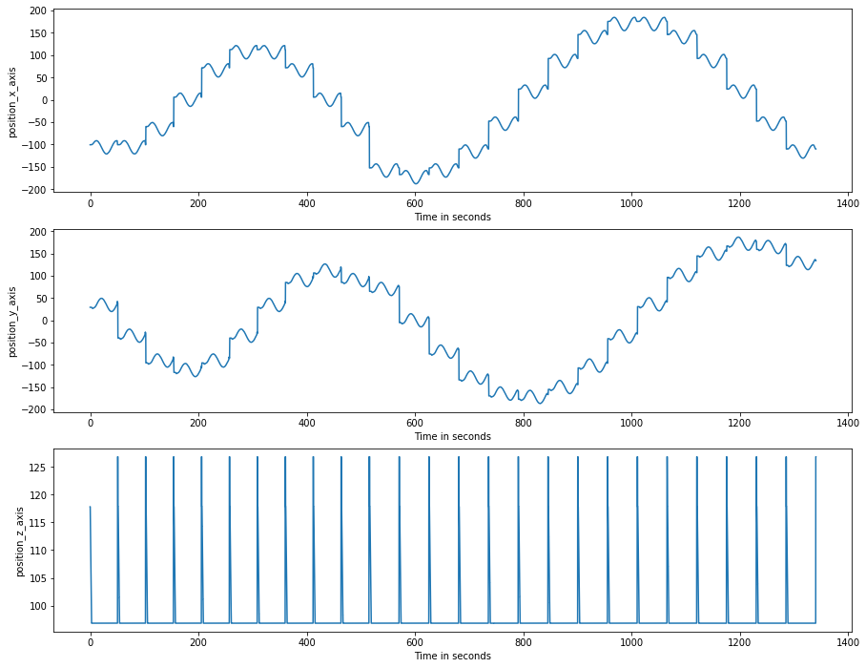
Lageistwert (Position)

Slide 4
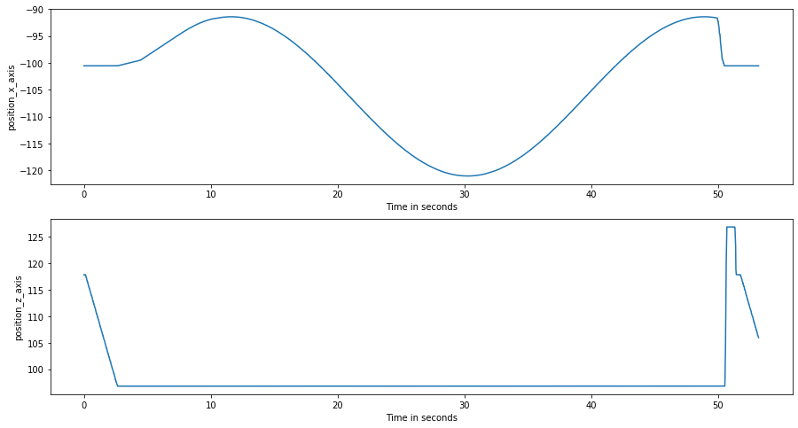
Cutting time for 1 hole

Slide 5
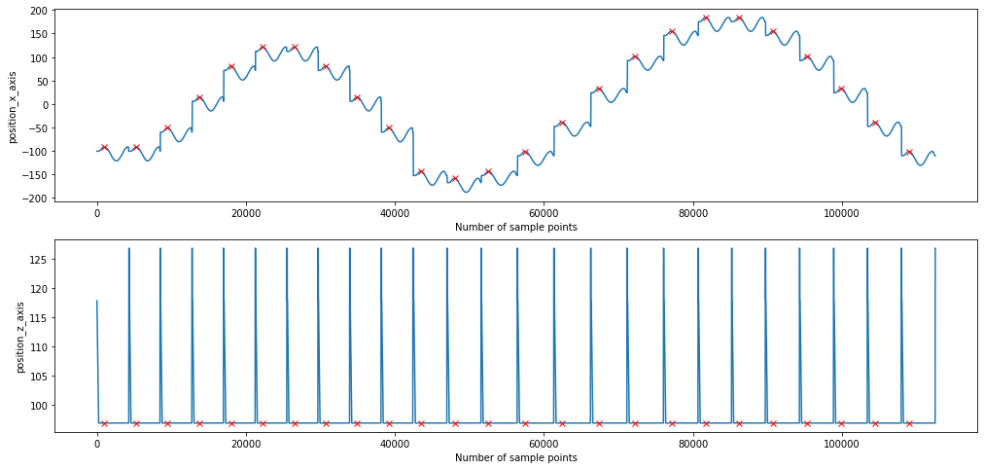
Peak points
find_peaks()
Distance

Slide 6
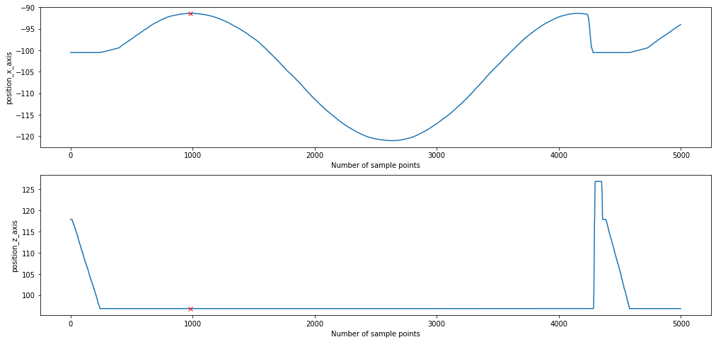
Peak points: Zoomed

Slide 7
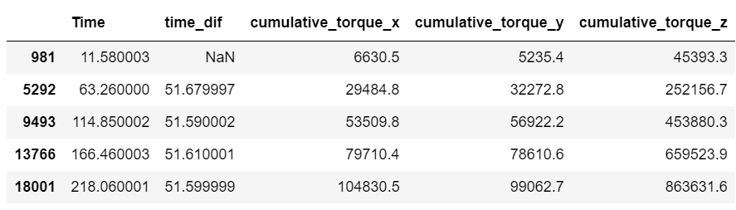
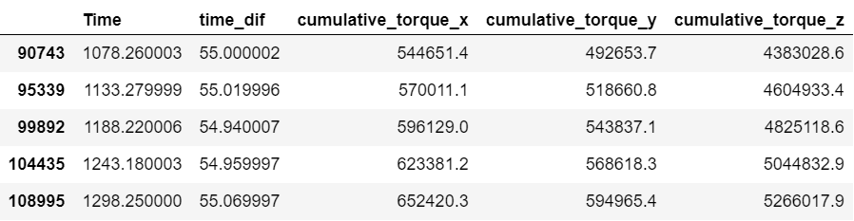
Sampled dataframe
Total 25 Data points (Each per hole)
Time between 2 peaks of pos_x = Cutting time + Time required for tool to shift to the next hole

Slide 8
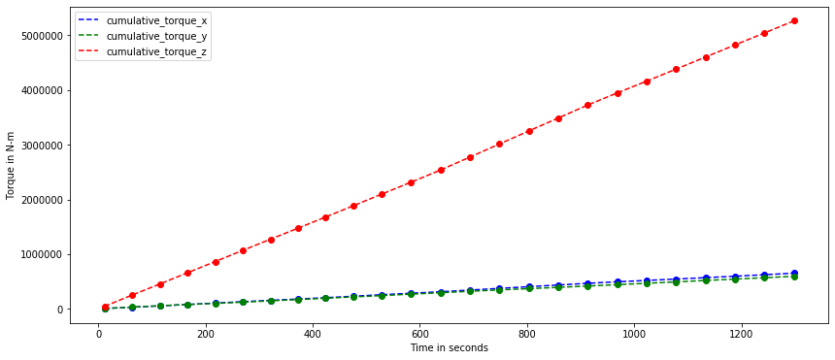
Cumulative Torques
Slope_z : 4084
Slope_x : 509
Slope_y : 456

