Slide 1
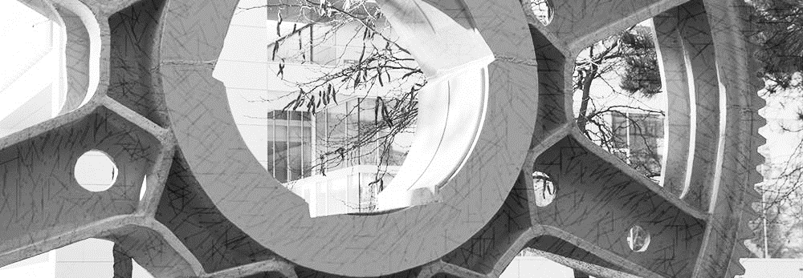
Work Updates: Extraction of cutting times
Darmstadt | 17. March 2022

Slide 2
Agenda
1
Lageistwert

Slide 3
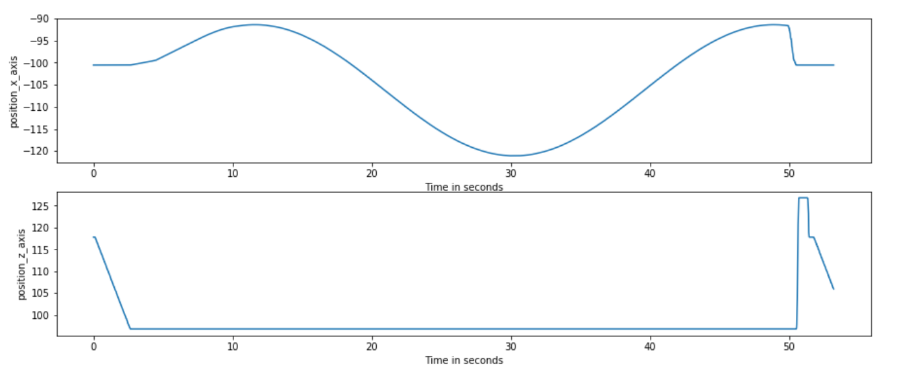
Lageistwert (Position)

Slide 4
Lageistwert (Position)
Looks straight line…But, “Not” really

Slide 5
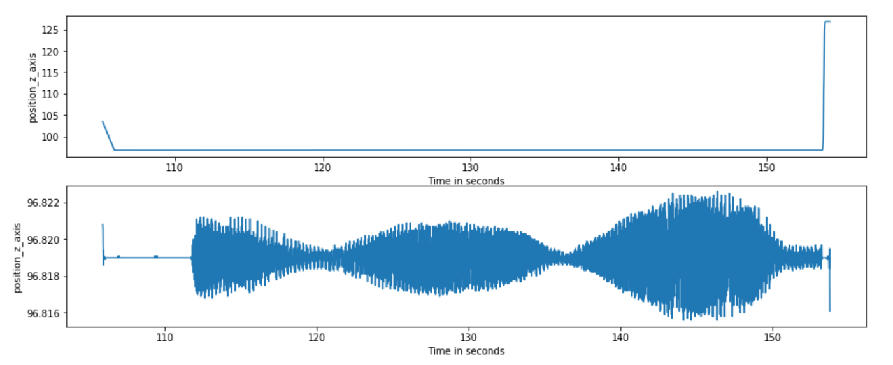
Position_Z: Zoomed profile

Slide 6
Position_Z: Zoomed profile
Error: So many peaks!

Slide 7
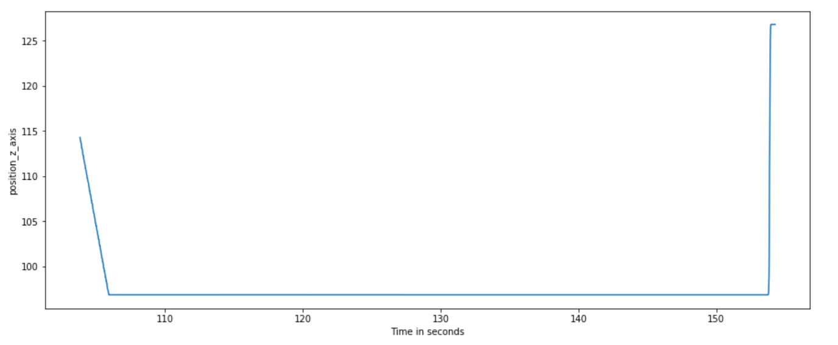
Algorithm:
Start sample point
End sample point
1
2
Set the baseline ---> Curently: 96 (whole number part, leaving decimal part)
Capture transitions from baseline level

Slide 8
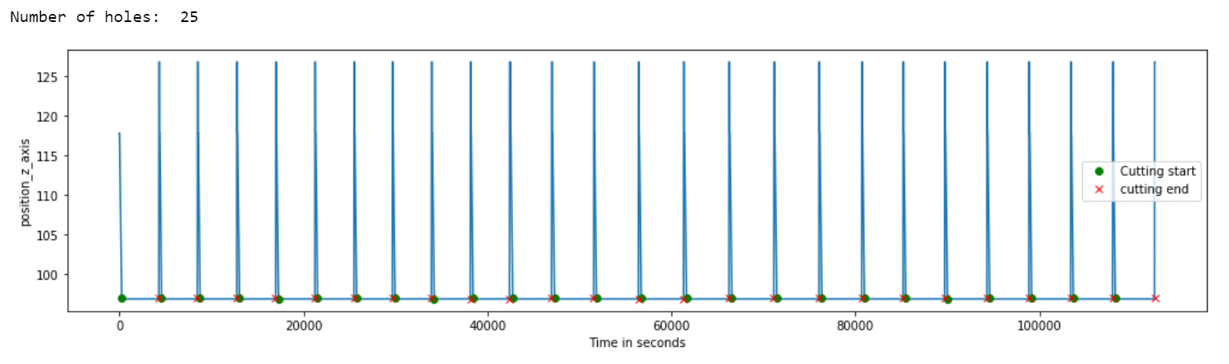
Results:

Slide 9
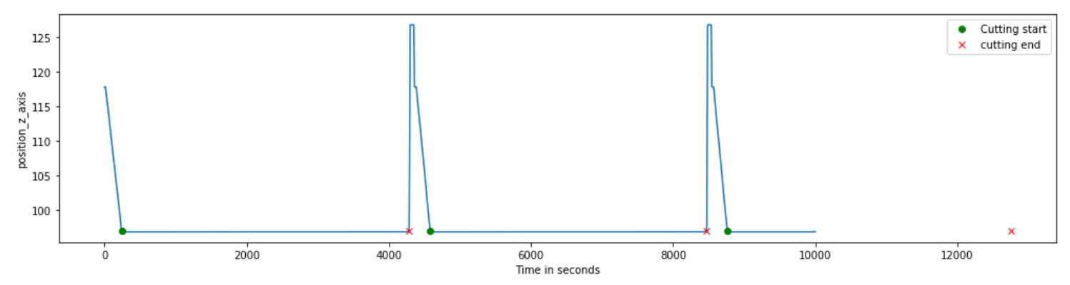
Results:

Slide 10
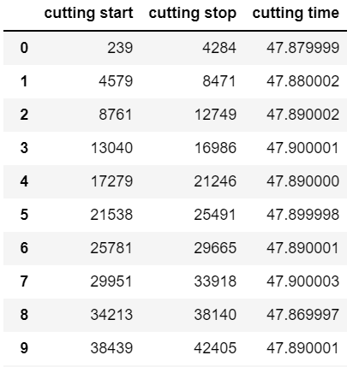
Result: Cutting points

Slide 11
Next:
End sample point
End sample point
1
2
Automatic Baseline Selection

