Slide 1
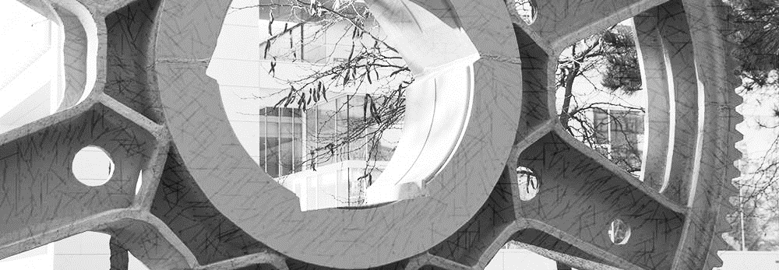
Work Updates: Protocol trends
Darmstadt | 05. may 2022

Slide 2
Agenda
1
Primary trends of protocols

Slide 3
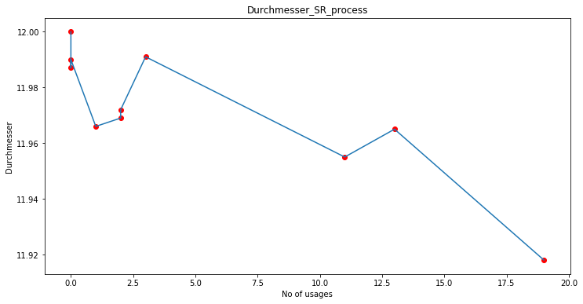
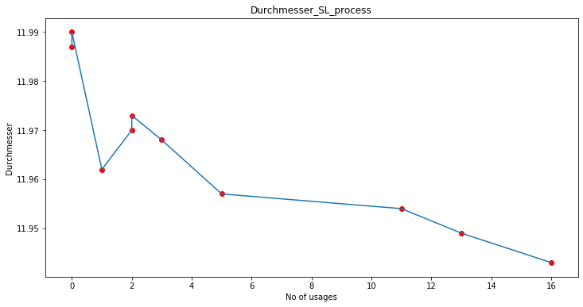
Durchmesser
Clear Downward trend

Slide 4
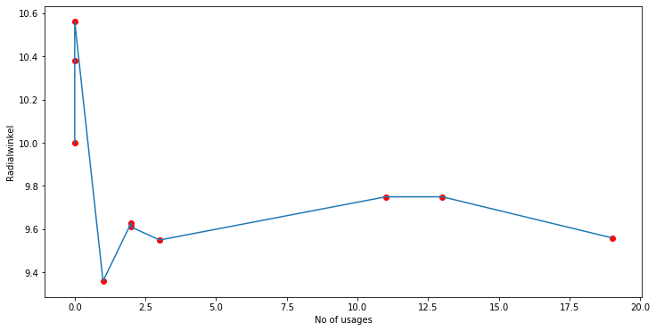
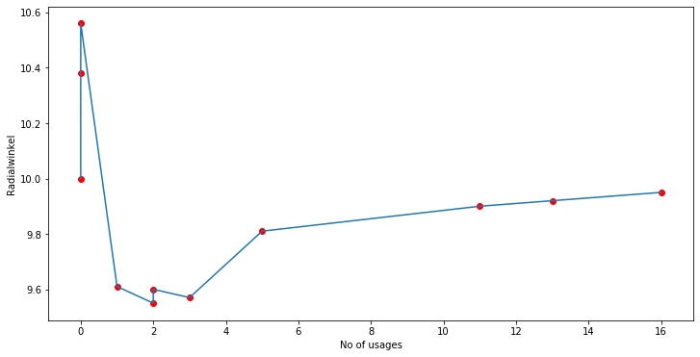
Radialwinkel
Radialwinkel SR
Radialwinkel SL

Slide 5
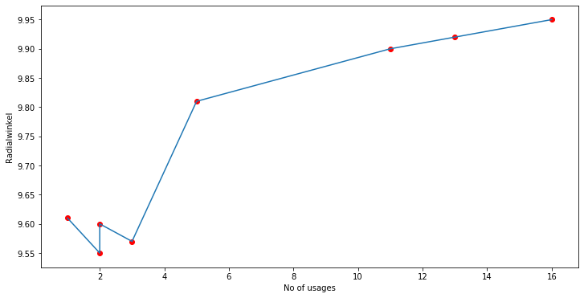
Radialwinkel
Radialwinkel SL
Upward trend

Slide 6
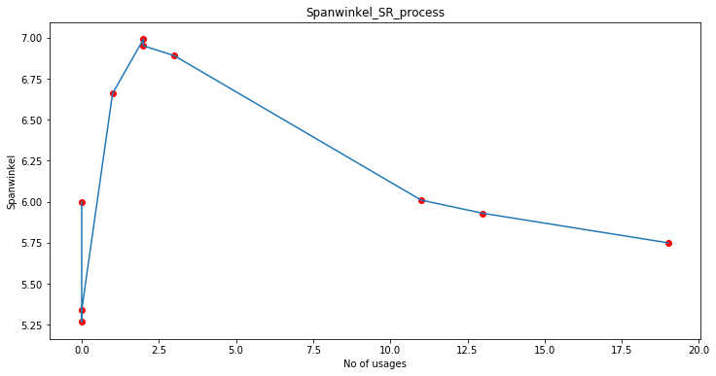
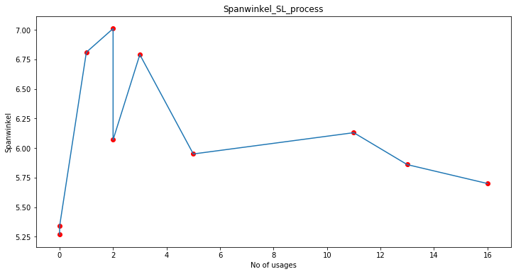
Spanwinkel
Clear Downward trend

Slide 7
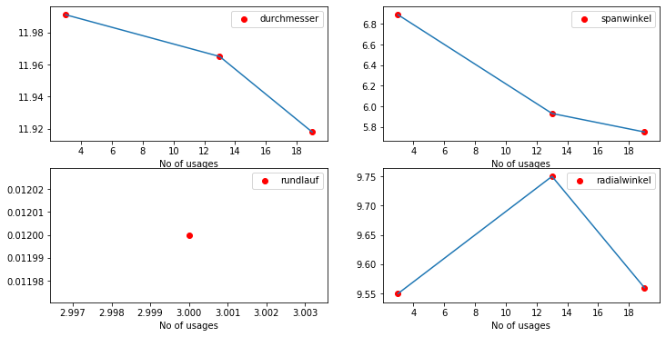
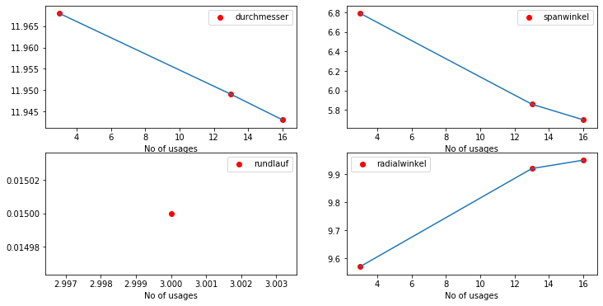
Single tool analysis: TOOL 3
SR process
SL process

Slide 8
Trends
PROTOCOL | TREND
Durchmesser | Decreasing
Spanwinkel | Decreasing
Radialwinkel | Increasing
Abstand | Equal value (Currently less data points)
Rundlauf | Not available in new protocol
Schneidkantenradius | Not available in old protocol

