Slide 1
UNSURE Workshop
UNcertainty for Safe Utilization of machine leaRning in mEdical imaging
Tal Arbel, Christian Baumgartner, Adrian Dalca, Carole Sudre, Ryutaro Tanno, Sandy Wells

Slide 2
Rationale and organisation
Rationale / Objective
Started at MICCAI 2018
Bringing the community together around the theme of uncertainty
Essential for clinical translation / assessment of safety
Not directed towards MIC or CAI but spanning both
Organisation
6 organisers, 4 countries
15 final submissions – 21 reviewers – 3 reviewers per paper – 2 metareviewers
8 paper finally selected – 3 long orals – 5 spotlight talks
2 keynotes
Long orals: 15’ + 5’ questions – Spotlights: 5’ without questions

Slide 3
Program for the day / Practical organisation
12.30 - 12.35 Welcoming words
12.35 - 13.10 Keynote 1 - Koen van Leemput - Input and output uncertainty in medical image analysis
13.10 – 2.00 Oral session 1
13.10 - 13.30 Long Oral 1 “Propagating Uncertainty Across Cascaded Medical Imaging Tasks for Improved Deep learning Inference” Raghav Mehta, Thomas D Christinck, Tanya Nair, Paul Lemaitre, Douglas Arnold, Tal Arbel
13.30 - 13.35 Spotlight 1 “Probabilistic Surface reconstruction with unknown Correspondence” Dennis Madsen, Thomas Vetter, Marcel Luthi
13.35 - 13.40 Spotlight 2 “Probabilistic Image Registration via Deep Multi=class Classification Characterizing uncertainty” Alireza Sedghi, Jie Luo, Tina Kapur, Parvin Mousavi, William M Wells
13.40 - 13.45 Spotlight 3 “Reg R-CNN: Lesion Detection and Grading under Noisy Labels” Gregor N Ramien, Paul Jäger, Simon A Kohl, Klaus H. Maier-Hein – presented by David Zimmerer
13.45 - 13.50 Spotlight 4 “Quantifying Uncertainty of deep neural networks in skin lesion classification” Pieter Van Molle
13.50 - 13.55 Spotlight 5 “A Generalized Approach to Determine Confident Samples for Deep Neural Network on Unseen data” Min Zhang, Kevin Leung, Zili Ma, Wen Jin, Avinash Gopal
14.00 - 15.00 Poster session - coffee break – Room Espana
15.00 - 15.35 Keynote 2 - Yinzheng Li
15.35 – 16.15 Oral session 2
15.35 - 15.55 Long Oral 2 “Fast Nonparametric Mutual-Information based registration and uncertainty estimation” Mikael Agn, Koen Van Leemput
15.55 - 16.15 Long Oral 3 “Out of distribution detection for intra operative functional imaging” Tim Adler, Leonardo Ayala, Lynton Ardizzone, Hannes Kenngott, Anant Vemuri, Beat Muller-Stich, Carsten Rother, Ullrich Köthe, Lena Mair-Hein
16.15 - 16.30 Concluding remarks – Best paper award

Slide 4
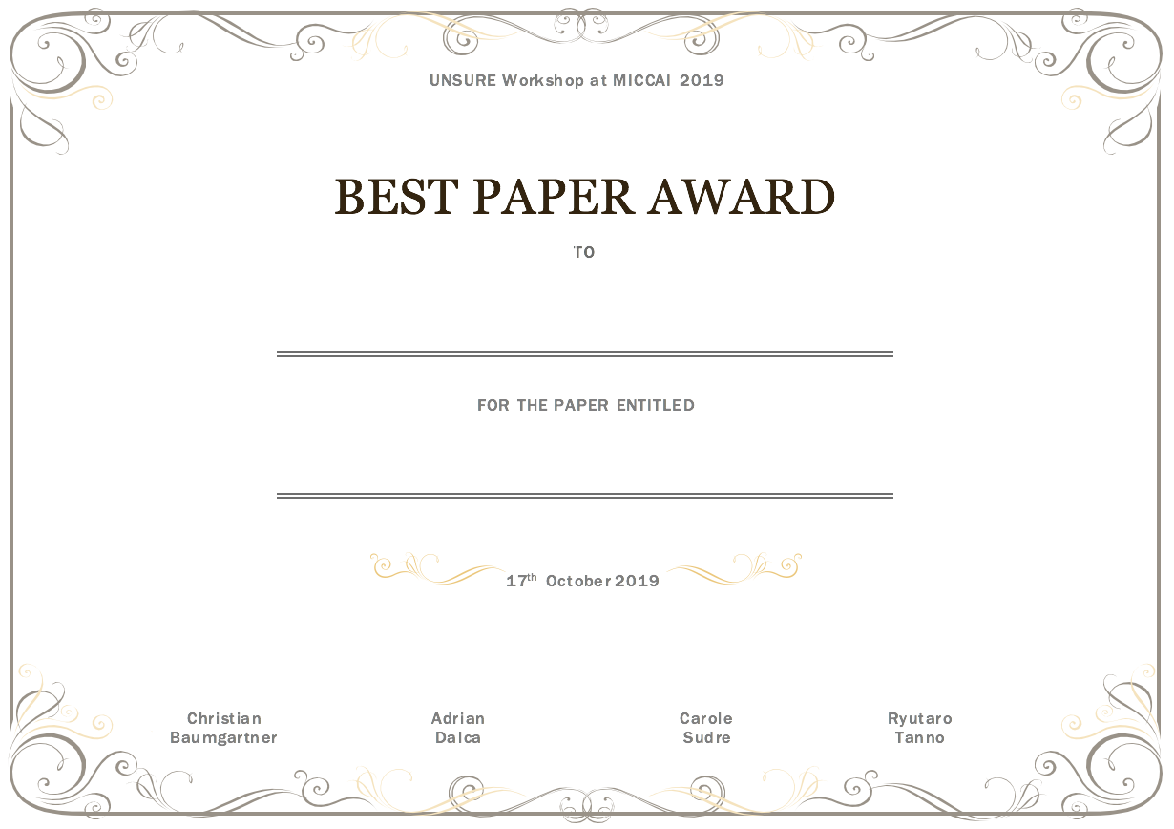
Best paper award

