Slide 1
Fast Nonparametric Mutual-Information-based Registration & Uncertainty Estimation
Mikael Agn and Koen Van Leemput
DTU Health Tech, Denmark Martinos Center, MGH, USA

Slide 2
Similarity metrics: MI vs. SSD
Sum of squared differences (SSD)
For uni-modal images.
Associated probabilistic model.
Fast, dedicated optimization algorithm – Demons.
Mutual Information (MI)
For multi-modal images.
No associated probabilistic model.
General-purpose optimization algorithms.

Slide 3
Contributions
MI computation with partial volume interpolation can be re-cast as a generative probabilistic model.
Using model structure to derive:
Expectation-Maximization optimization algorithm similar to Demons.
Gibbs sampler for uncertainty estimation.

Slide 4
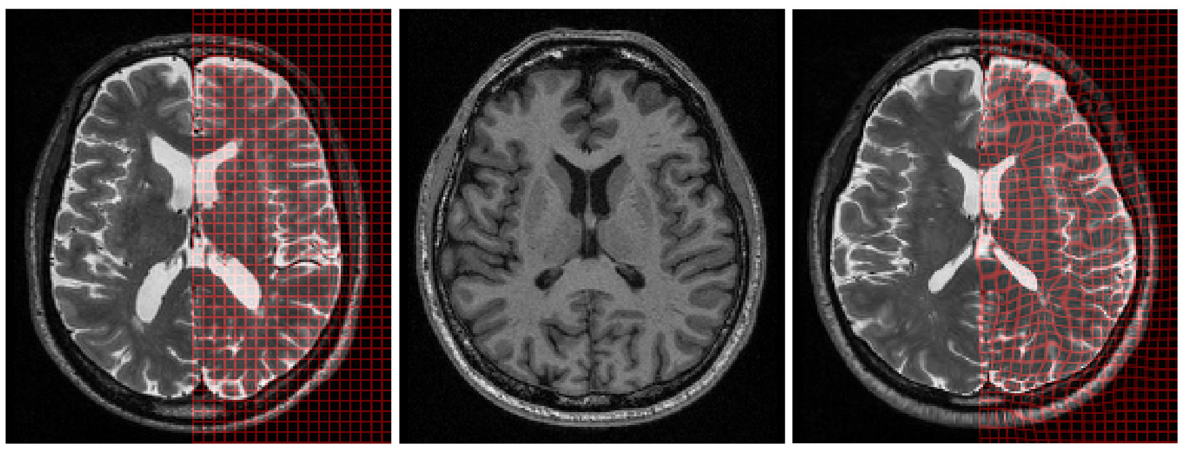
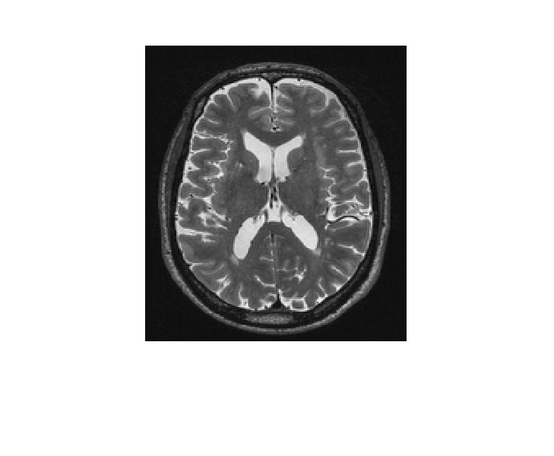


Problem statement
$$u$$
$$v$$
Register image u with image v.
Different contrast properties.
Notes:
Change this, make a general introduction stating the goal, discretization and present posterior of parameters and such. Then this slide or maybe together. Label images and discretizise them in 4 in the same color to make the point

Slide 5
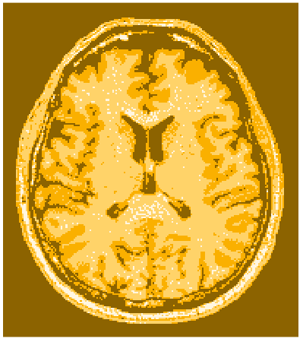



Problem statement
$$u$$
$$v$$
Register image u with image v.
Different contrast properties.
Discretize u into L levels and v into K levels .
$$v$$
$$u$$
Notes:
Change this, make a general introduction stating the goal, discretization and present posterior of parameters and such. Then this slide or maybe together. Label images and discretizise them in 4 in the same color to make the point

Slide 6


Generative model
Model to generate u from v – through latent variables n.
To register u with v, fit model parameters to data :
$$p\left(d,θ | u\right)∝p\left(u | θ,d\right)p\left(d\right)p(θ)$$
$$v$$
$$u$$

Slide 7


Deformation field
A deformation field d is added.
A deformation prior to encourage smoothness:
$$v$$
$$p\left(d\right)=exp⁡\left(− \frac{γ}{2}{\left\|Γd\right\|}^{2}\right)$$
$$d$$
$$u$$
Notes:
Only d, nothing about x

Slide 8

Generate latent variables n
$$v$$
$$d_{i}$$
$$u$$

Slide 9
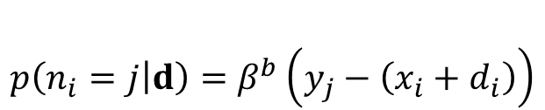

Generate latent variables n
$$p\left(n_{i}=j | d\right)=β^{b}\left(y_{j}−\left(x_{i}+d_{i}\right)\right)$$
B-spline centered at each deformed point.
$$p\left(n | d\right)= \prod_{i=1}^{I}{p\left(n_{i} | d\right)}$$
$$v$$
$$d_{i}$$
$$u$$

Slide 10

Generate latent variables n
$$p\left(n_{i}=j | d\right)=β^{b}\left(y_{j}−\left(x_{i}+d_{i}\right)\right)$$
B-spline centered at each deformed point.
$$p\left(n | d\right)= \prod_{i=1}^{I}{p\left(n_{i} | d\right)}$$
$$v$$
$$d_{i}$$
$$n_{i}$$
$$u$$

Slide 11

Generate latent variables n
B-spline centered at each deformed point.
$$p\left(n | d\right)= \prod_{i=1}^{I}{p\left(n_{i} | d\right)}$$
$$v$$
$$n$$
$$u$$

Slide 12
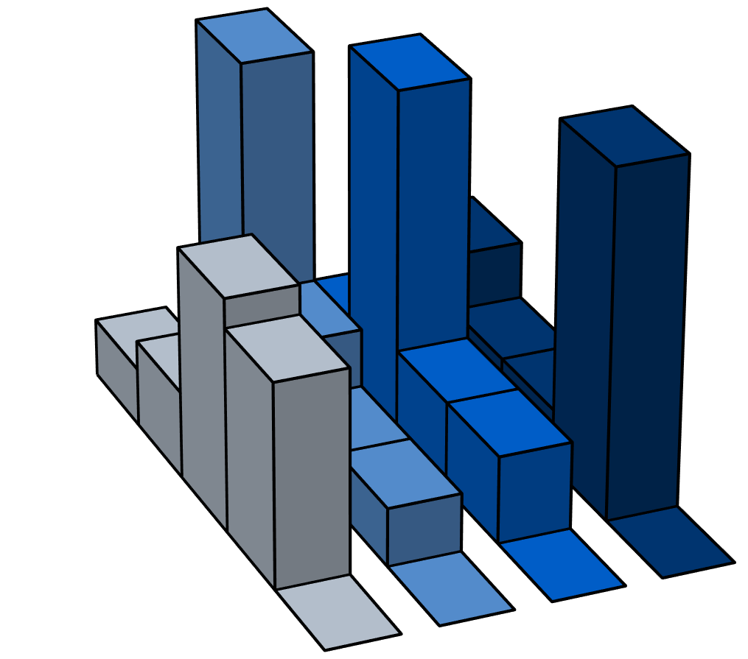

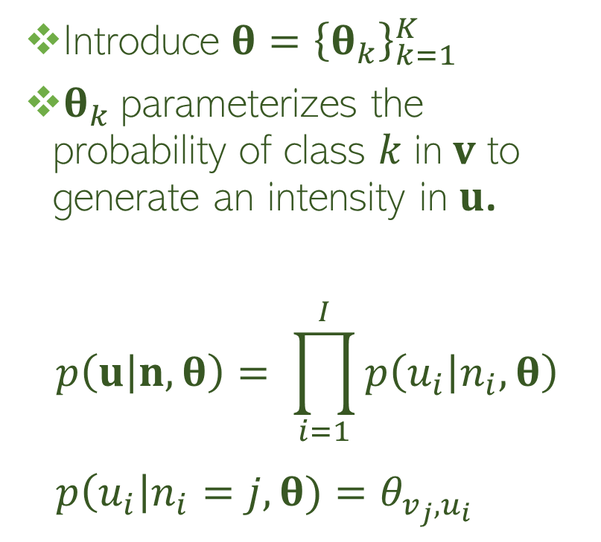
Generate u through n
$$θ$$
Introduce $θ={\left\{θ_{k}\right\}}_{k=1}^{K}$
$θ_{k}$ parameterizes the probability of class $k$ in $v$ to generate an intensity in $u$.
$$p\left(u | n,θ\right)= \prod_{i=1}^{I}{p\left(u_{i} | n_{i},θ\right)} \\ p\left(u_{i}\right|n_{i}=j, θ)=θ_{v_{j},u_{i}}$$
$$v$$
$$n$$
$$u$$

Slide 13

Generate u through n
$$θ$$
Introduce $θ={\left\{θ_{k}\right\}}_{k=1}^{K}$
$θ_{k}$ parameterizes the probability of class $k$ in $v$ to generate an intensity in $u$.
$$p\left(u | n,θ\right)= \prod_{i=1}^{I}{p\left(u_{i} | n_{i},θ\right)} \\ p\left(u_{i}\right|n_{i}=j, θ)=θ_{v_{j},u_{i}}$$
$$v$$
$$n$$
$$u$$

Slide 14
Generate u through n
$$θ$$
Introduce $θ={\left\{θ_{k}\right\}}_{k=1}^{K}$
$θ_{k}$ parameterizes the probability of class $k$ in $v$ to generate an intensity in $u$.
$$p\left(u | n,θ\right)= \prod_{i=1}^{I}{p\left(u_{i} | n_{i},θ\right)} \\ p\left(u_{i}\right|n_{i}=j, θ)=θ_{v_{j},u_{i}}$$
$$v$$
$$n$$
$$u$$

Slide 15
Generate u through n
$$θ$$
Introduce $θ={\left\{θ_{k}\right\}}_{k=1}^{K}$
$θ_{k}$ parameterizes the probability of class $k$ in $v$ to generate an intensity in $u$.
$$p\left(u | n,θ\right)= \prod_{i=1}^{I}{p\left(u_{i} | n_{i},θ\right)} \\ p\left(u_{i}\right|n_{i}=j, θ)=θ_{v_{j},u_{i}}$$
$$v$$
$$n$$
$$u$$

Slide 16

Generate u through n
$$p\left(θ\right)= \prod_{k=1}^{K}{Dir\left(θ_{k} | α_{0}\right)}$$
$$θ$$
Introduce $θ={\left\{θ_{k}\right\}}_{k=1}^{K}$
$θ_{k}$ parameterizes the probability of class $k$ in $v$ to generate an intensity in $u$.
$$p\left(u | n,θ\right)= \prod_{i=1}^{I}{p\left(u_{i} | n_{i},θ\right)} \\ p\left(u_{i}\right|n_{i}=j, θ)=θ_{v_{j},u_{i}}$$
$$v$$
$$n$$
$$u$$

Slide 17
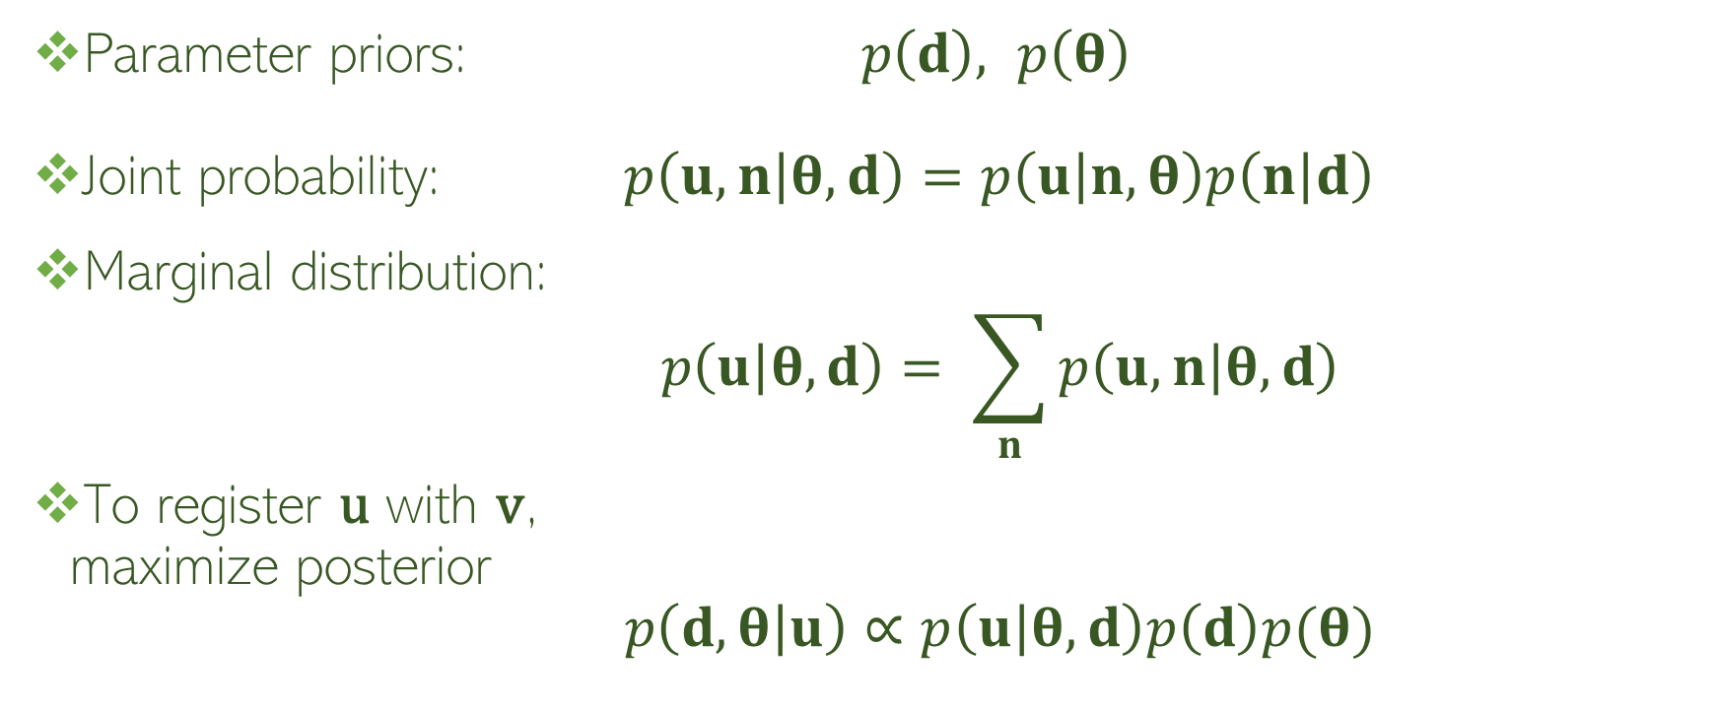
Summary of generative model
Parameter priors: $p\left(d\right),$ $p\left(θ\right)$
Joint probability: $p\left(u,n | θ,d\right)=p\left(u | n,θ\right)p\left(n | d\right)$
Marginal distribution: $p\left(u | θ,d\right)= \sum_{n}{p\left(u,n | θ,d\right)}$
To register u with v, maximize posterior $p\left(d,θ | u\right)∝p\left(u | θ,d\right)p\left(d\right)p(θ)$
Notes:
Summary of what we’ve said so far, then about optimization. Proportional

Slide 18

Summary of generative model
Parameter priors: $p\left(d\right),$ $p\left(θ\right)$
Joint probability: $p\left(u,n | θ,d\right)=p\left(u | n,θ\right)p\left(n | d\right)$
Marginal distribution: $p\left(u | θ,d\right)= \sum_{n}{p\left(u,n | θ,d\right)}$
To register u with v, maximize posterior $p\left(d,θ | u\right)∝p\left(u | θ,d\right)p\left(d\right)p(θ)$
Notes:
Summary of what we’ve said so far, then about optimization. Proportional

Slide 19

Summary of generative model
Parameter priors: $p\left(d\right),$ $p\left(θ\right)$
Joint probability: $p\left(u,n | θ,d\right)=p\left(u | n,θ\right)p\left(n | d\right)$
Marginal distribution: $p\left(u | θ,d\right)= \sum_{n}{p\left(u,n | θ,d\right)}$
To register u with v, maximize posterior $p\left(d,θ | u\right)∝p\left(u | θ,d\right)p\left(d\right)p(θ)$
Notes:
Summary of what we’ve said so far, then about optimization. Proportional

Slide 20
Summary of generative model
Parameter priors: $p\left(d\right),$ $p\left(θ\right)$
Joint probability: $p\left(u,n | θ,d\right)=p\left(u | n,θ\right)p\left(n | d\right)$
Marginal distribution: $p\left(u | θ,d\right)= \sum_{n}{p\left(u,n | θ,d\right)}$
To register u with v, maximize posterior $p\left(d,θ | u\right)∝p\left(u | θ,d\right)p\left(d\right)p(θ)$
Notes:
Summary of what we’ve said so far, then about optimization. Proportional

Slide 21
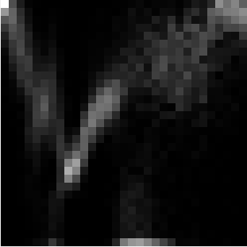



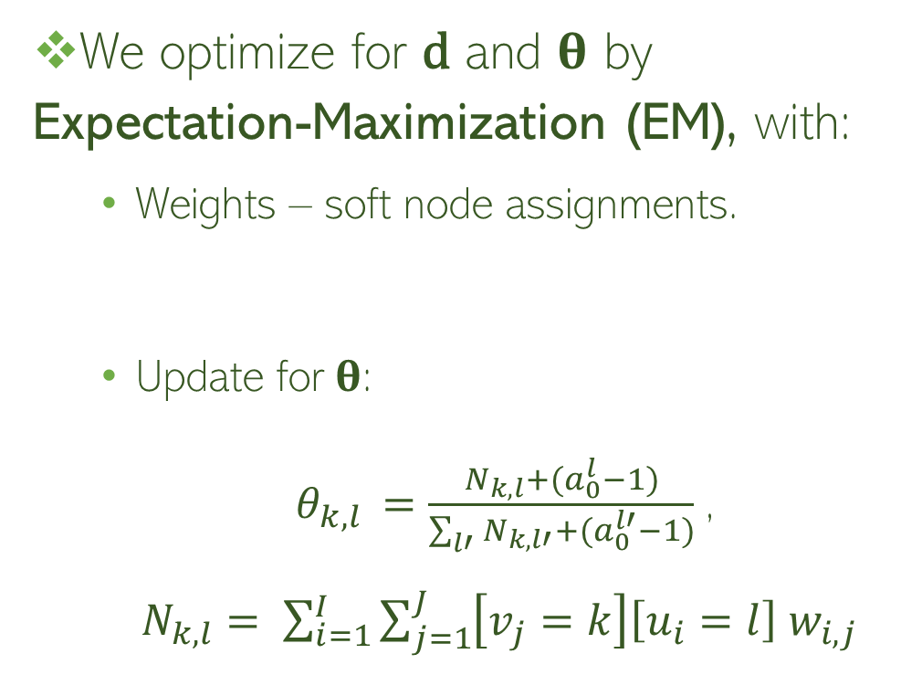

Optimization
$$v$$
We optimize for d and $θ$ by
Expectation-Maximization (EM), with:
Weights – soft node assignments.
Update for$θ$:
$θ_{k,l }=\frac{N_{k,l}+(a_{0}^{l}−1)}{\sum_{l′}{N_{k,l′}+(a_{0}^{l′}−1)}}$, $N_{k,l}= \sum_{i=1}^{I}{\sum_{j=1}^{J}{\left[v_{j}=k\right]\left[u_{i}=l\right]{ w}_{i,j} }}$
$$w_{i,j}= p\left(n_{i}=j | d,θ\right)$$
$$u$$
$$θ$$
u
v
Notes:
Remove all equations and show them instead in image.

Slide 22
Optimization
Approximate B-splines with Gaussians
→ update for d in closed form.
Notes:
One slides missing, summarizing EM. Also: show what delta is and just say that S is a smoother matrix and show how it smooths the image. Say somewhere that it is FFT, so I don’t forget to mention it

Slide 23




Optimization
Approximate B-splines with Gaussians
→ update for d in closed form.
FFT
$$δ_{i}=\sum_{j}{w_{i,j}y_{j}}−x_{i}$$
1
2
$$d=Sδ$$
$$δ$$
$$d$$
Notes:
One slides missing, summarizing EM. Also: show what delta is and just say that S is a smoother matrix and show how it smooths the image. Say somewhere that it is FFT, so I don’t forget to mention it

Slide 24
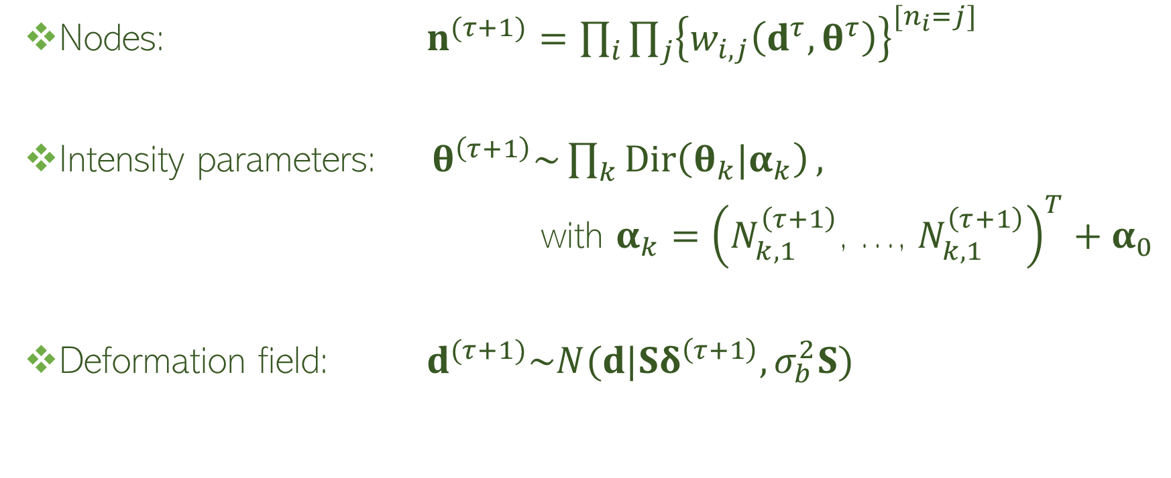
Gibbs sampler
Nodes: $n^{(τ+1)}=\prod_{i}{\prod_{j}{{\left\{w_{i,j}\left(d^{τ},θ^{τ}\right)\right\}}^{[n_{i}=j]}}}$
Intensity parameters: $θ^{\left(τ+1\right)}\sim \prod_{k}{Dir\left(θ_{k}|α_{k}\right)},$
with $α_{k}={\left(N_{k,1 }^{\left(τ+1\right)}\text{, }\text{…}\text{, }N_{k,1 }^{\left(τ+1\right)}\right)}^{T}+α_{0}$
Deformation field: $d^{(τ+1)}\sim N(d|Sδ^{\left(τ+1\right)},σ_{b}^{2}S)$
FFT
Notes:
Also show FFT here.

Slide 25
Equivalence to MI
Translation experiment using 32 intensity levels per image.

Slide 26
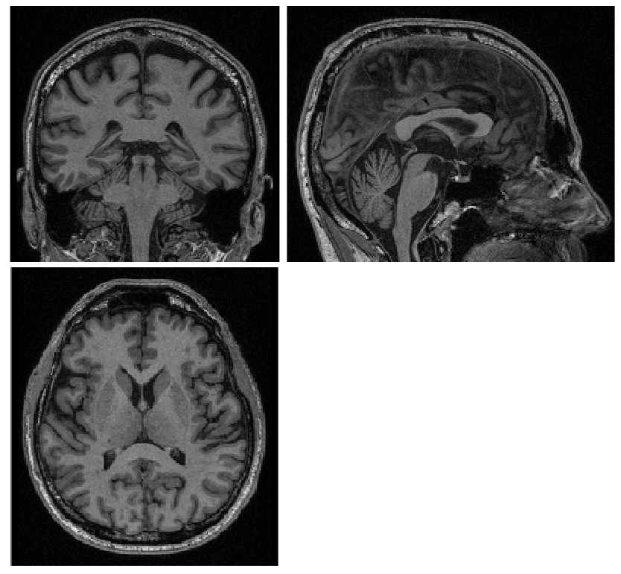
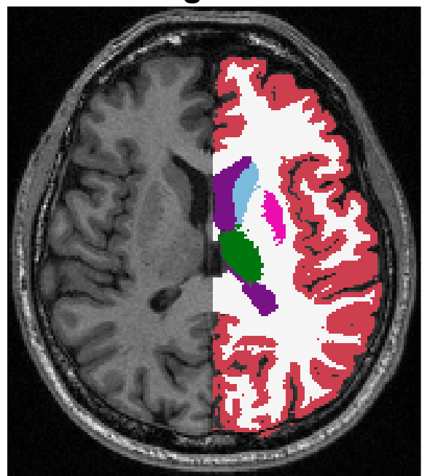
Optimization experiment
6 subjects registered to 10 subjects (60 pairs).
Varying flexibility (highest: 2.4 millions effective DoF).
4 resolution levels with 100 iterations in each.
v
u
deformed v
segmentations
Notes:
Present complete optimization experiment here. Say that we use dice score to measure accuracy, and point to the labels.

Slide 27
Results – comparing to Elastix (FFD, MI)
MRI T1 to T2.
Varying model flexibility and number of iterations.
Dice scores for 10 largest structures.
Notes:
Remove last plot

Slide 28
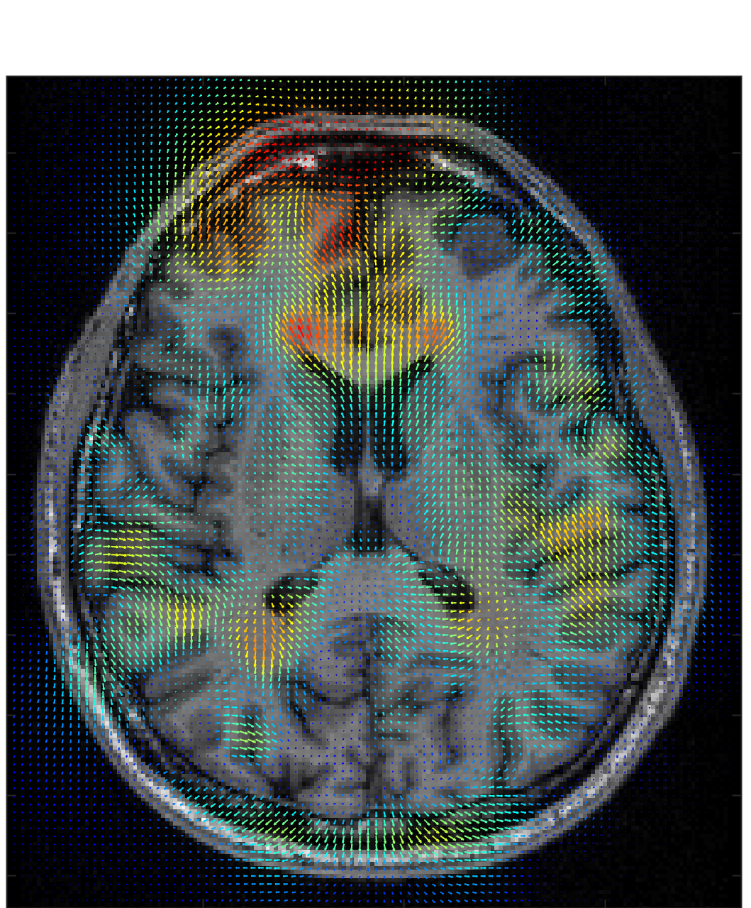
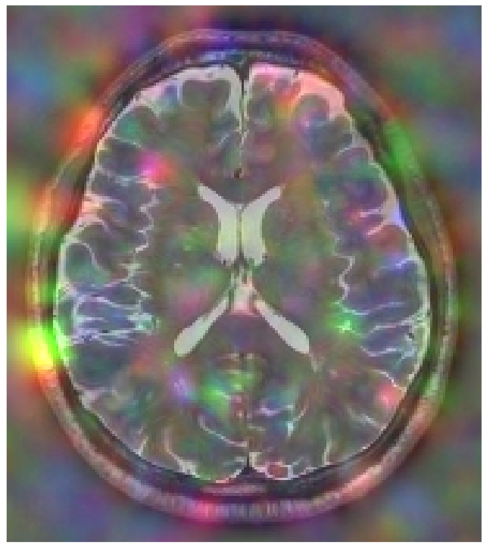

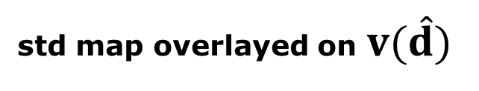
Sampler ̶ uncertainty estimation
v
20 000 samples starting at estimated mode $\hat{d}$.
std map overlayed on $v(\hat{d}$)
u
$$v(d^{\left(τ\right)})$$
Notes:
Show deformations, how would this look?

Slide 29
Sampler ̶ uncertainty estimation
v
20 000 samples starting at estimated mode $\hat{d}$.
std map overlayed on $v(\hat{d}$)
u
$$v(d^{\left(τ\right)})$$
Notes:
Show deformations, how would this look?

Slide 30
Sampler ̶ uncertainty estimation
v
20 000 samples starting at estimated mode $\hat{d}$.
std map overlayed on $v(\hat{d}$)
u
$$v(d^{\left(τ\right)})$$
Notes:
Show deformations, how would this look?

Slide 31

Sampler ̶ uncertainty estimation
v
20 000 samples starting at estimated mode $\hat{d}$.
std map overlayed on $v(\hat{d}$)
u
$$v(d^{\left(τ\right)})$$
$$d^{(τ)}$$
Notes:
Show deformations, how would this look?

Slide 32
Results – comparing to Demons (SSD)
Same experiments, but T1 to T1.
Highest model flexibility and number of iterations.
Notes:
Have this here but just mention it really fast and that we don’t have time.

Slide 33
Summary and future work
Fast, dedicated optimizer for MI.
Alternative to Demons.
Gibbs sampler enables uncertainty estimation for MI.
Future work:
Diffeomorphic registration.
Notes:
Can serve as an alternative to Demons in SSD

