Slide 1
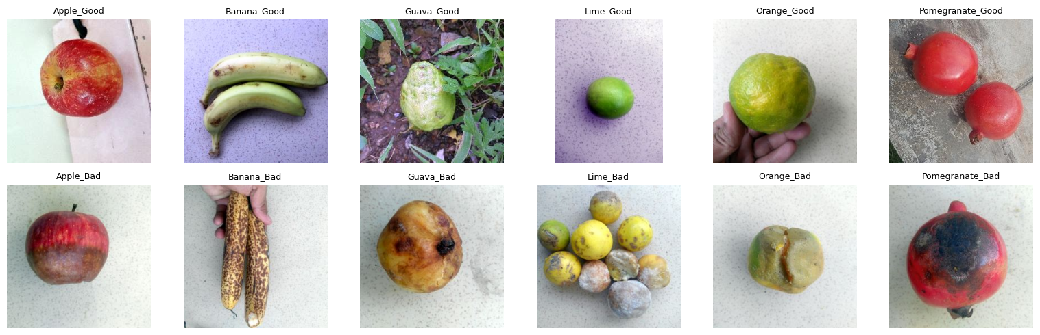
Leakage-aware fruit quality inspection
FreshGuard
A computer vision pipeline for Good/Bad fruit inspection, with honest evaluation against near-duplicate train/test leakage.
Abrar Mustafa
Student ID: 925259
Intelligent Monitoring and Control Systems
1/16

Slide 2
FRESHGUARD IMCS
Abrar Mustafa | Student ID: 925259
The Project Story
Problem
Risk
Response
Fruit quality inspection needs a reliable way to separate Good fruit from Bad fruit before shipping.
If near-duplicate fruit images appear in both train and test, evaluation can look excellent while hiding memorization.
FreshGuard audits leakage with perceptual hashing, then evaluates models on a clean group-aware split.
2/16

Slide 3
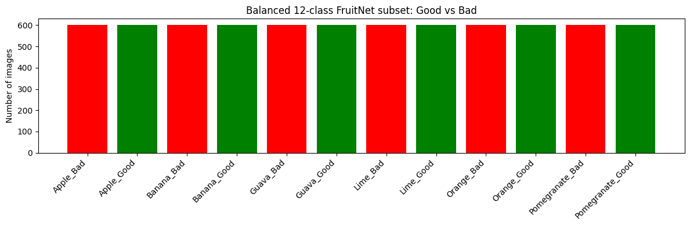
FRESHGUARD IMCS
Abrar Mustafa | Student ID: 925259
Dataset and Scope
7,200
total images
12
classes: 6 fruits x Good/Bad
Each class was capped at 600 images to keep training balanced and manageable. Mixed-quality labels were excluded because they add ambiguity.
3/16

Slide 4
FRESHGUARD IMCS
Abrar Mustafa | Student ID: 925259
Visual Sanity Check
Before training, it checks that labels are readable: Good and Bad examples are visibly different across all six fruit types.
4/16

Slide 5
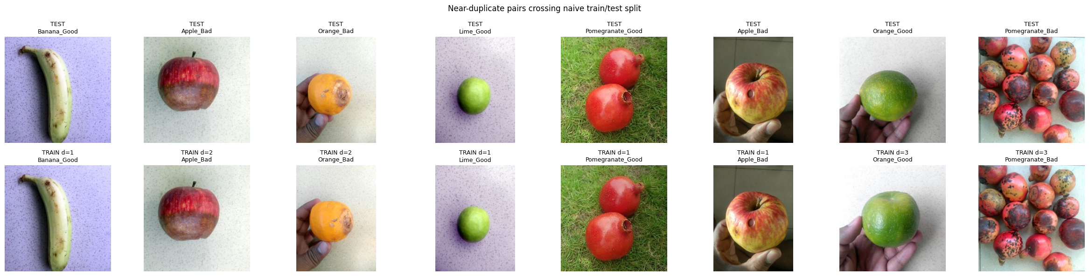
FRESHGUARD IMCS
Abrar Mustafa | Student ID: 925259
Why Naive Accuracy Can Be Misleading
57.31%
naive test images with near-duplicate leakage
619/1080
leaked test images in naive split
The model may see almost the same physical fruit during training and testing. That makes performance look stronger than real-world generalization.
5/16

Slide 6
FRESHGUARD IMCS
Abrar Mustafa | Student ID: 925259
Leakage-Aware Split
1
2
3
4
Hash
Group
Split
Re-audit
Compute 64-bit perceptual dHash for every image.
Connect near-duplicates using Hamming distance <= 5.
Assign whole groups to train, validation, or test.
Confirm no near-duplicate leakage remains.
0.00%
1,083
3,472
leakage after group-aware split
clean held-out test images
near-duplicate groups found
6/16

Slide 7
FRESHGUARD IMCS
Abrar Mustafa | Student ID: 925259
End-to-End Pipeline
Collect
Clean
Balance
1
2
3
Download FruitNet and store the raw dataset in Google Drive.
Keep Good/Bad fruit folders, remove ambiguous Mixed labels.
Create 12 ImageFolder classes with 600 images per class.
Audit
Train
Explain
4
5
6
Detect near-duplicates before trusting model scores.
Fine-tune ResNet-18 and ViT-Base on the clean split.
Use Grad-CAM and LIME to check visual reasoning.
This is the main project logic: data quality first, model training second, trust and deployment evidence last.
7/16

Slide 8
FRESHGUARD IMCS
Abrar Mustafa | Student ID: 925259
Dataset Preparation Details
Folder standardization
It converts the original FruitNet folders into a simple ImageFolder layout such as Apple_Bad, Apple_Good, Banana_Bad, and Banana_Good.
Balanced sampling
Every class is capped at 600 images. This prevents one class from dominating training and makes model comparison fairer.
Prepared dataset: 12 classes x 600 images = 7,200 images.
Label discipline
Mixed-quality folders are excluded because ambiguous labels can confuse supervised learning and weaken evaluation.
8/16

Slide 9
FRESHGUARD IMCS
Abrar Mustafa | Student ID: 925259
Leakage Audit Mechanics
dHash fingerprint
Hamming distance
Why it matters
Each image is converted into a compact 64-bit perceptual hash. Visually similar images produce similar hash patterns.
It compares hashes and treats distance <= 5 as a near-duplicate signal.
A test image with a near-duplicate in training can reward memorization instead of generalization.
57.31%
417
0.00%
leakage in naive test split
largest near-duplicate group
leakage after clean split
9/16

Slide 10
FRESHGUARD IMCS
Abrar Mustafa | Student ID: 925259
Clean Split Strategy
Naive split
5,040 train | 1,080 val | 1,080 test
Class-balanced, but near-duplicate leakage remains.
Group-aware split
5,213 train | 904 val | 1,083 test
Near-duplicate groups stay together in one split.
Re-audit result
0 / 1,083 leaked test images
The final test set is a more honest generalization check.
This split is the core methodological choice in FreshGuard: it makes the test score harder to achieve, but more meaningful.
10/16

Slide 11
FRESHGUARD IMCS
Abrar Mustafa | Student ID: 925259
Modeling Pipeline
Preprocess
Train
Evaluate
Explain
ImageNet normalization, 224px input, augmentation for training.
Compare pretrained ResNet-18 and ViT-Base/16 on clean split.
Report multiclass accuracy, macro-F1, confusion matrices, and binary Good/Bad metrics.
Use Grad-CAM and LIME to check whether predictions focus on fruit defects.
Model sizes: ResNet-18 = 11.2M parameters; ViT-Base/16 = 85.8M parameters.
11/16

Slide 12
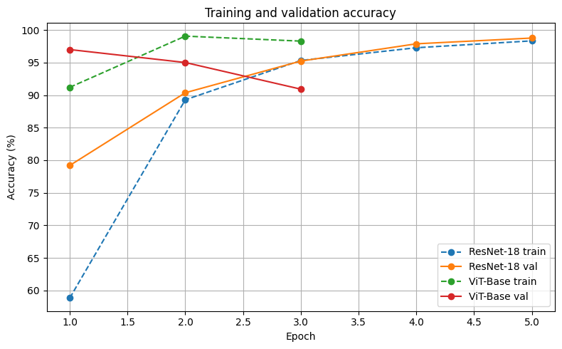
FRESHGUARD IMCS
Abrar Mustafa | Student ID: 925259
Training and Final Model Comparison
Clean Test Accuracy
ResNet-18
99.35%
ViT-Base
98.34%
Macro-F1
ResNet-18
99.30%
ViT-Base
98.01%
ResNet-18 performed slightly better while being much smaller, making it the stronger deployment candidate.
12/16

Slide 13
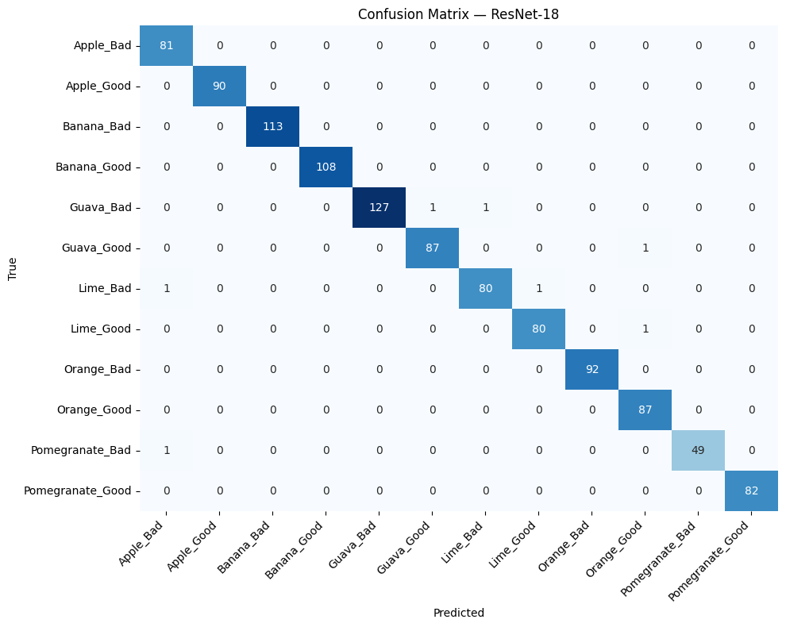
FRESHGUARD IMCS
Abrar Mustafa | Student ID: 925259
Confusion Matrix Evidence
What to look for
A strong confusion matrix is mostly diagonal. This means each fruit-quality class is usually predicted as itself.
ResNet-18 result
The ResNet matrix is almost fully diagonal on the clean test set, with only a small number of off-diagonal mistakes.
Why include it
Accuracy gives one number. The matrix shows which classes are still confused.
13/16

Slide 14
FRESHGUARD IMCS
Abrar Mustafa | Student ID: 925259
Production View: Good/Bad Monitoring
Why binary matters
False accept
False reject
For a production-line system, the key decision is often Accept or Reject, not just the exact fruit class.
Bad fruit predicted as Good. This is the highest-risk error because defective fruit may be shipped.
Good fruit predicted as Bad. This wastes usable fruit, but is usually less risky than false accept.
99.82%
0.37%
0.00%
ResNet-18 binary accuracy
ResNet-18 false accept
ResNet-18 false reject
14/16

Slide 15
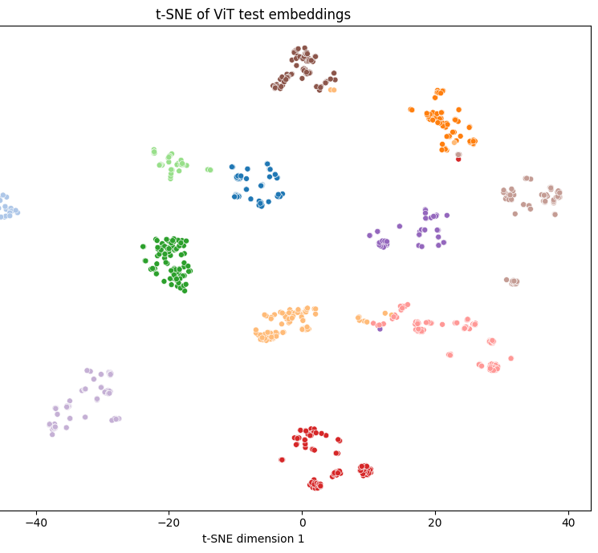
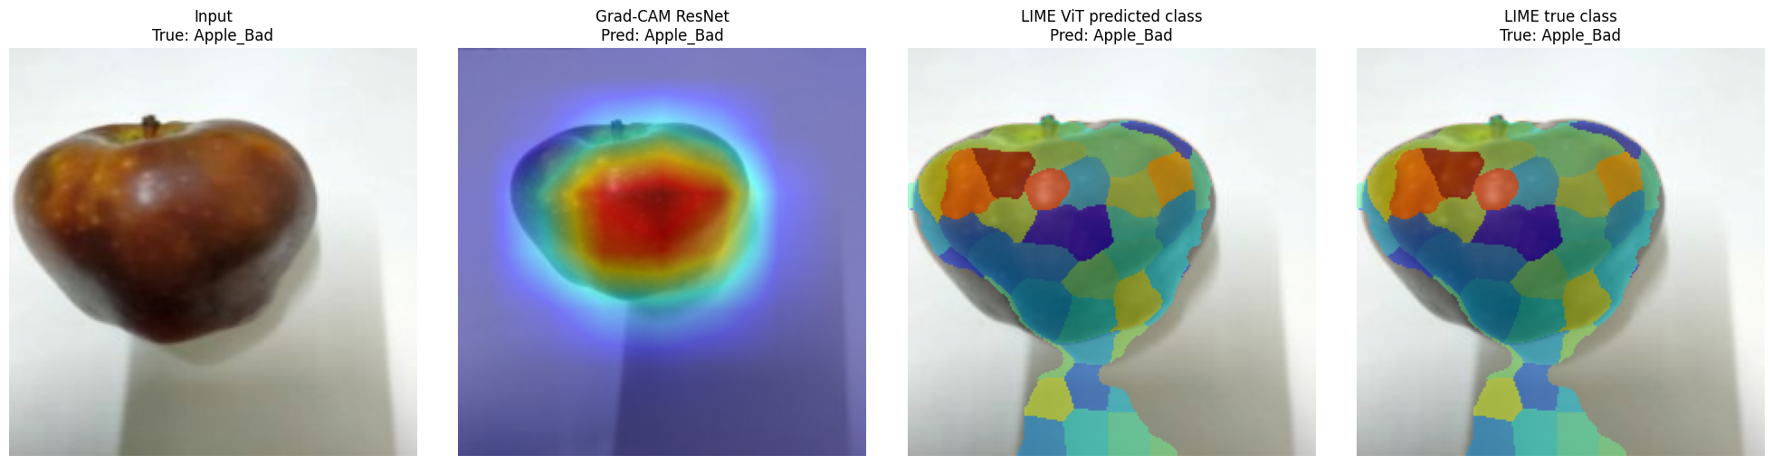
FRESHGUARD IMCS
Abrar Mustafa | Student ID: 925259
Explainability and Trust
What the explanations show
What t-SNE adds
Grad-CAM and LIME highlight the fruit body and defect regions. This supports the claim that predictions use visual quality cues, not only background noise.
The embedding plot gives a quick view of class separability. Clearer clusters suggest the model learned useful visual representations.
15/16

Slide 16
Conclusion
FreshGuard is strongest because it treats evaluation honestly, not just optimistically.
1. Leakage matters
2. Clean testing matters
3. Deployment matters
A naive split had 57.31% near-duplicate leakage, which could overstate model quality.
A group-aware split removed leakage and kept a clean 1,083-image test set.
ResNet-18 gave strong accuracy with fewer parameters and lower false-accept risk.
Future work: edge deployment with MobileNet/EfficientNet, quantization, threshold tuning, and anomaly detection trained only on Good fruit.
Thank you
Abrar Mustafa | Student ID: 925259
16/16

