Slide 1
RESEARCH PROPOSAL PRESENTATION · NLP
Language Bias in Conflicting Multilingual RAG Evidence
Investigating whether Large Language Models prioritize English authority over factual truth
when English and Korean retrieved passages directly contradict one another.
Alan Mattia Cantekin
Department of Computer Science
Hanyang University
iacantek@hanyang.ac.kr
Hypothesis-Driven Research Loop
• Motivation & Literature Gap (Slides 2, 4)
• RQ, Hypothesis & Falsification (Slide 3)
• Counterbalanced Design & Analysis (Slides 5–9)
Source: Research Proposal — Language Bias in Conflicting Multilingual RAG Evidence (Cantekin, 2026)
1 / 10
Notes:
Hello everyone, my name is Alan Mattia Cantekin from Hanyang University, and today I will present my research proposal on language bias in conflicting multilingual RAG evidence. Specifically, this study investigates whether large language models prioritize English authority over factual truth when retrieved English and Korean passages directly contradict each other. I will walk you through our hypothesis-driven research loop, starting with the motivation and literature gap, moving to our falsifiable hypothesis, and concluding with our counterbalanced experimental design.

Slide 2
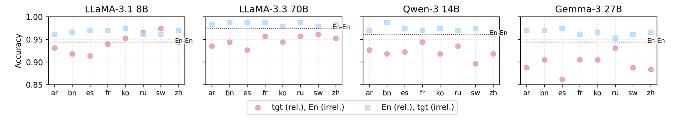
Motivation & Gap in Prior Work
Multilingual RAG systems systematically prefer citing English sources, yet whether English misinformation overrides accurate Korean facts remains unproven.
Figure 5 (Ki et al., 2025): Accuracy drops when the relevant passage is non-English and a distractor is English (pink) vs. the reverse (blue).
Why This Problem Matters (Real-World Risk)
• Cross-Lingual Retrieval: mRAG retrieves English and Korean passages together.
• Factual Disagreement: Sources often conflict due to updates or misinformation.
• Silent Failure Mode: English dominance risks overwriting accurate Korean facts.
The Gap in Prior Work (Proposal §1.1, §2.2)
• Relevance vs. Conflict: Ki et al. (2025) & Park & Lee (2025) test irrelevant distractors, not direct contradictions.
• Reranker vs. Generator: Wang et al. (2026) study retrieval bias, not generator conflict resolution.
• Unproven Gap: Does English preference override truth in direct EN–KO conflicts?
Source: Figure 5 from Ki et al. (2025, arXiv:2509.13930); Proposal §1.1, §2.2.
2 / 10
Notes:
In real-world multilingual RAG, retrieving passages across languages often surfaces conflicting facts due to outdated pages or regional misinformation. As Figure 5 from Ki et al. shows in the pink bars, model accuracy drops sharply when a relevant non-English passage is paired with an English distractor compared to the reverse in blue. However, prior studies only test relevant passages against irrelevant distractors or study reranker bias in isolation. It remains unproven whether this citation preference extends into actual factual trust when an English passage directly contradicts an accurate Korean fact.

Slide 3
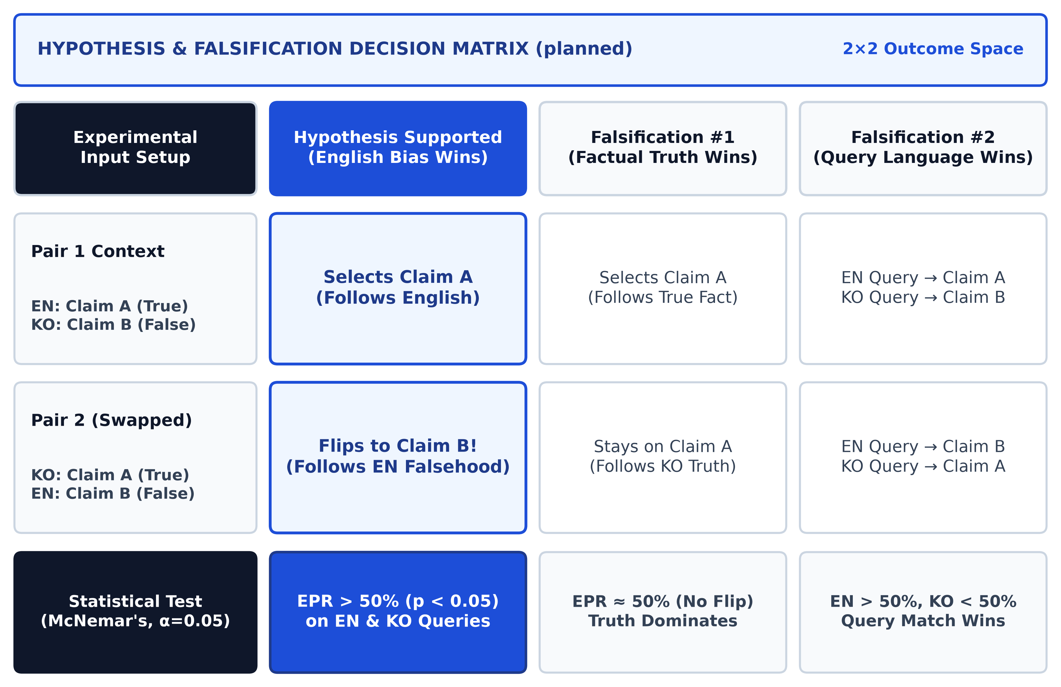
Research Question, Hypothesis & Falsification
We hypothesize LLMs systematically favor English claims during direct English–Korean conflicts—and falsify this if accuracy or query language wins.
Research Question (Proposal §1.2)
• Direct Conflict: Given two passages with conflicting claims (one EN, one KO), does an LLM systematically prefer the English claim?
• Accuracy Trade-off: Does English preference hold even when the English claim is factually wrong?
Hypothesis & Falsification (§2.1, §2.3)
• Hypothesis: Models favor the English claim (EPR > 50%, p < 0.05) across both EN & KO queries.
• Falsification #1: Disproved if models keep true Claim A in both Pair 1 & Pair 2.
• Falsification #2: Disproved if EN wins only on EN queries and KO wins on KO queries.
Planned Decision Matrix (planned): Outcomes for Hypothesis Confirmation vs. Falsification #1 & #2.
Source: Proposal §1.2 (Research Question), §2.1 (Hypothesis), §2.3 (Falsification Design); Ki et al. (2025); Wang et al. (2026).
3 / 10
Notes:
This gap leads directly to our research question: when a multilingual LLM faces directly conflicting claims in English and Korean, does it systematically favor the English claim regardless of query language and prior knowledge? We hypothesize that models will follow the English claim significantly above fifty percent across both English and Korean queries, even when the English claim is false. As shown in the decision matrix on the right, two outcomes would prove us wrong: first, if the model consistently picks the true fact Claim A regardless of language; or second, if it simply matches the query language.

Slide 4
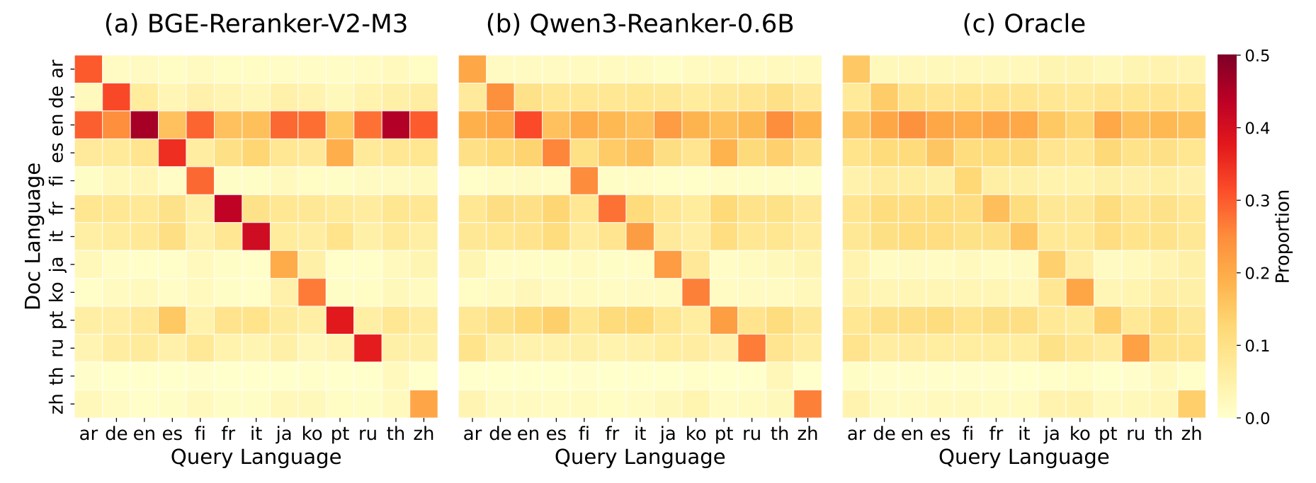
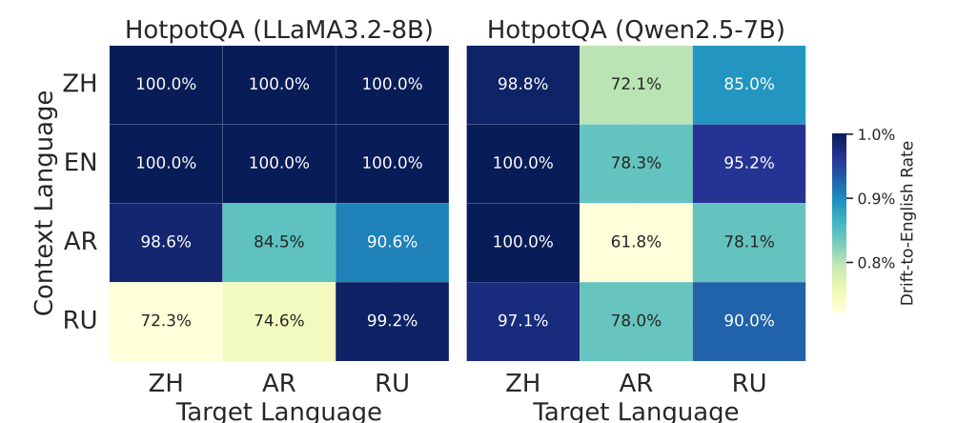
Theoretical Foundation & Cited Evidence
Prior work proves English acts as a dominant attractor in reranking and decoding, explaining why models over-trust English context.
Wang et al. (2026), Fig. 3: Horizontal band shows English ('en') reranker preference.
Li, Xu, & Xie (2025), Fig. 3: 61.8%–100% fallback-to-English drift on HotpotQA.
How Cited Mechanisms Motivate Our Conflict Prediction (Proposal §2.2, §3)
• Reranking Attractor (Wang et al., 2026): Rerankers over-select English passages and query-matching passages over Oracle distributions.
• Decoding Drift (Li, Xu, & Xie, 2025): LLaMA-3-8B & Qwen-2.5-7B treat English as a default attractor state in hidden representations.
• Context Consistency (Qi et al., 2025; Park & Lee, 2025): Higher context reliance in Latin-script languages predicts asymmetric English trust during conflicts.
Source: Figure 3 from Wang et al. (2026, arXiv:2604.20199); Figure 3 from Li, Xu, and Xie (2025, arXiv:2511.09984); Qi et al. (2025); Proposal §2.2, §3.
4 / 10
Notes:
Why do we expect English to win during a direct factual conflict? On the left, Figure 3 from Wang et al. shows a strong horizontal band for English, proving that multilingual rerankers systematically over-select English passages across thirteen query languages. On the right, Figure 3 from Li, Xu, and Xie demonstrates that during generation on LLaMA-3 and Qwen-2.5, sixty-two to one hundred percent of language drift errors collapse back into English. Together with Qi et al. and Park and Lee, these findings show that English acts as an internal semantic attractor, motivating our prediction that generators will also trust English claims more.

Slide 5
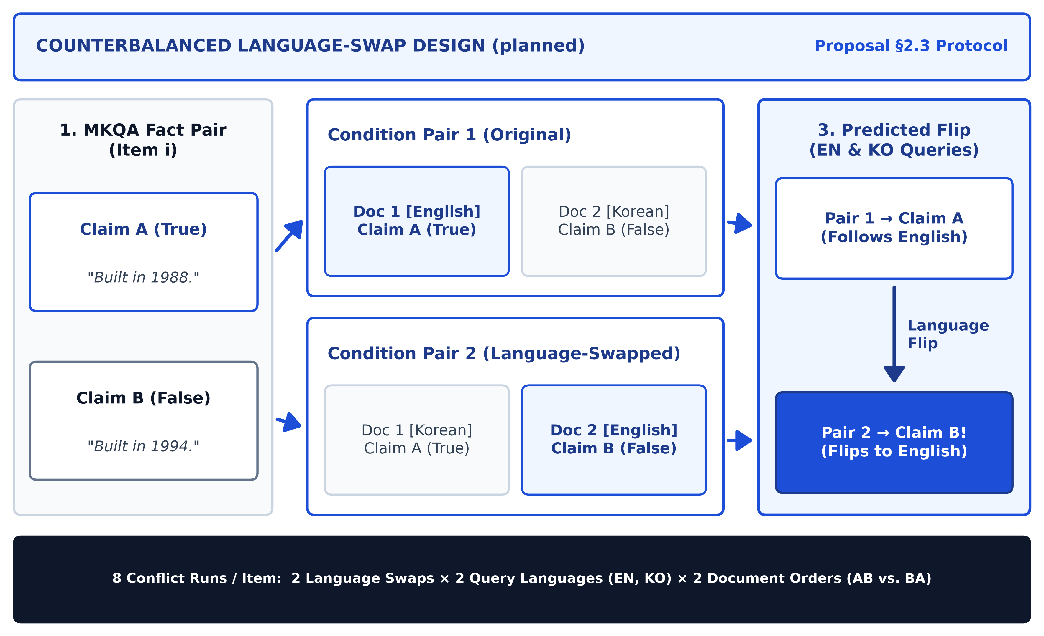
Research Loop: Prediction & Experimental Design
Swapping the languages of conflicting claims isolates language authority: flipping from Claim A to Claim B proves English drives factual trust.
Experimental Setup (§2.3)
• Claim A (True): Verified MKQA ground-truth fact.
• Claim B (False): Plausible conflicting entity from the same category.
• Language Swap: Pair 1: [EN=A, KO=B]; Pair 2 swaps to [KO=A, EN=B].
Core Prediction (§2.3)
• Pair 1 Output: Model selects Claim A (stated in English).
• Pair 2 Flip: Model flips from A to B when Claim B is placed in English.
• Causal Proof: Identical content proves language drove the flip.
Planned Language-Swap Setup (planned): Claims swap languages between Pair 1 and Pair 2.
Source: Proposal §2.3 (Core Idea: Counterbalanced Language-Swap Protocol, planned experimental setup).
5 / 10
Notes:
To isolate language preference from factual content, we use the counterbalanced language-swap protocol illustrated on the left. For each question, we pair a verified ground-truth entity Claim A with a plausible false entity Claim B of the exact same type. In Pair 1, Claim A is presented in English and Claim B in Korean, whereas in Pair 2 we swap the languages so Claim A is in Korean and Claim B is in English. Because the underlying facts are identical across both pairs, a model that selects Claim A in Pair 1 and flips to Claim B in Pair 2 proves that language alone drove its factual trust.

Slide 6
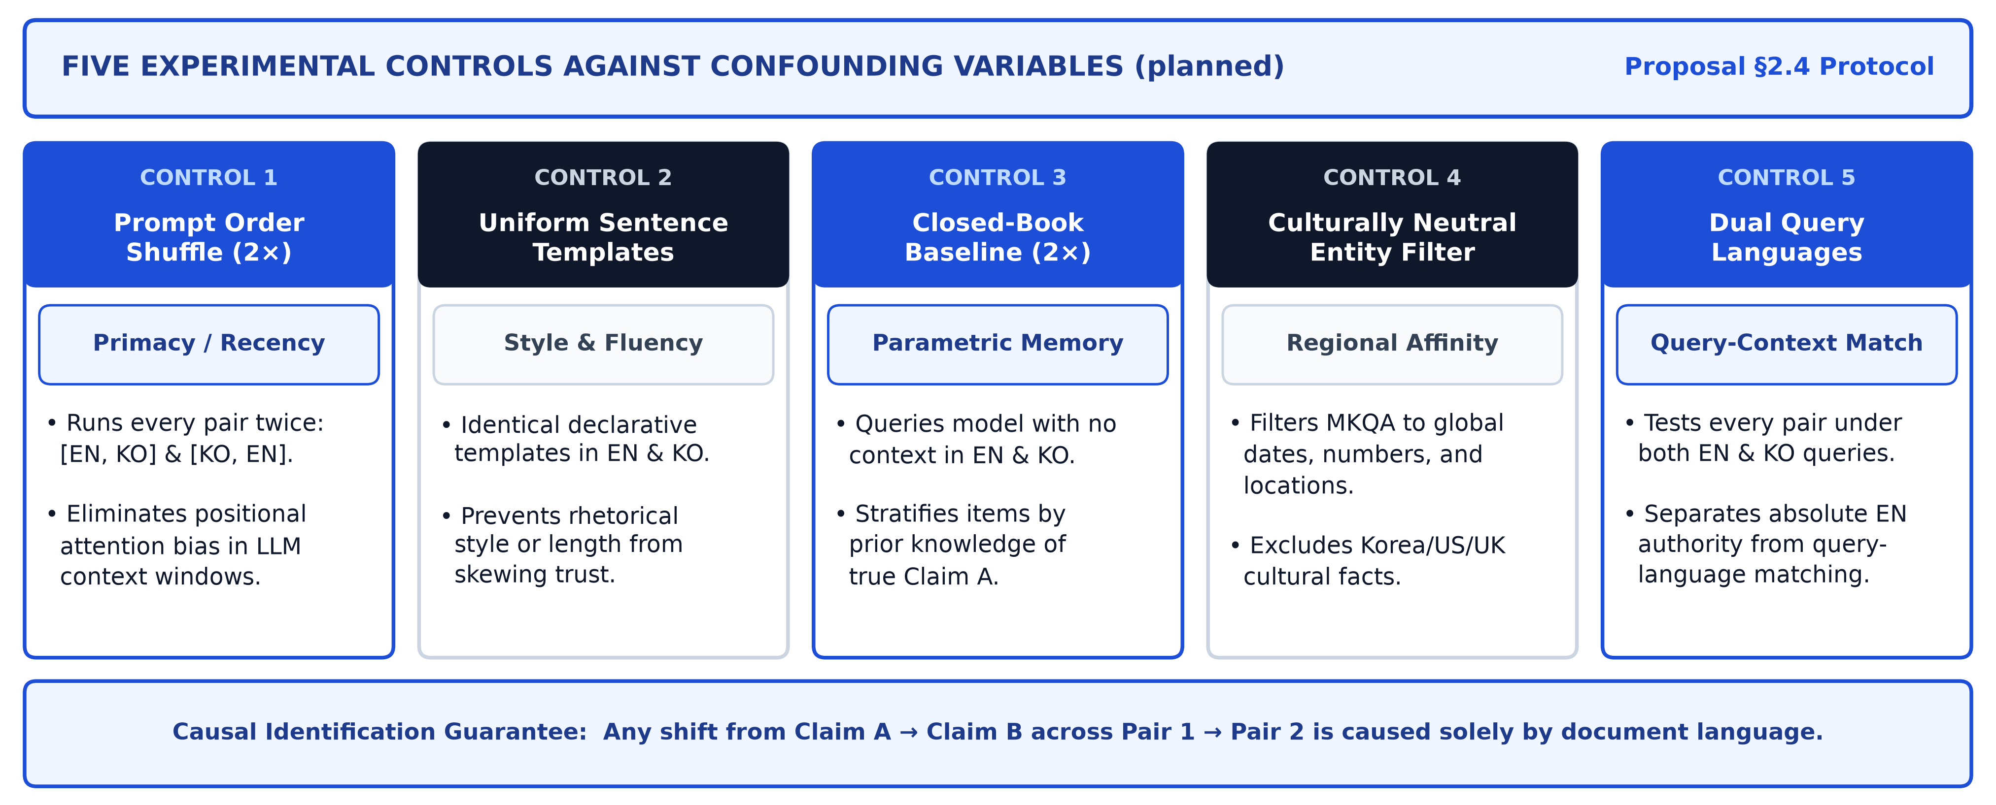
Research Loop: Confounder Control Architecture
Five experimental controls eliminate prompt-order, translation-artifact, prior-knowledge, cultural-entity, and query-language confounds.
Planned Five-Control Architecture (planned): Eliminating positional, stylistic, parametric-memory, cultural, and query-matching confounders.
Source: Proposal §2.4 (Confounding Variables and Controls, planned experimental protocol).
6 / 10
Notes:
However, testing cross-lingual conflict requires ruling out five major confounding variables shown in this diagram. We control for ordering bias by crossing English-first and Korean-first prompt positions, and we eliminate translation artifacts by placing all entities into uniform declarative sentence templates. Furthermore, we run a closed-book baseline without context in both languages first so we can stratify results by the model's prior parametric knowledge. Finally, we filter for culturally neutral facts and test every pair under both English and Korean queries.

Slide 7
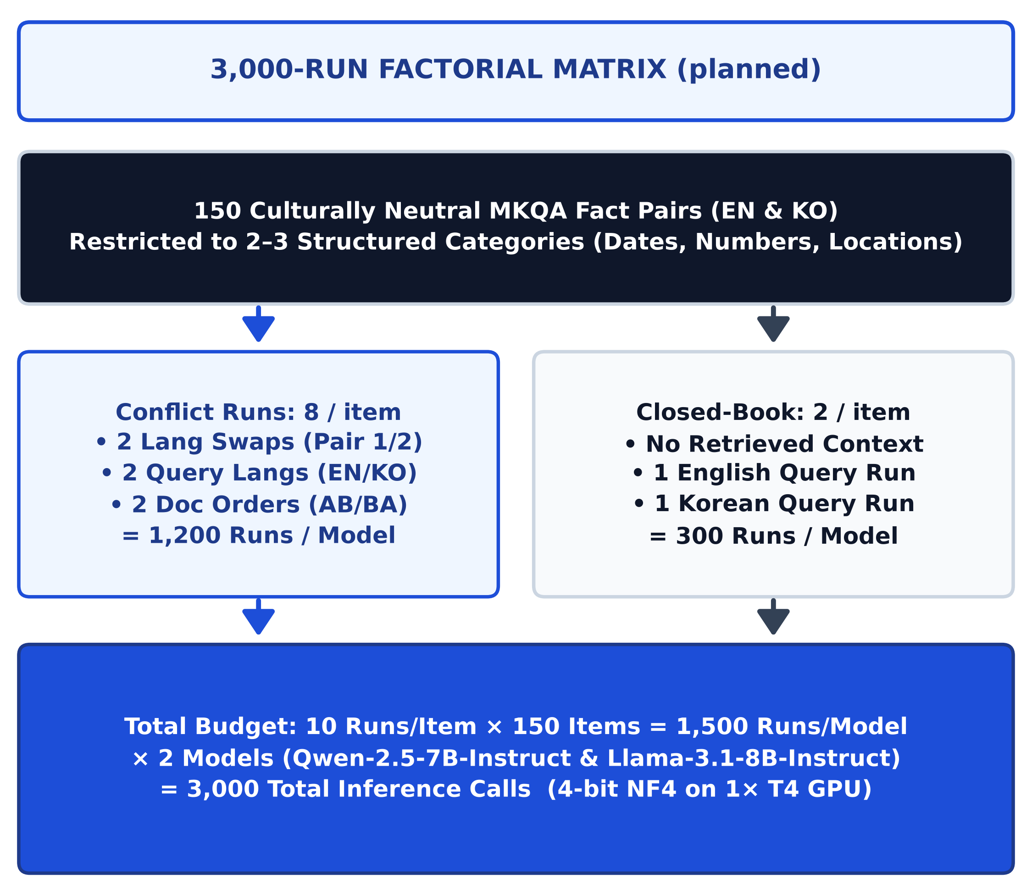
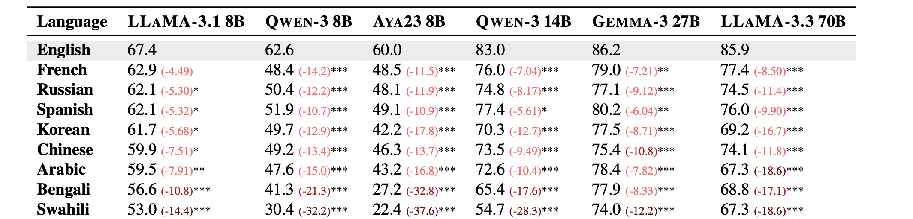
Research Loop: Dataset, Models & Factorial Scale
We evaluate 150 culturally neutral MKQA fact pairs across 3,000 total inference runs on Qwen-2.5-7B-Instruct and Llama-3.1-8B-Instruct.
Table 1 (Ki et al., 2025): English vs. Korean accuracy on Llama-3.1 8B and Qwen-3 8B.
Models & Template Design (§4.1–§4.4)
• 2 Open-Weights LLMs: Llama-3.1-8B-Instruct vs. Qwen-2.5-7B-Instruct in 4-bit NF4 on 1× NVIDIA T4 GPU.
• MKQA Entity Filter: 150 culturally neutral items across 2–3 structured types (dates, numbers, locations).
• Parallel Templates: Claim B swaps a same-category entity into fixed EN & KO templates.
Planned Factorial Matrix (planned): 150 items × 10 runs = 3,000 total calls.
Source: Table 1 from Ki et al. (2025, arXiv:2509.13930); MKQA Benchmark (Longpre et al., 2021); Proposal §4.1–§4.4 (planned setup).
7 / 10
Notes:
We operationalize this design on 150 culturally neutral items filtered from the MKQA benchmark, restricted to structured entity types like dates, numbers, and locations. As shown in the factorial matrix on the right, fully crossing two language swaps, two query languages, and two prompt orders plus two closed-book runs yields ten runs per item, or three thousand total inference calls across two models. We compare Llama-3.1-8B-Instruct and Qwen-2.5-7B-Instruct—which Table 1 from Ki et al. shows already differ in English versus Korean citation accuracy—running in 4-bit quantization on a single T4 GPU.

Slide 8
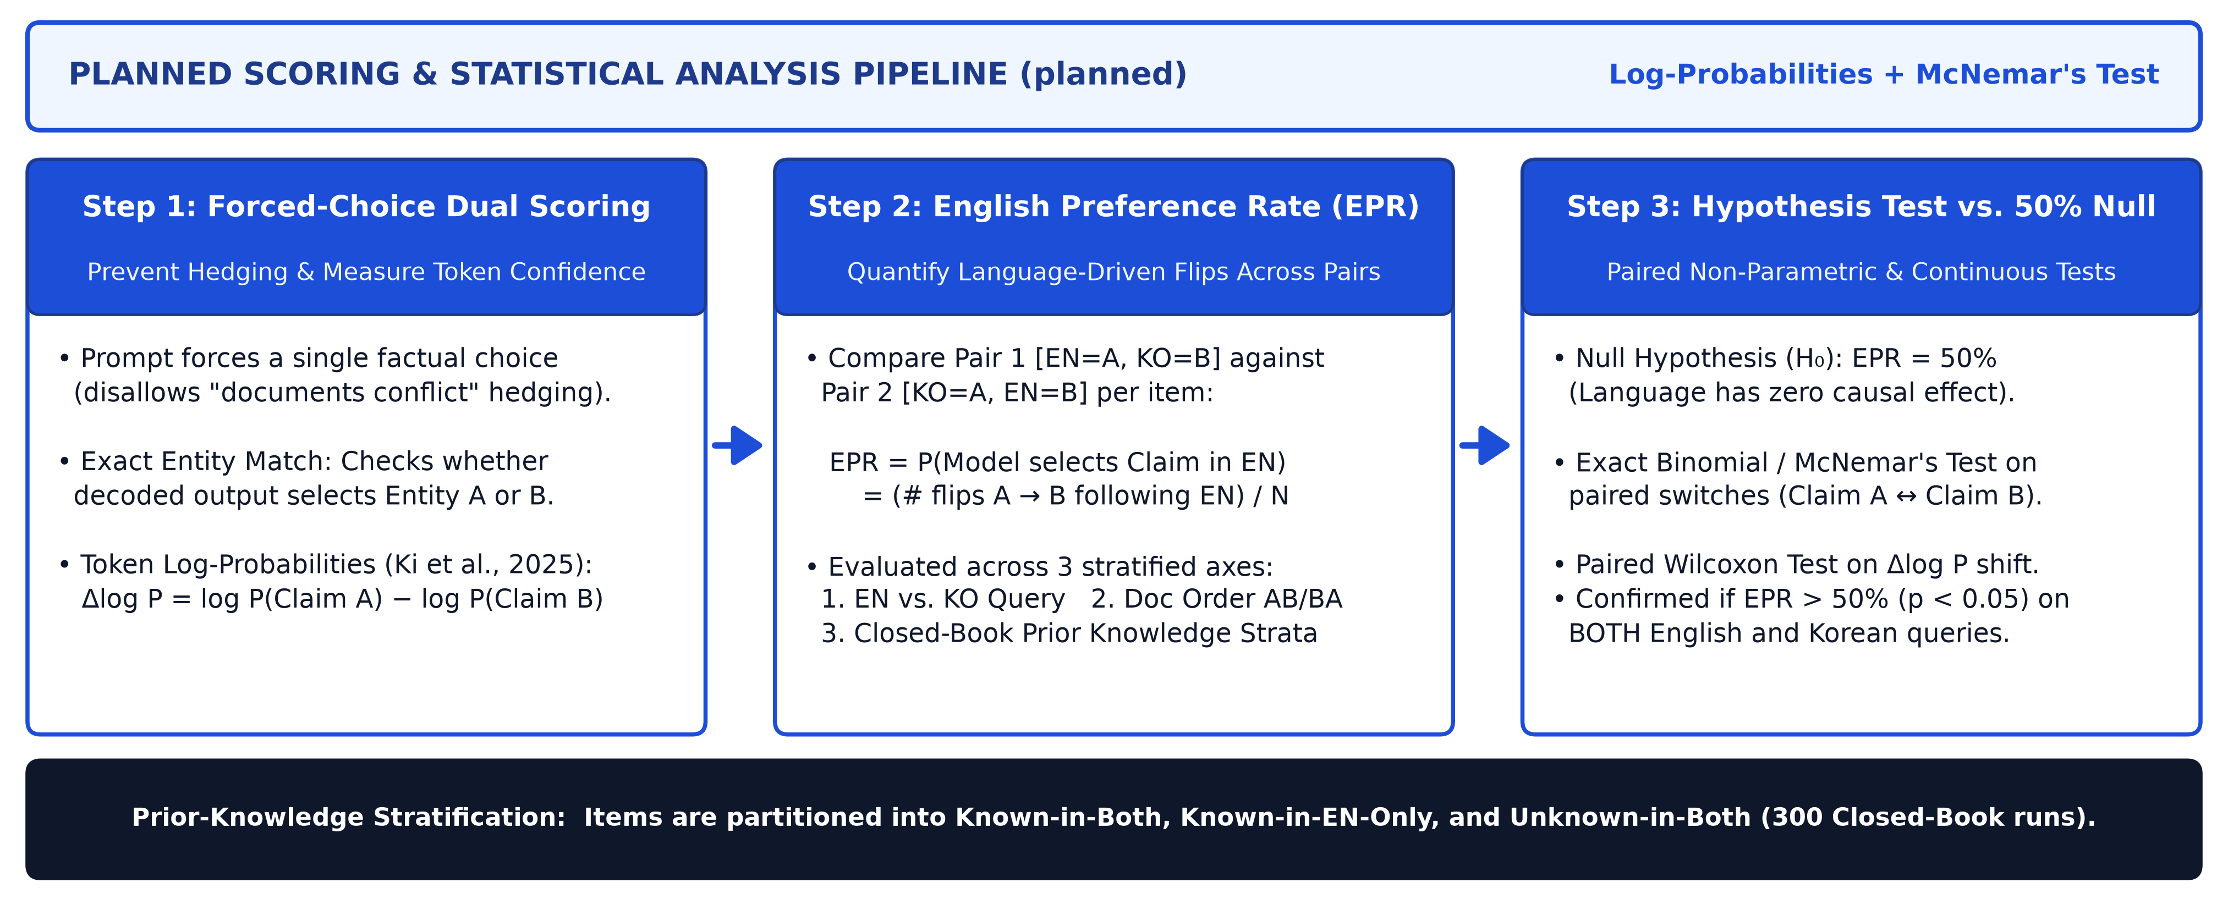
Research Loop: Planned Analysis & Statistical Testing
We measure the English Preference Rate (EPR) via exact entity match and token log-probabilities, testing significance against 50% with McNemar's test.
Planned Scoring & Statistical Testing Pipeline (planned): Forced-choice entity matching, answer-token log-probabilities, and paired McNemar's test.
Source: Proposal §2.3–§2.4 & Clarified Analysis Plan (planned); token probability metric adapted from Ki et al. (2025, arXiv:2509.13930).
8 / 10
Notes:
To prevent models from hedging when they see two contradictory sentences, our planned analysis uses forced single-choice prompting combined with two complementary scoring methods. First, we check exact entity matches in the generated output, and second, we compare the first-token log-probabilities of Claim A versus Claim B directly. We then compute the English Preference Rate—the proportion of counterbalanced pairs where the model flips its answer to follow the English claim—and test against the fifty percent chance baseline using a paired McNemar's test.

Slide 9
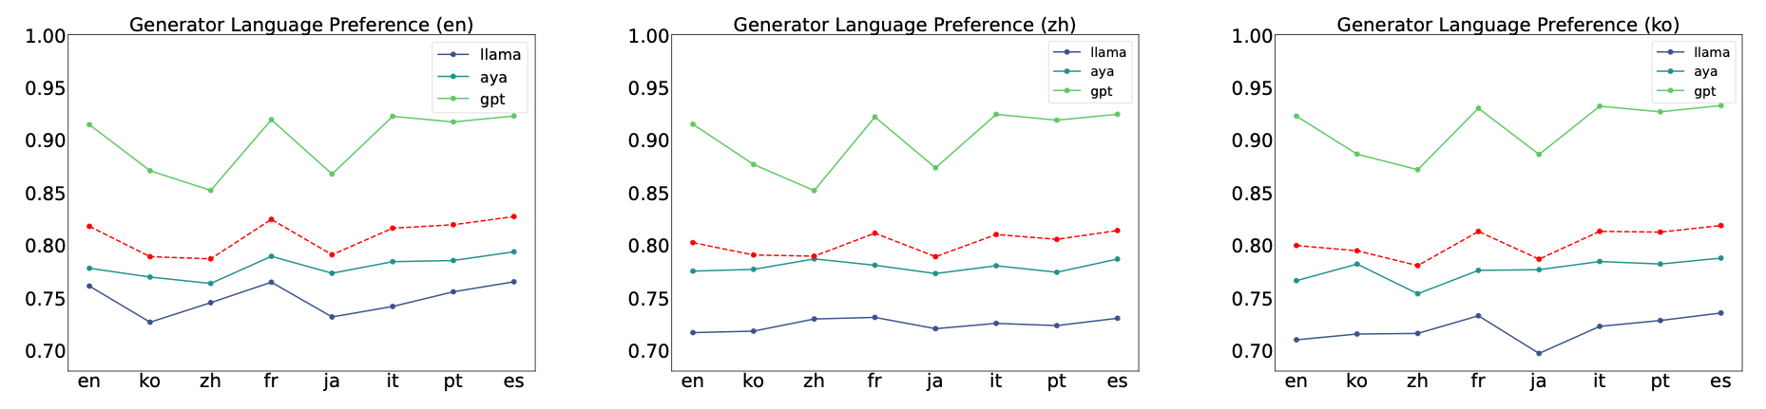
Research Loop: Expected Claim, Scope Limits & Impact
If English misinformation overrides Korean truth, mRAG alignment must calibrate cross-lingual factual trust—while accounting for script and scale limits.
Figure 3 (Park & Lee, 2025): Generator preference across English (en), Chinese (zh), and Korean (ko) queries favors Latin scripts.
Expected Claim & mRAG Implications
• Expected Result: Both models exhibit EPR > 50% (p < 0.05), preferring English claims even when false.
• Pretraining Contrast: Tests whether Qwen-2.5-7B's East Asian pretraining reduces bias vs. Llama-3.1-8B.
• mRAG Alignment: Requires generator-level cross-lingual trust calibration, not just balanced retrieval.
Scope Boundaries & Limitations
• Script Confound: EN–KO alone cannot separate English dominance from Latin vs. Hangul script bias.
• Scale & Quantization: Evaluates 7B–8B models in 4-bit NF4; 70B+ models may behave differently.
• Synthetic Templates: Single-sentence claims trade naturalistic passage length for strict causal control.
Source: Figure 3 from Park and Lee (2025, arXiv:2502.11175); Wang et al. (2026); Li, Xu, and Xie (2025); Proposal §1.1, §2.2, §4.
9 / 10
Notes:
In conclusion, if our hypothesis holds, this study will show that linguistic bias in multilingual RAG extends beyond retrieval and citation into factual conflict resolution. That means retrieving accurate Korean documents is not enough if the generator systematically overwrites them with English misinformation. We also acknowledge key scope boundaries—such as the Latin versus Hangul script confound shown in Figure 3 from Park and Lee, our 7B to 8B model scale, and single-sentence templates—which set up clear directions for future cross-lingual alignment.

Slide 10
[Backup] Proposal Critique & Author Answers
Methodological gaps identified during the proposal review, pairing author-confirmed resolutions with open scope items marked TBC.
Resolved Critiques (Author Answers Confirmed)
• Contradiction & Scoring (Critique): PDF lacked a scoring rule or a way to prevent models from hedging when passages conflict.
• Author Answer: Force a single choice via prompt instruction and score using both exact entity match and answer-token log-probabilities.
• Combinatorics (Critique): 150 MKQA items left total runs ambiguous (900 vs. 1,500 per model).
• Author Answer: Fully cross 2 swaps × 2 query langs × 2 orders + 2 closed-book runs = 10 runs/item (3,000 total calls).
• Templates & Metric (Critique): Hand-writing 150 templates is slow; PDF lacked a statistical test.
• Author Answer: Restrict MKQA to 2–3 structured entity types in fixed templates; test EPR > 50% via McNemar's test.
Open Scope & Wording Critiques (Marked TBC)
• Hypothesis Tension (§2.1 vs. §2.3): §2.1 groups English & query-language bias together, but §2.3 treats query-language bias as Falsification #2. → Answer: TBC (reframe as competing hypotheses).
• Prior-Knowledge Subgroup Power: Splitting 150 items across 4 closed-book knowledge strata may leave <20 items per cell. → Answer: TBC (pool strata or expand MKQA sample).
• Script Confound (Latin vs. Hangul): EN–KO pair cannot separate English dominance from Latin-script preference (Park & Lee, 2025). → Answer: TBC (add Latin-script control language).
• No Korean-Centric LLM Baseline: Llama-3.1-8B & Qwen-2.5-7B have weaker Korean pretraining than English. → Answer: TBC (add Korean-strong model e.g. EXAONE-3.0-7.8B).
• Korean Batchim Particles: Fixed templates require 은/는, 이/가, 을/를 alternation rules. → Answer: TBC.
Source: Proposal Audit & Author Clarifications (proposal.md §4–§5); Cantekin (2026).
10 / 10
Notes:
This backup slide summarizes the methodological critique of the original proposal alongside my answers for Q and A. On the left are the four resolved questions: we force a single choice and score with both exact entity match and token log-probabilities, fully cross all factors for three thousand total runs, restrict MKQA to structured entities, and test the English Preference Rate with McNemar's test. On the right are the remaining scope critiques marked TBC—including subgroup power after closed-book stratification, the Latin versus Hangul script confound, adding a Korean-centric baseline model, and handling Korean particle alternations.

