Slide 1
RESEARCH PROPOSAL PRESENTATION · NLP
Language Bias in Conflicting
Multilingual RAG Evidence
Investigating whether Large Language Models prioritize English authority over factual truth
when English and Korean retrieved passages directly contradict one another.
Alan Mattia Cantekin
Department of Computer Science, Hanyang University
iacantek@hanyang.ac.kr
Hypothesis-Driven Research Loop
1. Motivation & Gap 2. RQ, Hypothesis & Falsification
3. Counterbalanced Design 4. Planned Statistical Analysis
Proposal: Language Bias in Conflicting Multilingual RAG Evidence (Cantekin, 2026)
1 / 9

Slide 2
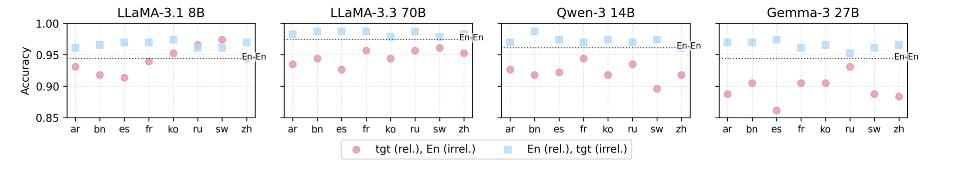
01 · MOTIVATION & GAP IN PRIOR WORK
Multilingual RAG systems systematically prefer citing English sources, yet whether English misinformation overrides accurate Korean facts remains unproven.
Figure 5 (Ki et al., 2025): Citation accuracy drops sharply when the relevant document is in a non-English target language and an irrelevant distractor is in English (pink circles) vs. the reverse (blue squares).
Why This Problem Matters (Real-World mRAG Risk)
• Cross-Lingual Retrieval: Multilingual RAG (mRAG) retrieves evidence from English and local languages (e.g., Korean) simultaneously.
• Factual Disagreement: Retrieved documents frequently disagree due to outdated timestamps, regional reporting differences, or misinformation.
• Silent Failure Mode: If LLMs treat English as inherently more authoritative, false English claims will overwrite true local-language evidence.
The Gap in Prior Literature (Proposal §1.1, §2.2)
• Relevance vs. Conflict: Ki et al. (2025) and Park & Lee (2025) test relevant vs. irrelevant distractors, not direct factual contradictions.
• Reranker vs. Generator: Wang et al. (2026) focus on retrieval/reranking bias rather than generator-level truth resolution.
• Our Target Gap: No controlled benchmark tests whether English language dominance overrides factual accuracy during direct EN–KO conflict.
Source: Figure 5 from Ki et al. (2025), 'Linguistic Nepotism: Trading-off Quality for Language Preference in Multilingual RAG' (arXiv:2509.13930); Proposal §1.1, §2.2.
2 / 9

Slide 3
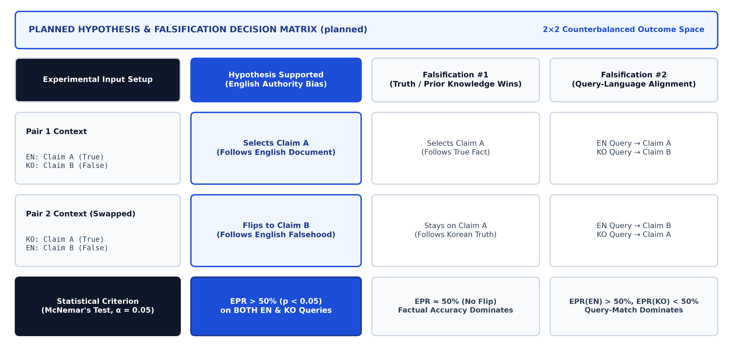
02 · RESEARCH QUESTION, HYPOTHESIS & FALSIFICATION
We hypothesize LLMs systematically favor English claims during direct English–Korean conflicts—and falsify this if accuracy or query language wins.
Research Question (Proposal §1.2)
• Core Question: "When a multilingual LLM is given two retrieved passages that make directly conflicting factual claims on the same topic, one in English and one in Korean, does it systematically prefer the claim stated in English, and does this preference hold even when the English claim is factually wrong?"
• Scope: Evaluates both English queries and Korean queries across open-weights LLMs.
Primary Hypothesis & Falsification (§2.1)
• Hypothesis: LLMs exhibit a statistically significant preference for the English-language claim (EPR > 50%) even when it is false.
• Falsification #1 (Truth Wins): Disproved if models consistently select true Claim A in both Pair 1 and Pair 2.
• Falsification #2 (Query Wins): Disproved if English wins only on EN queries and Korean wins on KO queries.
Planned Decision Matrix (planned): Mapping counterbalanced outcomes to Hypothesis Confirmation vs. Falsification #1 and #2.
Source: Proposal §1.2 (Research Question), §2.1 (Hypothesis), §2.3 (Counterbalanced Falsification Design); Ki et al. (2025); Wang et al. (2026).
3 / 9

Slide 4
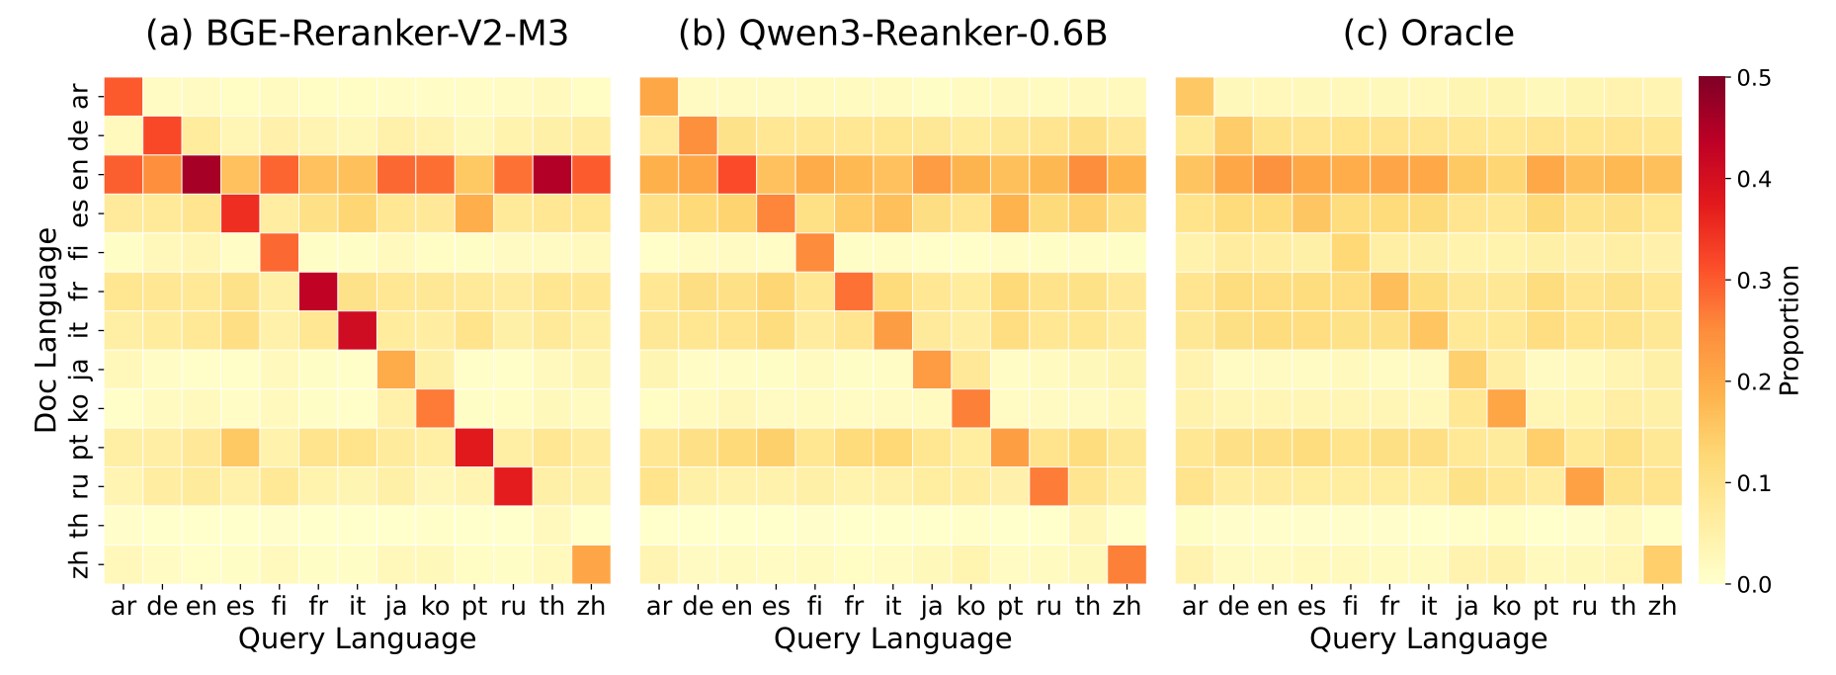
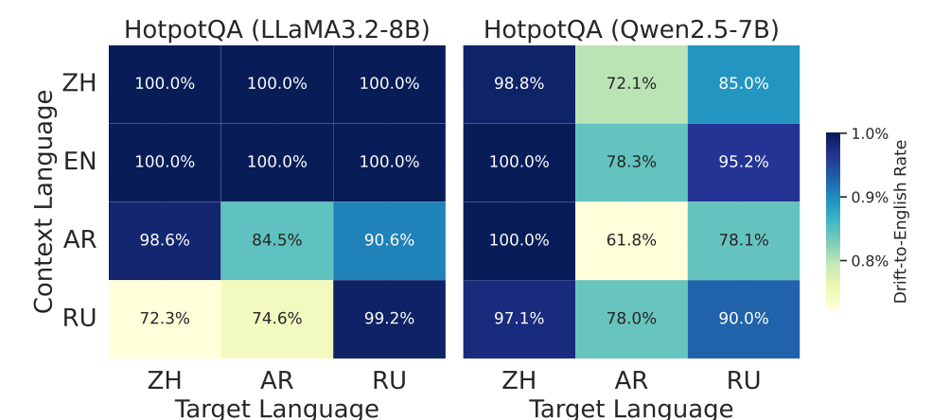
03 · THEORETICAL FOUNDATION & CITED EVIDENCE
Prior work proves English acts as a dominant attractor in reranking and decoding, explaining why models over-trust English context.
Wang et al. (2026), Fig. 3: Neural rerankers exhibit a strong horizontal band favoring English ('en') documents across all 13 query languages.
Li, Xu, & Xie (2025), Fig. 3: LLaMA3-8B & Qwen2.5-7B exhibit 61.8%–100% fallback-to-English generation drift across multilingual contexts.
How Prior Empirical Findings Motivate Our Conflict Prediction (Proposal §2.2, §3)
• Reranking Attractor (Wang et al., 2026): Multilingual rerankers systematically over-select English passages + query-matching passages over ground-truth Oracle distributions.
• Decoding Drift (Li, Xu, & Xie, 2025): LLaMA-3-8B and Qwen-2.5-7B treat English as a default attractor state in hidden representations during generation.
• Context Consistency (Qi et al., 2025; Park & Lee, 2025): Models rely more heavily on high-resource Latin-script context than Korean context, predicting asymmetric trust during direct conflicts.
Source: Figure 3 from Wang et al. (2026, arXiv:2604.20199); Figure 3 from Li, Xu, and Xie (2025, arXiv:2511.09984); Qi et al. (2025); Proposal §2.2, §3.
4 / 9

Slide 5
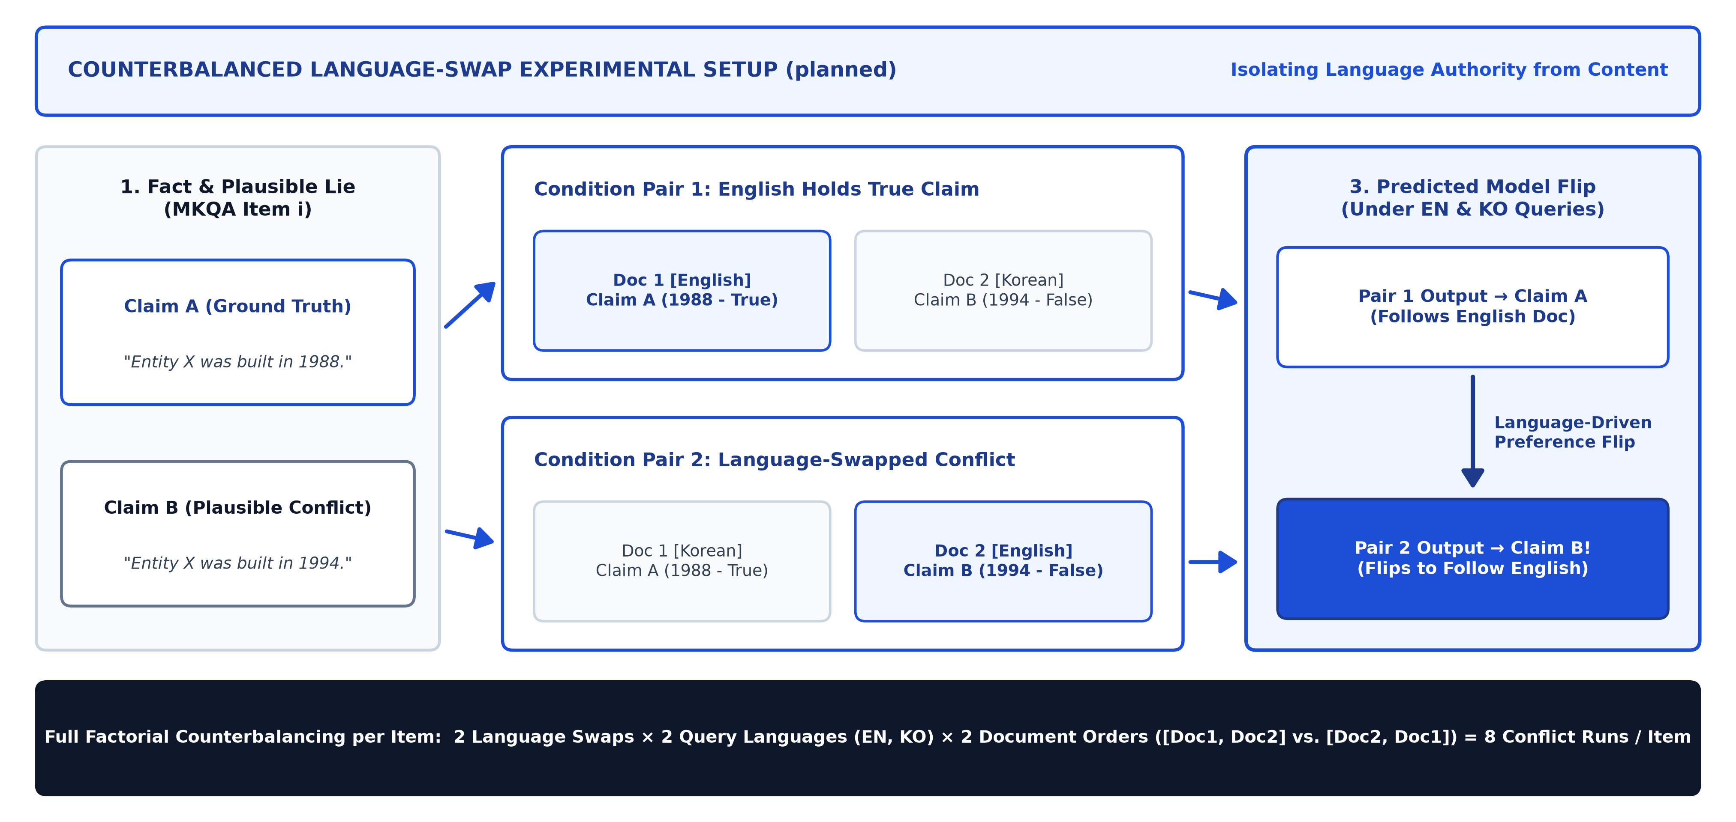
04 · RESEARCH LOOP: PREDICTION & EXPERIMENTAL DESIGN
Swapping the languages of conflicting claims isolates language authority: flipping from Claim A to Claim B proves English drives factual trust.
Experimental Setup (§2.3)
• Claim A (True): Verified ground-truth fact from MKQA (e.g., 'Entity X was built in 1988').
• Claim B (False): Plausible conflicting entity from the same category ('built in 1994').
• Language Swap: Pair 1 puts Claim A in EN & Claim B in KO; Pair 2 swaps them.
Core Prediction (§2.3)
• Pair 1 Prediction: Model selects Claim A when stated in English.
• Pair 2 Flip: When Claim B is placed in English, the model flips its answer from A to B.
• Causal Proof: Because content is identical, a flip proves language—not truth—drove selection.
Planned Counterbalanced Language-Swap Setup (planned): Identical factual claims are swapped between English and Korean across Pair 1 and Pair 2.
Source: Proposal §2.3 (Core Idea: Counterbalanced Language-Swap Protocol, planned experimental setup).
5 / 9

Slide 6
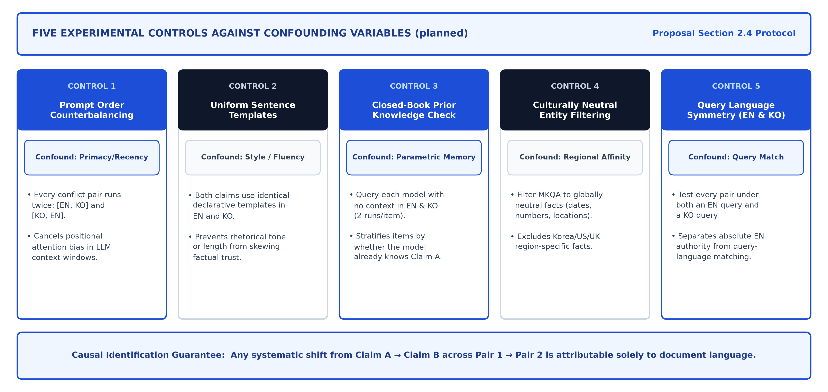
05 · RESEARCH LOOP: CONFOUNDER CONTROL ARCHITECTURE
Five experimental controls eliminate prompt-order, translation-artifact, prior-knowledge, cultural-entity, and query-language confounds.
Planned Five-Control Architecture (planned): Isolating document language from positional, stylistic, parametric-memory, cultural, and query-matching confounders.
Source: Proposal §2.4 (Confounding Variables and Controls, planned experimental protocol).
6 / 9

Slide 7
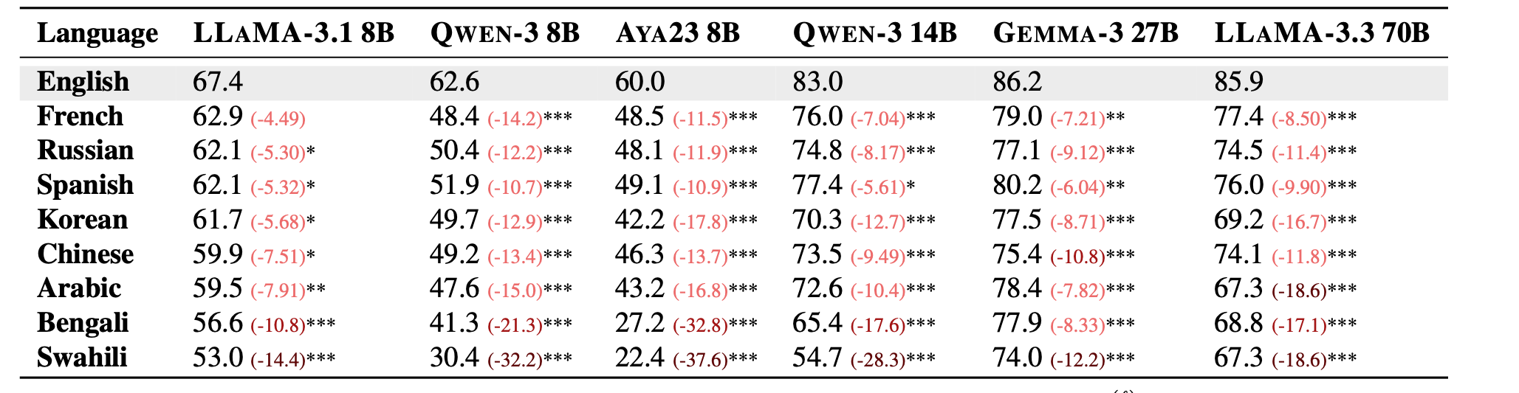
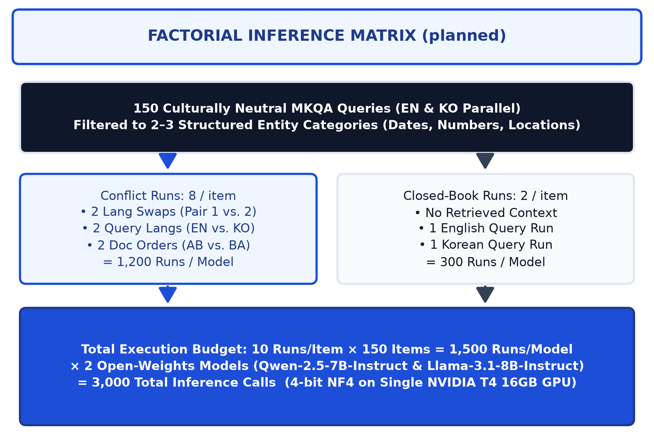
06 · RESEARCH LOOP: DATASET, MODELS & FACTORIAL SCALE
We evaluate 150 culturally neutral MKQA fact pairs across 3,000 total inference runs on Qwen-2.5-7B-Instruct and Llama-3.1-8B-Instruct.
Table 1 (Ki et al., 2025): Baseline citation accuracy is significantly higher in English than Korean on Llama-3.1 8B (67.4% vs. 61.7%) and Qwen-3 8B (62.6% vs. 49.7%).
Models & Controlled Template Construction (§4.1–§4.4)
• 2 Open-Weights Models: Llama-3.1-8B-Instruct (English-centric) vs. Qwen-2.5-7B-Instruct (strong East Asian pretraining) via HuggingFace in 4-bit NF4 on 1× T4 GPU.
• MKQA Entity Filtering: 150 culturally neutral queries restricted to 2–3 structured entity types (dates/years, numbers, global locations).
• Parallel Templates: Claim B swaps an entity from the same category into fixed parallel EN & KO declarative templates.
Planned Factorial Inference Matrix (planned): 150 MKQA items × 10 runs/item = 1,500 runs/model (3,000 total inference calls).
Source: Table 1 from Ki et al. (2025, arXiv:2509.13930); MKQA Benchmark (Longpre et al., 2021); Proposal §4.1–§4.4 (planned dataset & model setup).
7 / 9

Slide 8
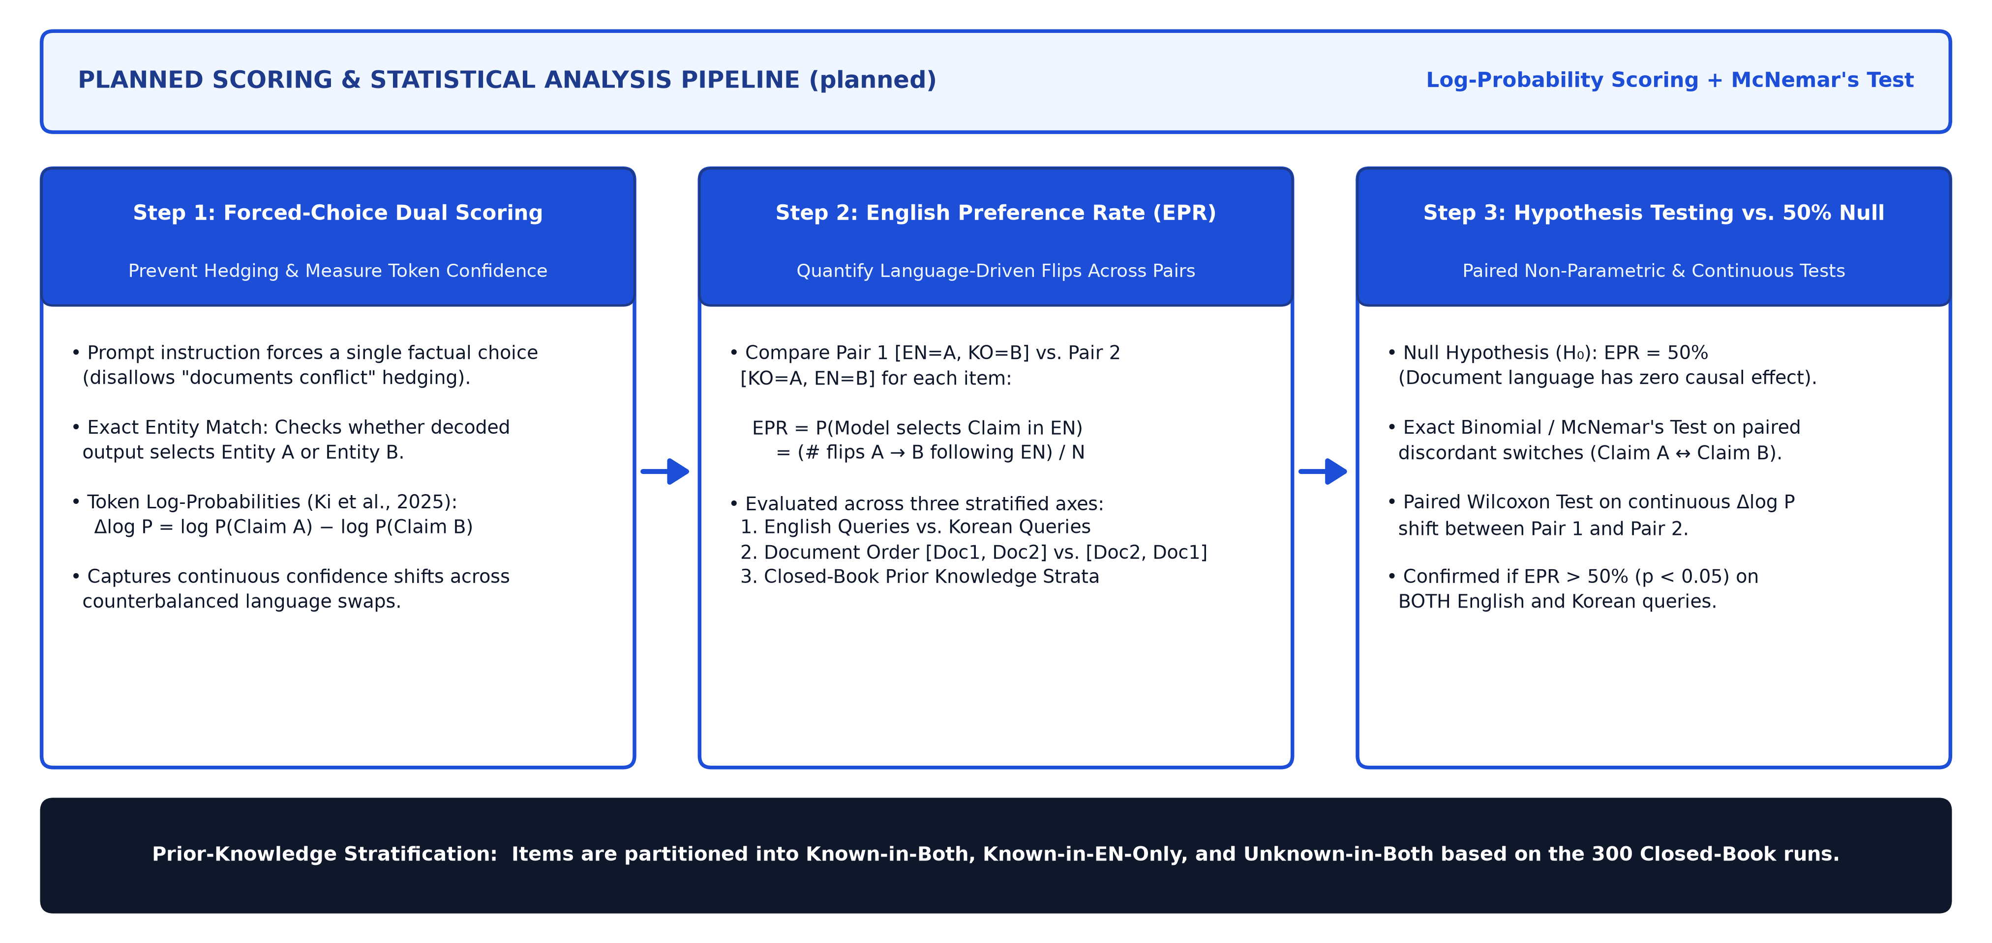
07 · RESEARCH LOOP: PLANNED ANALYSIS & STATISTICAL TESTING
We measure the English Preference Rate (EPR) via exact entity match and token log-probabilities, testing significance against 50% with McNemar's test.
Planned Scoring & Statistical Testing Pipeline (planned): Combining forced-choice entity matching, answer-token log-probabilities, and paired McNemar's testing.
Source: Proposal §2.3–§2.4 & Clarified Analysis Plan (planned); token probability formulation adapted from Ki et al. (2025, arXiv:2509.13930).
8 / 9

Slide 9
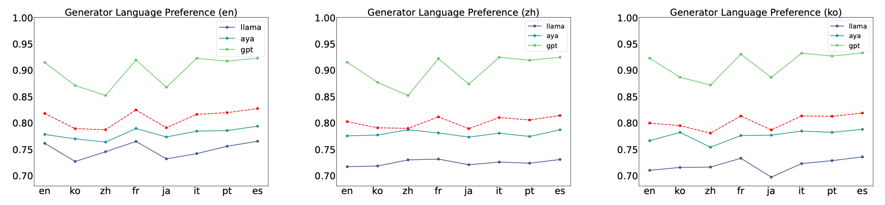
08 · RESEARCH LOOP: EXPECTED CLAIM, SCOPE LIMITS & IMPACT
If English misinformation overrides Korean truth, mRAG alignment must calibrate cross-lingual factual trust—while accounting for script and scale limits.
Figure 3 (Park & Lee, 2025): Generator language preference across English (en), Chinese (zh), and Korean (ko) queries shows persistent structural preference for Latin-script sources.
Expected Claim & Implications for mRAG Design
• Expected Empirical Claim: Both 7B–8B models exhibit EPR > 50% (p < 0.05), preferring English claims even when false and under Korean queries.
• Pretraining Comparison: Tests whether Qwen-2.5-7B's stronger East Asian pretraining mitigates bias relative to English-centric Llama-3.1-8B.
• System Mitigation: Demonstrates that mRAG requires generator-level cross-lingual trust calibration, not just balanced retrieval.
Scope Boundaries & Limitations (Proposal Audit)
• Script Confound (Latin vs. Hangul): Testing only EN–KO cannot fully separate English dominance from script bias without a Latin-script control (e.g., Spanish/French).
• Model Scale & Quantization: Restricted to 7B–8B models in 4-bit NF4 quantization; 70B+ frontier models may resolve conflicts differently.
• Synthetic Templates: Single-sentence declarative claims sacrifice naturalistic multi-paragraph document structure for strict causal control.
Source: Figure 3 from Park and Lee (2025, arXiv:2502.11175); Wang et al. (2026); Li, Xu, and Xie (2025); Proposal §1.1, §2.2, §4.
9 / 9

