Slide 1
RESEARCH PROPOSAL PRESENTATION · NLP
Language Bias in Conflicting
Multilingual RAG Evidence
Investigating whether Large Language Models prioritize English authority over factual truth
when English and Korean retrieved passages directly contradict one another.
Alan Mattia Cantekin
Department of Computer Science
Hanyang University
iacantek@hanyang.ac.kr
Hypothesis-Driven Research Loop
• Motivation & Literature Gap (Slides 2, 4)
• RQ, Hypothesis & Falsification (Slide 3)
• Counterbalanced Design & Analysis (Slides 5–9)
Source: Research Proposal — Language Bias in Conflicting Multilingual RAG Evidence (Cantekin, 2026)
1 / 9

Slide 2
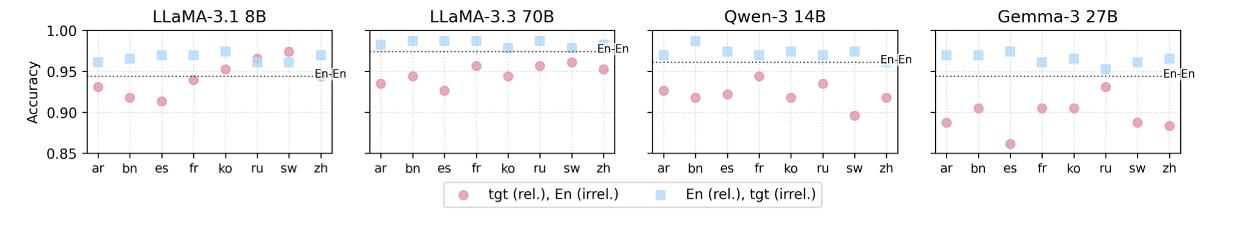
01 · MOTIVATION & GAP IN PRIOR WORK
Multilingual RAG systems systematically prefer citing English sources, yet whether English misinformation overrides accurate Korean facts remains unproven.
Figure 5 (Ki et al., 2025): Accuracy drops when the relevant passage is non-English and a distractor is English (pink) vs. the reverse (blue).
Why This Problem Matters (Real-World Risk)
• Cross-Lingual Retrieval: mRAG retrieves English and Korean passages together.
• Factual Disagreement: Sources often conflict due to updates or misinformation.
• Silent Failure Mode: English dominance risks overwriting accurate Korean facts.
The Gap in Prior Work (Proposal §1.1, §2.2)
• Relevance vs. Conflict: Ki et al. (2025) & Park & Lee (2025) test irrelevant distractors, not direct contradictions.
• Reranker vs. Generator: Wang et al. (2026) study retrieval bias, not generator conflict resolution.
• Unproven Gap: Does English preference override truth in direct EN–KO conflicts?
Source: Figure 5 from Ki et al. (2025, arXiv:2509.13930); Proposal §1.1, §2.2.
2 / 9

Slide 3
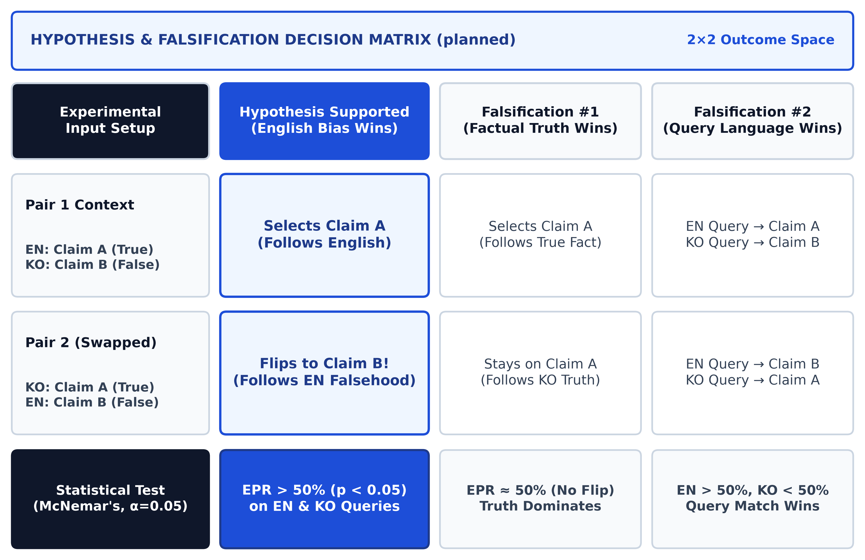
02 · RESEARCH QUESTION, HYPOTHESIS & FALSIFICATION
We hypothesize LLMs systematically favor English claims during direct English–Korean conflicts—and falsify this if accuracy or query language wins.
Research Question (Proposal §1.2)
• Direct Conflict: Given two passages with conflicting claims (one EN, one KO), does an LLM systematically prefer the English claim?
• Accuracy Trade-off: Does English preference hold even when the English claim is factually wrong?
Hypothesis & Falsification (§2.1, §2.3)
• Hypothesis: Models favor the English claim (EPR > 50%, p < 0.05) across both EN & KO queries.
• Falsification #1: Disproved if models keep true Claim A in both Pair 1 & Pair 2.
• Falsification #2: Disproved if EN wins only on EN queries and KO wins on KO queries.
Planned Decision Matrix (planned): Outcomes for Hypothesis Confirmation vs. Falsification #1 & #2.
Source: Proposal §1.2 (Research Question), §2.1 (Hypothesis), §2.3 (Falsification Design); Ki et al. (2025); Wang et al. (2026).
3 / 9

Slide 4
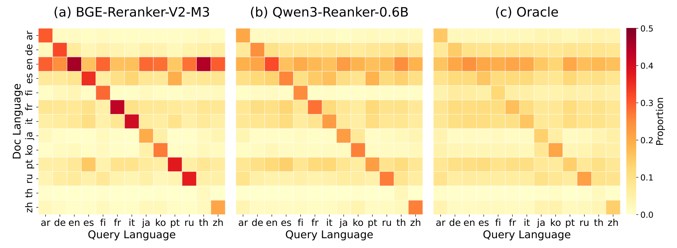
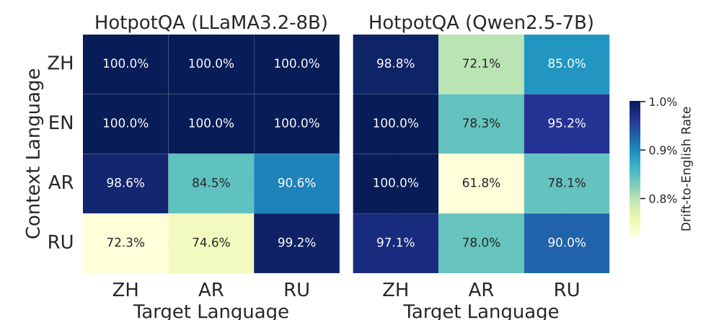
03 · THEORETICAL FOUNDATION & CITED EVIDENCE
Prior work proves English acts as a dominant attractor in reranking and decoding, explaining why models over-trust English context.
Wang et al. (2026), Fig. 3: Horizontal band shows English ('en') reranker preference.
Li, Xu, & Xie (2025), Fig. 3: 61.8%–100% fallback-to-English drift on HotpotQA.
How Cited Mechanisms Motivate Our Conflict Prediction (Proposal §2.2, §3)
• Reranking Attractor (Wang et al., 2026): Rerankers over-select English passages and query-matching passages over Oracle distributions.
• Decoding Drift (Li, Xu, & Xie, 2025): LLaMA-3-8B & Qwen-2.5-7B treat English as a default attractor state in hidden representations.
• Context Consistency (Qi et al., 2025; Park & Lee, 2025): Higher context reliance in Latin-script languages predicts asymmetric English trust during conflicts.
Source: Figure 3 from Wang et al. (2026, arXiv:2604.20199); Figure 3 from Li, Xu, and Xie (2025, arXiv:2511.09984); Qi et al. (2025); Proposal §2.2, §3.
4 / 9

Slide 5
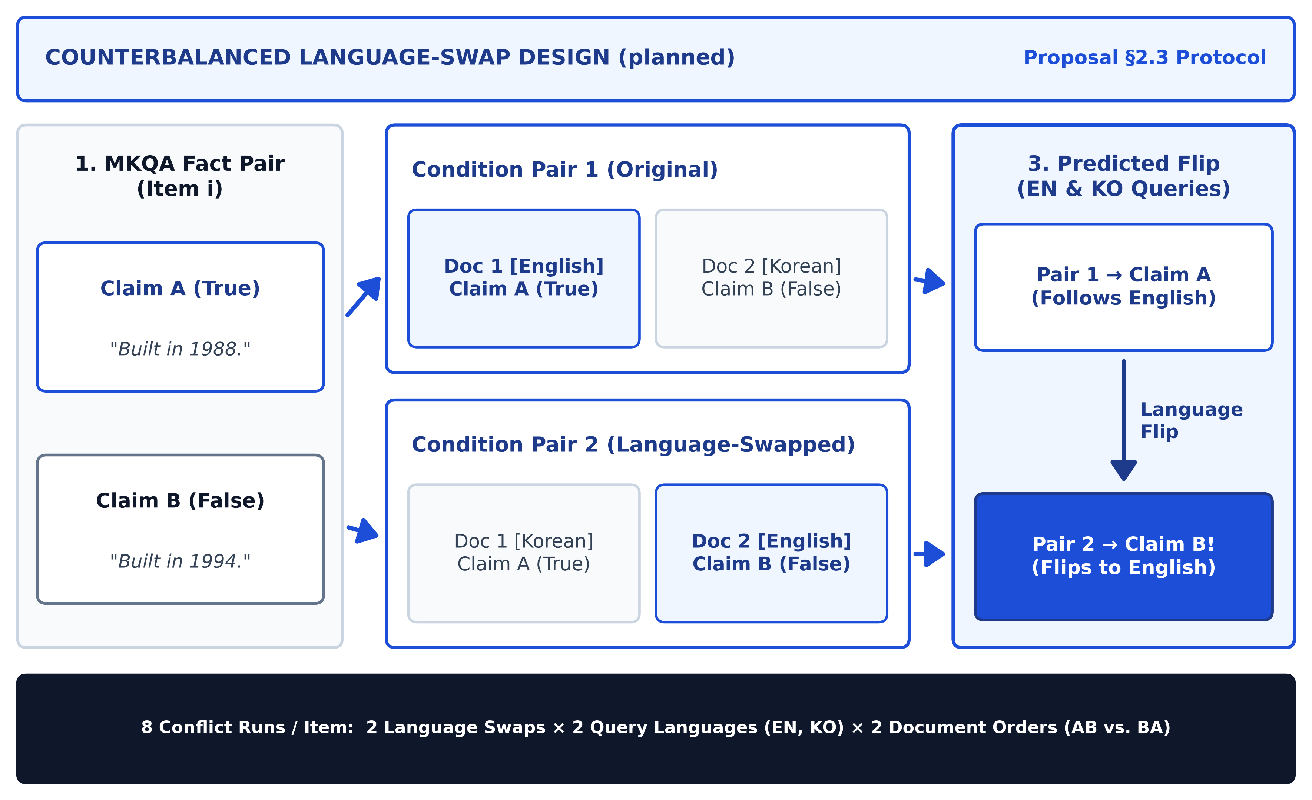
04 · RESEARCH LOOP: PREDICTION & EXPERIMENTAL DESIGN
Swapping the languages of conflicting claims isolates language authority: flipping from Claim A to Claim B proves English drives factual trust.
Experimental Setup (§2.3)
• Claim A (True): Verified MKQA ground-truth fact.
• Claim B (False): Plausible conflicting entity from the same category.
• Language Swap: Pair 1: [EN=A, KO=B]; Pair 2 swaps to [KO=A, EN=B].
Core Prediction (§2.3)
• Pair 1 Output: Model selects Claim A (stated in English).
• Pair 2 Flip: Model flips from A to B when Claim B is placed in English.
• Causal Proof: Identical content proves language drove the flip.
Planned Language-Swap Setup (planned): Claims swap languages between Pair 1 and Pair 2.
Source: Proposal §2.3 (Core Idea: Counterbalanced Language-Swap Protocol, planned experimental setup).
5 / 9

Slide 6
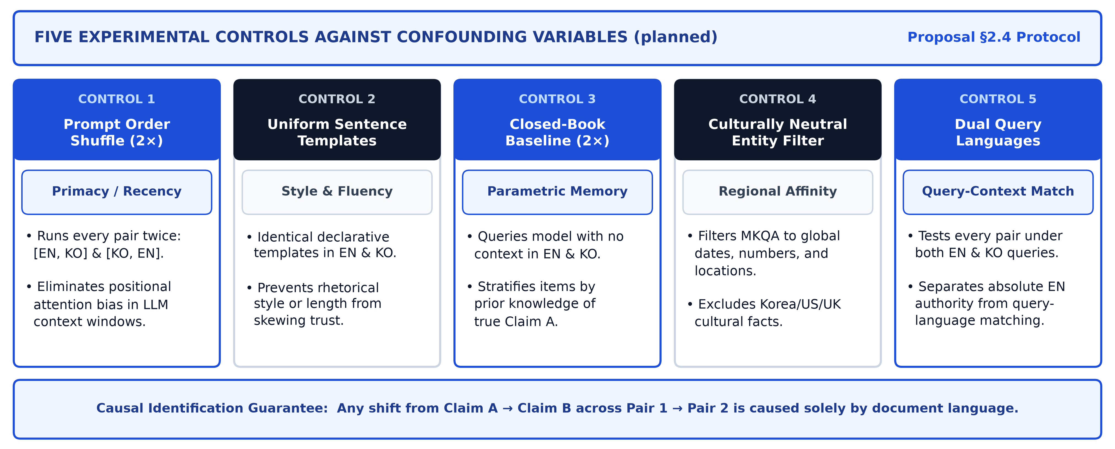
05 · RESEARCH LOOP: CONFOUNDER CONTROL ARCHITECTURE
Five experimental controls eliminate prompt-order, translation-artifact, prior-knowledge, cultural-entity, and query-language confounds.
Planned Five-Control Architecture (planned): Eliminating positional, stylistic, parametric-memory, cultural, and query-matching confounders.
Source: Proposal §2.4 (Confounding Variables and Controls, planned experimental protocol).
6 / 9

Slide 7
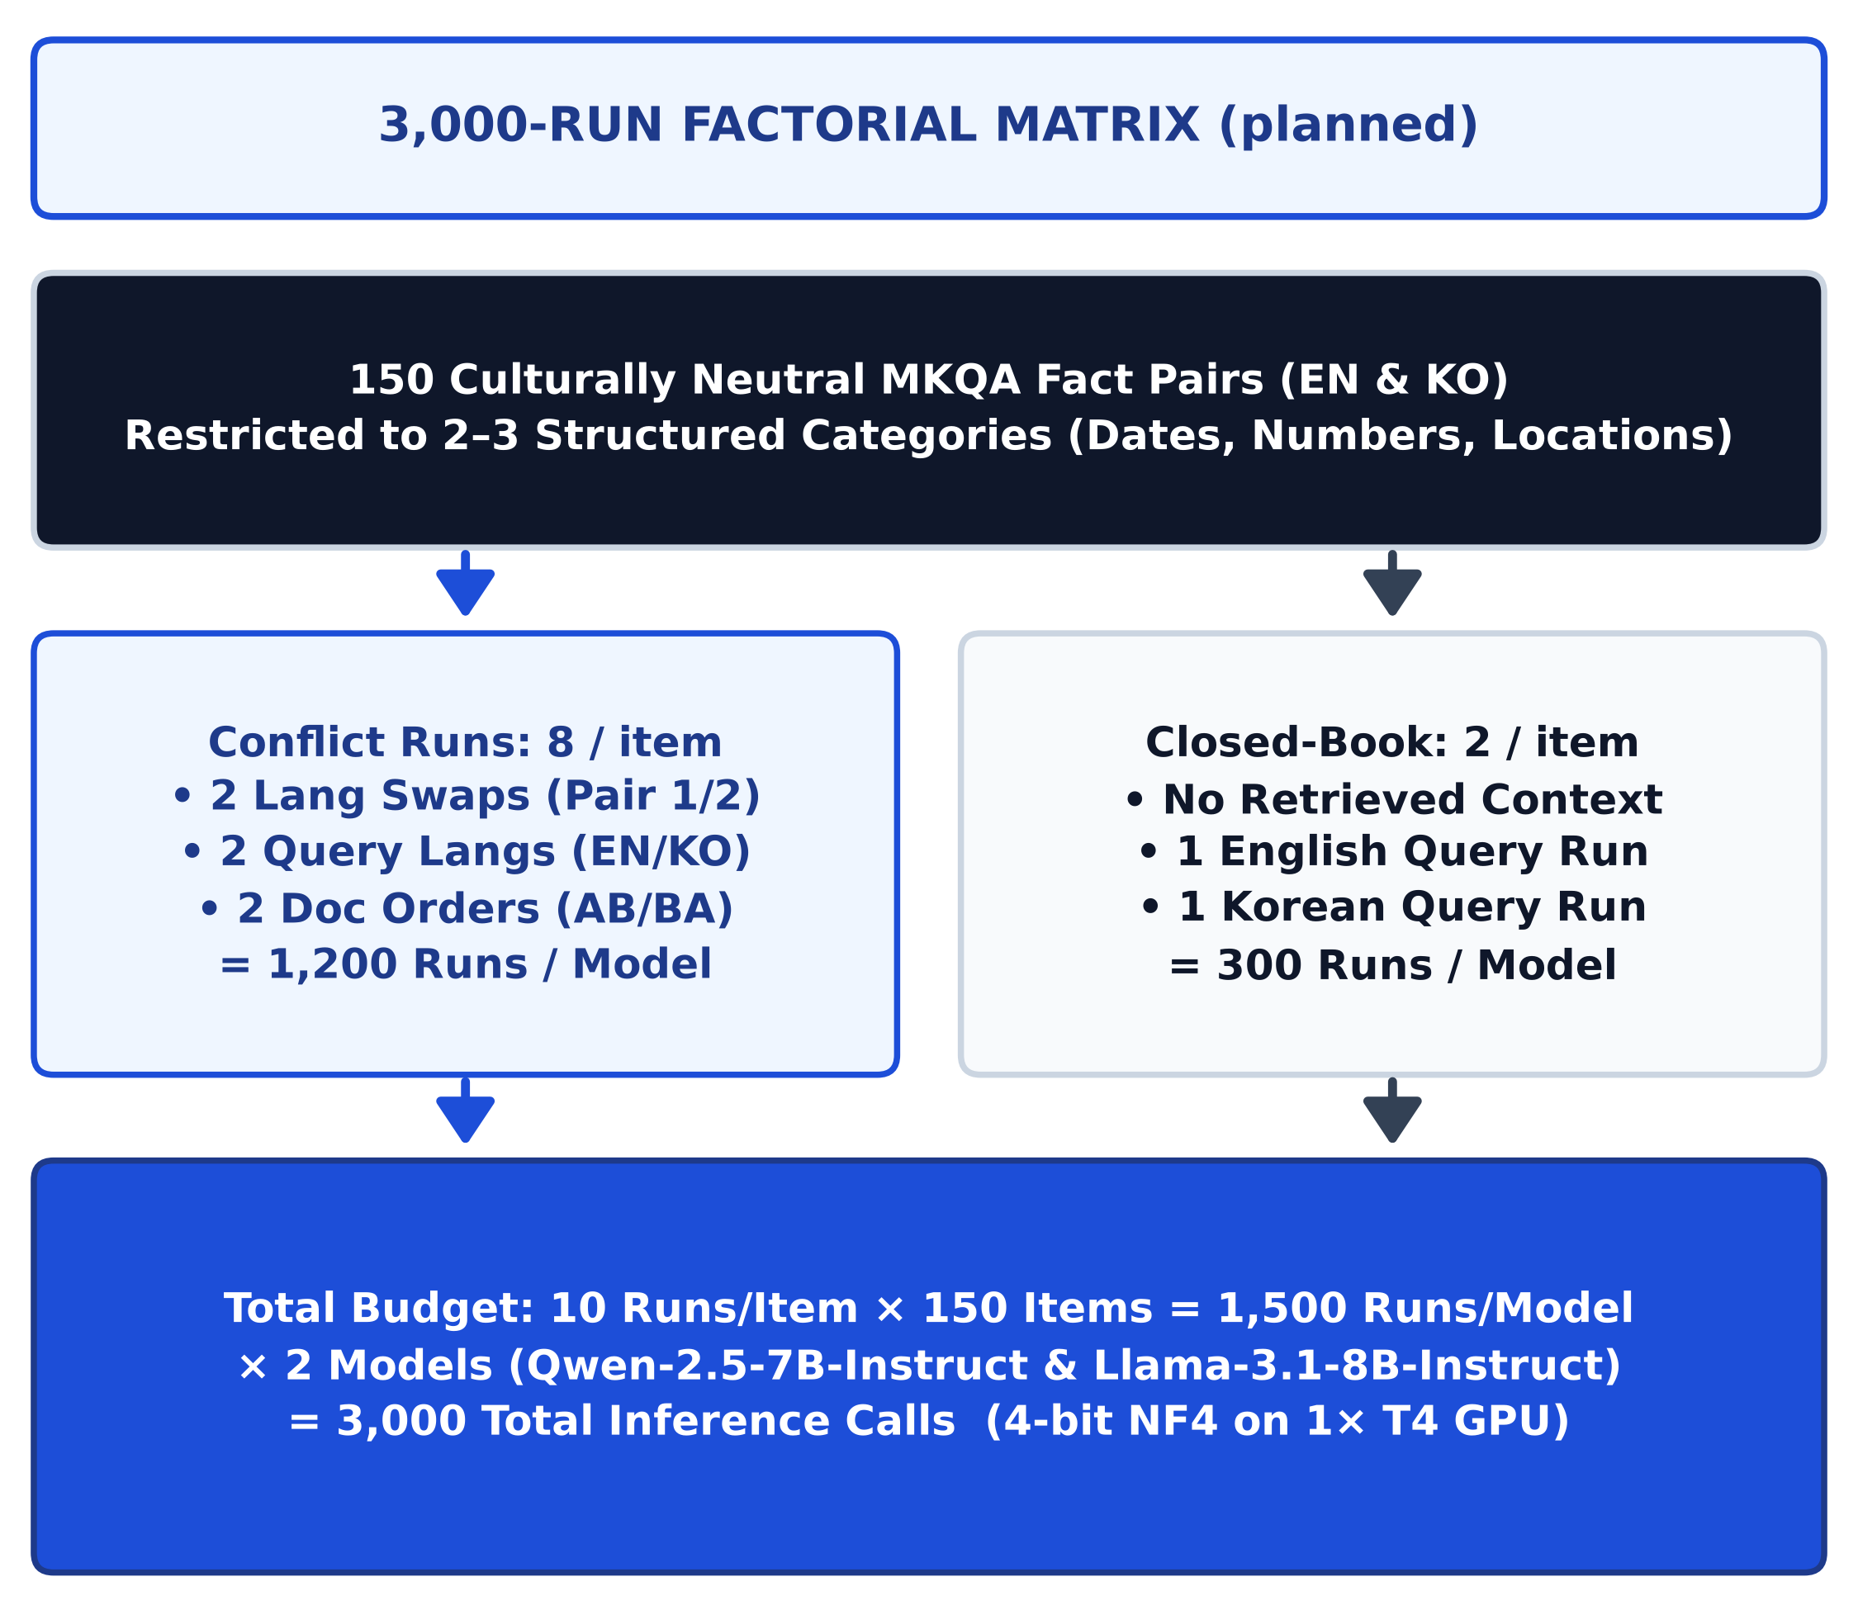
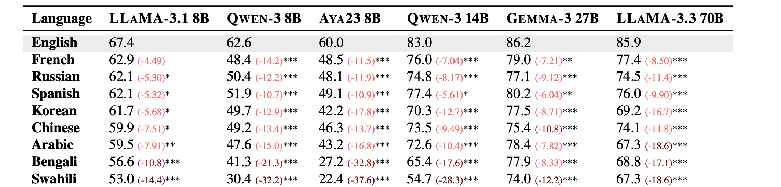
06 · RESEARCH LOOP: DATASET, MODELS & FACTORIAL SCALE
We evaluate 150 culturally neutral MKQA fact pairs across 3,000 total inference runs on Qwen-2.5-7B-Instruct and Llama-3.1-8B-Instruct.
Table 1 (Ki et al., 2025): English vs. Korean accuracy on Llama-3.1 8B and Qwen-3 8B.
Models & Template Design (§4.1–§4.4)
• 2 Open-Weights LLMs: Llama-3.1-8B-Instruct vs. Qwen-2.5-7B-Instruct in 4-bit NF4 on 1× NVIDIA T4 GPU.
• MKQA Entity Filter: 150 culturally neutral items across 2–3 structured types (dates, numbers, locations).
• Parallel Templates: Claim B swaps a same-category entity into fixed EN & KO templates.
Planned Factorial Matrix (planned): 150 items × 10 runs = 3,000 total calls.
Source: Table 1 from Ki et al. (2025, arXiv:2509.13930); MKQA Benchmark (Longpre et al., 2021); Proposal §4.1–§4.4 (planned setup).
7 / 9

Slide 8
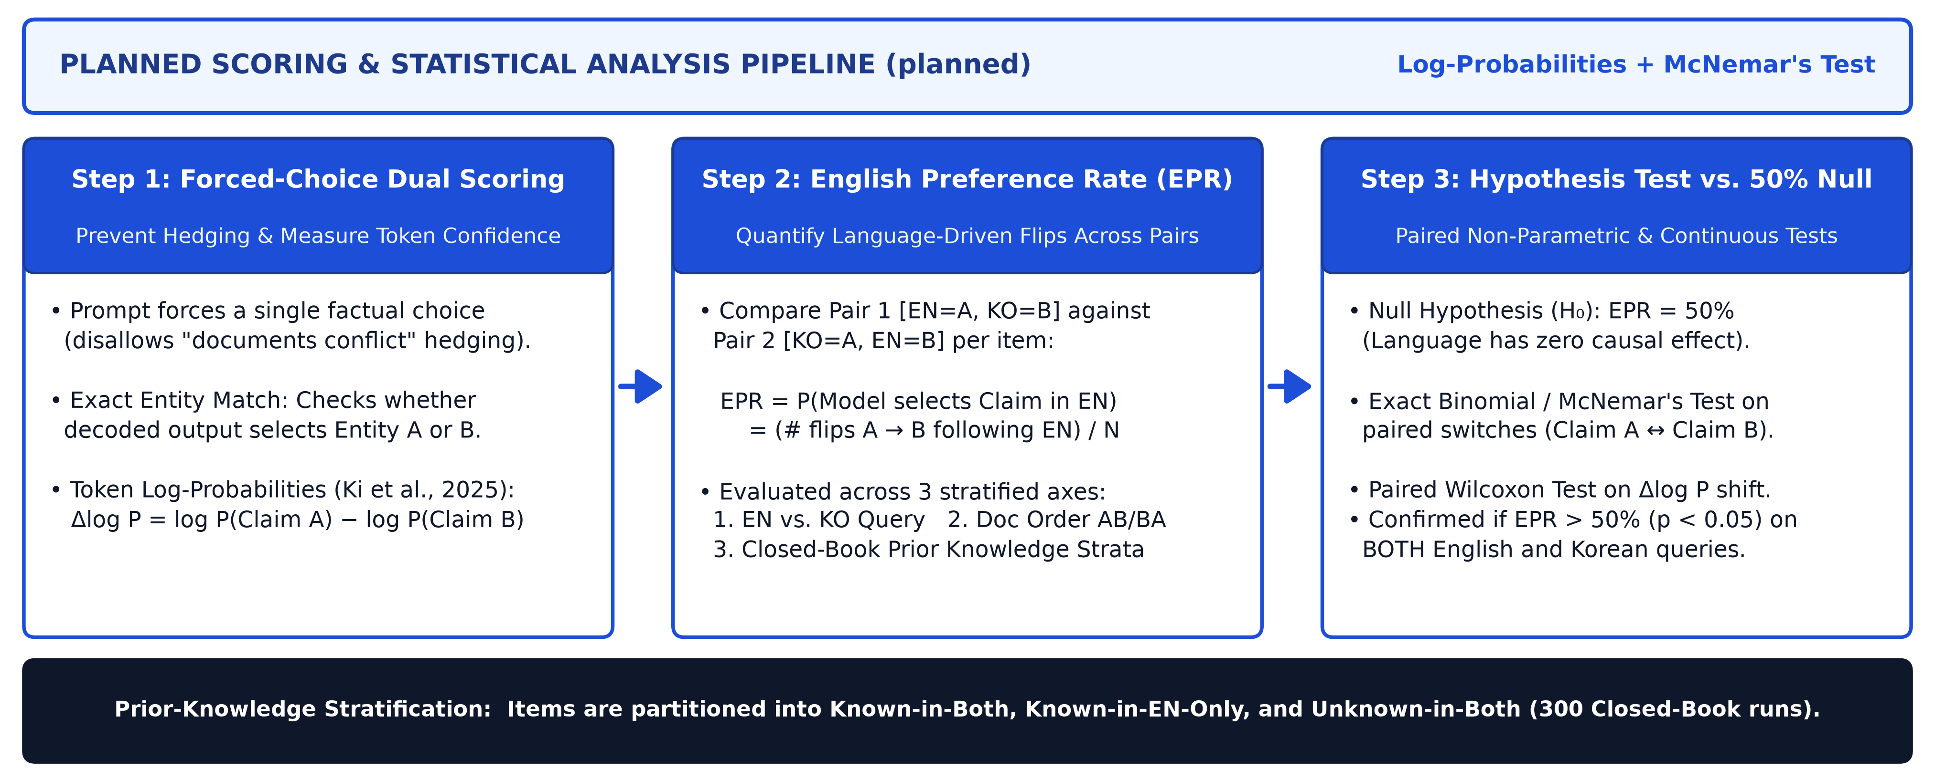
07 · RESEARCH LOOP: PLANNED ANALYSIS & STATISTICAL TESTING
We measure the English Preference Rate (EPR) via exact entity match and token log-probabilities, testing significance against 50% with McNemar's test.
Planned Scoring & Statistical Testing Pipeline (planned): Forced-choice entity matching, answer-token log-probabilities, and paired McNemar's test.
Source: Proposal §2.3–§2.4 & Clarified Analysis Plan (planned); token probability metric adapted from Ki et al. (2025, arXiv:2509.13930).
8 / 9

Slide 9
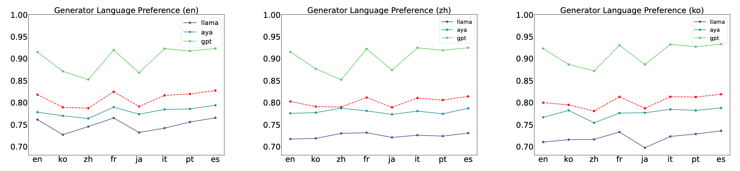
08 · RESEARCH LOOP: EXPECTED CLAIM, SCOPE LIMITS & IMPACT
If English misinformation overrides Korean truth, mRAG alignment must calibrate cross-lingual factual trust—while accounting for script and scale limits.
Figure 3 (Park & Lee, 2025): Generator preference across English (en), Chinese (zh), and Korean (ko) queries favors Latin scripts.
Expected Claim & mRAG Implications
• Expected Result: Both models exhibit EPR > 50% (p < 0.05), preferring English claims even when false.
• Pretraining Contrast: Tests whether Qwen-2.5-7B's East Asian pretraining reduces bias vs. Llama-3.1-8B.
• mRAG Alignment: Requires generator-level cross-lingual trust calibration, not just balanced retrieval.
Scope Boundaries & Limitations
• Script Confound: EN–KO alone cannot separate English dominance from Latin vs. Hangul script bias.
• Scale & Quantization: Evaluates 7B–8B models in 4-bit NF4; 70B+ models may behave differently.
• Synthetic Templates: Single-sentence claims trade naturalistic passage length for strict causal control.
Source: Figure 3 from Park and Lee (2025, arXiv:2502.11175); Wang et al. (2026); Li, Xu, and Xie (2025); Proposal §1.1, §2.2, §4.
9 / 9

