Slide 1
STATISTICS FOR DATA SCIENCE — PROJECT A.Y. 2025/26
Conformal Prediction on MNIST
An R re-implementation of LAC, Adaptive Prediction Sets and the evaluation protocol
PAPER
AUTHORS
SCRIPT
Angelopoulos & Bates, 2021 — Sections 1, 2.1, 4
Iacono & Mungo
Conformal_Prediction_MNIST_V6.4.R
Notes:
Introduce the paper and the two conformal methods we re-implemented. Everything on the following slides comes from one run of our own script.

Slide 2
FRAMING
Paper, Scope and Deliverables
WHAT WE RE-IMPLEMENTED
WHAT WE LEFT OUT
Section 1 — split conformal prediction with the least-ambiguous-classifier score.
Conformalized quantile regression (2.2), scalar uncertainty estimates (2.3), conformalized Bayes (2.4) and risk-controlling prediction sets (3) — all outside the classification setting we chose.
Section 2.1 — adaptive prediction sets built on cumulative softmax mass.
BASE MODEL
Section 4 — coverage and set-size checks, repeated over random splits.
The neural network is adapted from public code, not written by us. It is deliberately treated as a black box — which is exactly the setting conformal prediction is designed for.
Notes:
We did not cover the whole paper. We deliberately took the classification thread end to end: base conformal prediction, its adaptive variant, and the evaluation machinery.

Slide 3
METHOD
Split Conformal Prediction in Four Steps
01
02
Hold out calibration data
Define a score s(X, Y)
Data the fitted model never saw. We use 2,000 images.
LAC: 1 − p(true class). APS: cumulative mass down to the true class.
03
04
Take the conformal quantile
Form the set T(X)
q̂ is the ⌈(n+1)(1−α)⌉-th smallest calibration score, with α = 0.10.
Every label whose score falls at or below q̂. Coverage ≥ 1 − α follows.
Notes:
The four steps are identical for both methods. Only step two, the score function, changes. That is the whole point of the paper.

Slide 4
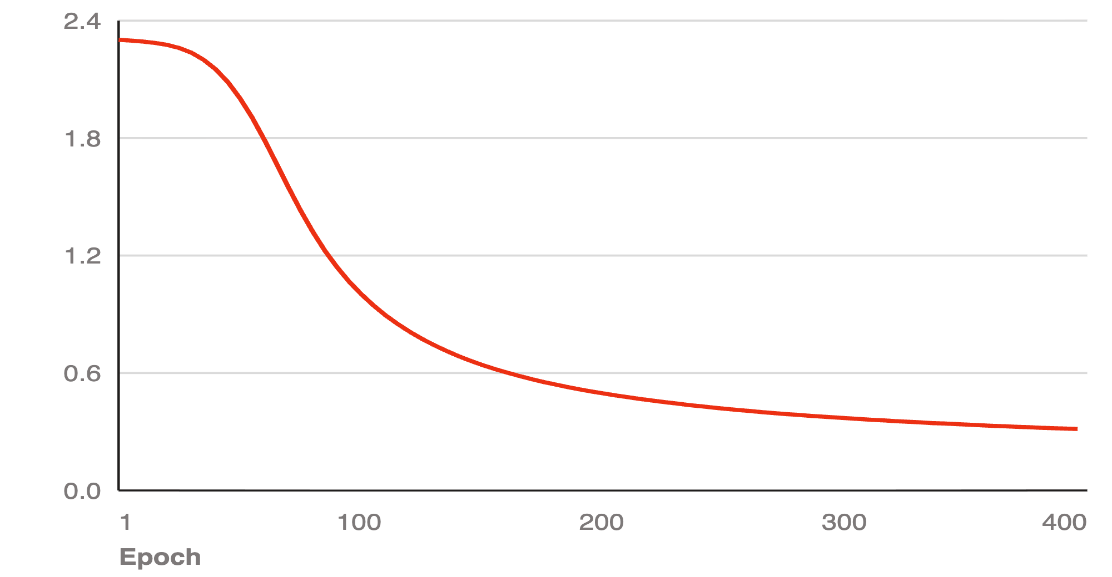
SETUP
Data, Splits and Base Classifier
TRAIN
CALIBRATE
TEST
CROSS-ENTROPY LOSS OVER 400 EPOCHS
4,000
2,000
2,000
784 pixels scaled to [0, 1] → one hidden layer of 64 ReLU units → softmax over 10 digits. Full-batch gradient descent, learning rate 0.1, 400 epochs, seed fixed.
Accuracy, training set
91.95%
Accuracy, test set
89.10%
Loss falls from 2.302 to 0.312. The curve is still descending — the classifier is adequate, not tuned.
Notes:
8,000 of the 70,000 MNIST images, split 50/25/25. The network is a single hidden layer trained by plain full-batch gradient descent for 400 epochs.

Slide 5
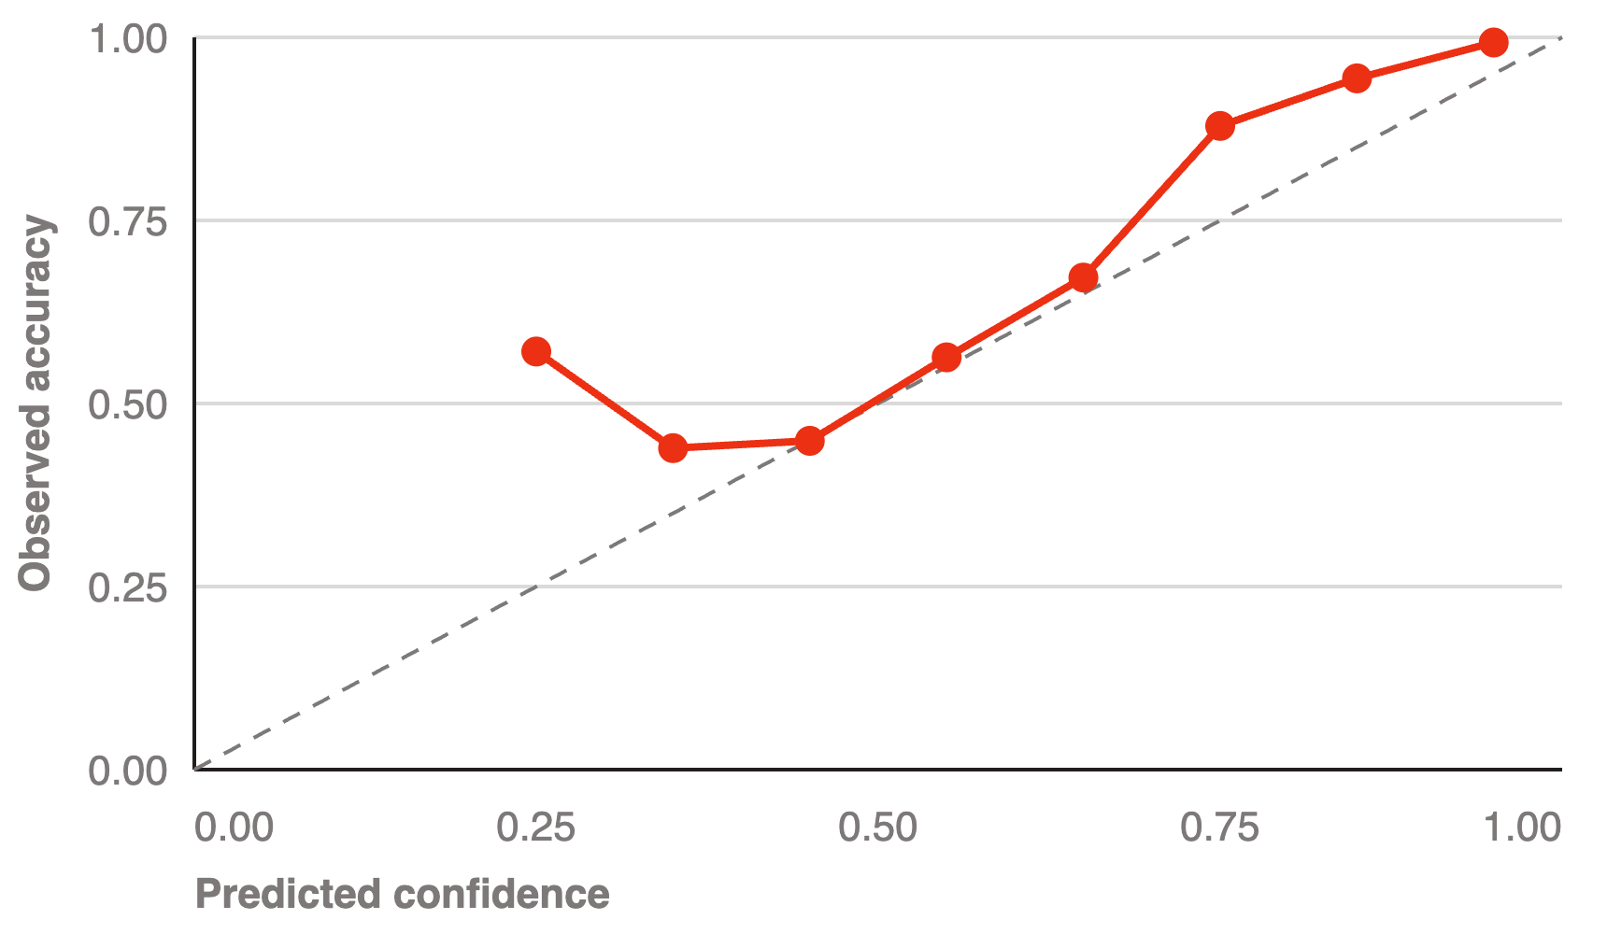
DIAGNOSTIC
Calibration of the Raw Softmax
The softmax is not a probability we can trust as it stands.
In the 0.75 bin the network is right 87.9% of the time and in the 0.85 bin 94.4% — it understates its own accuracy. Below 0.5 the estimates wander and the bins are thin.
55% of test images arrive with confidence above 0.90, where accuracy is 99.3%. The remaining tail is where prediction sets have to do the work.
This is why the paper insists the guarantee is distribution-free: nothing above needs to be fixed for conformal prediction to be valid.
Observed accuracy against predicted confidence, ten bins, 2,000 test images. Dashed line is perfect calibration.
Notes:
Before conformalising, ask whether the softmax is trustworthy on its own. It is not: in the 0.75 and 0.85 confidence bins the network is under-confident, and the low bins are noisy. This is the heuristic uncertainty the paper talks about.

Slide 6
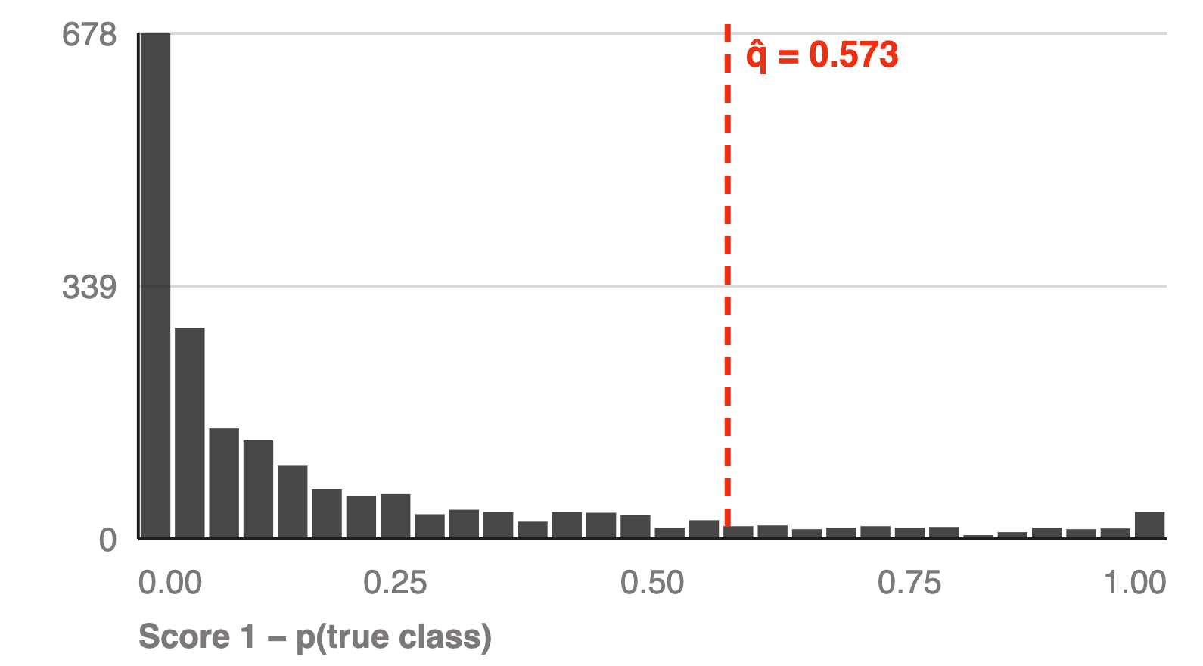
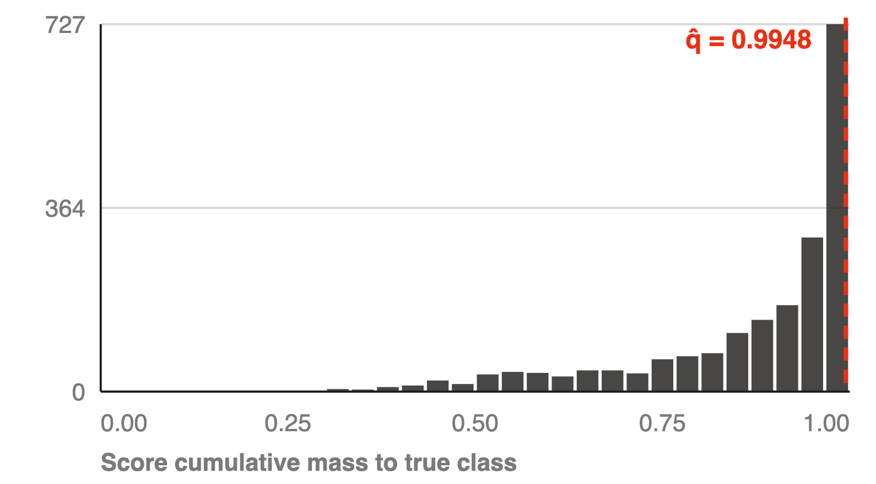
CALIBRATION
Conformal Scores and Thresholds
LAC — s = 1 − p(true class)
APS — cumulative mass to true class
Heavily right-skewed: 48% of calibration images score below 0.033. The 90th percentile lands at q̂ = 0.573 , so a label enters the set when its softmax exceeds 0.427.
Mirror image: mass concentrates just under 1. The quantile is pushed to q̂ = 0.9948 , which forces sets to accumulate almost all the probability mass.
Notes:
Two score functions, two very different calibration distributions. LAC scores pile up near zero; APS scores pile up near one. The quantile inherits that shape.

Slide 7
RESULTS — SECTION 1
LAC Results on the Test Split
THRESHOLD Q̂
EMPIRICAL COVERAGE
MEAN SET SIZE
0.573
88.15%
0.98
Sets are almost always a single digit: 96.1% of test images get exactly one label.
60 test images (3.0%) receive an empty set.
When no softmax value exceeds 1 − q̂ = 0.427, the rule returns nothing and coverage on those images is zero by construction. Marginal coverage still holds; the sets are simply useless where the model is most confused.
Only 18 images (0.9%) receive two or more labels. LAC is the most efficient score in the paper, and this is what that efficiency looks like.
Notes:
On this single split LAC came in at 88.15 percent, just under target. That is split noise, not a bug — slide 11 shows the average over fifty splits. Note the empty sets.

Slide 8
RESULTS — SECTION 2.1
APS Results on the Test Split
THRESHOLD Q̂
EMPIRICAL COVERAGE
MEAN SET SIZE
0.995
99.70%
4.04
The guarantee is a lower bound, and APS sits far above it.
Overconfident tails inflate q̂.
For the ~11% of calibration images the network gets badly wrong, the true class sits near the bottom of the ranking, so the cumulative mass needed to reach it is close to 1. The 90th percentile of that distribution is 0.9948, and every test image then pays for it.
We implemented Equation 2 without the randomised tie-breaking the paper mentions in its footnote. The greedy rule always adds one class past the threshold, so every set is at least as large as it needs to be — and never empty.
Notes:
APS over-covers badly here: 99.7 percent against a 90 percent target, with sets of four labels. This is the most interesting finding in the project and it has a concrete cause.

Slide 9



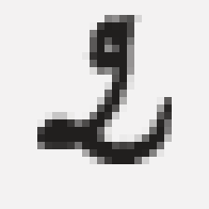


ILLUSTRATION
Prediction Sets on Real Digits
TRUE 0
TRUE 7
TRUE 2
TRUE 6
TRUE 9
TRUE 0
LAC {0}
LAC {7}
LAC {2}
LAC {6}
LAC {9}
LAC {0}
APS {0,2,6}
APS {7,9}
APS {2,6}
APS {2,5,6,8}
APS {3,4,5,8,9}
APS {0}
Both methods contain the truth in all six cases. APS spends extra labels to say where the image is ambiguous; LAC says nothing about it.
Notes:
Six test digits picked at random. LAC gives one label; APS widens where the image is genuinely ambiguous. The last one is easy and both agree.

Slide 10
COMPARISON
LAC versus APS, Side by Side
METRIC
LAC — SECTION 1
APS — SECTION 2.1
READING
Threshold q̂
0.573
0.995
Different scales, not comparable directly
Coverage, 50 splits
90.08%
99.71%
LAC hits the target; APS over-covers
Mean set size
1.00
4.08
Four times the labels for the same nominal α
Single-label sets
96.1%
9.5%
LAC behaves like a point classifier
Empty sets
3.0%
0.0%
LAC abstains silently on hard images
Worst digit coverage
79.4%
99.1%
Conditional coverage is where LAC pays
Notes:
The trade-off in one table. Neither score dominates — they fail in opposite directions.

Slide 11
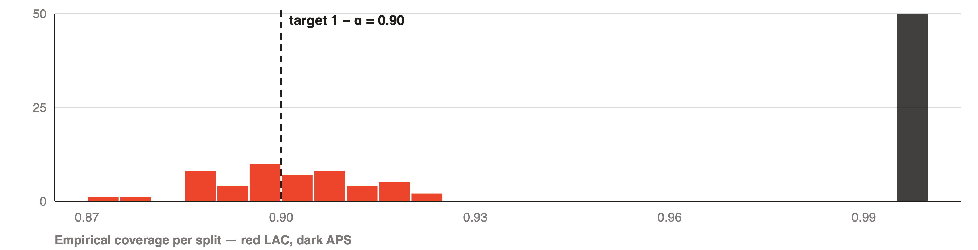
EVALUATION — SECTION 4.1
Coverage over Fifty Random Splits
LAC COVERAGE
APS COVERAGE
INTERPRETATION
90.08%
99.71%
The 88.15% seen on the single split was ordinary calibration noise. Averaged over splits the guarantee is met almost exactly — the theorem is about the average over calibration sets, not about one draw.
σ = 1.12 pts, range 87.4 – 92.1
σ = 0.10 pts, range 99.5 – 99.9
Notes:
This is Section 4.1 of the paper: rerun calibration and evaluation fifty times and look at the histogram. LAC centres on 0.90 exactly as the theorem says.

Slide 12
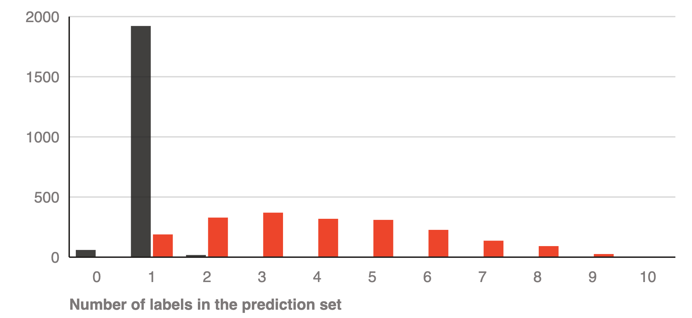
EVALUATION — SECTION 4.1
Set Size Distributions and Adaptiveness
LAC produces a spike; APS produces a distribution.
The paper argues a wider spread is desirable: it means the procedure separates easy inputs from hard ones. APS spans one to nine labels, LAC only zero to two.
But spread is not free. APS pays 4.08 labels per image on average, and its narrowest sets still over-cover. Adaptiveness here comes bundled with inefficiency, not instead of it.
Number of test images by set size. Dark bars LAC, red bars APS.
Notes:
The second basic check in Section 4.1. The spread of set sizes tells you whether the procedure distinguishes easy from hard inputs. LAC has no spread at all.

Slide 13
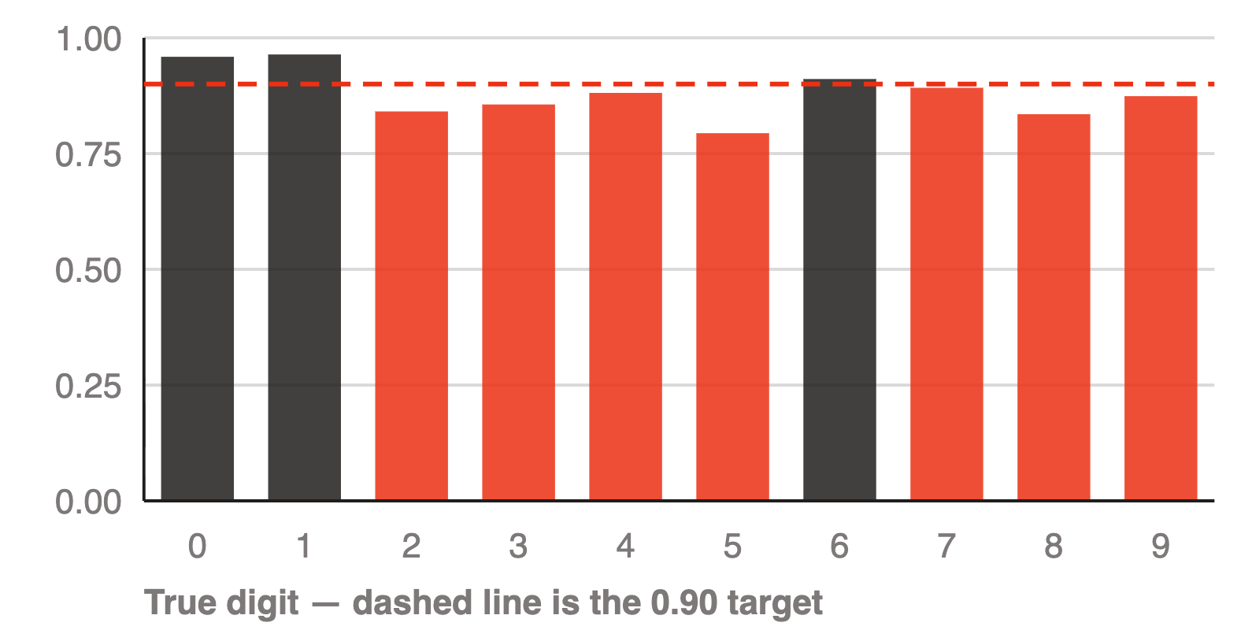
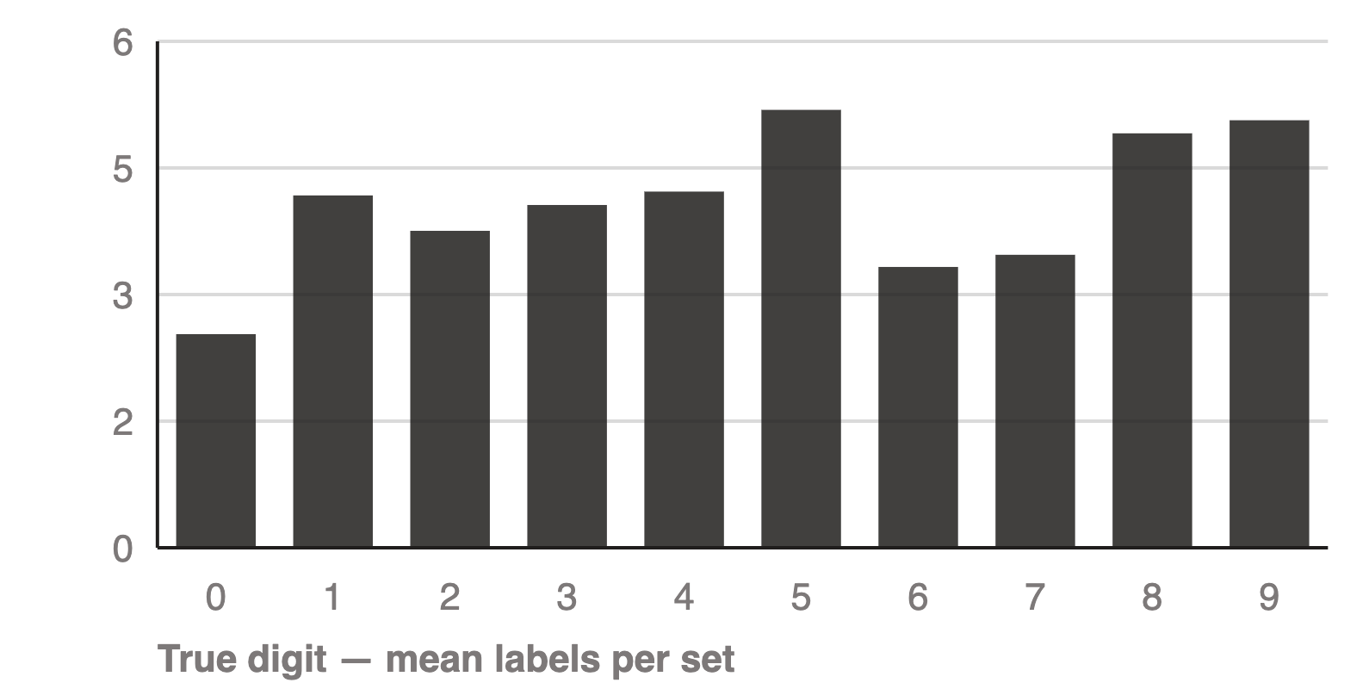
EVALUATION — SECTION 4.2
Coverage by Digit — Feature-Stratified
LAC coverage per digit
APS mean set size per digit
FSC metric = 0.794 on the digit 5, against a 0.90 target. Zeros and ones are over-covered at 0.96.
APS keeps every digit above 0.99 coverage and moves the cost into size: 2.53 labels for zeros, 5.19 for fives.
Notes:
Feature-stratified coverage from Section 4.2, with the digit label as the stratifying feature. LAC drops to 79 percent on fives — exactly the undercoverage of hard subgroups the paper predicts.

Slide 14
EVALUATION — SECTION 4.2
Coverage by Set Size — Set-Stratified
LAC — SSC = 0.000
APS — SSC = 0.995
size 0 · 60 images
0.000
size 1 · 189 images
1.000
size 1 · 1,922 images
0.909
size 2 · 329 images
0.997
size 2+ · 18 images
0.833
size 3–4 · 689 images
0.999
Marginal coverage is bought by covering the easy 96% and abandoning the rest.
size 5+ · 793 images
0.995
Uniform across bins — but uniformly above target, which is its own kind of miscalibration.
Notes:
Set-stratified coverage, the general-purpose adaptiveness metric from Section 4.2. The empty-set bin is the honest failure: coverage there is zero by construction.

Slide 15
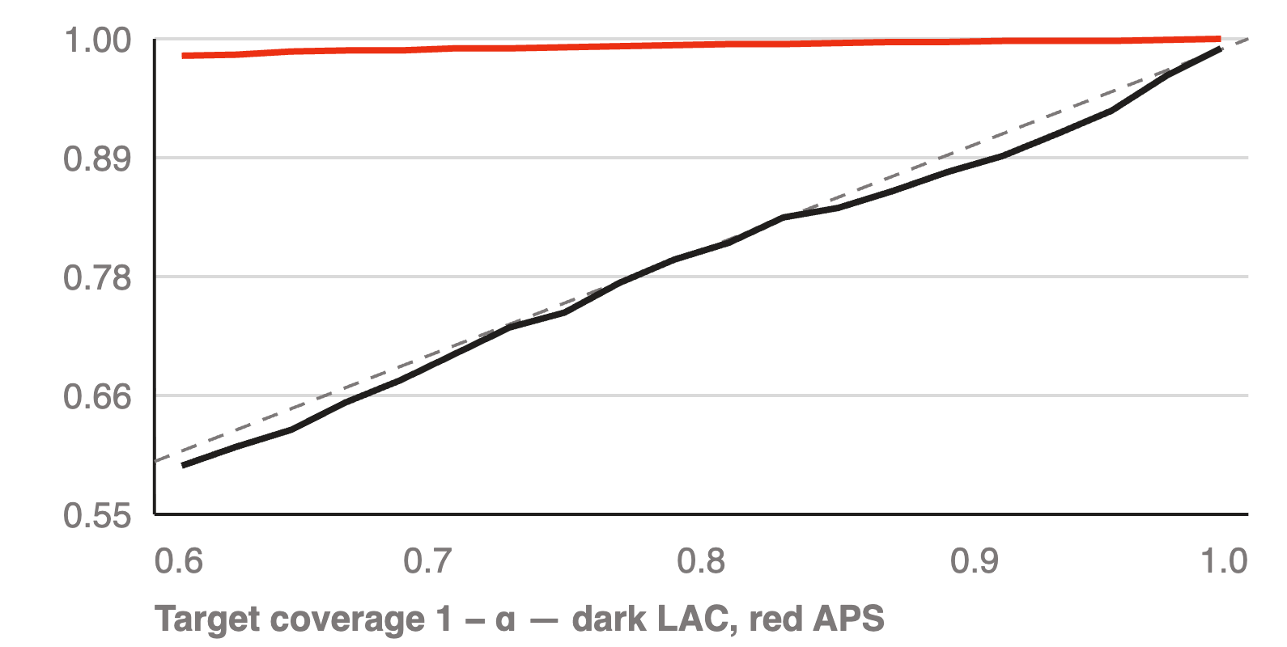
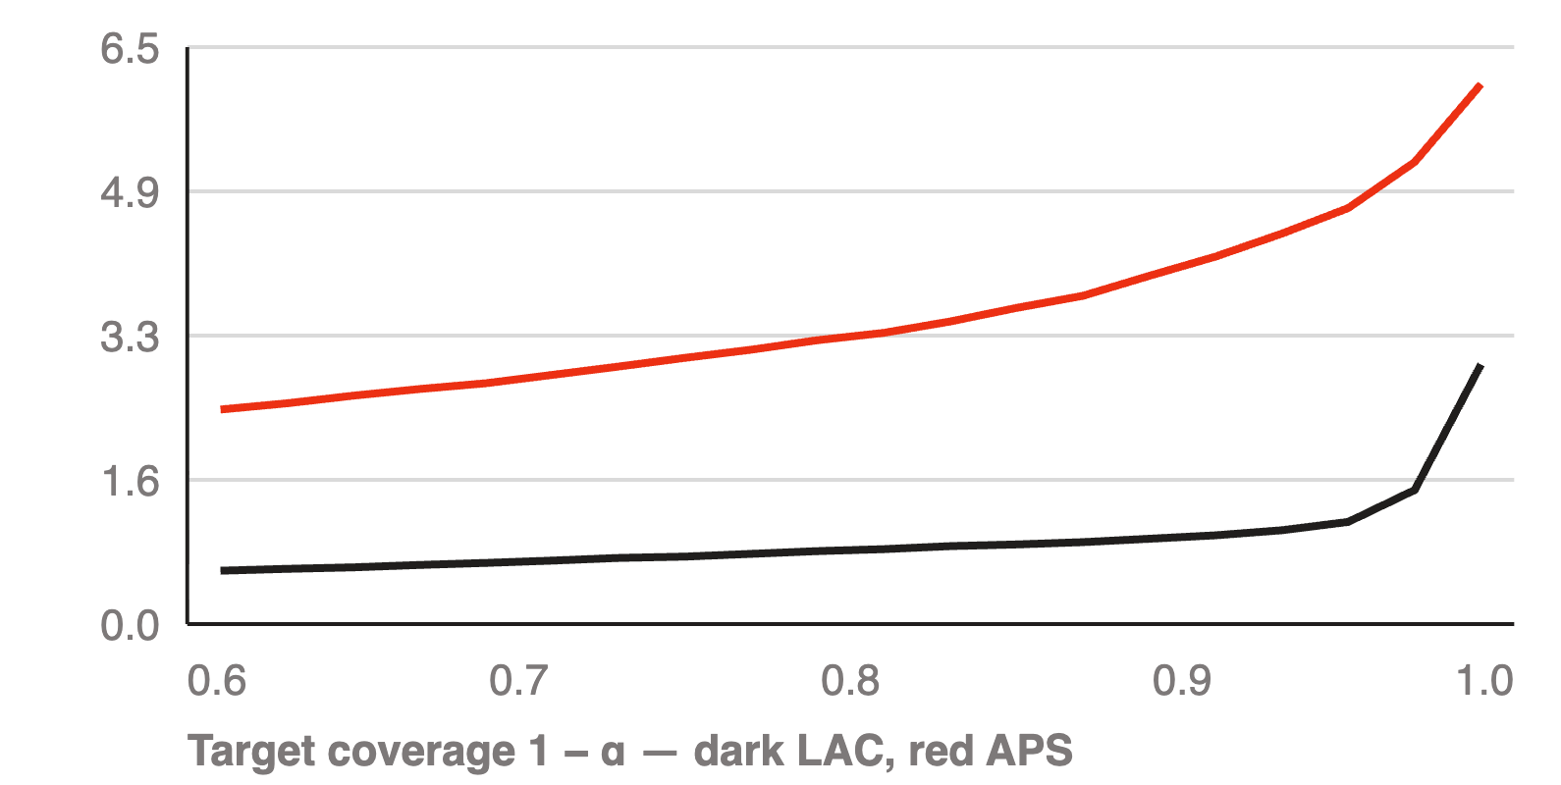
SENSITIVITY
The Coverage–Efficiency Trade-off
Empirical against target coverage
Mean set size against target
LAC follows the diagonal across the whole sweep, one to two points low. APS is pinned near 1.00 regardless of what we ask for.
The price of certainty is convex: LAC needs 1.00 labels for 91% and 2.93 for 99%. APS starts at 2.42 and reaches 6.08.
Notes:
Sweeping alpha from 0.01 to 0.39. LAC tracks the target line closely and its size grows sharply only past 0.97. APS is flat and high throughout.

Slide 16
CONCLUSIONS
Findings, Limitations and Next Steps
The coverage guarantee reproduced on the first try. Everything difficult was about which score to use.
FINDING 01
FINDING 02
FINDING 03
LAC met the 90% target over 50 splits with a mean set size of 1.00 — but under-covered fives at 79% and returned empty sets for 3% of images.
APS equalised coverage across digits and set sizes, at four times the labels and a 9.7-point overshoot — validity is easy, tightness is not.
Single-split coverage was 88.15%; the fifty-split average was 90.08%. Reporting one split would have looked like a failed reproduction.
LIMITATIONS
NEXT STEPS
8,000 of 70,000 images, one network, one seed. APS omits the randomised tie-breaking that would remove most of its overshoot.
Add randomised APS, report Mondrian per-digit calibration for LAC, and re-run the sweep on a convolutional base model.
Notes:
Close on the three things we actually learned, and be honest about the two limitations. Randomised APS and a stronger base model are the obvious next steps.

