Slide 1
ML Project 25/26
Authors : Francesco Bernardini, Alessandro Iacono
Computer Science (AI), Data Science
f.bernardini22@studenti .unipi.it , a.iacono8@studenti.unipi.it
Team Name : EnSIUMble
Date 15/05/2026
Type of Project : B

Slide 2
Objectives of our Project
1
Our goal for this project was to be able to have a practical vision of the topics covered in class
To do that we decided to test most of the ML models covered during the course and see their various behaviors for the various algorithms :
Algorithms tested for each dataset :
Linear Regression / Logistic Regression
Linear + Lasso (L1)
Linear + Ridge (L2)
K-NN
SVM
Neural Networks (MLP)
For all the project the results of each gridsearch are based on a 5-Fold Cross Validation
We fixed for every datasets the seed 42, to ensure the reproducibility of the results
For each activation functions we used the weights initialization suggested by the bibliography [1] [2]
Implementation note : At the coding level we have taken advantage of LLMs
For the implementation we used the following libraries :
Scikit-Learn [3]: For all models except Neural Networks
PyTorch [4]: For Neural Network’s Implementation
We’ll leave in the same folder both the Jupyter Notebook files “Monks_Summary.ipynb” and “Cup_Summary.ipynb”

Slide 3
MONKs Analysis
2
Regarding the MONKs dataset, we decided to exploit its simplicity to be able to work more on the analysis of the results.
Since our objective is one of analysis rather than optimization, for each model a rigorous model selection was performed on the results of the Validation Set, but there is no general Model Selection among all the Models.
The results shown will be the results on the Test Set of the best (higher Accuracy) hyperparameter configuration based on the Validation Set
Pre-processing : We performed an One-Hot Encoding on Training Set only
6 categorical features → 17 binary features after One-Hot Encoding
REPETITA : The study on the MONKs dataset aims to understand the behavior of the various models and their differences, not to choose the best model.
Since the Monks dataset is a classification problem, we chose to use Binary Cross-Entropy as the loss function for the Neural Network, combined with the use of the Sigmoid function as the activation function of the output layer of the Neural Networks [5].

Slide 4
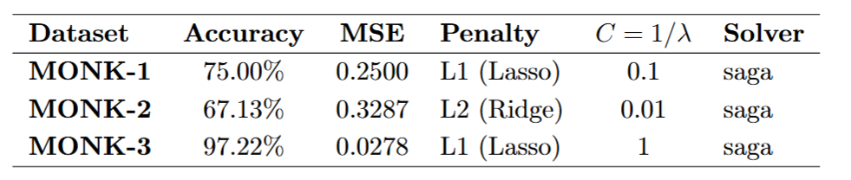
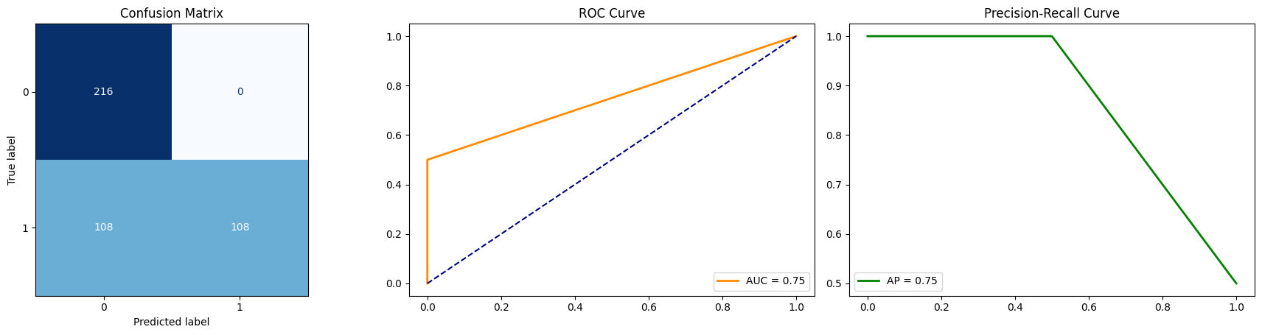
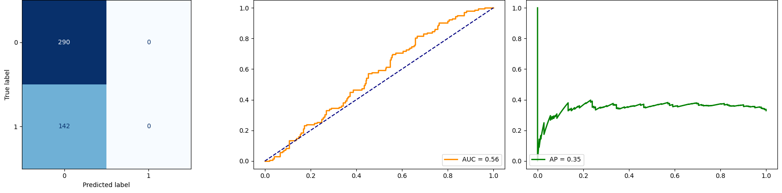
MONKs - Linear Models (I)
3
The application of linear models represents an excellent starting point for our analysis :
It allows us to establish whether the datasets are linearly separable or whether we need to introduce non-linearity
Provides a baseline for subsequent models
Logistic Regression :
The most interesting results come from MONK-1 and MONK-2 :
MONK-1 : The model achieved decent performance by choosing a very strong L1 regularization (C=0.1). The choice of the L1 penalty indicates the model tried to “turn off” many variables, isolating only a few key predictors. The Confusion Matrix shows that the model is perfectly accurate on one class, but frequently misclassifies the other (false negative)
MONK-2: In this case the model selected an even harder regularization (L2 with C=0.01). Unlike L1, L2 does not zero out coefficients but shrinks all weights uniformly toward zero, flattening the decision function. As a result, the prediction is dominated by the bias term, which converges to the majority class. The Confusion Matrix confirms this: the model degenerates into a majority-class classifier, predicting 0 for every instance.
Both results suggest that the relationship in the data is not linearly separable.
MONK-3 : Reached instead a near-perfect performance, using a moderate L1 regularization.

Slide 5
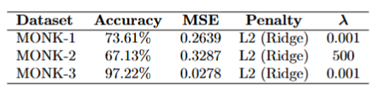
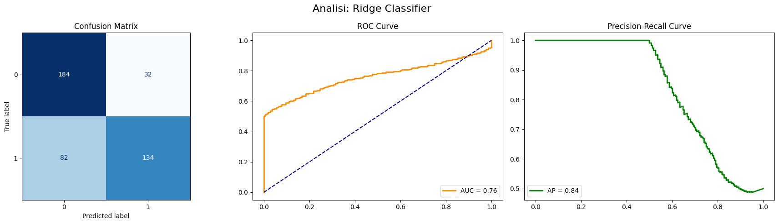
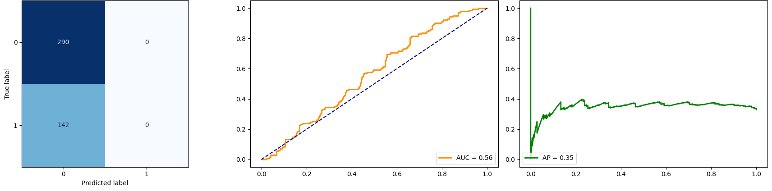
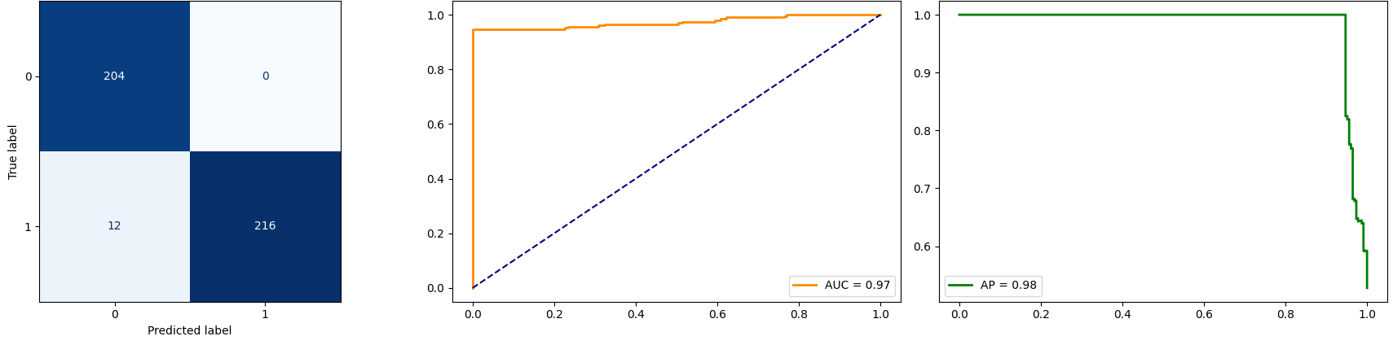
MONKs - Linear Models (II)
4
Ridge Classifier :
Similarly to what was observed for Logistic, the most interesting results remain those of MONK-1 and MONK-2 :
MONK-1 : The behavior is similar to Logistic but with a different mechanism. Ridge L2 does not zero the coefficients like L1, it flattens them uniformly towards zero. The model maintains some residual discriminatory power (CM shows 134 TPs vs. Logistic's 108), but suffers from false positives (32 FPs vs. 0).
MONK-2 : In this case, the interesting finding is the victory of a model with very high regularization. Like Logistic, it degenerates into a majority-class classifier.
MONK- 3 : Same result as Logistic
Ridge confirms what Logistic showed, leading to the same conclusion: the linear boundary is insufficient for MONK-1 and MONK-2, proving us the necessity of non-linearity to solve these two problems.
Furthermore, the fact that the MONK-3 result is identical to the result for Logistic (both 97.22%) makes us hypothesize that there may be noise rather than a difficulty of the model in solving the problem.

Slide 6

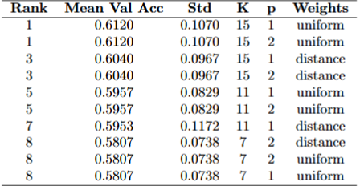
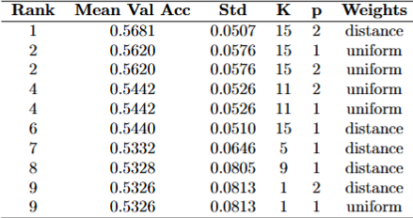
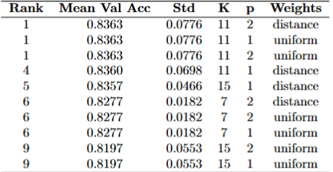
MONKs - K-NN
5
K-NN represents the first brush with nonlinearity for our analysis of the MONKs dataset.
MONK-1 : The high K value is the most significant finding. With on a 124-sample training set, the model consults over K=15 12% of the dataset for each prediction, effectively performing a global vote rather than a local decision.
MONK-2 : The same K=15 pattern appears, but here K-NN represents the first non-linear model in our analysis, and the improvement over linear classifiers is notable (75.9% vs 67.1%). The grid search selected distance-weighted voting over uniform, suggesting the model is trying to extract a finer signal from the neighbor distances, but with limited success.
MONK-3 : We have the only drop in performance on the Test Set (from 97.22% to 89.12%), compared to the Linear Models. One hypothesis to explain this behavior is the presence of noise within the Training Set. When mislabeled training samples fall in the neighborhood (K=11) of a test point, they corrupt the majority vote. Unlike parametric models which fit a global boundary and are robust to individual noisy points, K-NN memorizes every training sample including the corrupted ones.
Interesting Notes : The parameter p (Manhattan vs Euclidean) has no effect on any dataset, as expected in binary OHE space where both metrics induce the same neighbor ranking [6].
MONK-1
MONK-2
MONK-3

Slide 7

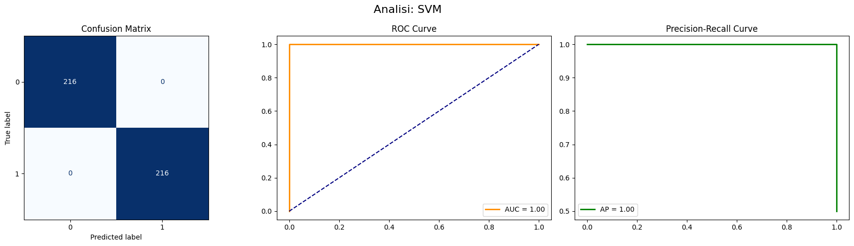
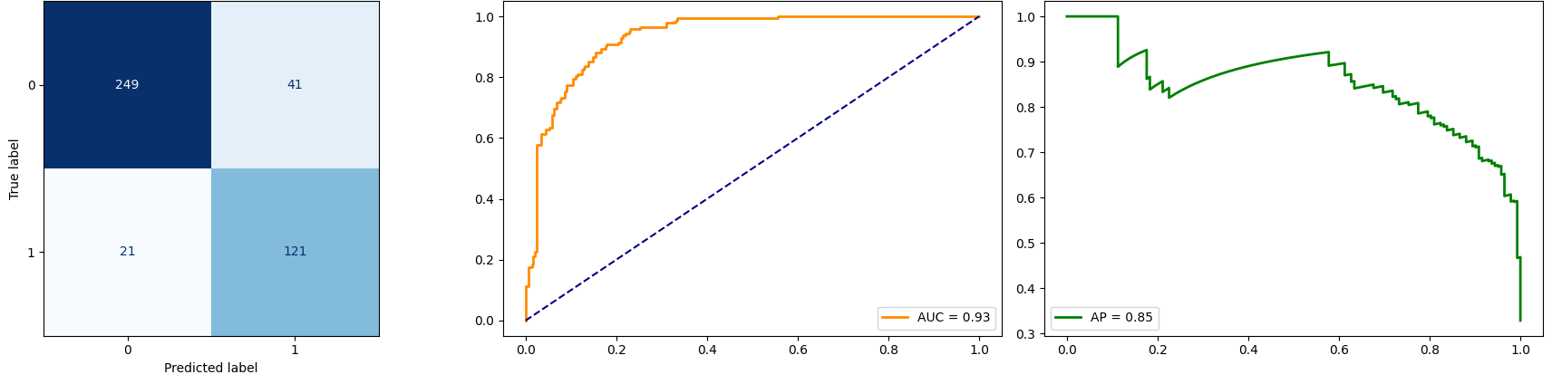

MONKs – SVM
6
SVM : We decided to test the 4 Kernels seen during the SVM’s lecture on all 3 datasets: Linear, Polynomial Learning Machine, Radial Basis Function Net, Two-layer perceptron.
MONK-1 : SVM completely solves the problem. The CM shows zero errors and AUC = 1 confirms the separation with no overlap. The victory of poly of degree = 2, confirms that the problem requires feature interactions (non-linearity), but these interactions are relatively simple.
MONK-2 : In this case the degree increases from 2 to 3 compared to MONK-1, signaling a more complex decision boundary. The CM shows an important difference with the previous models, a relatively balanced error distribution, indicating the model has learned a genuine discriminative pattern rather than simply favoring one class. However, the model does not reach 100% of accuracy, suggesting that the underlying structure requires even higher-order interactions that degree 3 cannot fully capture
MONK-3 : For the first time across all datasets, a linear kernel wins the grid search. The CM shows 0 FP and only 12 FN (Like in Linear Models), this data confirms the hypothesis made in the previous slide, the fact that a linear model wins over models that are able to describe non-linear relationships but still without reaching 100% accuracy is further proof that the small gap between 97 and 100 is due to noise in the dataset, not to the chosen model.

Slide 8
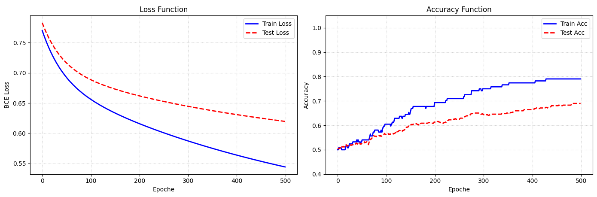
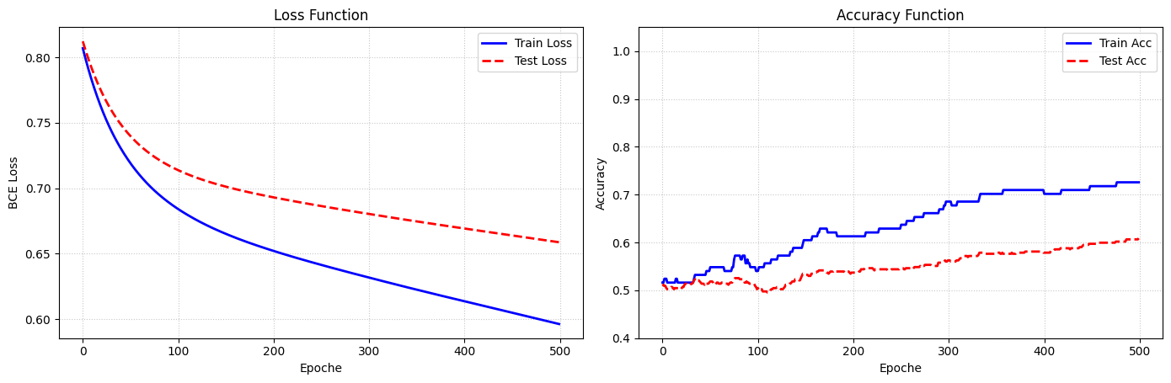
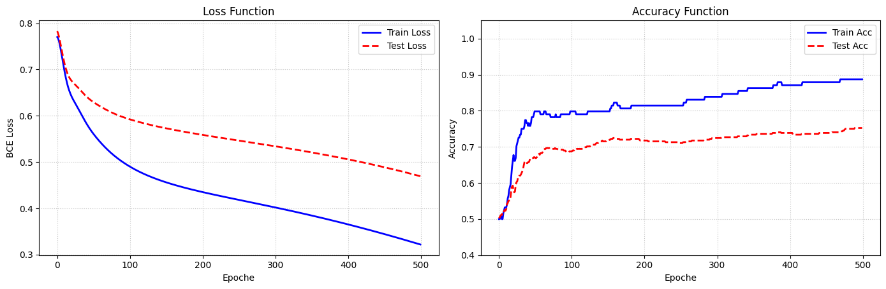
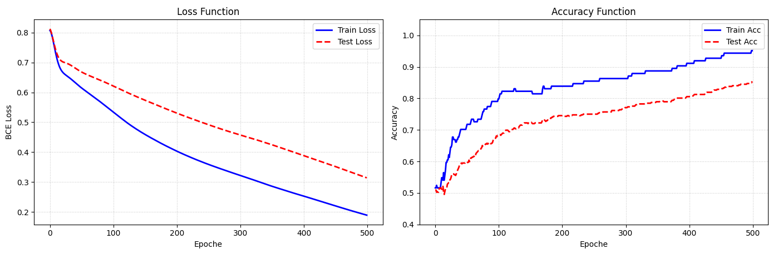
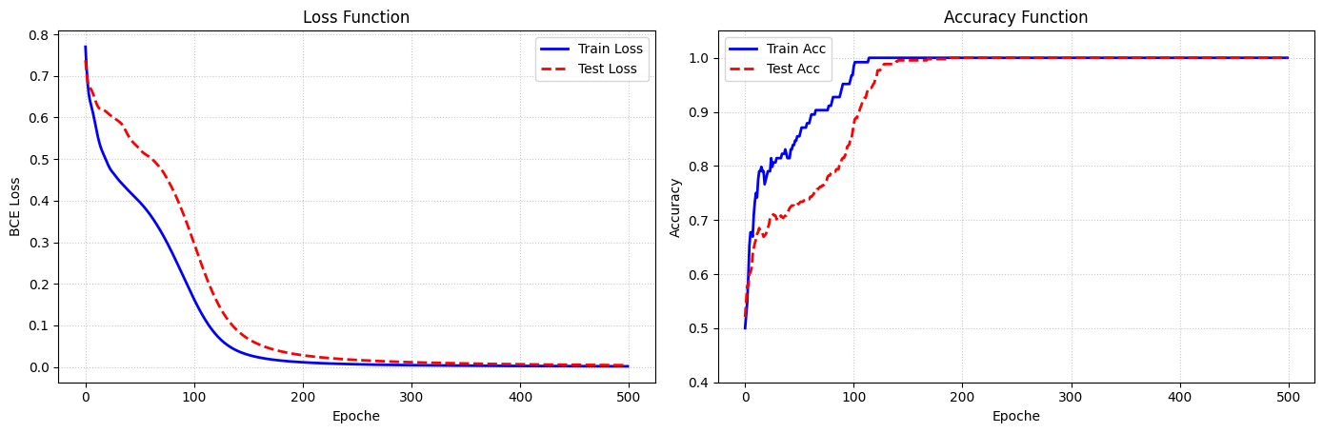
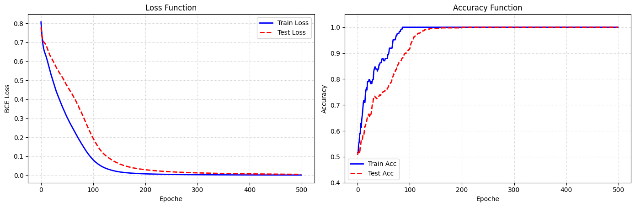
MONKs - NN (I)
7
Before moving on to a real gridsearch for the 3 datasets we decided to define a simple Neural Network with fixed parameters:
Architecture : (16,)
Learning Rate : 0.01
Epochs : 500
The parameters were set to reasonable default values, as the purpose was not to perform tuning but to isolate the effect of the optimizer.
Our goal is to test and see the behavior of the neural network with Stochastic Gradient Descent, add the Momentum and finally use an Adaptive Learning Rate (Adam specifically).
We will test these configurations using two specific activation functions: Tanh and ReLU
 | Tanh | ReLU
SGD
SGD + Momentum (0.9)
ADAM

Slide 9
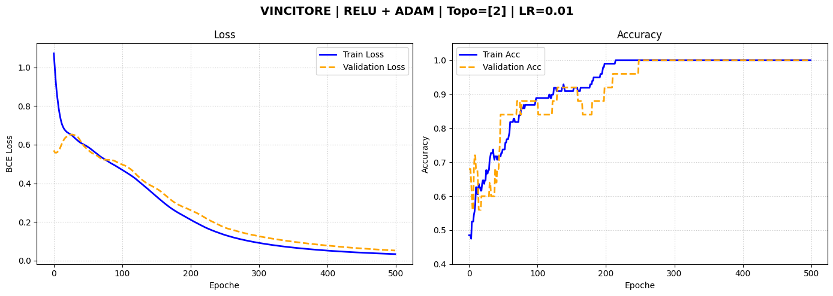
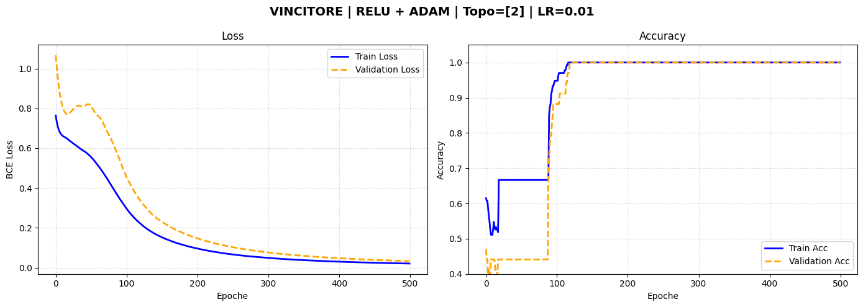
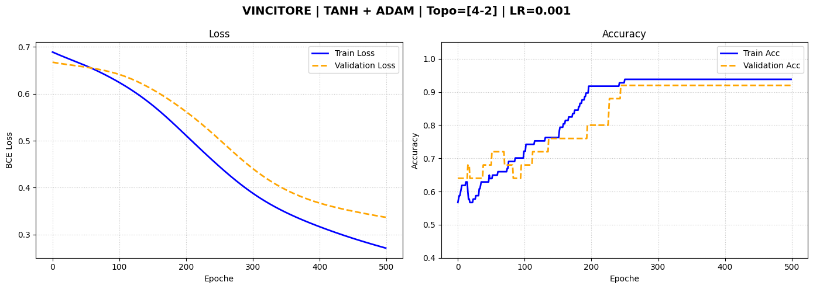
MONKs - NN (II) + Conclusions
8
MONK-1 : TR = 100%| VL = 100%| TS= 100% In the previous slides we hypothesized that MONK-1 is a non-linear problem with relatively simple structure. To confirm this, we restricted the grid search to single-layer architectures with a limited number of units (2 or 4). The fact that this constrained search space still yields 100% test accuracy, consistent with the result previously obtained by SVM with a polynomial kernel of degree 2 ,provides strong empirical confirmation of our hypothesis: MONK-1 requires non-linearity, but the underlying decision boundary can be captured by networks of low capacity.
MONK-2 : TR = 100%| VL = 100%| TS = 100% This result proves that MONK-2 is also fully solvable, even with a simple architecture (1 hidden layer with 2 units), highlighting the capability of neural networks to learn adaptive intermediate representations. The failure of SVM (85.6%) is not due to insufficient dimensionality (kernel methods can project into very high-dimensional spaces) but rather to the fixed nature of kernel transformations: polynomial and RBF kernels generate predefined feature mappings, while a network learns adaptive intermediate representations tailored to the specific problem [7].
MONK-3 : TR = 94.26%| VL = 94.40%| TS = 97.22% For this model, too, we get the same result to those seen previously. The fact that even a three-layer network isn't able to solve the problem is final proof of the presence of noise in the dataset. Now we can say : the limiting factor is not model capacity but data quality.

Slide 10
ML_CUP Analysis
9
For ML_CUP we decided to test the same models tested for Monk datasets.
The difference with Monk stands in the aim : The goal for this dataset is not fully analytical, but we’re performing a trade-off between analysis ad optimization.
In that sense we decided to split the dataset (according to the Golden Rule), in order to have an internal Test set to perform a proper Model Assessment.:
80% (400 samples) → used for all model selection
20% (100 samples) → We had never touch those 100 samples until the end of the Model Selection, only for Model Assessment
Implementation Note : Although most of the analysis was performed almost entirely in a Notebook, we decided to run the gridsearch for MLP on external files and then report the table of the Top 10 results.
Those Top 10 tables were the ones that guided us during our hyperparameters tuning

Slide 11
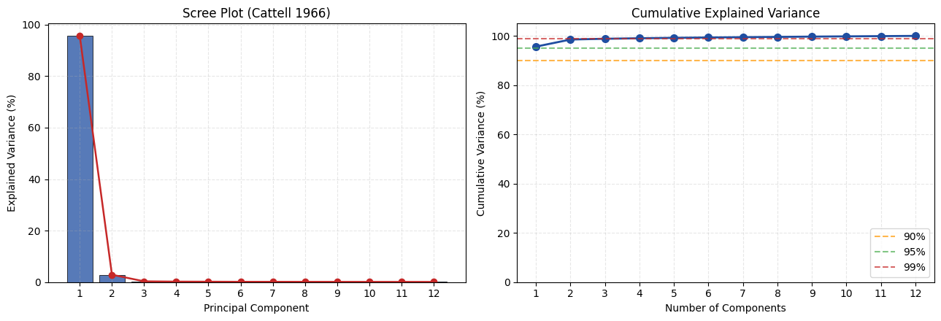
ML_CUP – Baseline and Linear Models
10
We started our analysis by finding a baseline with a simple Linear Model (OLS) : MEE : 26.1816 → We need to improve this !!!
The first step to improve this value is adding the L1 or L2 regularization :
L1 (Lasso) : alphas_lasso = [0.0001, 0.001, 0.01, 0.1, 1.0, 10.0] → WINNER : alpha = 0.1 , Validation MEE = 25.6353
L2 (Ridge) : alphas_ridge = [0.001, 0.01, 0.1, 1.0, 10.0, 100.0, 1000.0] → WINNER : alpha = 100, Validation MEE = 25.5736
As we can see from these results, the regularization is improving the MEE; this makes us think about : noise in the data or collinearity between features.
So let’s do a feature analysis to detect any collinearity, Principal Components Analysis (PCA) [8]
We can see that the features have a strong collinearity :
The first principal component alone is sufficient to explain over 95% of the variance in the data (input)
However, high variance in the input space does not guarantee high correlation with the target y [9]
For the next models (K-NN and SVM), we'll treat the number of PCA components as a hyperparameter in the grid search.
We thought it could be useful for the Curse of Dimensionality (Especially for K-NN).

Slide 12
ML_CUP – K-NN and SVM
11
As we can see from the results of the previous slide we need to add non-linearity to our project:
So we decided to test at first K-NN and SVM , tested for all the possible numbers for PCA components [1, 12] :
K-NN :
k_values = [3, 4, 5, 7, 10, 15, 20, 30]
weight_options = ['uniform', 'distance’]
WINNER :
PCA_Components = 6 , K = 3, Weight = ‘distance’ → Validation MEE : 15.1070
SVM (SVR) : We tested the exact 4 Kernel that we used for MONKs datasets (Linear, RBF, Polynomial and Two-layer perceptron):
Linear : C = [0.01, 0.1, 1, 10, 100]
RBF : C = [1, 2, 3, 4, 5, 6, 7, 8, 9, 10], gamma = ['scale', 1, 2, 3, 5, 10, 100, 1000]
Polynomial : Degree = [1, 2, 3, 4], C = [0.1, 1, 10], coef0 = [0, 1]
Two-layer perceptron : C = [0.1, 1, 10], coef0 = [0,1]
WINNER :
PCA_Components = 4, Kernel = RBF, C = 3, gamma = 3 → Validation MEE : 15.5959

Slide 13
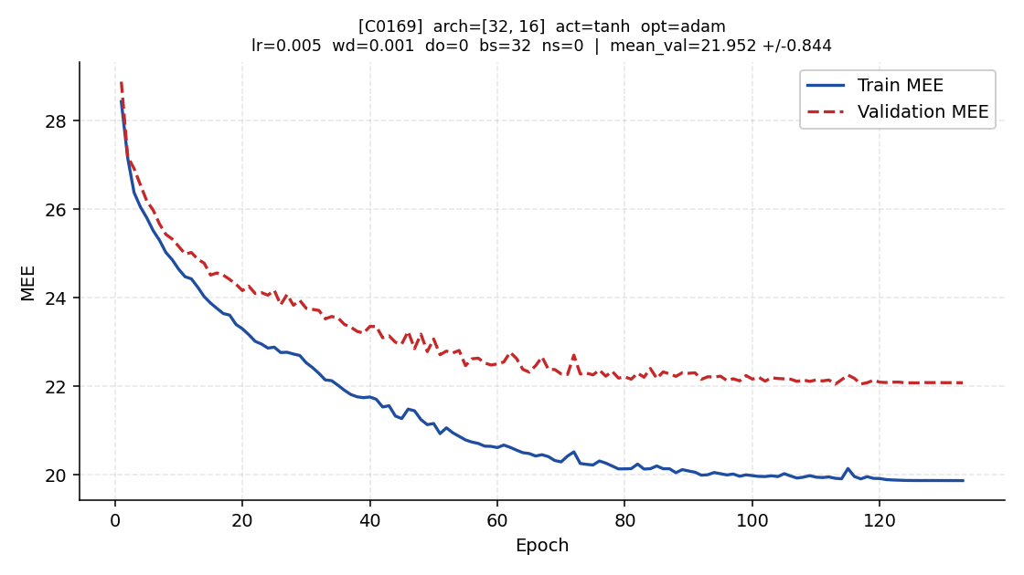
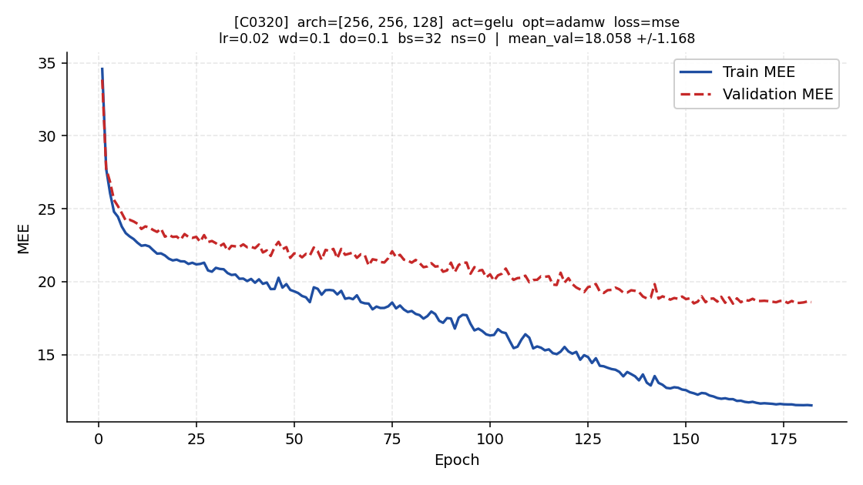
ML_CUP – MLP
12
As for the Neural Network, we decided to carry out a series of medium-sized gridsearches (a few hundred configurations at a time), so as not to have too long execution times, and then go on to analyse the best results obtained and understand where to move for the next gridsearch.
NOTE : Here we kept all the features for computational purpose
Winner of the first gridsearch :
Winner of the last gridsearch :
The most relevant aspects that we were able to observe are:
A little dimension of the batch seems to be generally preferred to minimize MEE (batch_size = 32)
GeLU was by far the best activation function (We’ve tested Tanh, ReLU, GeLU, SeLU, eLU)
We noticed a general improvement for MEE switching from ‘ReduceLROnPlateau’ to ‘CosineAnnealing’ [10]
‘Adam’ [11] and ‘Adamw’ [12] were the two optimizer who performed the best

Slide 14
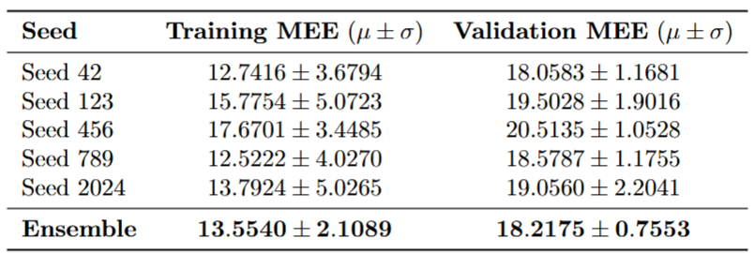
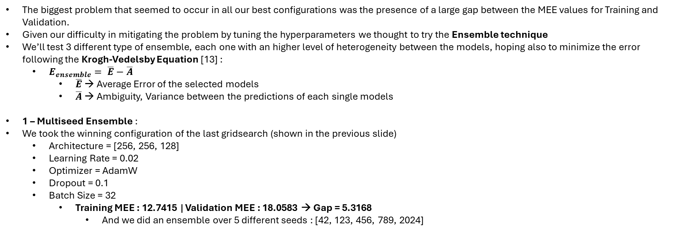
ML_CUP – Ensembling (I)
13
The biggest problem that seemed to occur in all our best configurations was the presence of a large gap between the MEE values ​​for Training and Validation.
Given our difficulty in mitigating the problem by tuning the hyperparameters we thought to try the Ensemble technique
We’ll test 3 different type of ensemble, each one with an higher level of heterogeneity between the models, hoping also to minimize the error following the Krogh-Vedelsby Equation [13] :
$E_{ensemble}= \overline{E}−\overline{A}$
$\overline{E}$ → Average Error of the selected models
$\overline{A}$ → Ambiguity, Variance between the predictions of each single models
1 – Multiseed Ensemble :
We took the winning configuration of the last gridsearch (shown in the previous slide)
Architecture = [256, 256, 128]
Learning Rate = 0.02
Optimizer = AdamW
Dropout = 0.1
Batch Size = 32
Training MEE : 12.7415 | Validation MEE : 18.0583 → Gap = 5.3168
And we did an ensemble over 5 different seeds : [42, 123, 456, 789, 2024]
The results of the configuration came from a ‘lucky seed’, this also is the reason why we didn’t reach a lower MEE
At the same time we found a model better then the other 4 seeds
But if we want to compare the seed 42’s result with this, we can say that we found a more stable model (as we can see from the Standard Deviation), that also reduce the gap between Training e Validation → Gap = 4.6635
The Ensemble also performed better than the mean of the 5 seeds :
18.2175 vs 19.14186

Slide 15
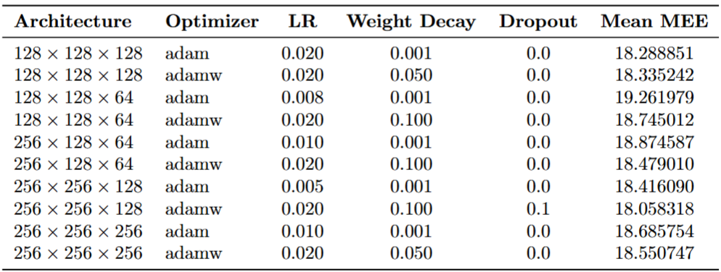
ML_CUP – Ensembling (II)
14
2 – Ensemble between 10 different configurations :
Looking at the top 10 table of our last MLP’s gridsearch we saw that the best configuration with ‘Adam’ preferred to use a low regularization (Weight Decay), on the other hand ‘AdamW’ applied a stronger regularization
So we decided to add the heterogeneity doing an ensemble between the best 5 configurations for Adam ad AdamW (so 10 in total) :
Ensemble Results:
Training MEE : 11.6355
Validation MEE : 17.390
This time we have a different result compared with the previous one.
We didn’t decrease the gap between Training and Validation (Gap = 5.7545), but for the first time we were able to reach a value for MEE lower than 18.

Slide 16
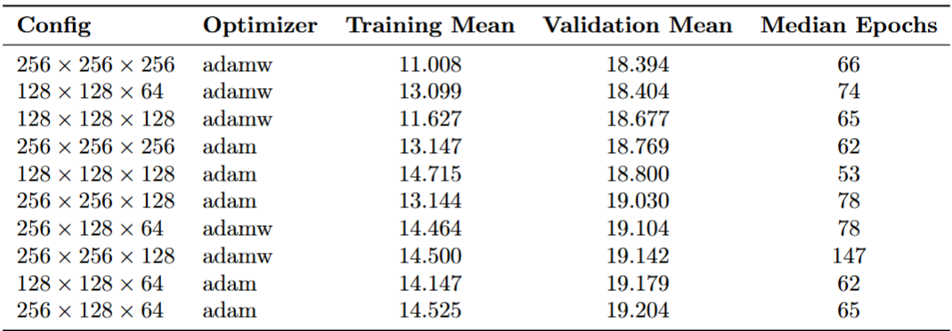
ML_CUP – Ensembling (III)
15
3 – Ensemble Meta-Learner RidgeCV :
For the last step we went for an Ensemble stacking between MLP, K-NN and SVM; building a meta-learner (RidgeCV [14]) based on the result of the 3 models, hoping to maximize the heterogeneity and also minimize the MEE error with the help of the good results of K-NN and SVM
First thing to do was choosing the configuration for MLP. Knowing that our best result of the gridsearches is based on a lucky seed, we decided to do a Multiple Restart over 5 seeds for the same 10 configurations of the previous ensemble and pick one based on the average :
This is the winner !!
It will be part of the ensemble stacking [15] with the winners of K-NN and SVM shown in the slide «ML_CUP – K-NN and SVM»
RidgeCV’s Result → Validation MEE : 14.3715 , alpha = 10.00
This result was the best of all the study, so we decided to choose it as our final model
So we went for the Model Assessment, but only after a first Re-training on the full 400 samples (TR + VL), cause we’ve used 10% for the early stopping (this time we used a median of the epochs to not waste any data)
Test MEE : 14.3289
Then after a final Re-training on the full dataset we’ve produced the outputs for the Blind Test

Slide 17
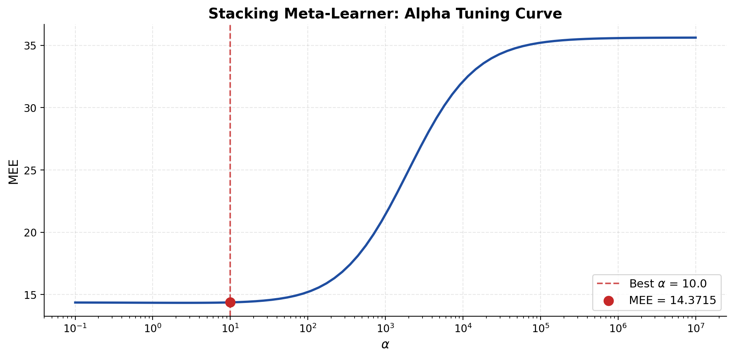
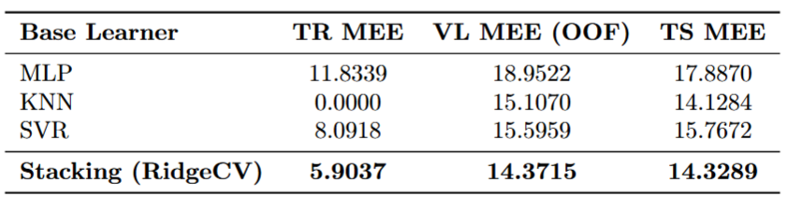
Conclusions
16
Since our final model is an Ensemble Stacking we were not able to plot a standard Loss Curve.
But we can show an alpha curve
TR / VL / TS TABLE :
FINAL THOUGHTS :
The results of our three ensemble approaches illustrate the Krogh-Vedelsby decomposition [13] : «Ensemble methods mathematically guarantee a decrease in error”
Furthermore, the choice of a Stacking Meta-Learner as the final model allows us to leverage the strong individual performances of KNN and SVR alongside MLP: the RidgeCV meta-learner learns to optimally weight the three base learners' predictions, exploiting their complementary error patterns to reduce the overall MEE beyond what any single model achieves alone.
This project gave us the chance to have a first taste of a Machine Learning problem. Beside being the first experience for both of us this experience was rewarding and enjoyable. Being able to see and experiment with concepts that we had previously only seen in class was definitely a great experience.

Slide 18
Bibliography
[1] - Xavier Glorot and Yoshua Bengio. Understanding the difficulty of training deep feedforward neural networks. Proceedings of the thirteenth international conference on artificial intelligence and statistics, 249-256, 2010.
[2] - Kaiming He, Xiangyu Zhang, Shaoqing Ren, and Jian Sun. Delving deep into rectifiers: Surpassing human-level performance on ImageNet classification. Proceedings of the IEEE international conference on computer vision, 1026-1034, 2015.
[3] – Scikit-Learn : https://scikit-learn.org/stable/
[4] – PyTorch : https://pytorch.org/
[5] - Goodfellow, I., Bengio, Y., & Courville, A. (2016). Deep Learning. MIT Press. (Chapter 6.2.2.2 - "Loss Functions for Output Units")
[6] - Choi, S., Cha, S., & Tappert, C.C. (2010). A Survey of Binary Similarity and Distance Measures. Journal of Systemics, Cybernetics and Informatics, 8(1), 43-48.
[7] - Cho, Y., & Saul, L.K. (2009). Kernel Methods for Deep Learning. Advances in Neural Information Processing Systems (NeurIPS), 22.
[8] - Jolliffe, I.T. (2002). Principal Component Analysis (2nd ed.). Springer Series in Statistics.
[9] - Hadi & Ling (1998). "Some Cautionary Notes on the Use of Principal Components Regression“
[10] - Loshchilov, I. & Hutter, F. (2017). SGDR: Stochastic Gradient Descent with Warm Restarts. International Conference on Learning Representations (ICLR).
[11] - Kingma, D.P. & Ba, J. (2015). Adam: A Method for Stochastic Optimization. International Conference on Learning Representations (ICLR).
[12] - Loshchilov, I. & Hutter, F. (2019). Decoupled Weight Decay Regularization. International Conference on Learning Representations (ICLR).
[13] - Krogh, A., & Vedelsby, J. (1995). Neural network ensembles, cross validation, and active learning. Advances in Neural Information Processing Systems, 7, 231-238.
[14] - Golub, G.H., Heath, M., & Wahba, G. (1979). Generalized Cross-Validation as a Method for Choosing a Good Ridge Parameter. Technometrics, 21(2), 215–223.
[15] - Wolpert, D.H. (1992). Stacked Generalization. Neural Networks, 5(2), 241–259.

