Slide 1
Rayleigh-Bénard Convection: Drekar Simulation on Odyssey
Harvard IACS AC 290R

Slide 2
Problem Statement & Motivation
Rayleigh-Bénard Convection (RBC) arises when a fluid has a temperature gradient in a gravitational field
It is an important physical phenomenon arising in stellar evolution, plate tectonics, and weather systems
We ran a numerical simulation of RBC based on the Boussinesq approximation, in which we assume that fluids develop a buoyancy force that is linear in the temperature
The simulation was run on the Harvard Odyssey computing cluster using the Drekar simulation code developed at Sandia National Lab

Slide 3
Description of Code
Drekar is a large scale computational fluid dynamics (CFD) code developed at Sandia National Lab
Drekar solves fluid PDEs using the Finite Element Method (FEM)
Core functionality is a massively parallel FEM implementation that runs on MPI with back ends from threads, OpenMP and CUDA
Drekar is part of the Trilinos package, which provides functionality including linear algebra, nonlinear solvers, automatic differentiation, and time integration

Slide 4
Overview of Numerical Methods Used
The Finite Element Method (FEM) solves PDEs by discretizing them in space on a mesh.
The functions to be solved for (here pressure, temperature, and velocity) are represented by choosing a finite dimensional basis
This simulation used piecewise polynomials of order 1, i.e. rectilinear planar functions (analog to piecewise linear in 2D)
The time stepper discretizes in time; each time step leads to a set of linear equations to be solved and then a nonlinear solution

Slide 5
Parameters of the Simulation
Dimensions: Length L=2.0, Height =1.0, Γ = 2; N_{x} = 1024, N_{y} = 2048
Density ρ₀ = 1.0
Viscosity ν = 0.01
Volume Expansion Coefficient α_{V} = 10⁶
Gravity g = 1.0
Heat Capacity C_{p} = 1.0
Thermal Conductivity k = 0.01
Thermal diffusivity κ = k / ρ₀ C_{p} = 0.01
Temperature Change ΔT = 1.0
Time of Simulation: 5.0 target (0.22 achieved on case 1)

Slide 6
Results
Case 1 was initiated on 1024 cores but only ran on 512 cores due to a hardware fault.
It ran for about 1 day and got to time 0.22 before we restarted it.
Case 2 ran on all 1024 cores for about 5 days. It bogged down, getting progressively slower, and eventually crashed (out of memory)
It only got to a simulation time of 0.77; it should have gotten much further. After it crashed, out .exo output files became corrupted.
We suspect a memory leak
We present visualizations from the successful case 1 simulation

Slide 7
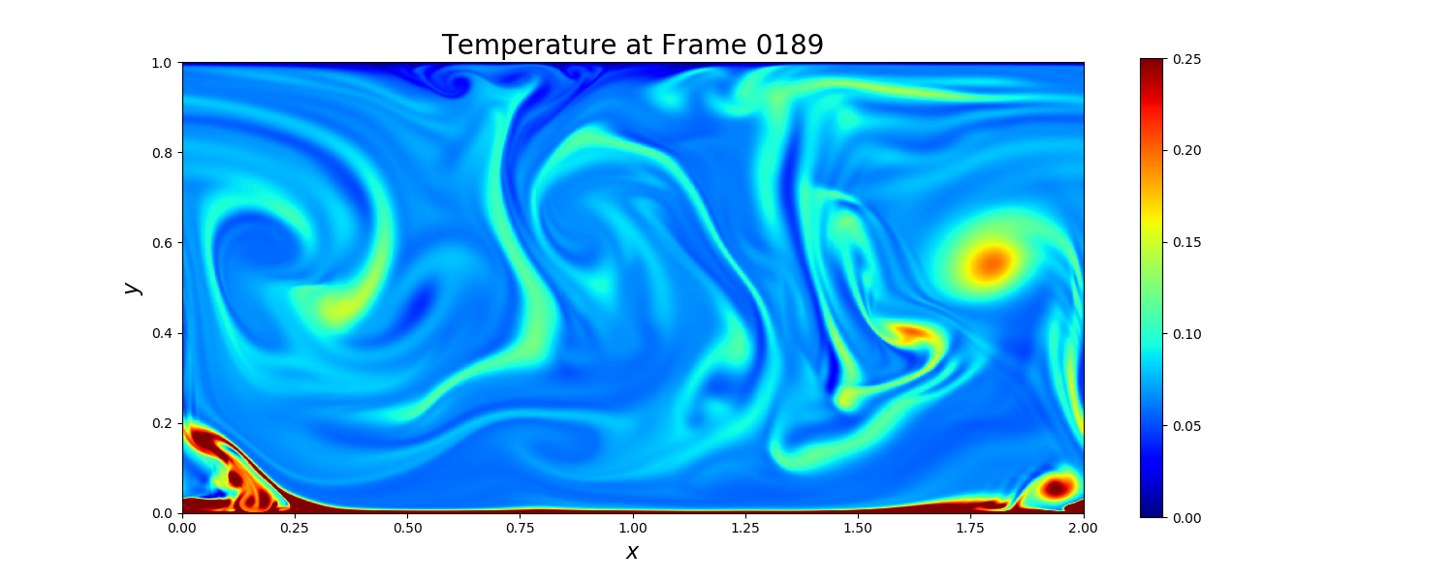
Sample Output: Temperature

Slide 8
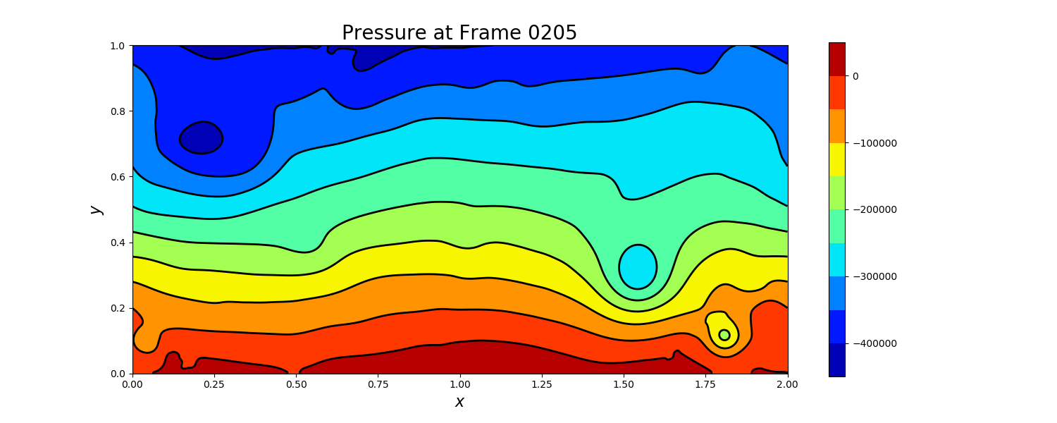
Sample Output: Pressure

Slide 9
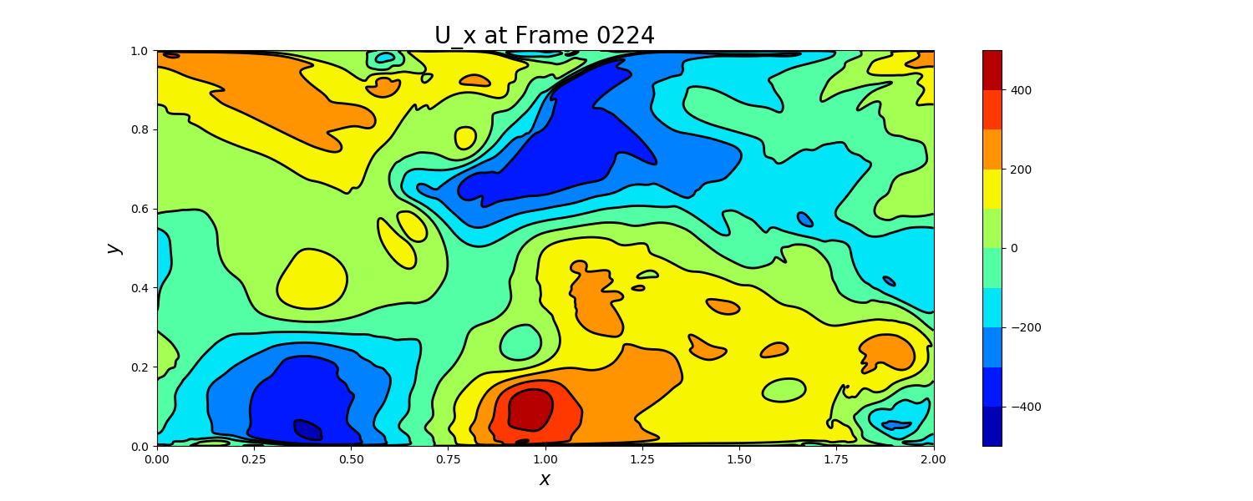
Sample Output: Velocity in x Direction

Slide 10
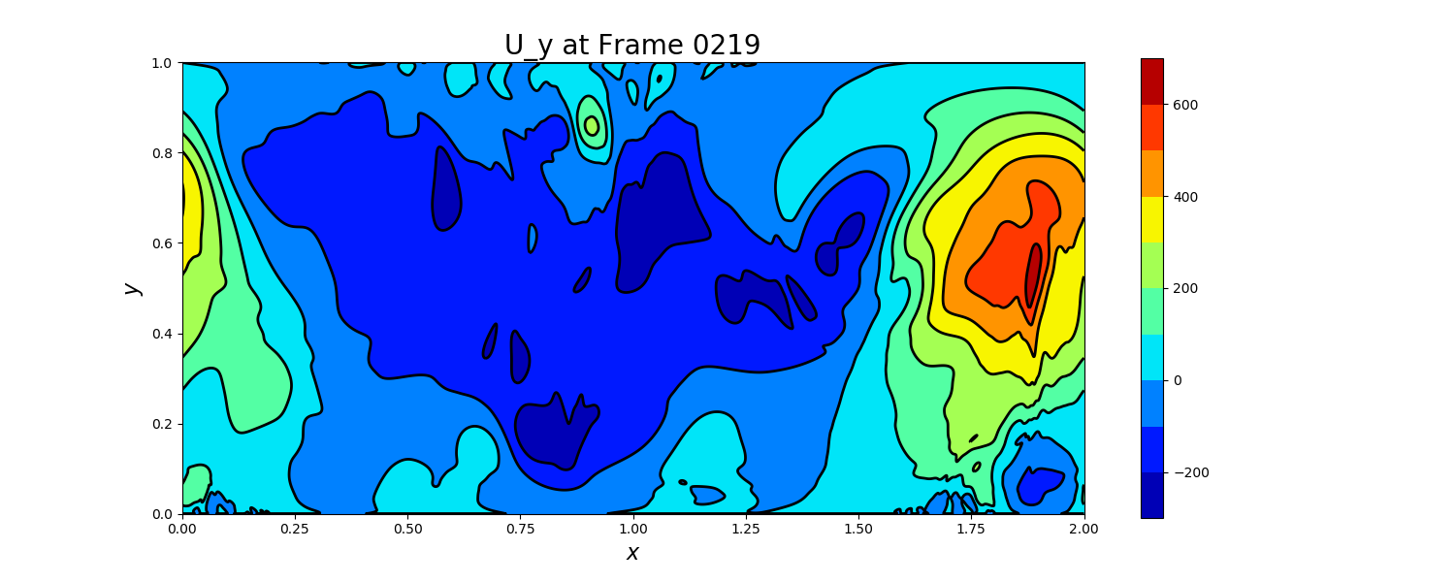
Sample Output: Velocity in y Direction

Slide 11
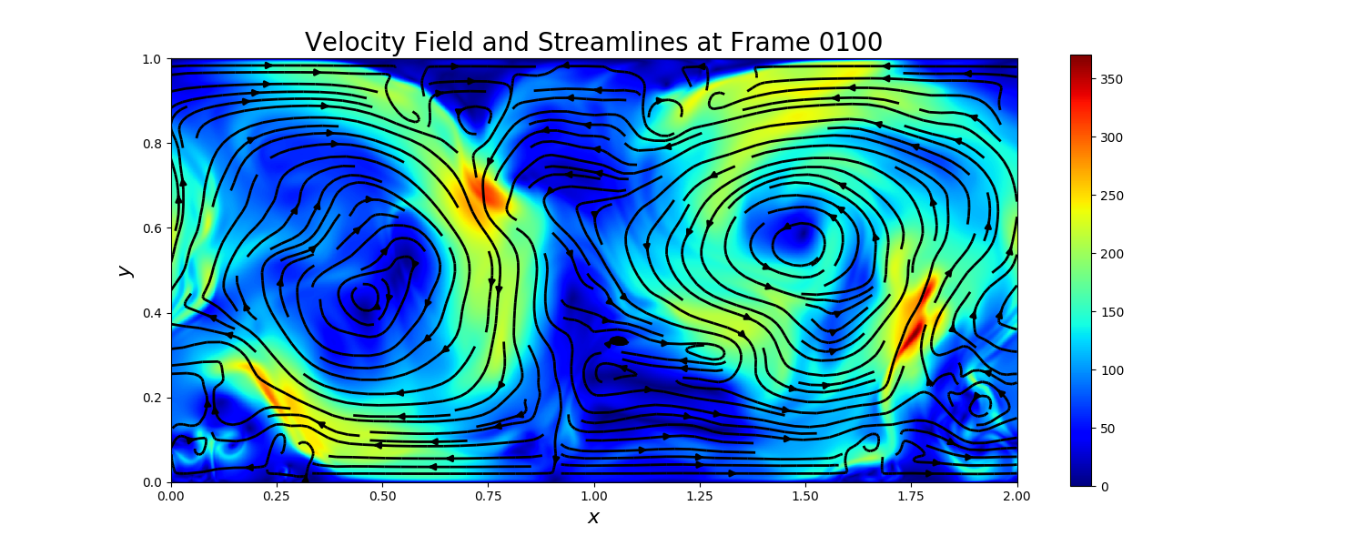
Sample Output: Velocity Field & Streamlines

