Slide 1


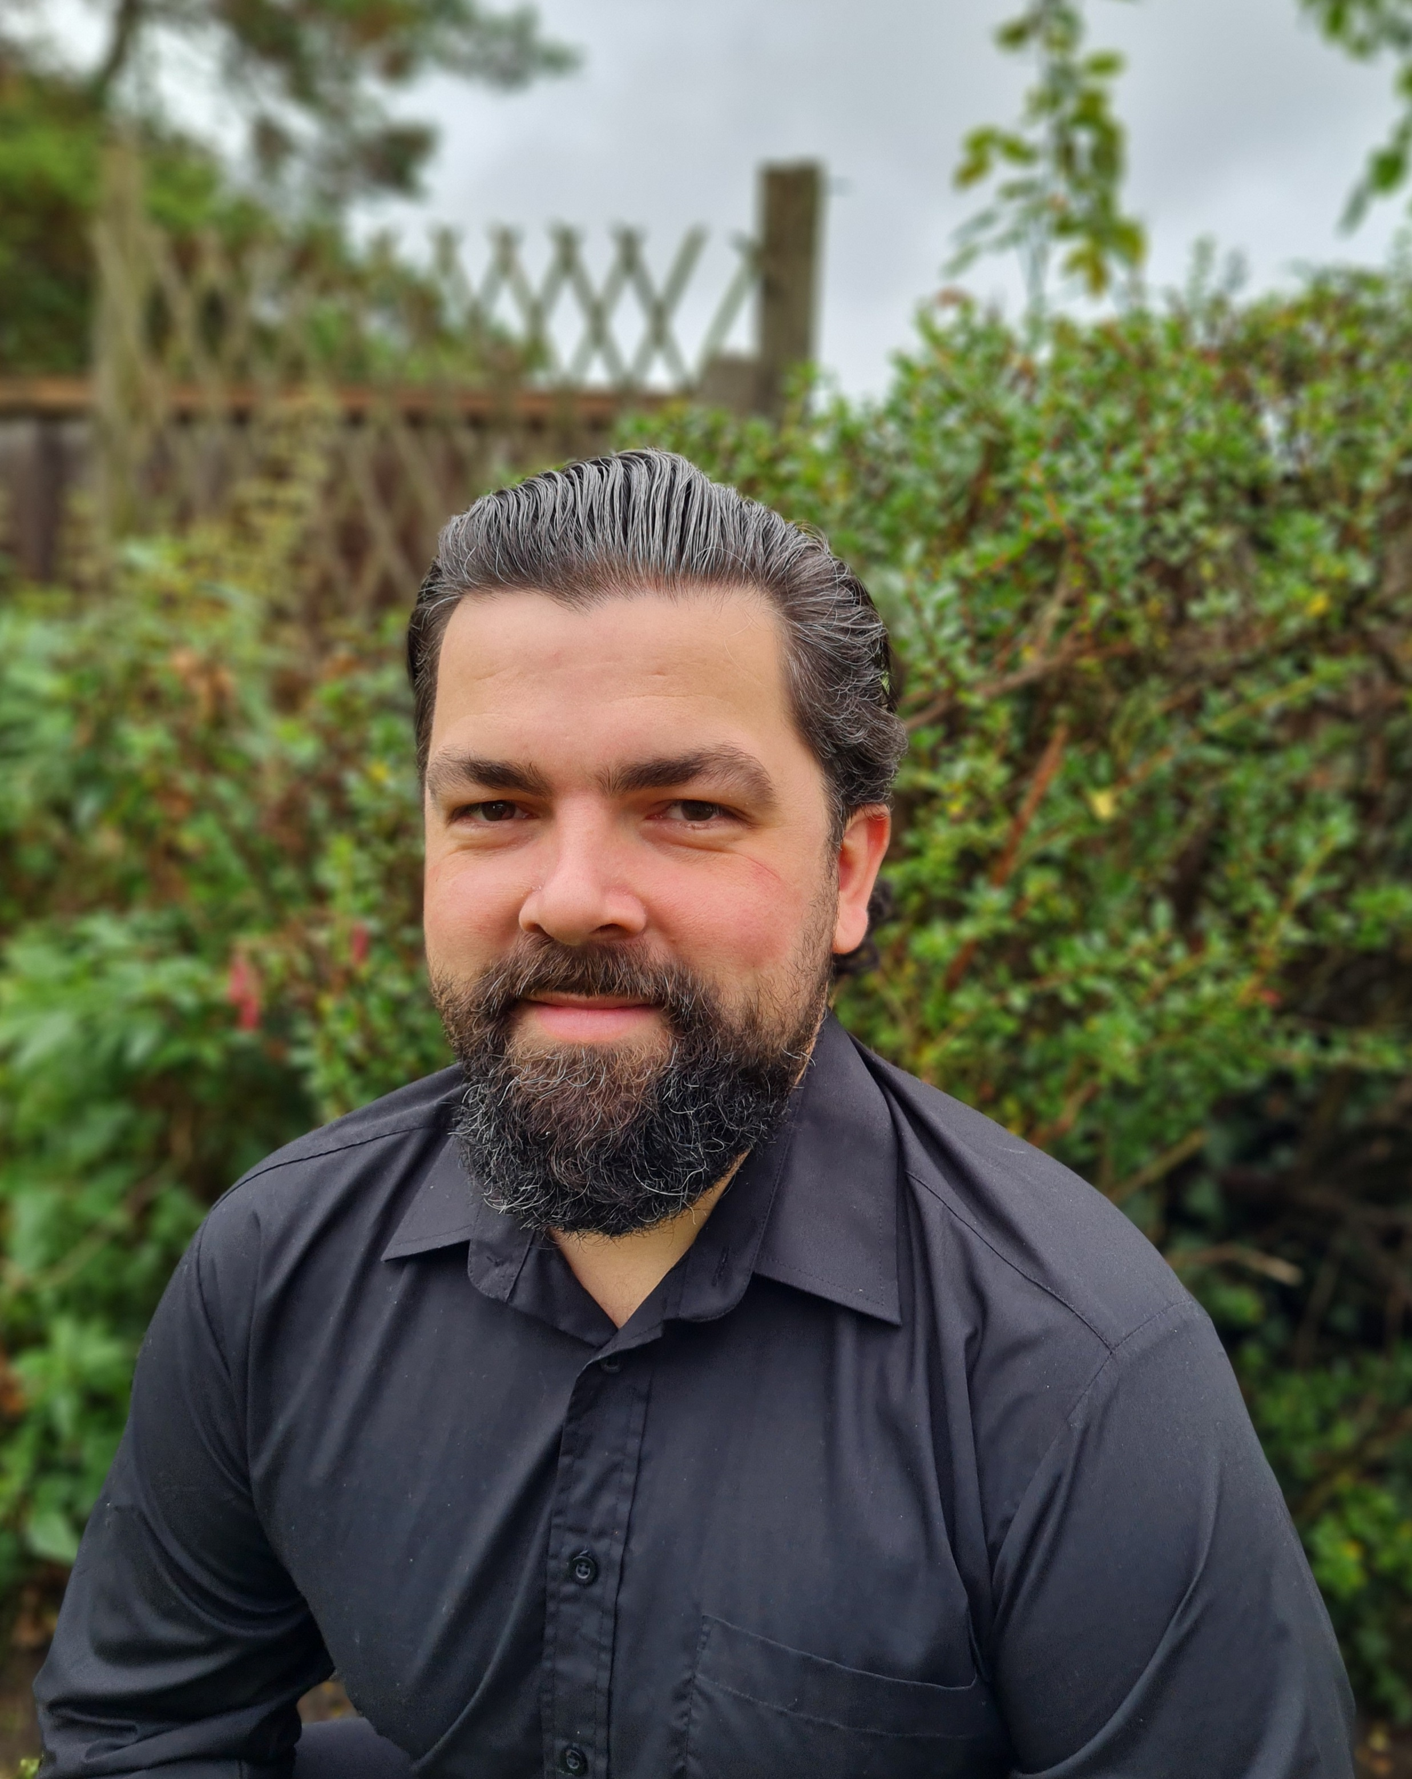
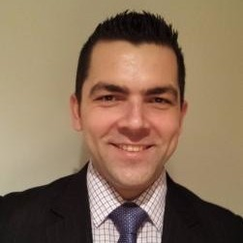
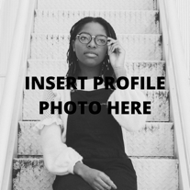
PROJECT OVERVIEW
https://iagardi.github.io/Portfolio/
https://github.com/iagardi/iagardi
Istvan
Agardi
Junior Full Stack Engineer
WORK EXPERIENCE
May 2019 – Oct 2020
Deputy General Manager, Royal Society of Arts (via CH&Co)
- Multi-award-winning events venue
- Team of 28 across hospitality, coffee house, kitchen and sales
- Set up a whole new reporting process for the coffee house weekly and monthly financial and sales reports
August 2017 – May 2019
Deputy General Manager, Reed Smith
(via BaxterStorey)
- International law firm
- Team of 30 across hospitality, staff restaurant, kitchen, reception and switchboard
- Part of the global admin team for EMS room booking system, achieved significant savings on labor and stationery costs by redesigning daily reports
ABOUT ME
Throughout my previous career in hospitality, I had always been fascinated by all the tools technology gave us, such as our booking systems, till systems and intranet communications. So during the first Covid lockdown, it felt natural to delve more into how that technology worked and learn about coding. After months of self-study, I decided to take a 12 week Software Development course at _nology, to gain more hands on experience and expand my career prospects in the tech industry.
KEY COURSE SKILLS
HTML5, CSS3, SASS, JavaScript, React, Jest, Cypress, Github Actions, TDD, CI/CD, OOP, Java, Spring, SQL.
EDUCATION
2002 GCSE in Hungary with Information Technology and English language as main subjects
HOBBIES
In my free time I really enjoy going on motorbike trips and learning about anything releted to personal finance.
Notes:
Once you have filled out your profile completely – export the document as a PDF.
Please do not move the _nology logo, ink drop or main layout of the document. The section sizes will differ person to person, but the overall layout must remain the same.

