Slide 1
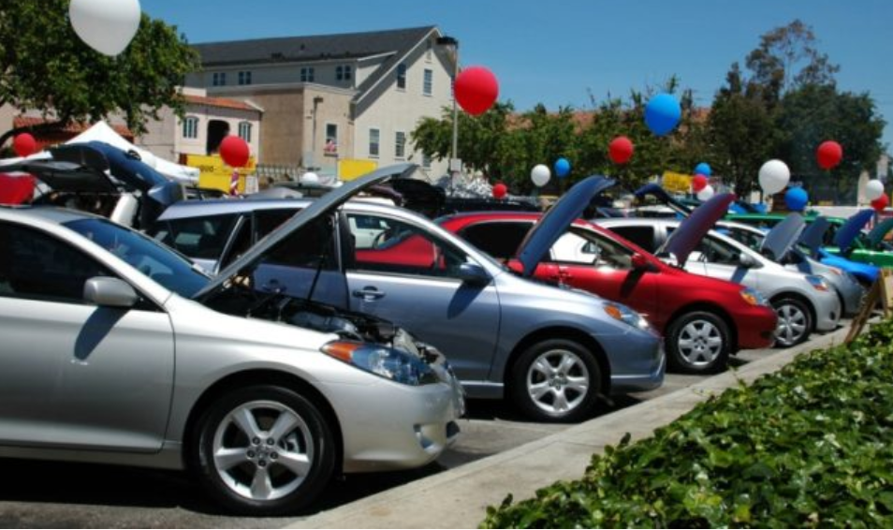
Car Sales EDA
by Indira Gohad

Slide 2
Ukrainian Car Sales EDA
Automobile industry being the fore front in grabbing most chunk of market share; it becomes important for everyone to do data mining on car sales

Slide 3
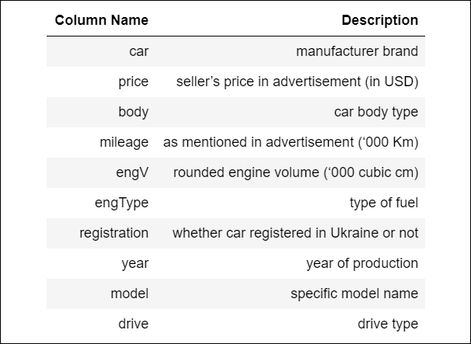
Ukrainian Car Sales EDA
Dataset

Slide 4
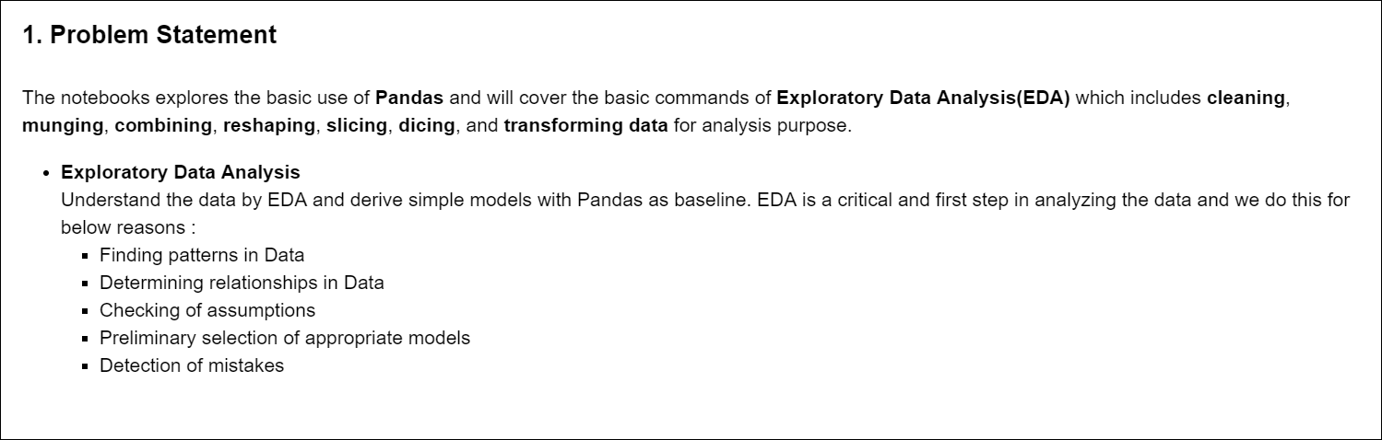
Ukrainian Car Sales EDA

Slide 5
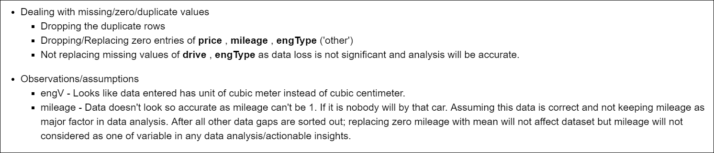
Ukrainian Car Sales EDA
Step1 : Data preprocessing
There were many gaps in data. Below steps were followed to process data.

Slide 6
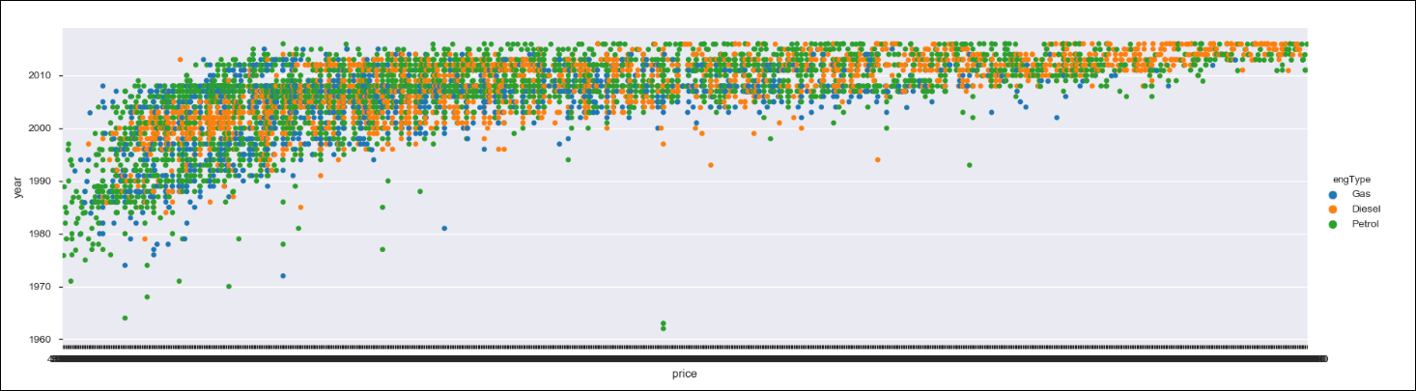
Correlation of Price and other features
Price Vs Year

Slide 7
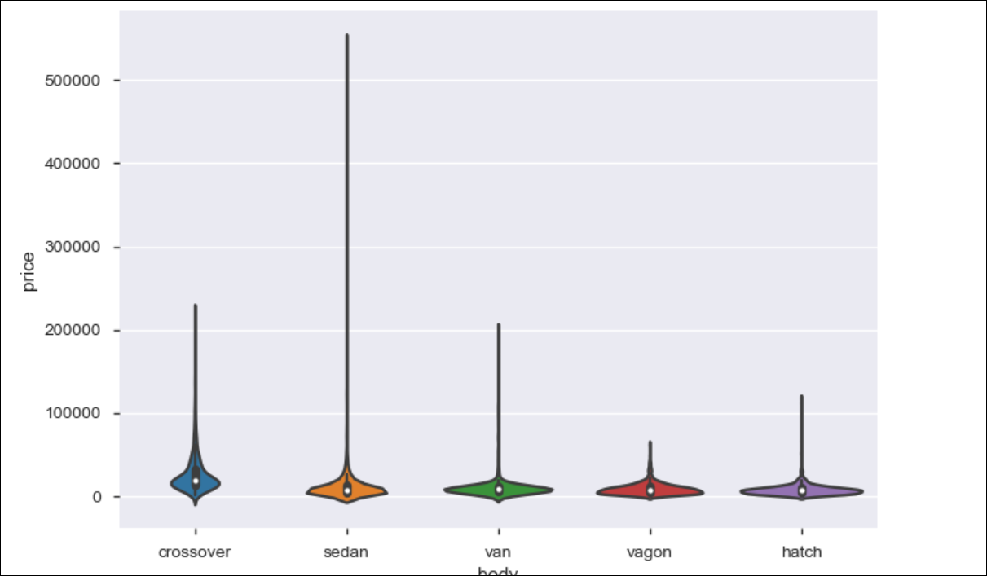
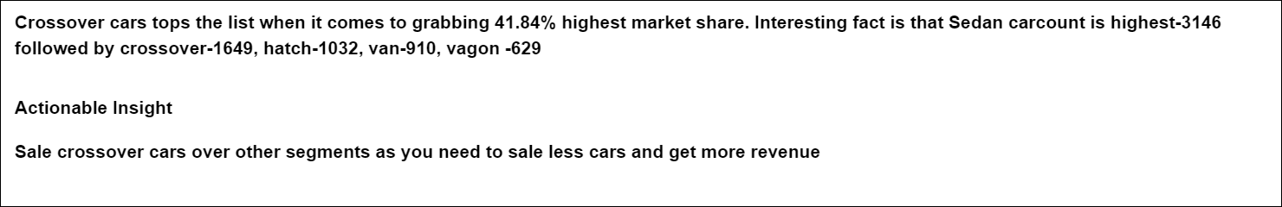
Widely available cars for sale
Price Vs Body type

Slide 8
Actionable insight for Mercedes-Benz

Slide 9
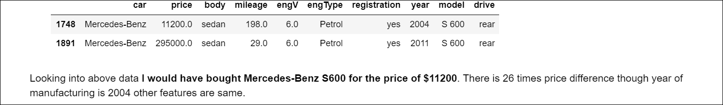
Which is "best value for money" deal for customer?

Slide 10
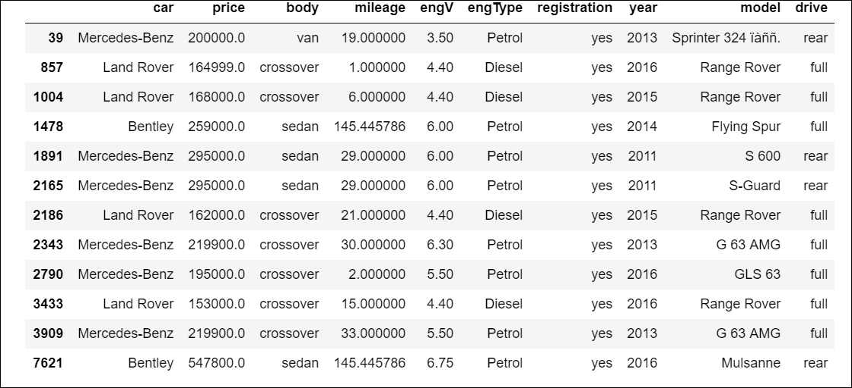
Which are expensive cars with less engine power than recently available cheaper cars with more engine power?

Slide 11
Why do Ukrainians buy non-Ukraine registered cars?
Those are seen to cheaper than Ukraine registered cars

Slide 12
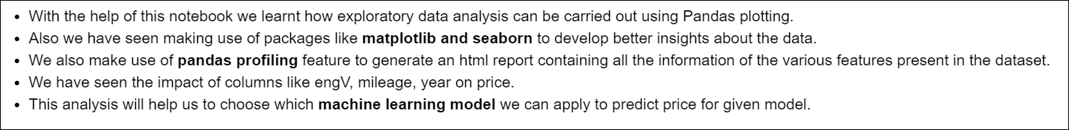
Conclusion

