Slide 1
A quick intro to MSE
Iago Mosqueira
Cefas, UK

Slide 2
MSE
“use of computer simulation to develop robust management strategies that can meet multiple objectives” Kell et al, 2007
Pioneered by IWC (Hammond, Donovan, Kirkwood)
South Africa (Butterworth, De Oliveira)
Australia (Punt, Smith, Dichmont, Polacheck)

Slide 3
Uncertainty
SA generally assumes that
  input data are appropriate and not biased
  stock assessment models accurately reflect both population and fisheries dynamics
  management measures are perfectly implemented
Not always true!
How robust is our advice to error & bias?

Slide 4
Error
process error: caused by disregarding variability, temporal and spatial, in dynamic population and fisheries processes
observation error: sampling error and measurement error
estimation error: arising when estimating parameters of the models used in the assessment procedure
model error: related to the ability of the model structure to capture the core of the system dynamics
implementation error: where the effects of management actions may differ from those intended

Slide 5
Simulation
Simulation to generate data, conditional on a set of assumptions about the dynamics to evaluate
  accuracy and precision of estimates derived from stock assessment models
  the robustness of those models to misspecification
  sensitivity to changes in the input data.
Errors are inter-dependent, cannot be decomposed

Slide 6
Elements of the fishery system
Operating Model: the simulated reality
  Natural population
  Fishing operations
Management Procedure
  Provision of advice (SA)
  Management decision (automated, HCR)
Linked by observation model

Slide 7
Conceptual framework
Two systems: “true” and “observed”
OM includes all available knowledge
  full dynamics of the exploited populations,
  Fisher behaviour in response to management
  environmental conditions
  Plus interactions
greater level of complexity and knowledge than SA

Slide 8
Conceptual framework
MP: conventional process from data collection through stock assessment to management implementation
  an observation model that simulates data collection
  an assessment model
  a predefined set of management actions according to some specified rules (HCR)
Once implemented, management affects OM and MP

Slide 9
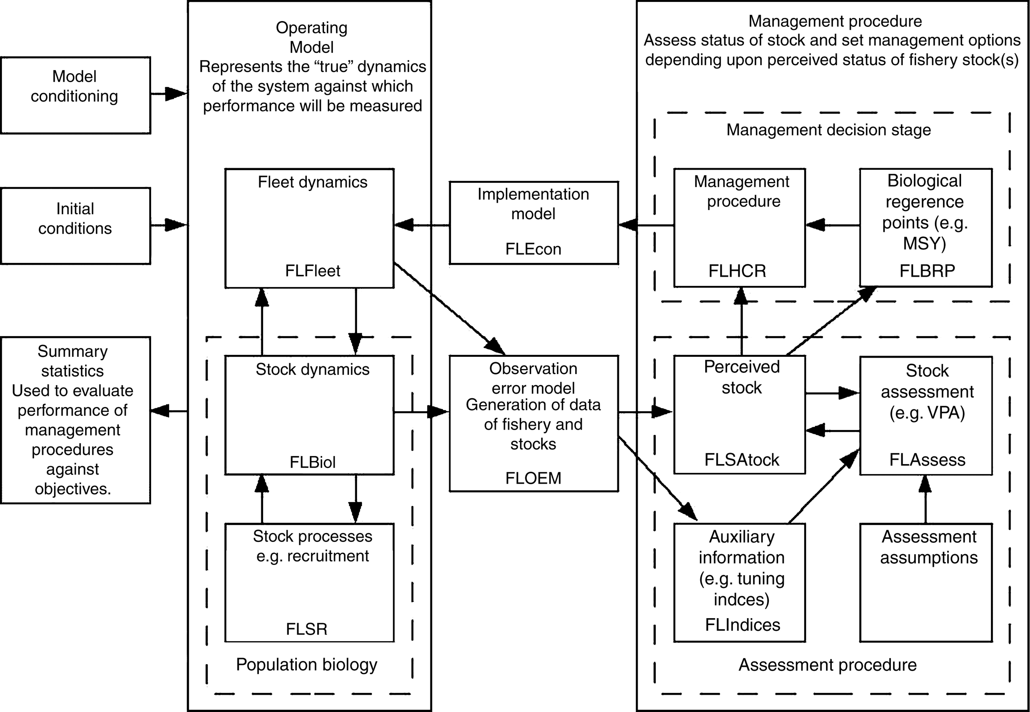
Conceptual framework

Slide 10
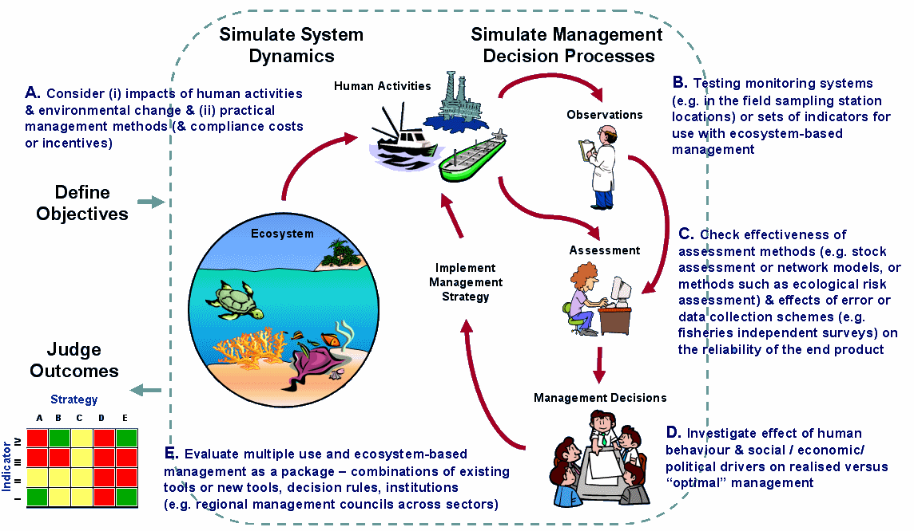
Conceptual framework

Slide 11
Development procedure
Process can be difficult but also very fruitful
  SBT, Kolody et al 2008
  IWC, Donovan
Likely to bring new data (surprises!)
Important for acceptance of HCR algorithm
Process needs as much effort as technical side
Choose a good chair!

Slide 12
HCRs
Generic HCRs to be tested first
  Froese et al, 2010
Accommodate industry/social concerns
Easy to understand, felt to be fair
Visualize expected results
Explain divergences: simulated vs. reality

Slide 13
Performance statistics
Agreed beforehand, difficult as not seen yet
Cannot be changed afterwards
Visualization of conflicting results
Show ranges of uncertainty in results
RISK

Slide 14
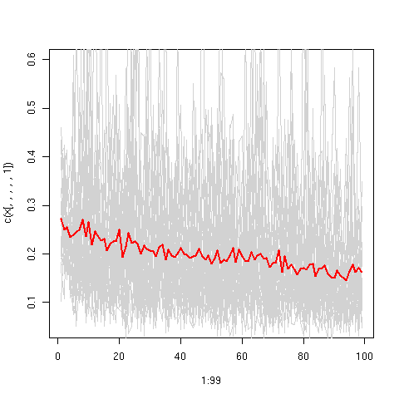
Performance statistics

