Slide 1
Stock recruitment relationships
Iago Mosqueira
Cefas, UK

Slide 2
Stock-recruitment
“The most important and generally most difficult problem in biological assessment of fisheries” - Hilborn & Walters, 1991.
How much can the stock drop before recruitment is affected.
Simplifies life history up to recruits: management

Slide 3
What are stock and recruits?
Stock (SSB) = reproductive potential
Recruits: individuals reaching a certain stage
  Larvae settlement
  Fishery
Recruits (N at age 1) = realized reproduction
SSB_y & rec_y+1

Slide 4
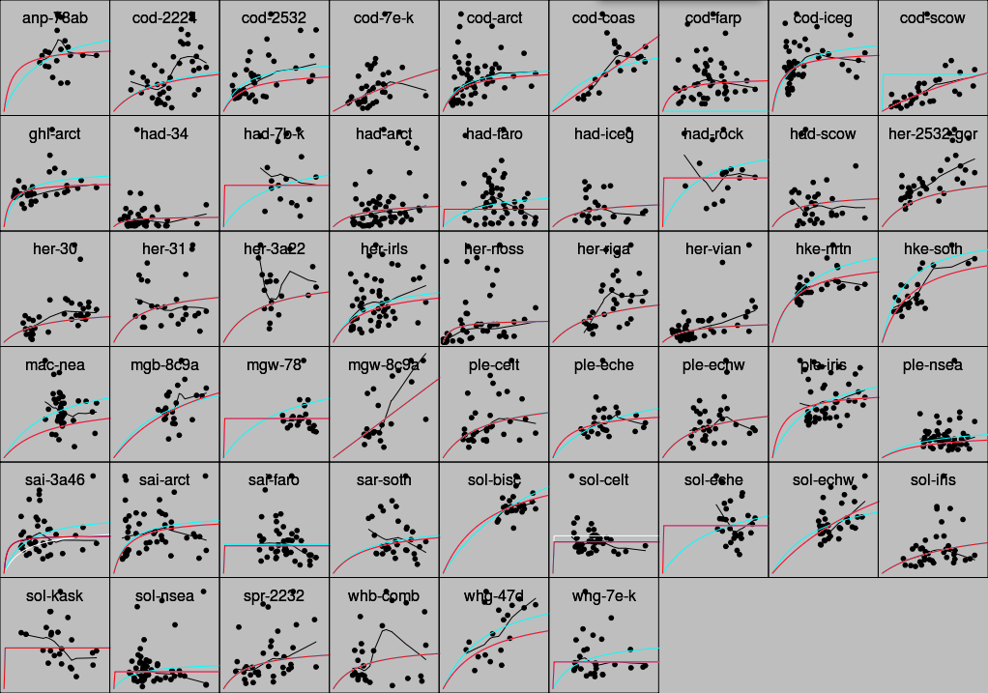

Slide 5
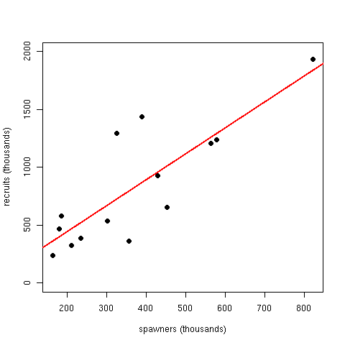
Biological processes
Density independence: predation, starvation and environmental impacts
Must have limits

Slide 6
Biological processes
Compensation: recruitment becomes independent of spawners
Recruits-per-spawner decreases
Competition for food or space, cannibalism

Slide 7
Biological processes
Depensation: recruits-per-spawner increases
(1) Predation constant, smaller % as SSB increases
(2) Reduced fertilization success (Allee effect)

Slide 8
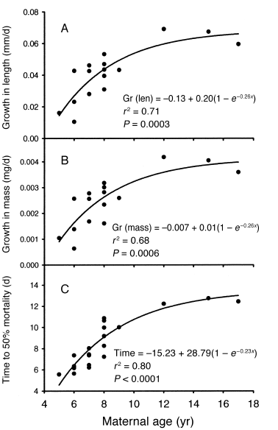
Reproductive potential and SSB
SSB is a proxy of reproductive potential
But egg production not linearly related to SSB
  eggs/g body weight
  Maternal effects
  Egg size vs. age
  BOFFFF hypothesis

Slide 9
Beverton & Holt
Mortality rate linearly dependent upon fish in cohort due to juvenile competition
a changes the height of the asymptote
b increases the rate of approach to it
α max number of recruits
β SSB that gives mean rec of α/2

Slide 10
Ricker
Mortality rate linearly dependent to initial cohort size
a is the density-independent parameter
b is the density-dependent parameter
Maximum mean rec at S = 1/b

Slide 11
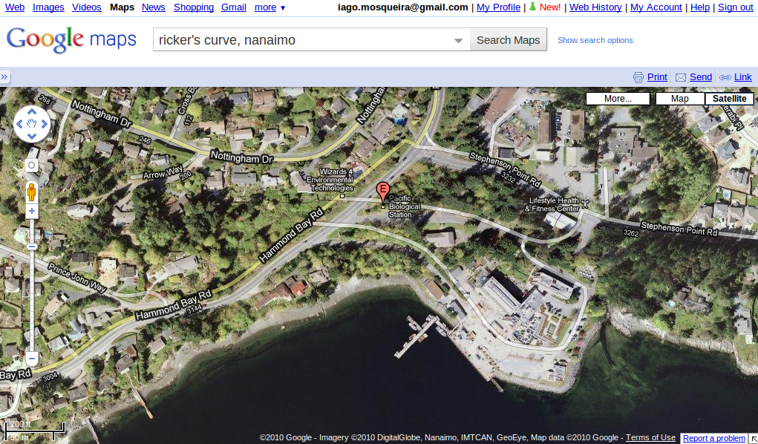

Slide 12


Slide 13
Exercise: Beverton & Holt
Plot B&H model changes with α, β
spawn <- seq(1,50)
a=6, b=seq(0.2, 0.4, by=0.1)
b=0.2, a=c(2,4,6)
EXTRA: Do the same for Ricker
a=0.05, b=c(0.05, 0.10, 0.15)
B=0.07, b=seq(1,5)

Slide 14
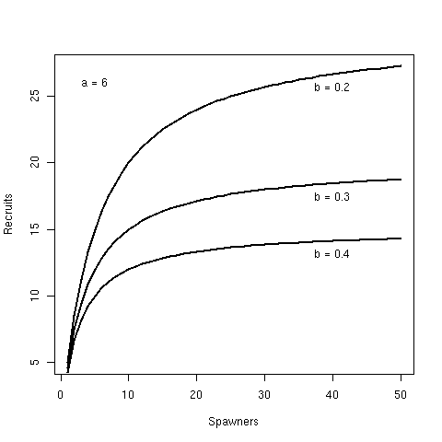
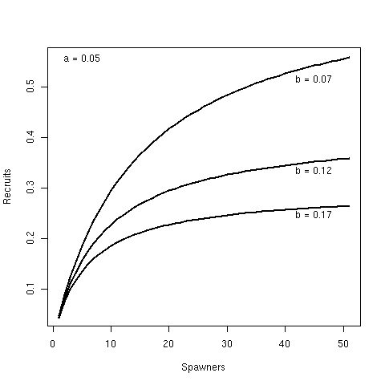
Exercise: Beverton & Holt

Slide 15
Shepherd
a slope at low stock sizes
b is the density-dependent parameter
c shape parameter
  c<1 curve rises
  c=1 B&H
  c>1 Ricker
Usually no information to estimate c, but worth trying!

Slide 16
Depensatory models
Potential recruits are then subject to predation
Models are added a depensatory parameter
M is greater than 1
Estimated from data, should be much greater than 1

Slide 17
Model fitting: good, bad and ugly
Some models can be linearized in log scale (Ricker)
Error structure given by lm, and inputs assumed without error
Non-linear regression, error structure chosen
Non-linear models, solved by numerical methods.
State-space for observation & model error
Bayesian models

Slide 18
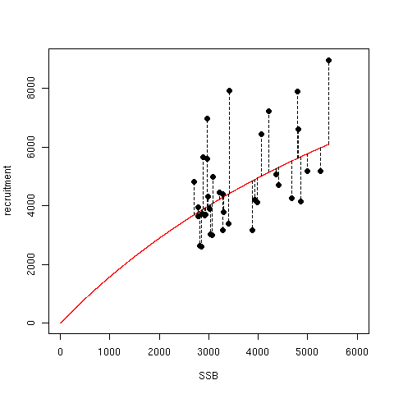
Model fitting: maximum likelihood
Alternative to SS
Minimize the -log(likelihood) of the model given the data
Explicit formulation of error structure

