Slide 1
GetThat
A Redacted Production

Slide 2
For that critical moment, when you decide you want to get fit but don’t know where to start.

Slide 3
Demo

Slide 4
HTML5
Sass
Ruby on Rails
Devise
SQLite

Slide 5
Design

Slide 6
Button
.button {
-webkit-border-radius: 15;
-moz-border-radius: 15;
border-radius: 15px;
color: #ffffff;
font-size: 20px;
background: none;
padding: 10px 20px 10px 20px;
border: solid #ffffff 2px;
text-decoration: none;
}
.button:hover {
text-decoration: none;
color: #C0C0C0;
border: solid #C0C0C0 2px;
}

Slide 7
Landing Page
{
background-image:linear-gradient(
rgba(0,0,0,0.7),
rgba(0,0,0,0.7)
),url("background.jpg");
background-size: 100% 100%;
background-repeat: no-repeat;
background-position: center;
}

Slide 8
Controller Specific

Slide 9
Design

Slide 10
Rails & Devise

Slide 11
before_action :authenticate_user!

Slide 12
What Is A Homepage?
def index
if user_signed_in?
redirect_to calendars_path
end
end

Slide 13
Data, Data, Baby
def index
@exercises = Exercise.all
respond_to do |format|
format.html #index.html.erb
format.json {render :json =>@exercises}
end
end

Slide 14
Data, Data, Baby
<% @exercises.each do |exercise| %>
...
<h1> <%= exercise.name %></h1>
<iframe width="420" height="315" src="https://www.youtube.com/embed/<%= exercise.url %>" frameborder="0" allowfullscreen></iframe>
<div id="description">
<ul><% x = exercise.description.split("-") %>
<% x.each do |r| %>
<p><li> <%=r %> </li></p>
<%end %>
</ul>
</td>
</div>
….
<%end%>

Slide 15
Rails & Devise

Slide 16
Database

Slide 17
bundle exec rake db:migrate
bundle exec rake db:seed

Slide 18
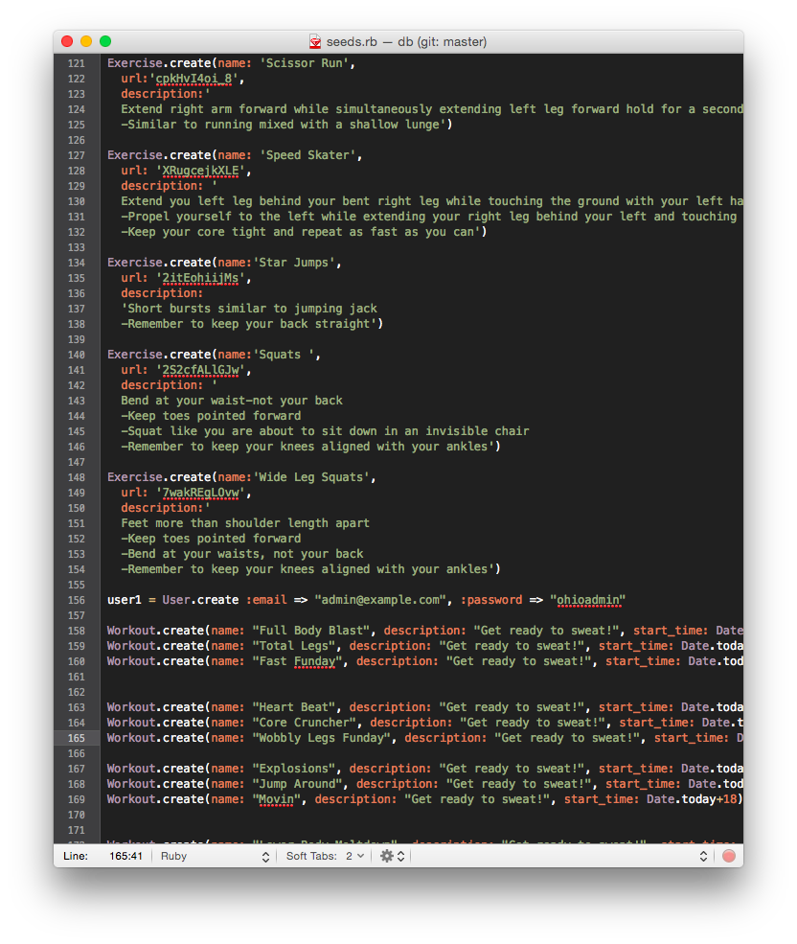

Slide 19
Database

Slide 20
GetThat
A Redacted Production

Slide 21
Thank You!

