Slide 1

Original Article “Super-Spreaders” and Person-to-Person Transmission of Andes Virus in Argentina
Valeria P. Martínez, Ph.D., Nicholas Di Paola, Sc.D., Daniel O. Alonso, B.Sc., Unai Pérez-Sautu, Ph.D., Carla M. Bellomo, Ph.D., Ayelén A. Iglesias, B.Sc., Rocio M. Coelho, B.Sc., Beatriz López, B.Sc., Natalia Periolo, Ph.D., Peter A. Larson, Ph.D., Elyse R. Nagle, M.Sc., Joseph A. Chitty, B.Sc., Catherine B. Pratt, M.Sc., Jorge Díaz, Ph.D., Daniel Cisterna, Ph.D., Josefina Campos, B.Sc., Heema Sharma, M.Sc., Bonnie Dighero-Kemp, B.Sc., Emiliano Biondo, M.D., Lorena Lewis, B.Sc., Constanza Anselmo, B.Sc., Camila P. Olivera, B.Sc., Fernanda Pontoriero, B.Sc., Enzo Lavarra, M.D., Jens H. Kuhn, M.D., Teresa Strella, M.D., Alexis Edelstein, Ph.D., Miriam I. Burgos, M.D., Mario Kaler, M.D., Adolfo Rubinstein, Ph.D., Jeffrey R. Kugelman, Ph.D., Mariano Sanchez-Lockhart, Ph.D., Claudia Perandones, Ph.D., and Gustavo Palacios, Ph.D.
N Engl J Med
Volume 383(23):2230-2241
December 3, 2020

Slide 2
Study Overview
In late 2018, Andes virus was identified as the cause of an outbreak of hantavirus pulmonary syndrome in Argentina.
This outbreak was associated with 34 confirmed infections and 11 deaths.
A detailed investigation identified person-to-person transmission that was driven by three symptomatic persons.

Slide 3
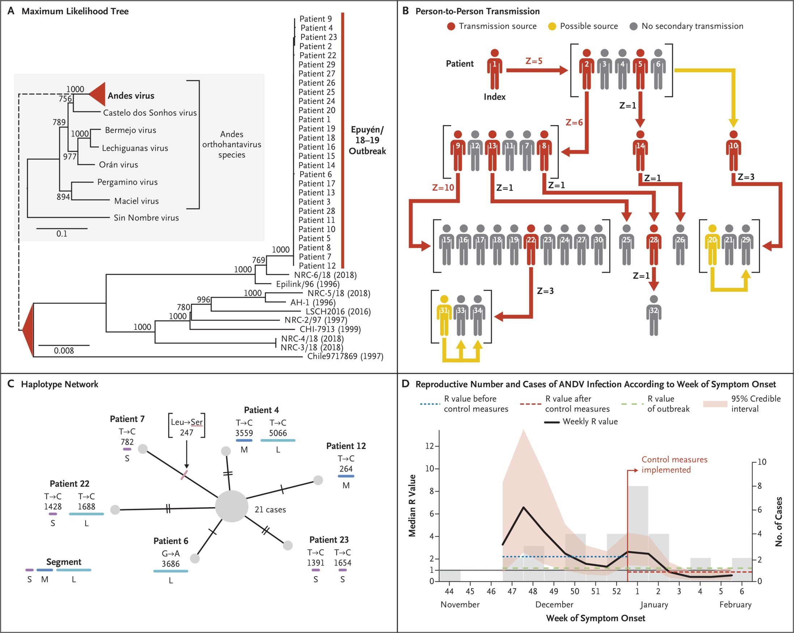
Epidemiologic Analysis of the 2018−2019 Outbreak of Andes Virus (ANDV) Hantavirus Pulmonary Syndrome and Transmission Dynamics in Humans.
Martínez VP et al. N Engl J Med2020;383:2230-2241
Notes:
Figure 1 Epidemiologic Analysis of the 2018−2019 Outbreak of Andes Virus (ANDV) Hantavirus Pulmonary Syndrome and Transmission Dynamics in Humans. Panel A shows the phylogenetic tree generated with the use of the maximum-likelihood method and estimated on the basis of S segment sequences (gray inset) and the concatenated S, M, and L segment sequences (ANDV subtree, right) with the use of 1000 bootstrap replications. The scale bars indicate the number of substitutions per site. Branch tips are labeled according to the strain designation and isolation date or patient number. Panel B shows an overview of ANDV transmission among patients. Patients who were the sources of transmission are indicated in red, and other possible but less likely transmission events between patients are indicated in yellow. Individual reproductive numbers (Z [the number of secondary infections caused by each patient, reported as an integer]) are shown where transmission events are indicated. Patients depicted in gray were not associated with evidence of extended transmission chains. Panel C shows a median-joining haplotype network generated with the use of concatenated segment sequences from 27 ANDV specimens. The loci of the nucleotide (black hash marks) and the amino acid (pink lines) are shown for each terminal node, which represents a single case. The S, M, and L segments of ANDV are represented by purple (S segment), dark blue (M segment), and light blue (L segment) bars. Panel D shows the reproductive number (R [the number of secondary cases per patient with a confirmed case]) and the incidence (gray shading) of ANDV hantavirus pulmonary syndrome of 34 cases over a 15-week period. The median R value was estimated for each week (solid black line) with 95% credible intervals (pink shading). The blue dashed line indicates the median R value before control measures were implemented (R=2.12) by the Ministry of Health, and the red dashed line indicates the R value after control measures were implemented (R=0.96); these values are shown for each 1-week period, where possible. The median R value for the entire 15-week period was 1.19. The thin black line indicates where R=1.00.

Slide 4
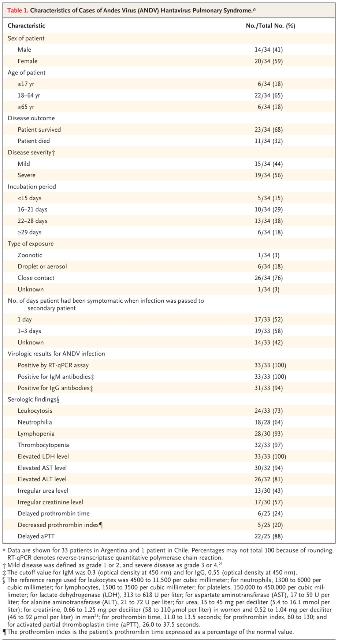
Characteristics of Cases of Andes Virus (ANDV) Hantavirus Pulmonary Syndrome.
Martínez VP et al. N Engl J Med2020;383:2230-2241
Notes:
Table 1 Characteristics of Cases of Andes Virus (ANDV) Hantavirus Pulmonary Syndrome.

Slide 5
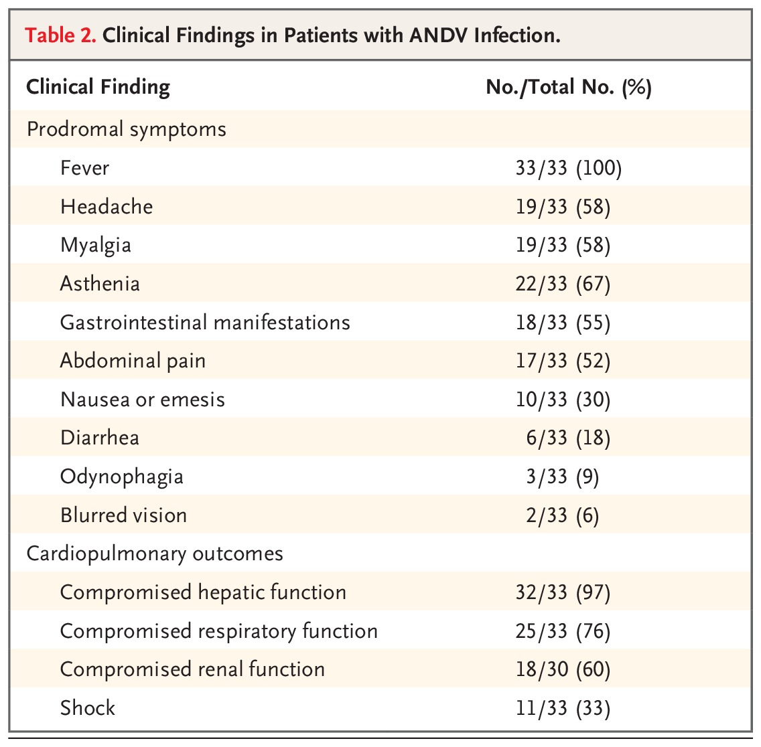
Clinical Findings in Patients with ANDV Infection.
Martínez VP et al. N Engl J Med2020;383:2230-2241
Notes:
Table 2 Clinical Findings in Patients with ANDV Infection.

Slide 6
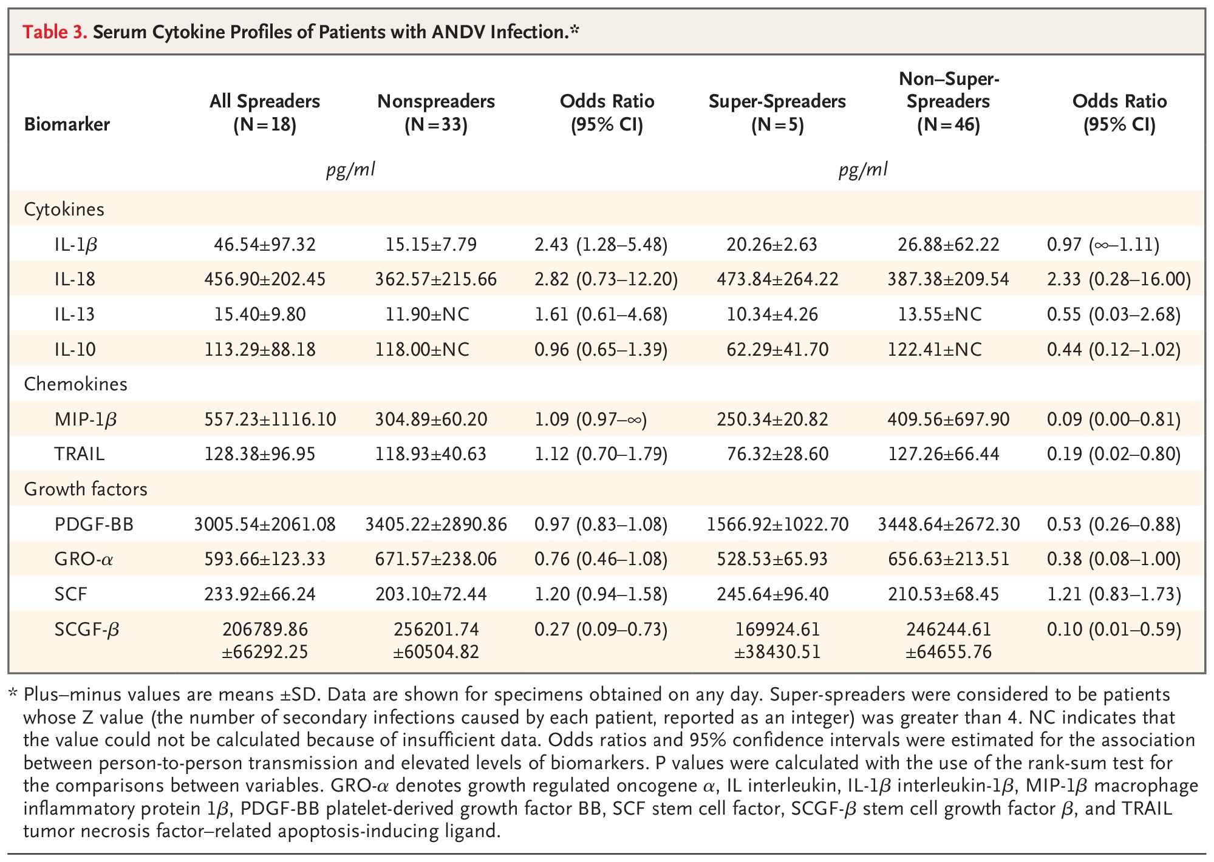
Serum Cytokine Profiles of Patients with ANDV Infection.
Martínez VP et al. N Engl J Med2020;383:2230-2241
Notes:
Table 3 Serum Cytokine Profiles of Patients with ANDV Infection.

Slide 7
Conclusions
Among patients with ANDV hantavirus pulmonary syndrome, high viral titers in combination with attendance at massive social gatherings or extensive contact among persons were associated with a higher likelihood of transmission.

