Slide 1
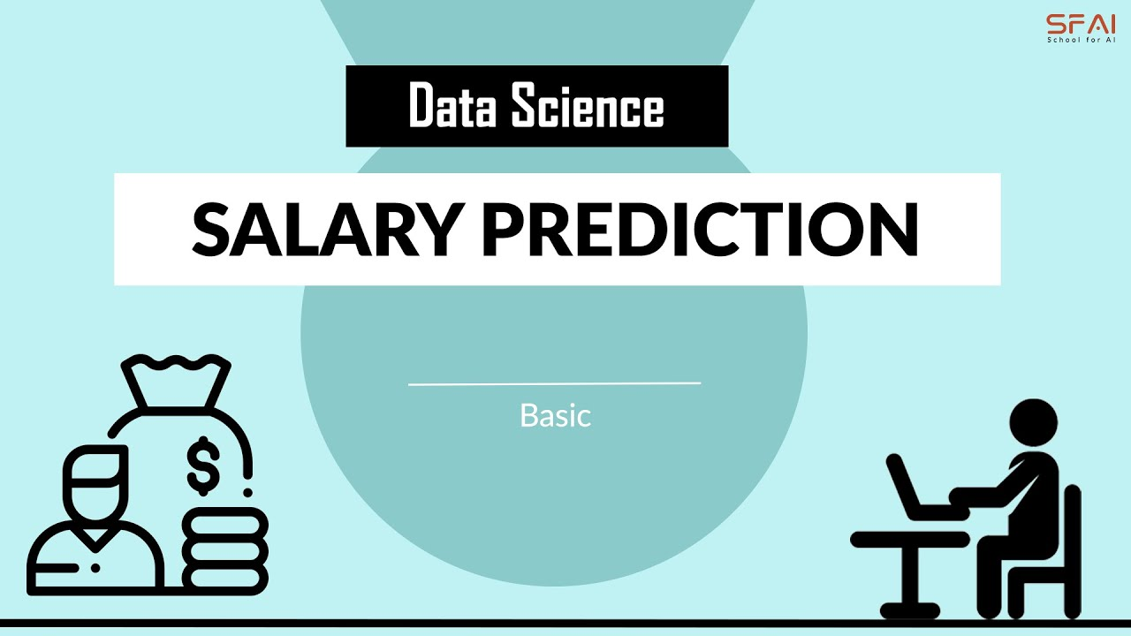
Salary Predictor
Irene Aguerri

Slide 2
EDA
Data loading
Analysis
Modelo

