Slide 1
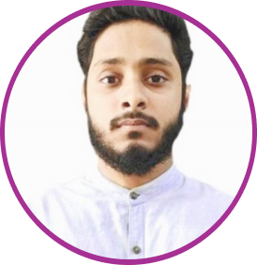















EDUCATION
Md. Ishaq Ahmad
Full Stack Developer
MERN
Creative IT Institution.
Currently, Learning other programming languages for develop my skills.
EXPERIENCE
Developed a fully functional Ecommerce website with Next JS
https://travel-bdh2o.vercel.app/
Project was based on modern interface development with emerging tools like tailwind css, state management with Redux, backend development with node js and many more.
ABOUT ME
A professional React Developer for past 2 years. Recently, I have create 2 projects one of is travel and others is e-Commerce with React and Next JS. Working with these projects I am confident that I can do good for your organization.
Chatting app Landing page, Reg & Login
One of my recent project that I have completed.
https://h2-o-chi.vercel.app/
Many more Side Projects as Freelancer
I have developed many more side projects like Food shop ui, Crud applications and Ui designs. Also worked in Freelanching.com.
MY SKILLS
Im.Ishaq.bd@gmail.com
01568202869 & 01960465052
React Framework
Tailwindcss
Redux
Framer Motion
Facebook/ishaqmoonira
Next JS
MonogDB
Node js
MySQL
LANGUAGES
English
Fluent grip on HTML, CSS and Javascript concepts.
Understanding of core react and Next JS concepts like DOM manipulation, context and directory structure.
Knows how to sync workflows from different modules.
Bangla

