Slide 1
Translator app

Slide 2
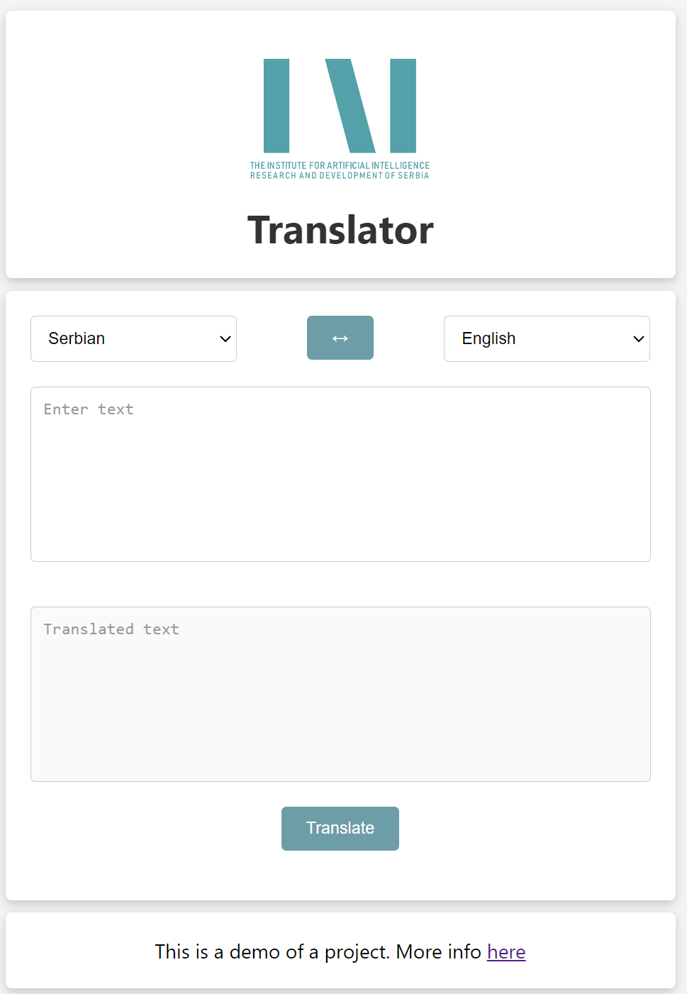
Description (1/2)
Test version of Translator application can be accessed via link:
http://147.91.175.237:52628/

Slide 3
Description (2/2)
Translator application consist of two main parts:
Backend part: API REST server realized in Flask (Python web framework) and Mindspore NLP model executed on NPU
Frontend part: web application realized in Vue3 (Web development framework)
Frontend part is static HTML/JS generated using Vue that is served through Waitress web server.
Each static page make API backend call using API REST protocol
API REST server is served through the same web server
API REST service is communicating with NLP model executed on NPU

Slide 4
Logical structure
Logical structure of system id presented with following block diagram:

Slide 5
Implementation
webapp folder – main folder
backend – folder for Flask app
dist – Static HTML/CSS/JS files served
node_modules – modules need for Vue
public – folder for template pages
src - source code of Vue application

