Slide 1
Translator app

Slide 2
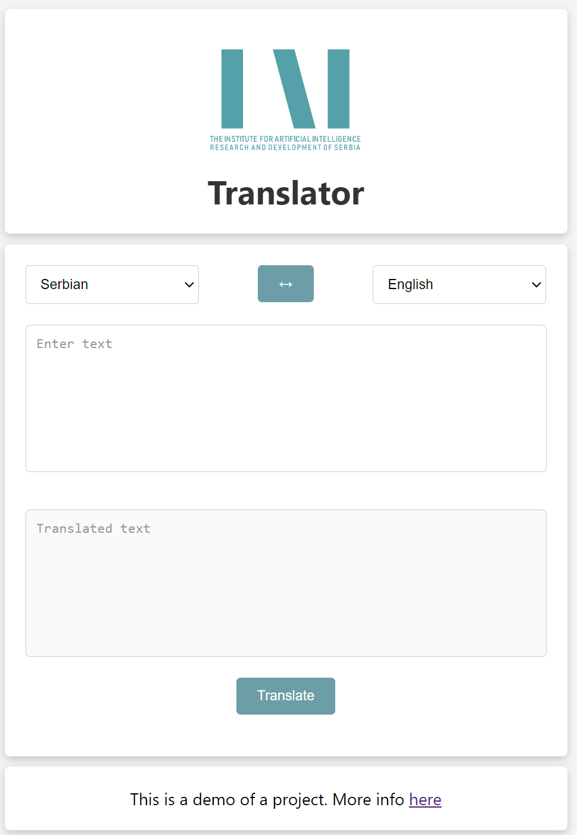
Description (1/2)
The test version of Translator application can be accessed via the link http://147.91.175.237:52628/

Slide 3
Description (2/2)
The translator application consists of two main parts:
Backend part: API REST server realized in Flask (Python web framework) and Mindspore NLP model executed on NPU
Frontend part: web application realized in Vue3 (Web development framework)
Frontend part is static HTML/JS generated using Vue that is served through Waitress web server.
Static page makes API backend calls using the API REST protocol
API REST service is served through the same web server
API REST service communicates with the NLP model executed on NPU

Slide 4
Logical structure
Logical structure of system is presented with following block diagram:

Slide 5
Implementation
webapp folder – main folder
backend – folder for Flask app
dist – Static HTML/CSS/JS files served
node_modules – modules need for Vue
public – folder for template pages
src - source code of Vue application

