Slide 1
North East Scotland · creative economy research · June 2026
A creative economy worth counting
Scale, structure and strategic opportunity
in the creative economy of Aberdeen and Aberdeenshire
Commissioned by Aberdeen City Council
Research by The Fifth Sector | Unscrambled.world

Slide 2
Section 1 · Measurement problem
Standard measures miss most of this economy
National statistics count employment in registered businesses only.
Applied to North East Scotland, that approach produces a count of 4,690 workers in 2024 – including up to 1,600 generic IT consultants with no creative-digital activity.
In a sector where over 90% of firms employ fewer than ten people and more than a third of practitioners are freelance, the exclusion of self-employed workers is a structural flaw in the measurement, not a small rounding error.
This research works across three layers of evidence to find the workers, firms and value that official statistics miss.
The official picture
4,690
Employees – standard
DCMS methodology
↓ 2.2× larger
This research
10,490
Creative workforce identified
across four tiers
Source: BRES 2024; The Fifth Sector (2026) four-tier model

Slide 3
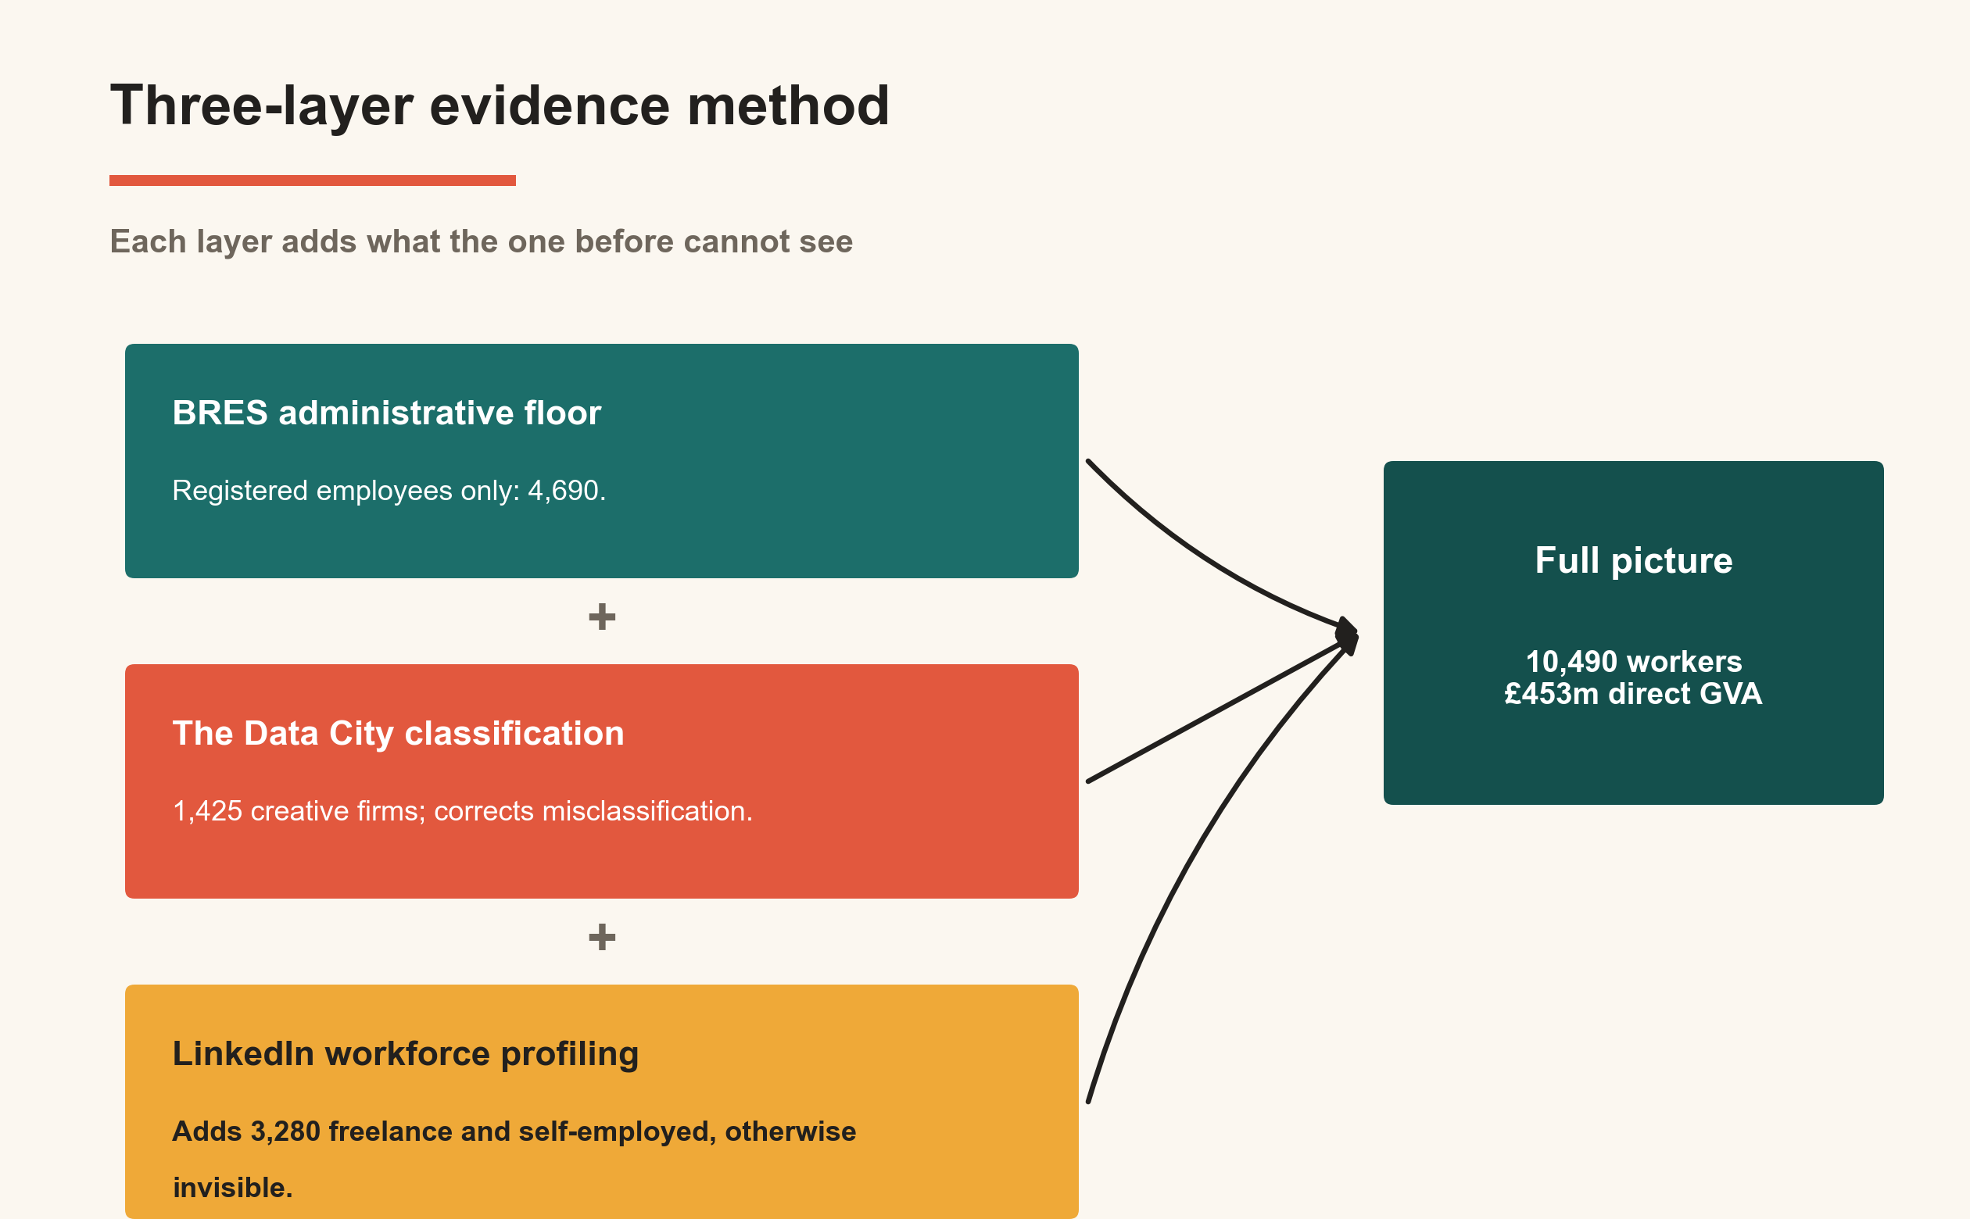
Section 1 · Methodology
Three evidence layers, one complete picture
Data analysis triangulation. Source: The Fifth Sector (2026).

Slide 4
Section 2 · Scale and significance
The combined picture is substantially larger
than any previous account of this economy
10,490
£453m
£675m
Creative workers
across four tiers
Direct gross
value added
Total economic
impact
These figures are not visible in any current policy framework because the measurement tools previously applied were not designed to find them.
985 registered businesses · 7,715 FTE · £453m direct GVA · Type II multiplier 1.51 average
Source: The Fifth Sector (2026). BRES, The Data City, LinkedIn Talent Insights and penetration gap analysis.

Slide 5
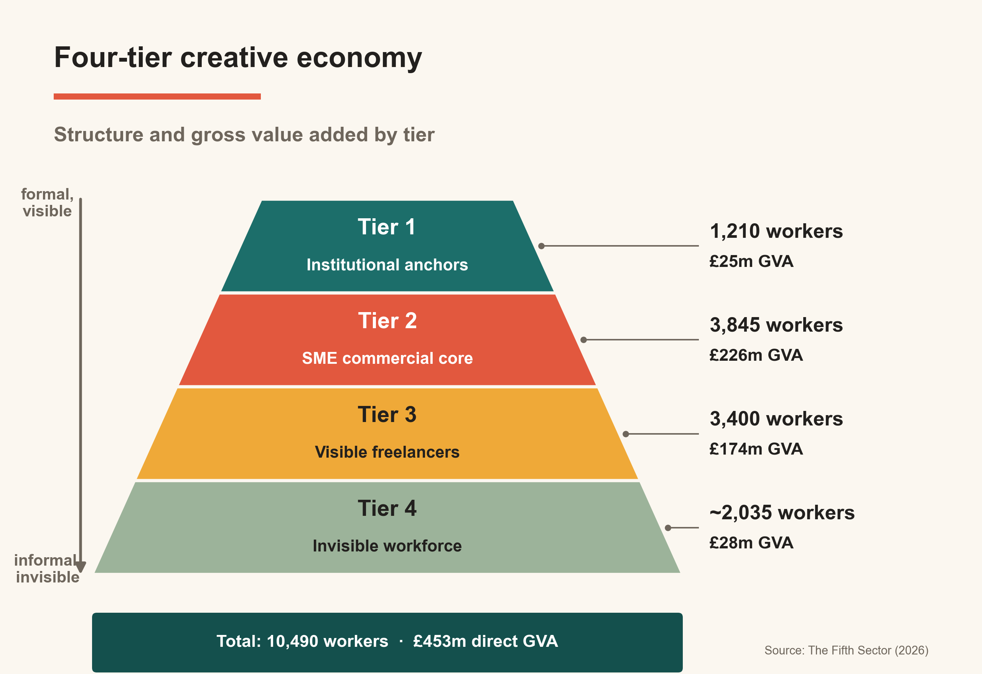
Section 2 · Four-tier model
A creative economy in four tiers, not one sector
Source: The Fifth Sector (2026)

Slide 6
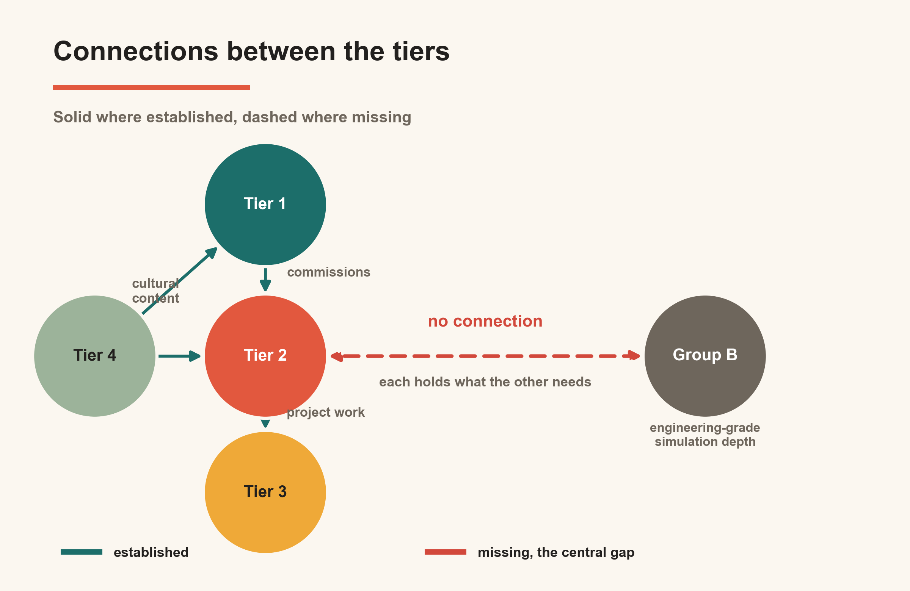
Section 2 · Four-tier model
The tiers are interdependent – and some connections are missing
Established connections
Tier 1 commissions from Tier 2; Tier 2 passes project work to Tier 3 freelancers; Tier 4 supplies cultural content inward through Tiers 1 and 2.
The structural gap
Adjacent technical firms (Group B) - with engineering-grade simulation skills - have no connection with city-centre creative agencies. Each holds what the other needs.
This separation points to a convergence opportunity
Connections between the tiers. Dashed lines indicate weak or absent connections. Source: The Fifth Sector (2026)

Slide 7
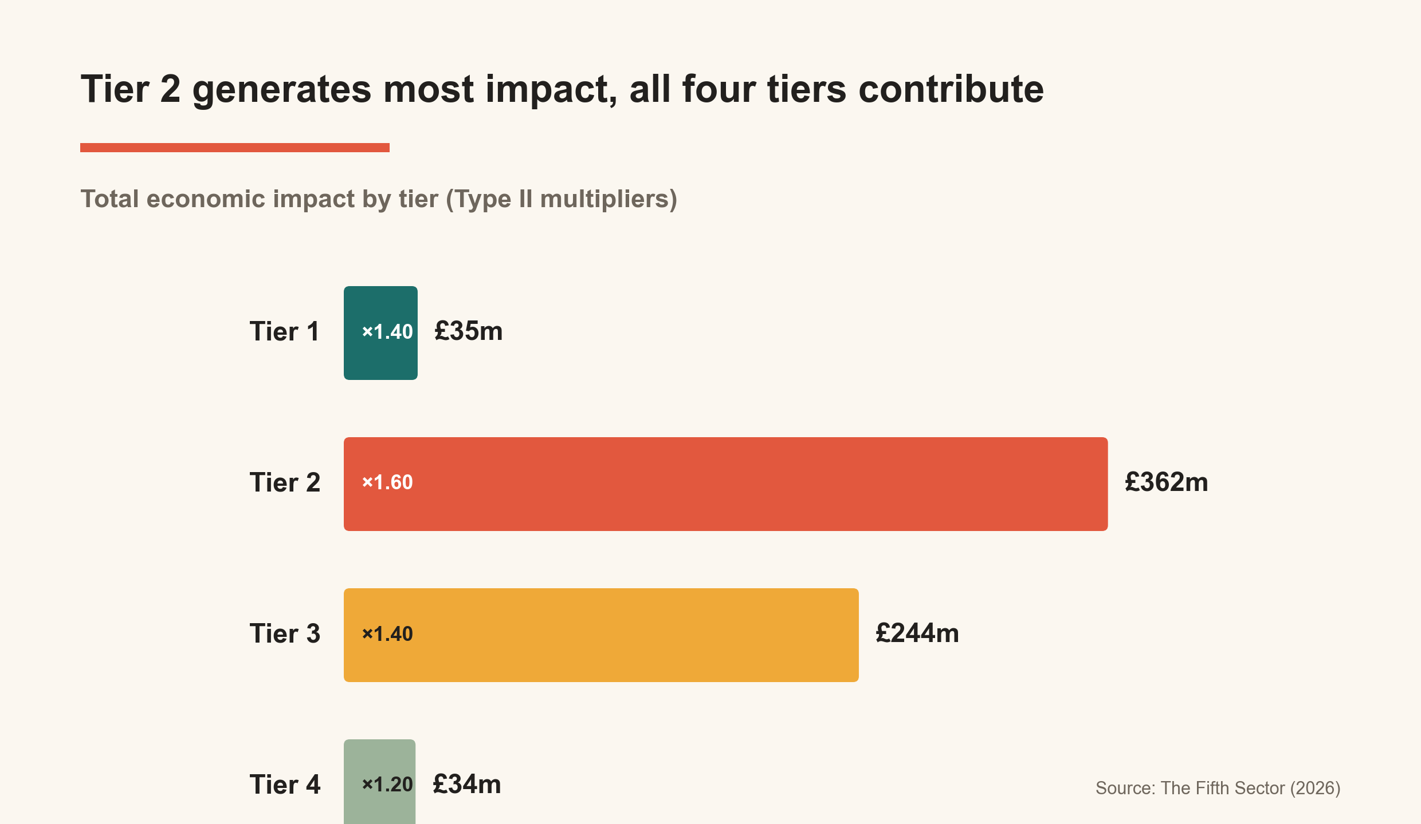
Section 2 · Economic impact
Tier 2 generates the greatest impact, but all four tiers contribute
Tier 2 SME core
£362m total impact
Tier 3 freelancers
£244m total impact
Tier 4 invisible workforce
£34m total impact
BRES records Tier 3 and Tier 4 population as zero.
Total economic impact by tier. Source: The Fifth Sector (2026); ONS, DCMS and Scottish Government definitions.

Slide 8
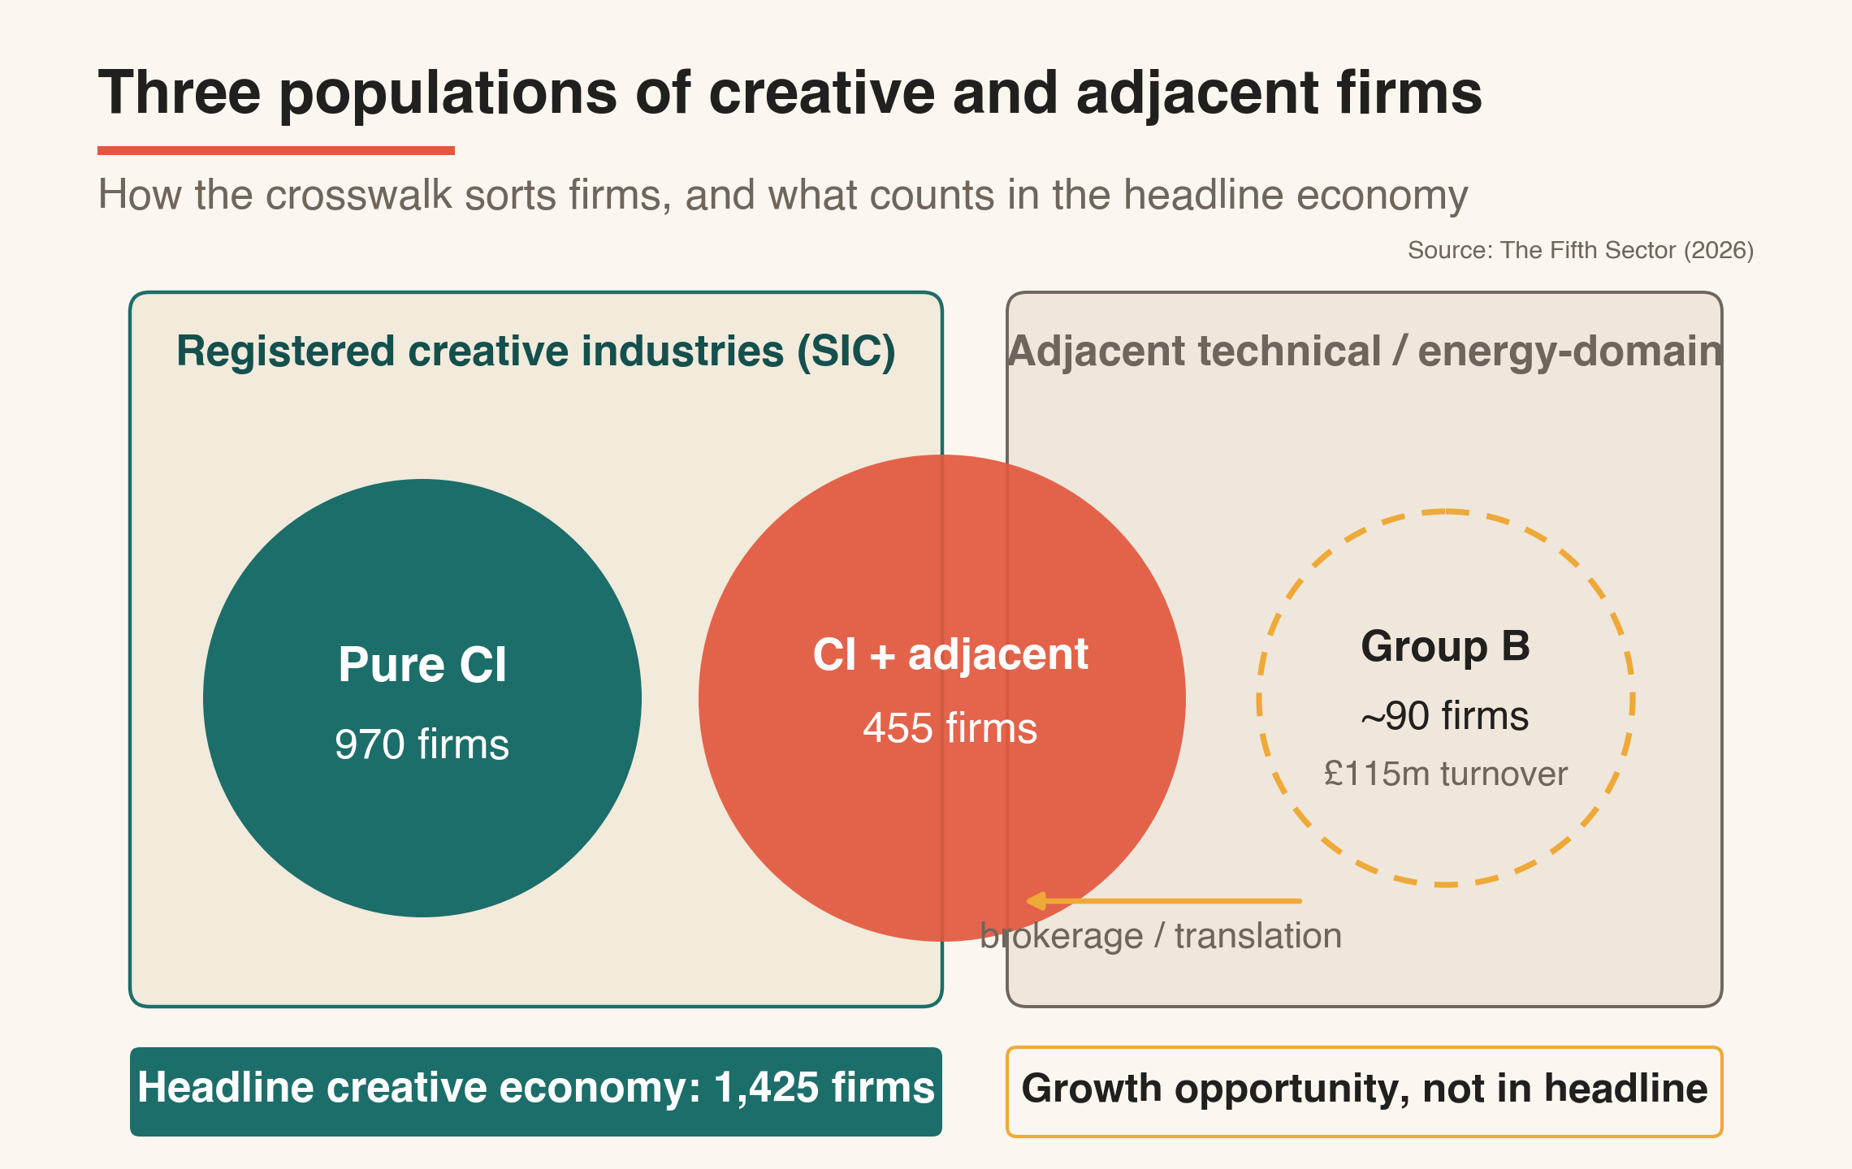
Group A and Group B: Convergence Opportunity
Figure 2: Three populations of creative and adjacent firms

Slide 9
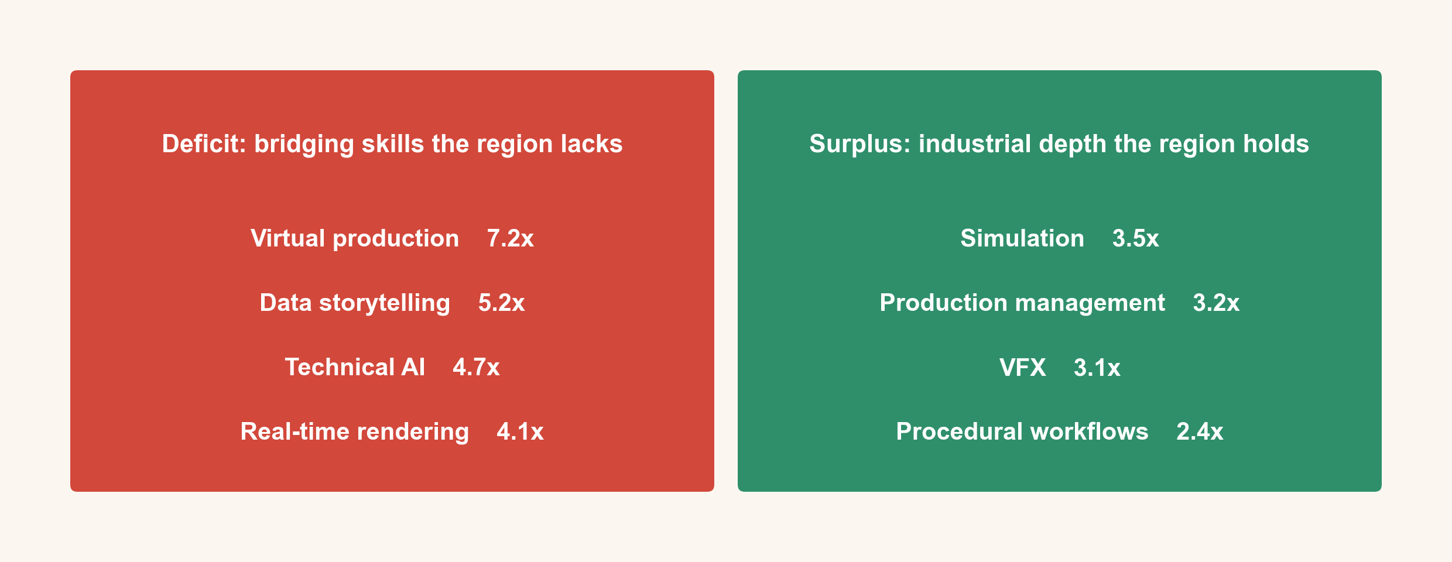
Section 3 · Skills analysis
Technically deep but commercially constrained
Skills position against Nottingham comparator. Source: LinkedIn / Unscrambled.world. NES base 219,256 profiles; Nottingham 357,597.

Slide 10
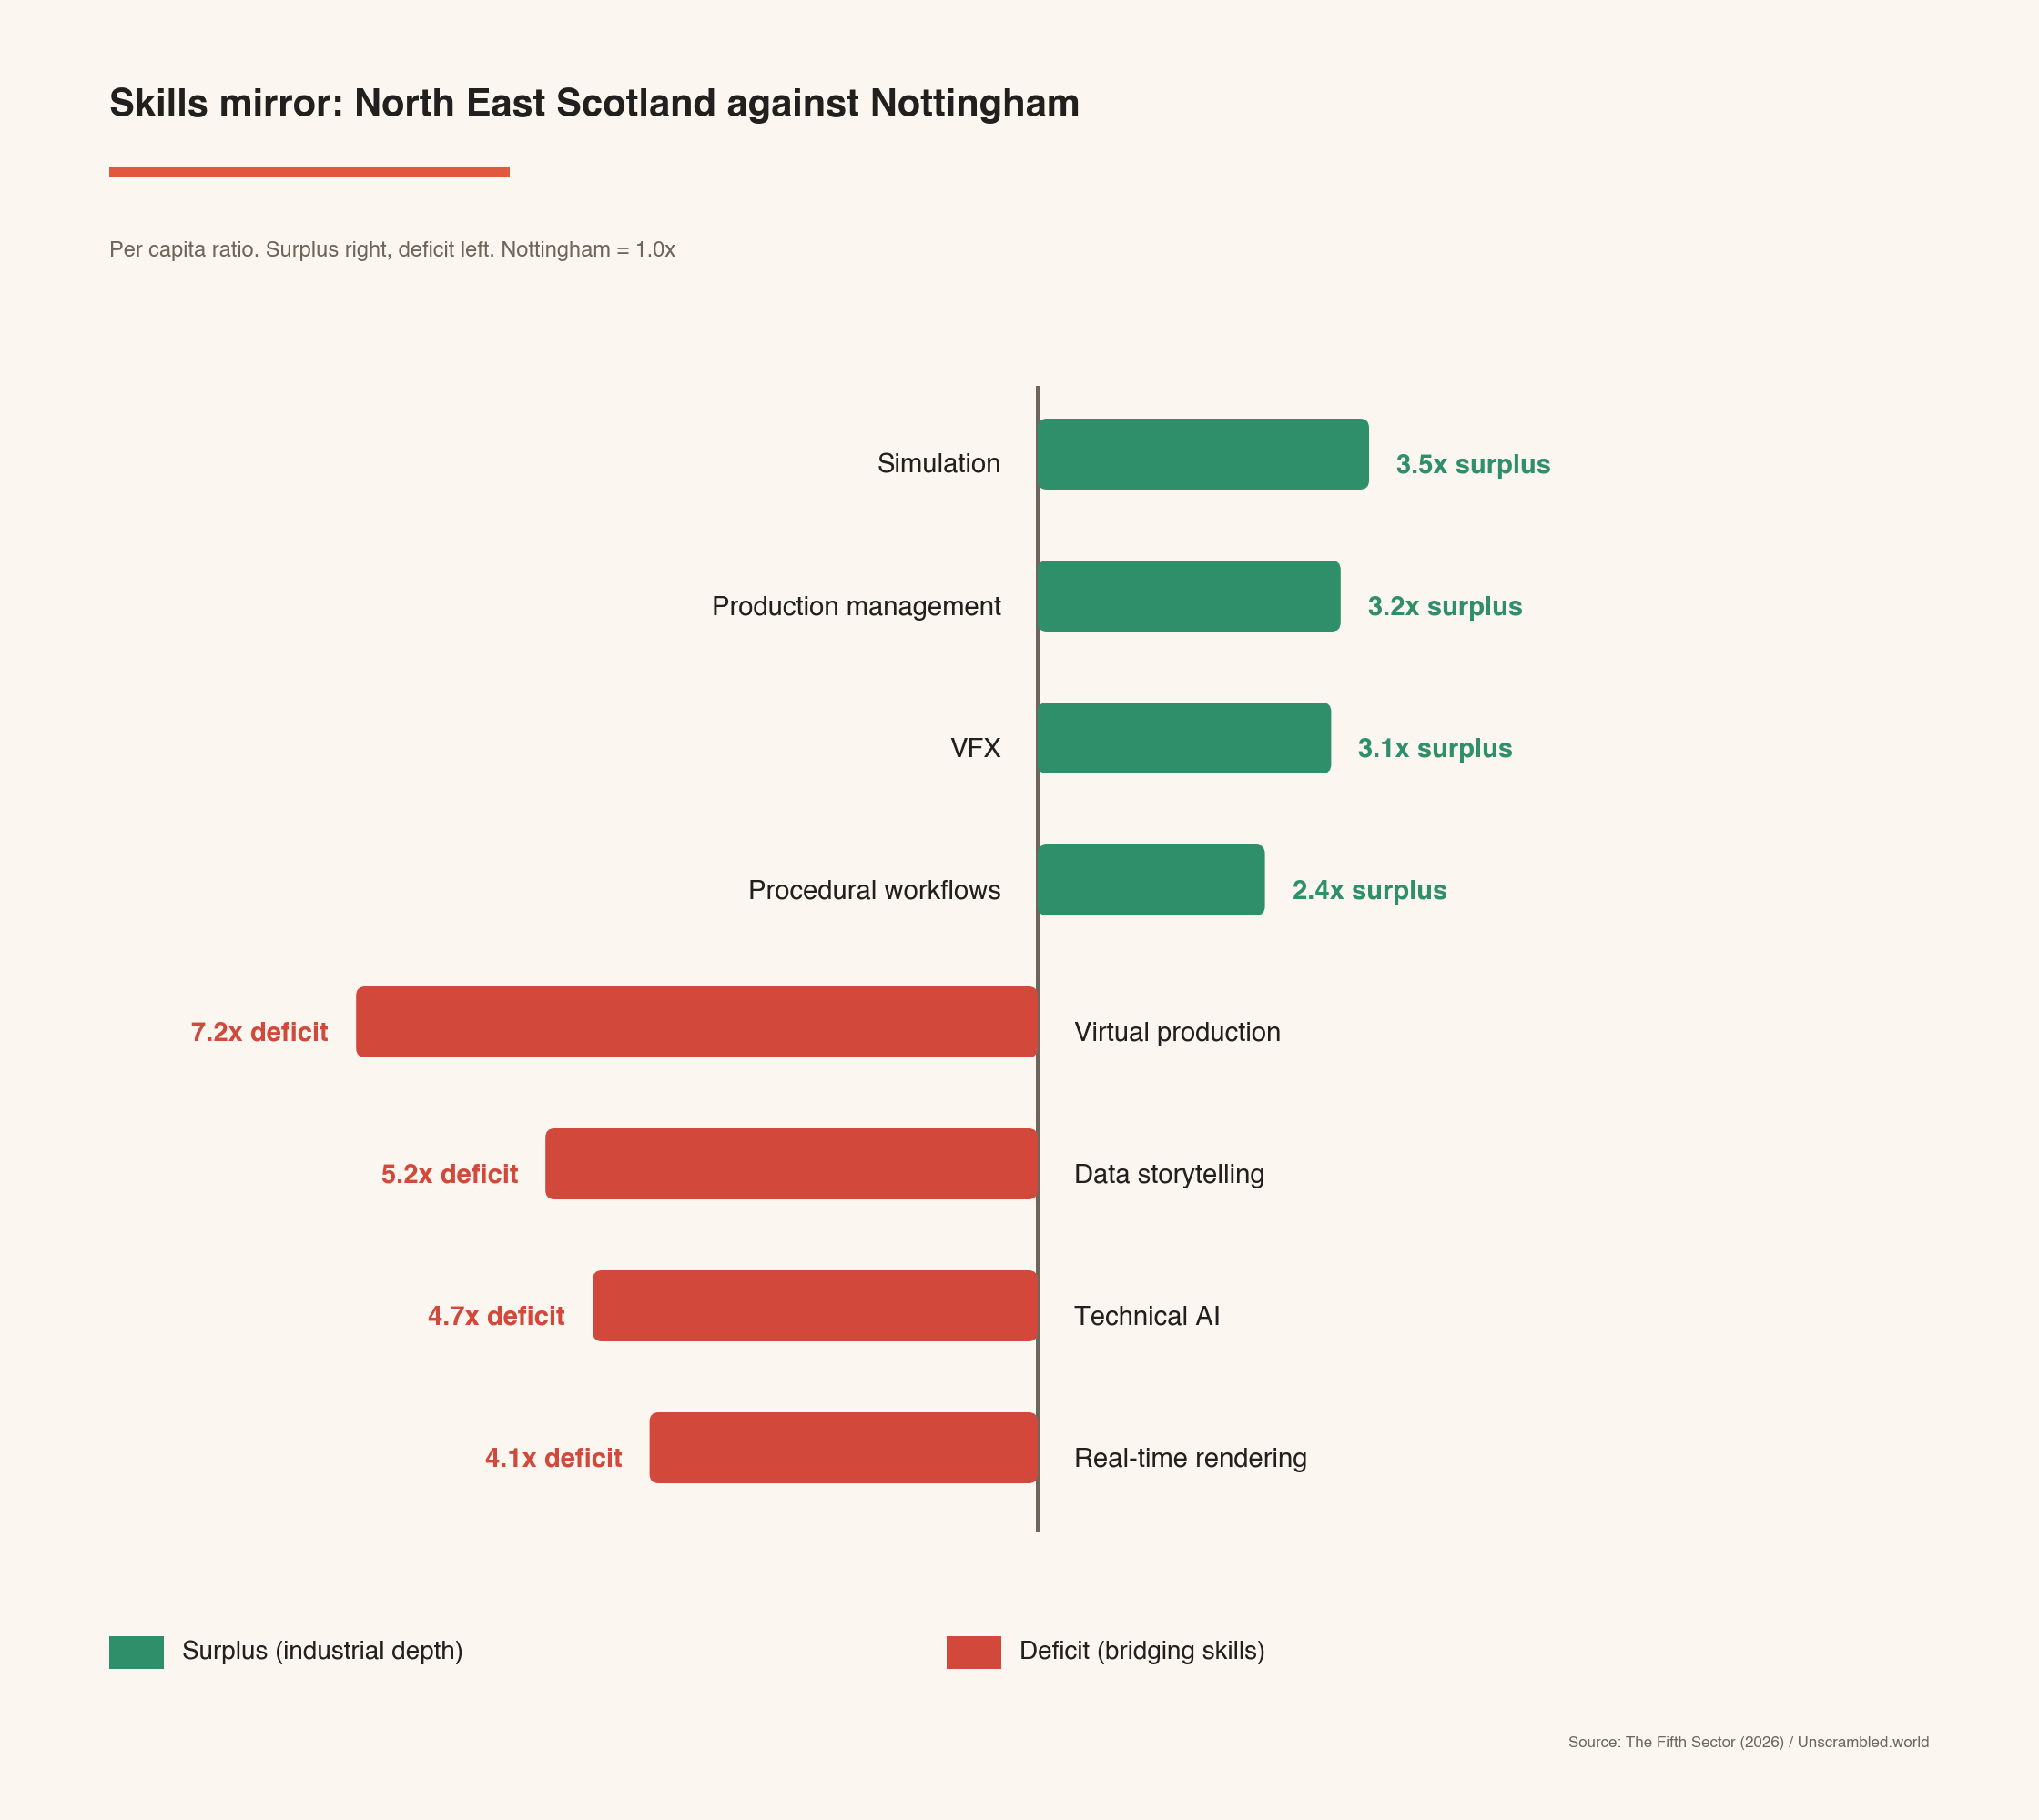
Section 3 · Convergence opportunity
Each half of this economy holds what the other needs
The skills gap is not between NE Scotland and other regions.
It is between parts of the same regional economy that have never had a mechanism for knowledge exchange.
~90 Group B firms
hold engineering-grade simulation depth
920 Tier 2 firms
hold narrative, design and production capability
Neither can reach the highest-value markets alone.
North East Scotland against Nottingham, per-capita skills. Source: LinkedIn / Unscrambled.world

Slide 11
Section 3 · Market context
Large and growing markets are waiting for this connection
UK creative industries
UK immersive technology
UK wind power market
Creative Industries Sector Plan
£145.8bn GVA in 2024
4.6% growth vs 1.0% for UK economy
Fastest-growing sub-sector: IT & software (+8.7%)
$1.35bn (2024) → $7.95bn (2033)
21.8% CAGR
NE Scotland simulation skills directly applicable
$39.3bn (2024) → $95.3bn (2032)
11.7% CAGR
Statutory community engagement requirements create demand
£100m UKRI Creative Clusters investment
CoSTAR satellite confirmation expected June 2026; CICP3 funding round 2027
NE Scotland is a credible applicant now
Sources: DCMS (2024); Verified Market Research (2024); Mordor Intelligence (2025); IMARC Group (2024). Market projections are indicative order-of-magnitude context only.

Slide 12
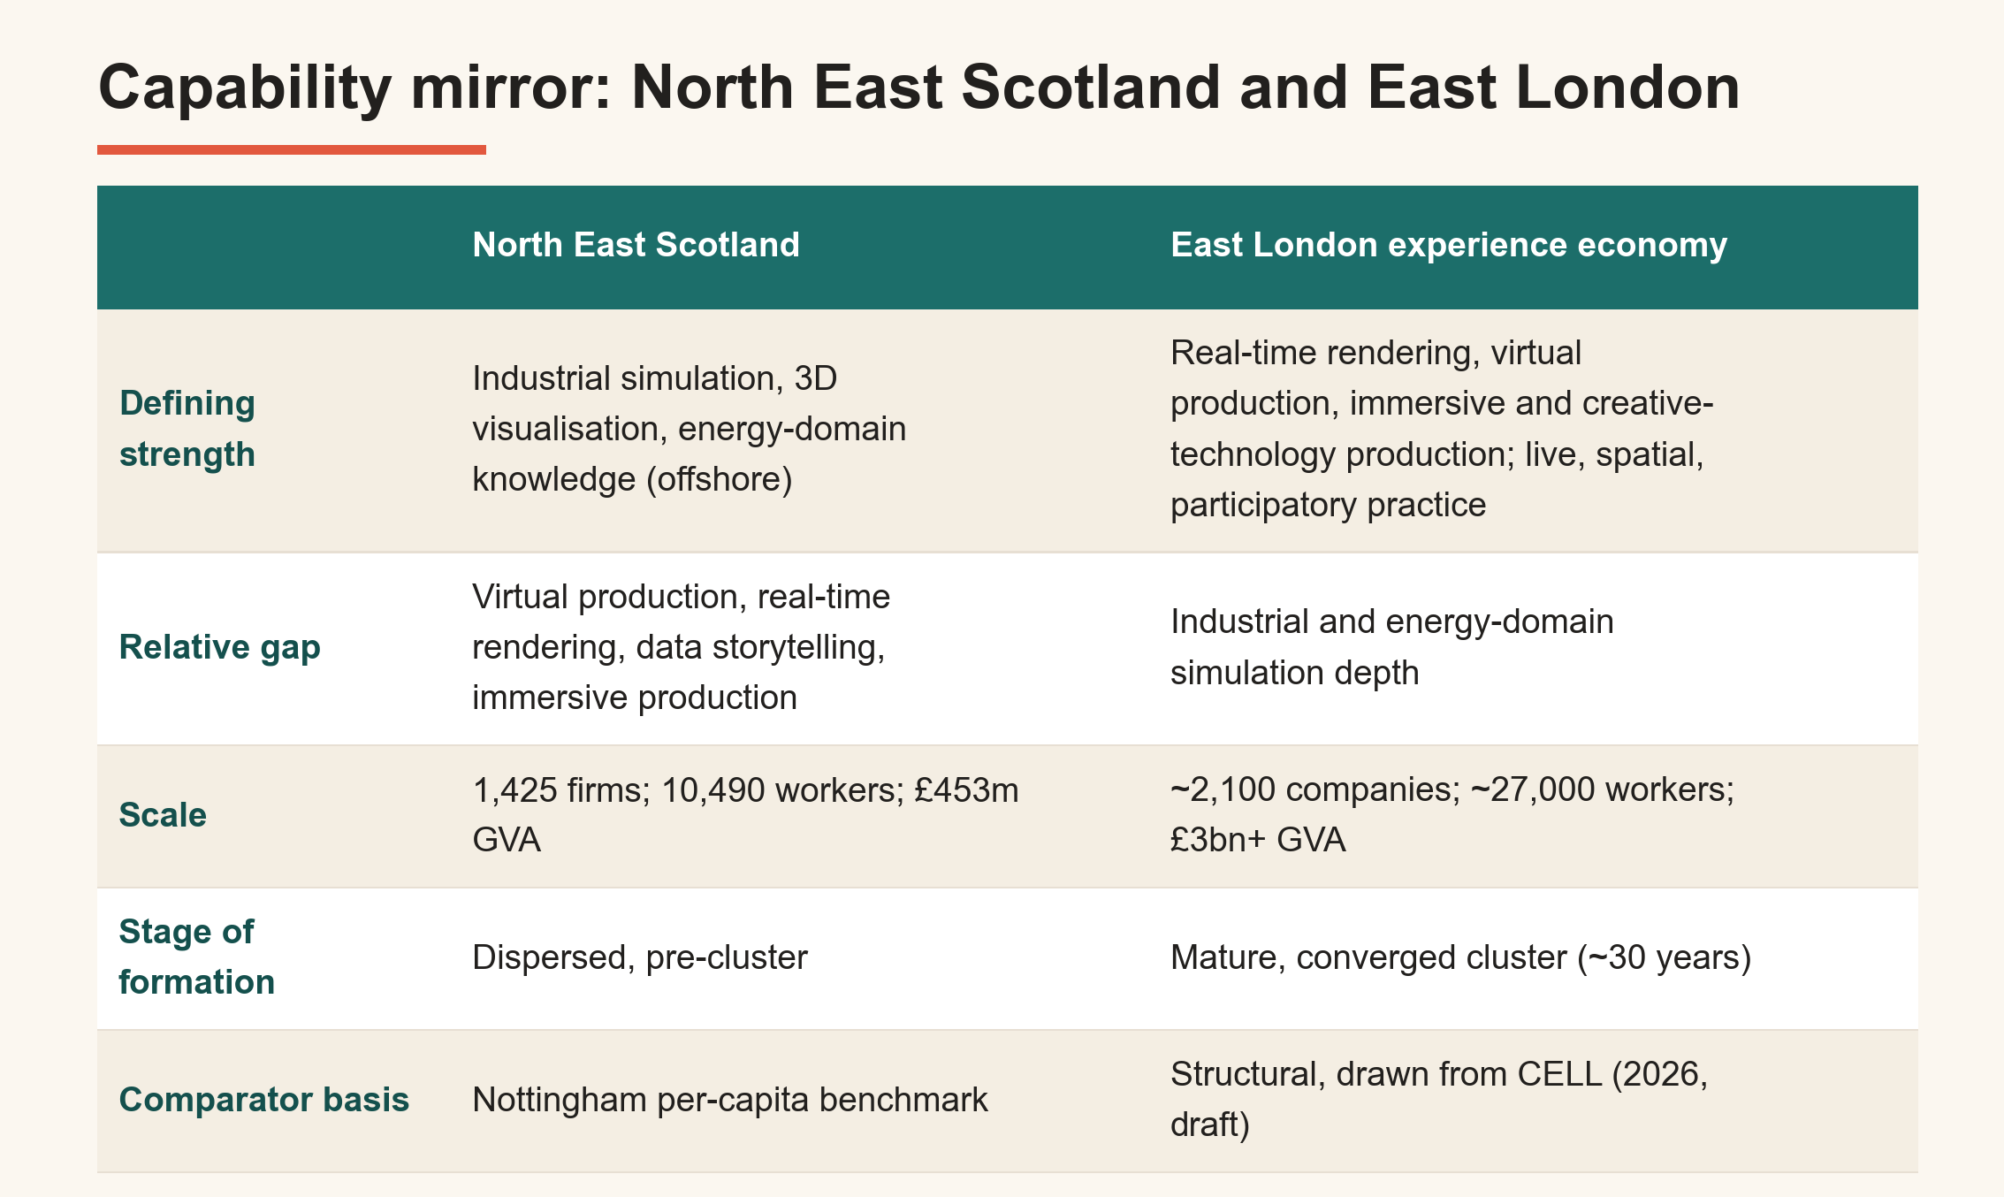
Section 3 · A London reference point
What converged capability becomes: a London comparator
Structural comparator from a parallel Fifth Sector study (LLDC/Loughborough Uni/UCL, 2026, draft); stronger signals only. Full provenance in report Appendix G.

Slide 13
Section 4 · Structural challenges
32% retention: graduates leave because the opportunity is invisible
32%
36%
23%
combined creative
alumni retention rate
RGU creative
alumni retained locally
University of Aberdeen
creative alumni retained
This is not a quality failure. It is a structural one.
The explanation is absorptive capacity and invisibility. Graduates leave primarily for the Central Belt – Edinburgh and Glasgow take more than London. A larger creative economy, more visible entry-level roles and more obvious professional networks provide the pull.
Making the opportunity visible - through connectivity (Strategy 1), the Creative Career Bridge (Strategy 3), and a consistent regional narrative (Strategy 4) - is the precondition for retention, not an optional complement to it.
"A graduate who can see three credible pathways has a reason to stay that is currently invisible to them at the point of graduation."
Source: LinkedIn / Unscrambled.world SOC Analysis. Mapped alumni from RGU and University of Aberdeen. See Part Five and Section 8.1.

Slide 14
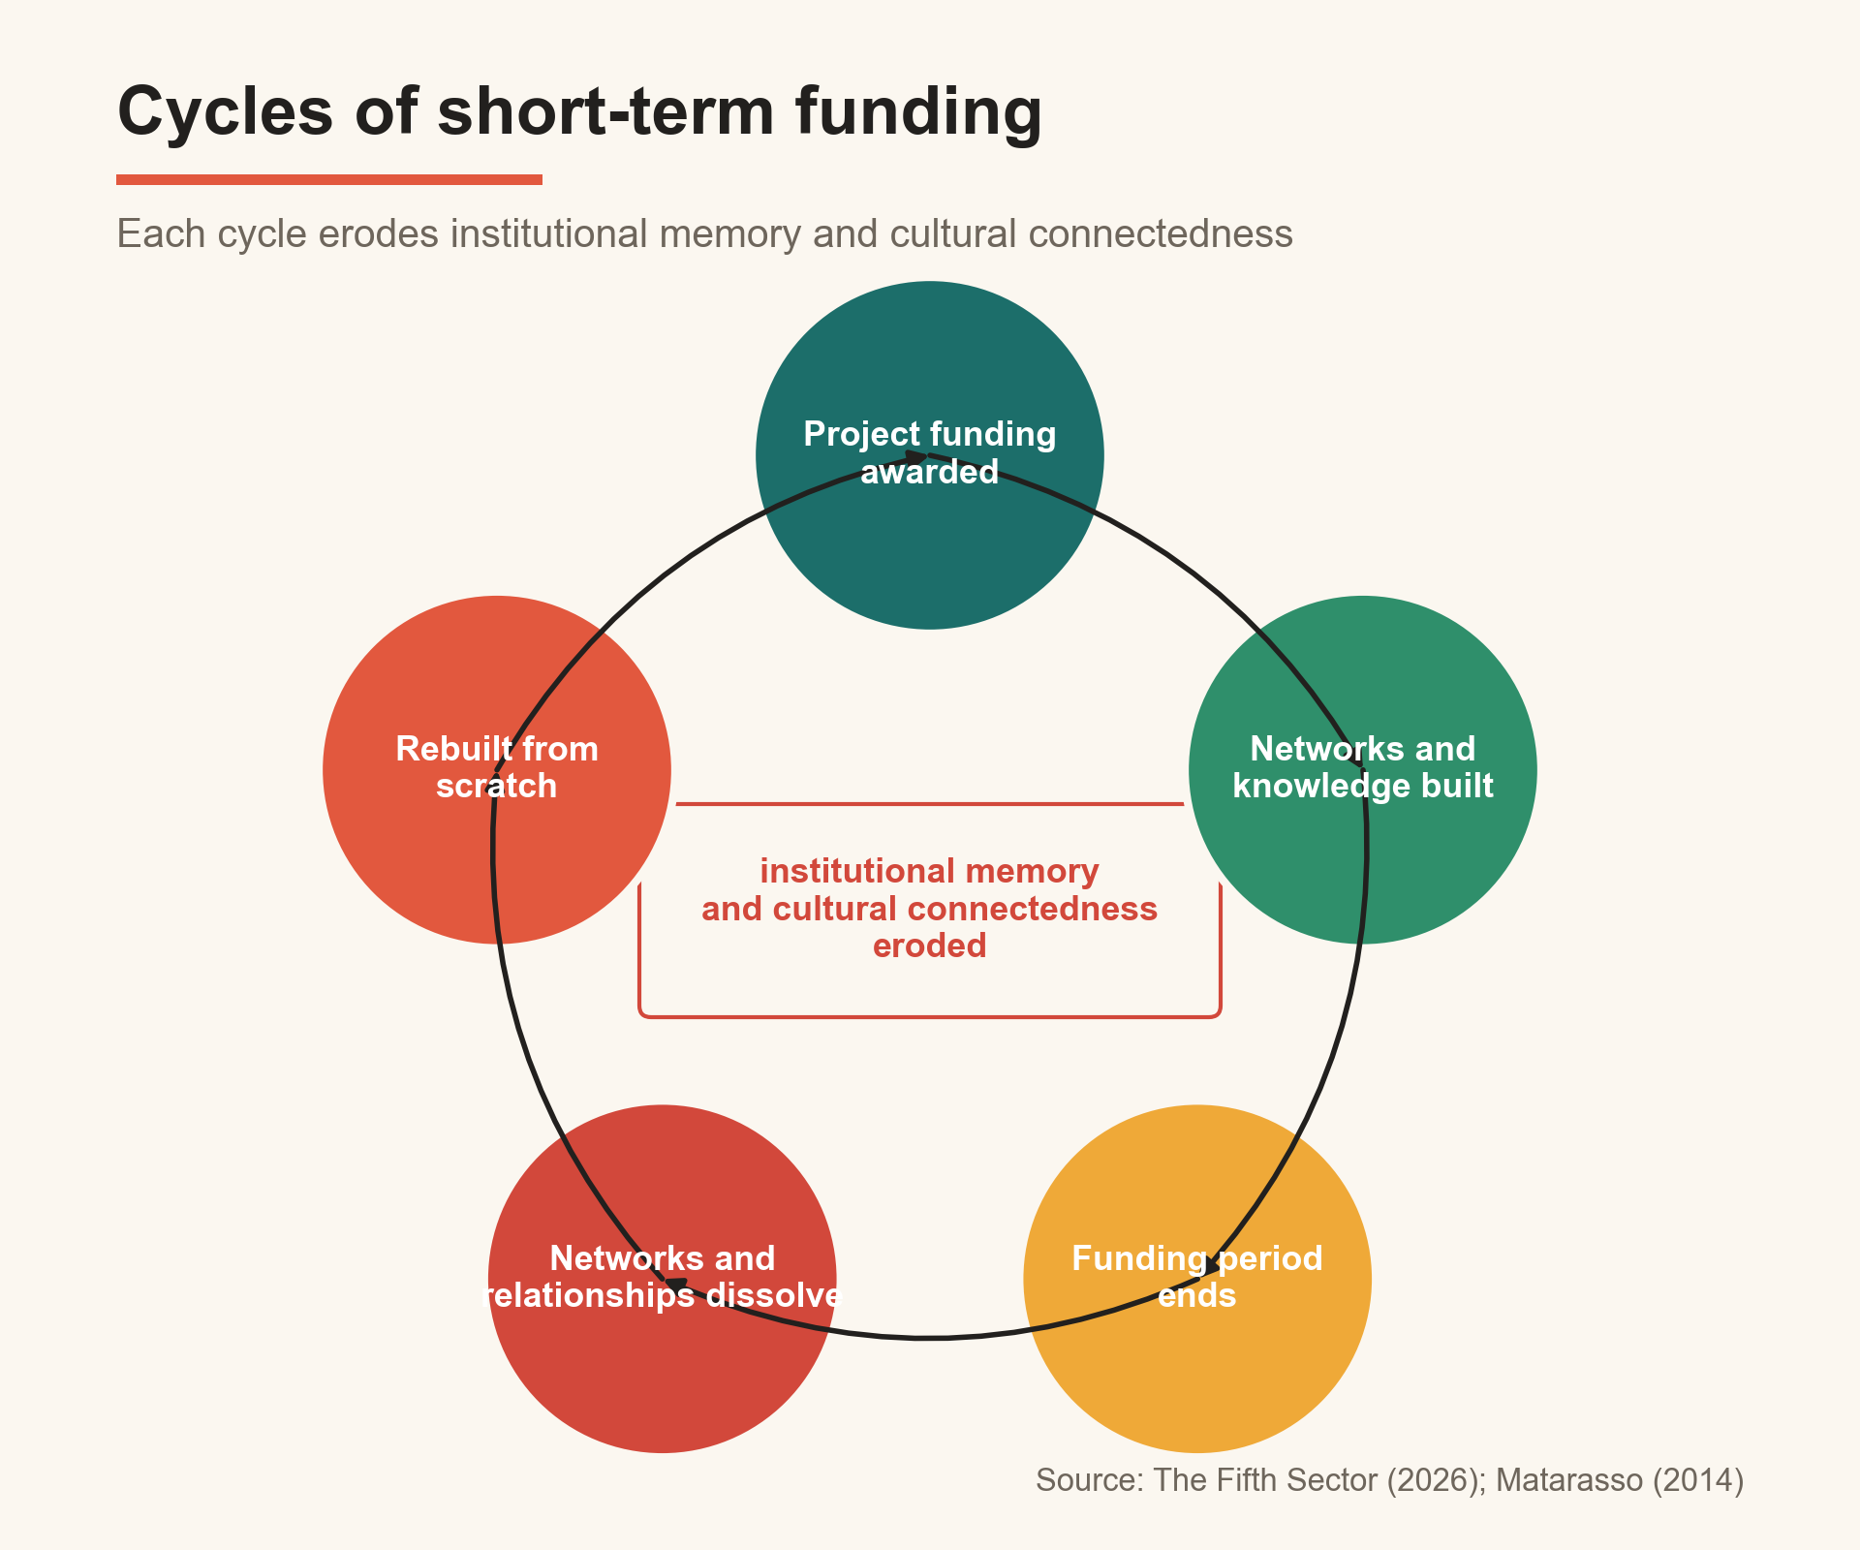
Section 4 · Structural challenges
Sector networks run on borrowed time
Organisational churn
The repeated formation, operation and dissolution of connective creative infrastructure under time-limited funding.
Connective sector network organisations from the 2014 audit
have closed without successors. Each cycle of short-term funding loses relationships and knowledge, eroding institutional memory.
The window to break the cycle is the next 12–24 months.
Cycles of short-term funding. Source: The Fifth Sector (2026). See Part Eight.

Slide 15
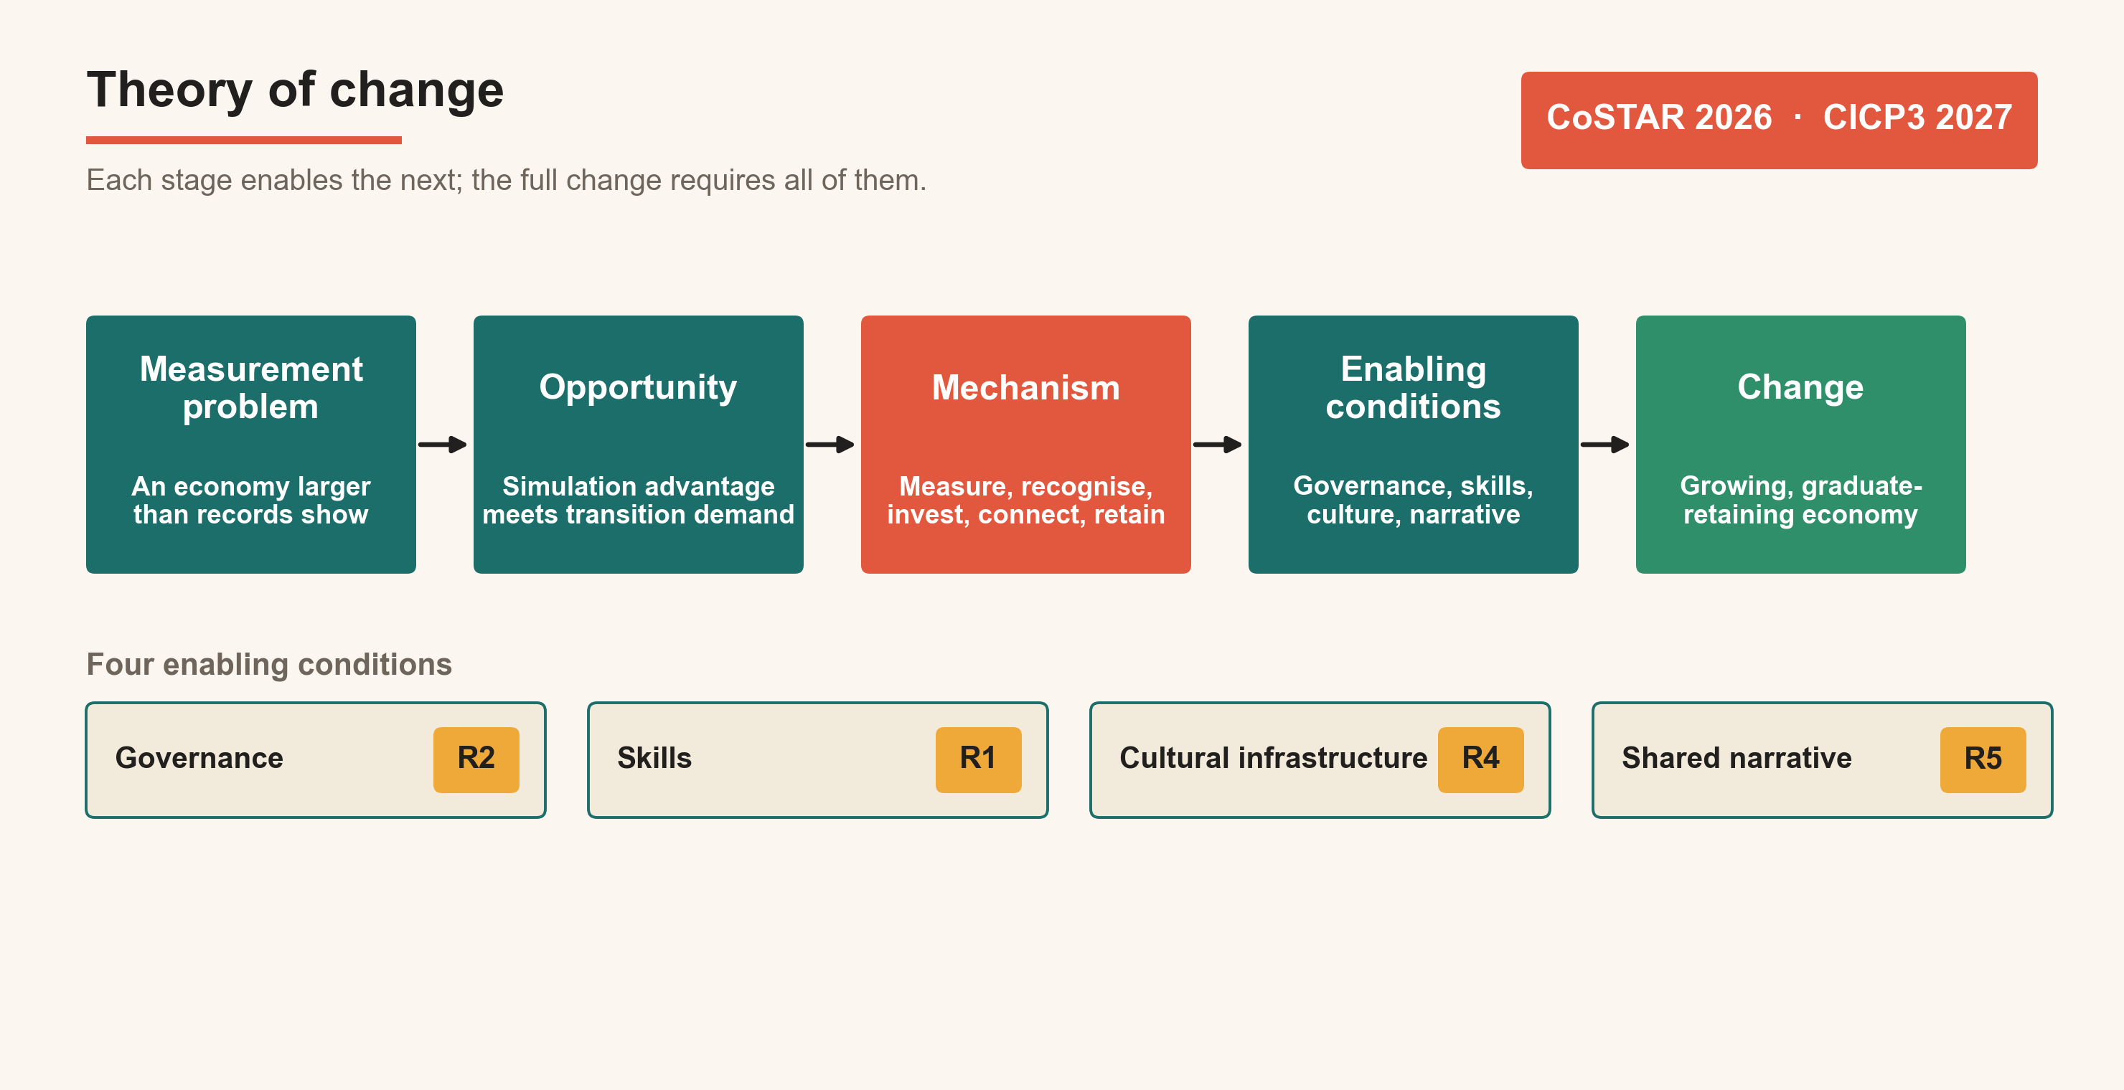
Theory of change
Translating evidence into action
Each stage enables the next; Recommendation 2 (Joint Board) is the precondition. Source: The Fifth Sector (2026).

Slide 16
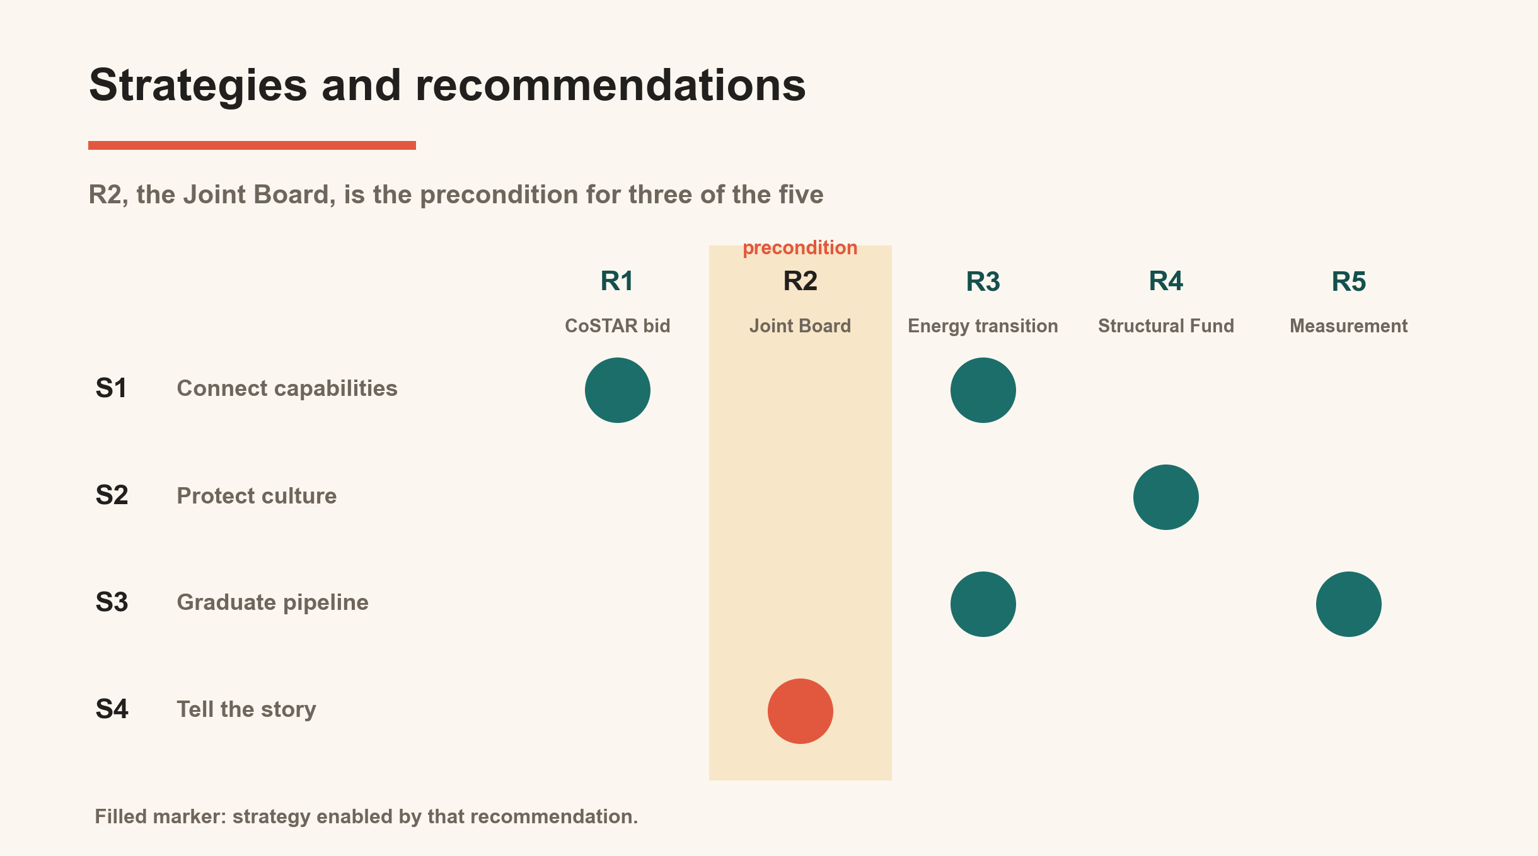
Section 5 · Four strategies
Four strategies, sequenced - each enabling the next
Strategies and recommendations: R2 (Joint Board) is the precondition for three of the five. Source: The Fifth Sector (2026).

Slide 17
Section 5 · Four strategies
From gap to action: what each strategy does in practice
Strategy 1
Strategy 2
Strategy 3
Strategy 4
Connect complementary capabilities commercially
Protect and develop the cultural sector
Reframe the graduate pipeline as a transition asset
Tell a different story
Named Creative-Digital Network + mutual CPD programme.
Group B simulation firms meet city-centre creative agencies.
First measurable output: 3 joint commercial relationships.
Secure Tier 1 institutional anchors and Tier 4 practitioner base.
Formalise Edit/Gray's graduate retention model.
Creative Wellbeing pilot as LOIP preventive health infrastructure.
12-month Creative Career Bridge placement programme.
Three visible pathways: creative core growth, energy transition,
and wider Createch (screen, games, immersive, real-time).
NES Creative Economy Narrative as formal policy commitment.
Deployed across RES, LOIP, investment prospectuses.
Precondition for all other strategies attracting sustained attention.
Source: The Fifth Sector (2026). See Part Nine for full strategy detail.

Slide 18
Section 6 · Five recommendations
Five recommendations – one governance precondition
R1 UKRI bid strategy
R2 ★ Precondition
R4 Creative Structural Fund
Joint university + council bids to CoSTAR, UKRI Creative Clusters programme. Frame as NES Createch translation model. Deadline: June 2026.
Cost: within existing university bid resource.
Joint Cultural and Creative
Economy Board
Multi-year revenue funding to connective sector organisations.
Min 3-year periods + pathway to MYF status.
Cost: £150k–£300k p.a. for 4–6 organisations. Years 1–2.
Shared budget · dedicated officer resource · formal mandate
Cross-boundary authority for measurement, funding, UKRI bid and advocacy
Cost: £50k–£100k p.a. + 1 FTE
Timescale: Year 1
R3 Energy transition programme
R5 Full-spectrum measurement
NES Creative Economy Narrative · Aberdeen-Dundee Corridor · Creative Career Bridge · market development programme with city-centre agencies.
Cost: £200k–£400k over 3 years. Years 2–4.
Shared framework covering all four tiers, updated every 3 years.
NES Culture Data Hub jointly governed by both local authorities.
Cost: £100k for first iteration. Year 1.
Without R2, three of the other four recommendations are not deliverable.
Source: The Fifth Sector (2026). See Part Ten for full recommendation detail.

Slide 19
Conclusion
Connecting what already exists
The analysis locates a connection waiting to be made.
Three parts of the same economy: a registered creative-digital core, a dispersed cultural practitioner base, and an adjacent technical capacity - each holds what the others need.
All three require the connections, shared language and institutional mechanisms to function as a coherent system rather than as three separate economies operating in proximity.
10,490
£675m
4 + 5
Workforce identified
Total economic impact
Strategies + recommendations

