Slide 1
SchemeSeq A Lisp-based Step-Sequencing Platform for Max and Max for Live
Iain C.T. Duncan
https://github.com/iainctduncan

Slide 2
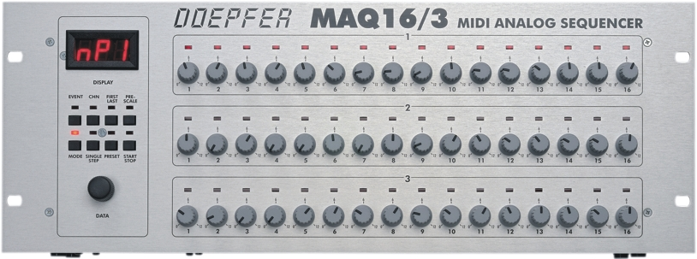
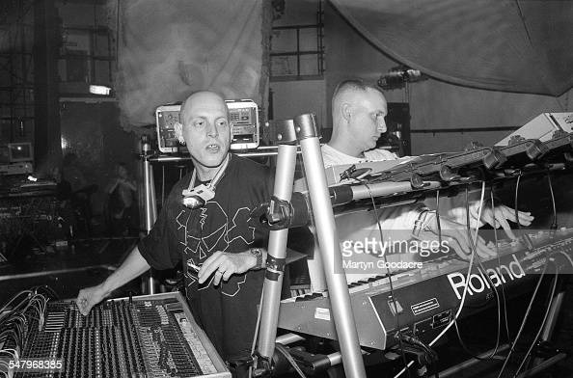
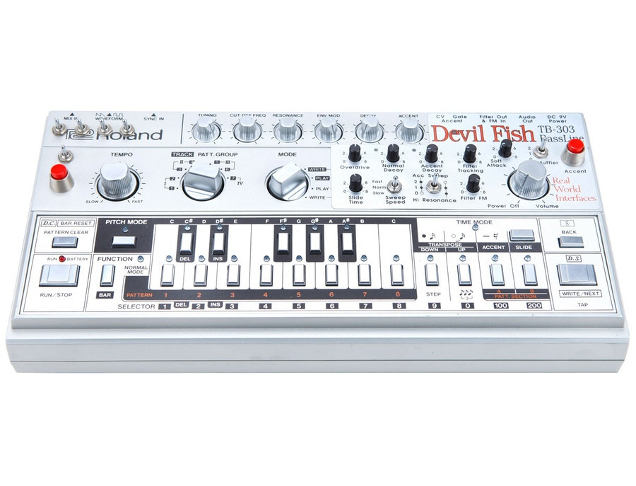
Motivation
Orbital, playing live in the 90’s.

Slide 3
Design Goals
Improvised step-sequencing – should feel like hardware
Supports algorithmic music making - in a good language
Plays well with commercial music tools – no academic ghetto
Possible to interactively extend and live-code
FAST – like using Vim or Emacs
Be the Keith Jarrett of Techno!

Slide 4
Design Decisions
Built on Scheme for Max – runs Lisp in Max and Ableton Live
Driven by modal editing with generic MIDI controllers
Editing doesn’t need visual confirmation, but does need practice!
Extensible Model-View-Controller modular architecture
Entire system is running Scheme for Max or Max extensions in C
Allows almost anything to be extended and coded in real-time

