Slide 1
Scheme for Max
Master of Music Technology – Final Project
Iain C.T. Duncan, University of Victoria

Slide 2
What we will cover
High-level goals
Background and related work
Design decisions
Features and capabilities
Evaluation, limitations, and future work

Slide 3
High-Level Goals
Build a better computer music programming platform
Target advanced users doing hard things
Work well with modern, commercial tools
For composer-programmers and tools-programmers
Support all complex scored pieces, real-time interaction, live-coding, and algorithmic music

Slide 4
Background & Related Work

Slide 5
Domain-Specific Languages
Music N, Csound, SuperCollider, ChucK, Faust
Easy to get making music
Less to decide
Less flexibility
Cumbersome for programming complex algorithms
Cumbersome for building large tools

Slide 6
Visual Patching Languages
Max, PureData, Reaktor, VCV
Easy to get started
Easy to build performer interactions
No assumptions about music structure
A lot to decide to get making music
Cumbersome for programming complex algorithms
Cumbersome for building large tools

Slide 7
General Purpose Languages
C, C++, Python, Ruby, Lisp, Scheme, Haskell, etc.
Libraries: STK, PortMidi, PortAudio, Core Audio
Frameworks: Common Music, Common Lisp Music, Nyquist
Very flexible
Appropriate for complex algorithms
Good tools for large software projects
MUCH more to learn, decide, and build

Slide 8
Multi-Language Hybrids
Csound in C or Python, Csound or SuperCollider in Max, JavaScript in Max, Clojure in from of SuperCollider, etc.
We can use the strengths of each component
EVEN MORE to learn!

Slide 9
Design Decisions

Slide 10
Scheme for Max
Uses Scheme, a GPPL in the Lisp family
Embeds this in Max (and Pure Data)
... where it can work with other (Csound, SC, Faust, VSTs)
Essentially a cross between the Max js object and the Common Music toolkit for algorithmic music.

Slide 11
Why use Max as the host?
Maturity, popularity, breadth of objects
Plays well with commercial tools (VSTs, Live, etc.)
Designed first around musical events (rather than DSP)
Has an open-source alternative in Pure Data

Slide 12
Why not just use the js object?
The js object is mature, with a rich API and extensive documentation
But... the js object only runs in the low-priority thread
And... JavaScript is a dog’s breakfast of a language

Slide 13
Why use Scheme (a Lisp)?
Symbolic computation and macros
Large body of historical and related work: Common Music, Common Lisp Music, OpenMusic, PatchWork, OpusMondi, MozLib, Slippery Chicken, etc., etc.
Interactive development with the REPL

Slide 14
Features and capabilities

Slide 15
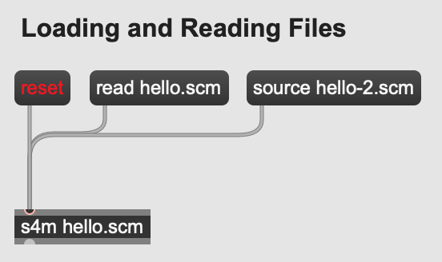
File I/O
Loading a main file from the object
Load other files additively
Read and write to/from the local file system directly

Slide 16
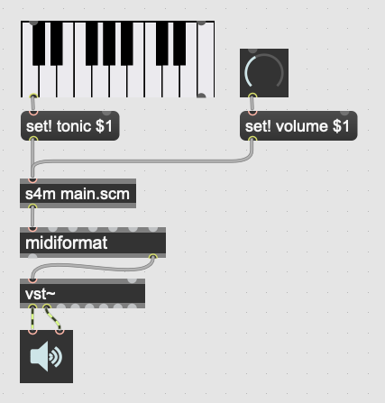
Evaluate messages as code
Max and Scheme syntax compatibility
No need to write callbacks to interact with interpreter

Slide 17
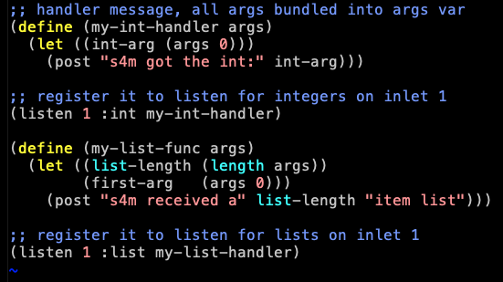
Receive messages as callbacks
Helpful when we don’t control messages (OSC, etc.)
Flexible registration and conversion system

Slide 18
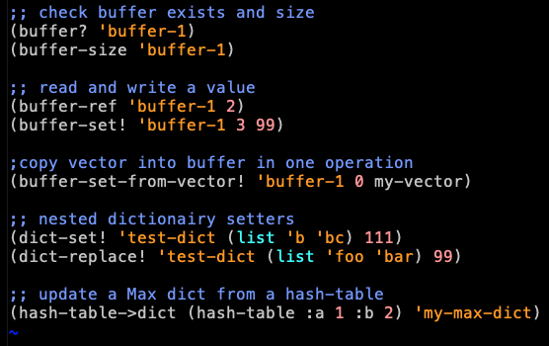
Max data integrations
Buffer, table, and dictionary API
Recursive conversions
Fast copy options

Slide 19
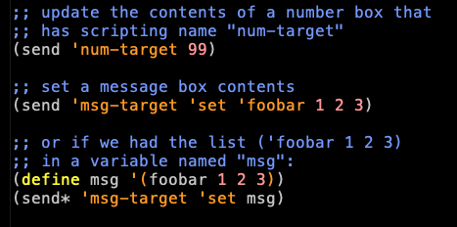
Sending Max messages
Send messages without cables
Enables use as orchestrator
Enables patcher scripting
Enables live-coding

Slide 20
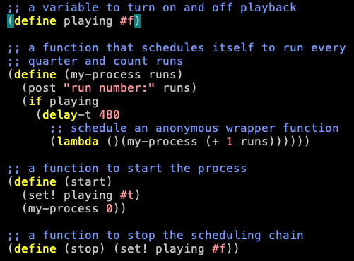
Scheduling Events
Scheduling anonymous functions
Runs in scheduler thread, accurate!
Supports using milliseconds, beats, quantized beats, transport integration

Slide 21
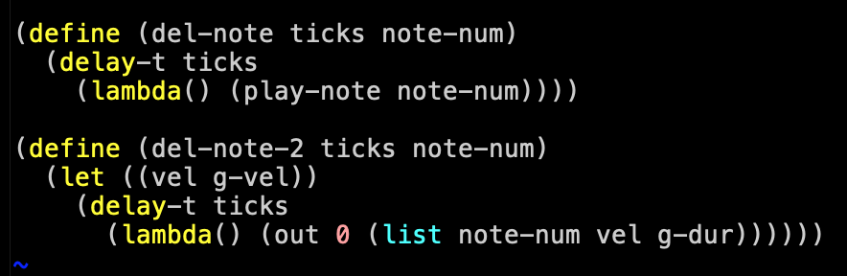
Scheduling and Closures
By using Scheme’s lexically scoped closures, we can schedule functions that use data as it is at scheduling time, or as it will be at execution time.

Slide 22
Conclusion

Slide 23
What has worked well
Performance and stability is suitable for real-world use
Integration with commercial tools works very well
Scheme and Lisp are great for music
Interactive development is awesome

Slide 24
Current Limitations
Realtime limits from garbage collector pauses
Currently a memory leak bug for certain scenarios
Does not run in audio thread (or more than one thread)

Slide 25
Future Work
Integrate with the Bach Project (computer assisted composition in Max)
Work on realtime-appropriate garbage collection
Make a version that runs in the audio thread

Slide 26
Project Pages
GitHub (main page): https://github.com/iainctduncan/scheme-for-max
Documentation: https://iainctduncan.github.io/scheme-for-max-docs/
YouTube channel:
https://www.youtube.com/c/MusicwithLisp

