Slide 1
Scheme for Max
Master of Music Technology – Final Project
Iain C.T. Duncan, University of Victoria

Slide 2
What we will cover

Slide 3
What we will cover
High-level goals

Slide 4
What we will cover
High-level goals
Background and related work

Slide 5
What we will cover
High-level goals
Background and related work
Design decisions

Slide 6
What we will cover
High-level goals
Background and related work
Design decisions
Features and capabilities

Slide 7
What we will cover
High-level goals
Background and related work
Design decisions
Features and capabilities
Evaluation, limitations, and future work

Slide 8
High-Level Goals

Slide 9
High-Level Goals
Build a better computer music programming platform

Slide 10
High-Level Goals
Build a better computer music programming platform
Target advanced users doing hard things

Slide 11
High-Level Goals
Build a better computer music programming platform
Target advanced users doing hard things
Work well with modern, commercial tools

Slide 12
High-Level Goals
Build a better computer music programming platform
Target advanced users doing hard things
Work well with modern, commercial tools
For composer-programmers and tools-programmers

Slide 13
High-Level Goals
Build a better computer music programming platform
Target advanced users doing hard things
Work well with modern, commercial tools
For composer-programmers and tools-programmers
Support all complex scored pieces, real-time interaction, live-coding, and algorithmic music

Slide 14
Background & Related Work

Slide 15
Domain-Specific Languages

Slide 16
Domain-Specific Languages
Music N, Csound, SuperCollider, ChucK, Faust

Slide 17
Domain-Specific Languages
Music N, Csound, SuperCollider, ChucK, Faust
Easy to get making music
Less to decide

Slide 18
Domain-Specific Languages
Music N, Csound, SuperCollider, ChucK, Faust
Easy to get making music
Less to decide
Less flexibility
Cumbersome for programming complex algorithms
Cumbersome for building large tools

Slide 19
Visual Patching Languages

Slide 20
Visual Patching Languages
Max, PureData, Reaktor, VCV

Slide 21
Visual Patching Languages
Max, PureData, Reaktor, VCV
Easy to get started
Easy to build performer interactions
No assumptions about music structure

Slide 22
Visual Patching Languages
Max, PureData, Reaktor, VCV
Easy to get started
Easy to build performer interactions
No assumptions about music structure
A lot to decide to get making music
Cumbersome for programming complex algorithms
Cumbersome for building large tools

Slide 23
General Purpose Languages

Slide 24
General Purpose Languages
C, C++, Python, Ruby, Lisp, Scheme, Haskell, etc.

Slide 25
General Purpose Languages
C, C++, Python, Ruby, Lisp, Scheme, Haskell, etc.
Libraries: STK, PortMidi, PortAudio, Core Audio

Slide 26
General Purpose Languages
C, C++, Python, Ruby, Lisp, Scheme, Haskell, etc.
Libraries: STK, PortMidi, PortAudio, Core Audio
Frameworks: Common Music, Common Lisp Music, Nyquist

Slide 27
General Purpose Languages
C, C++, Python, Ruby, Lisp, Scheme, Haskell, etc.
Libraries: STK, PortMidi, PortAudio, Core Audio
Frameworks: Common Music, Common Lisp Music, Nyquist
Very flexible
Appropriate for complex algorithms
Good tools for large software projects

Slide 28
General Purpose Languages
C, C++, Python, Ruby, Lisp, Scheme, Haskell, etc.
Libraries: STK, PortMidi, PortAudio, Core Audio
Frameworks: Common Music, Common Lisp Music, Nyquist
Very flexible
Appropriate for complex algorithms
Good tools for large software projects
MUCH more to learn, decide, and build

Slide 29
Multi-Language Hybrids

Slide 30
Multi-Language Hybrids
Csound in C or Python, Csound or SuperCollider in Max, Clojure in from of SuperCollider,
JavaScript in Max – GPPL in Max

Slide 31
Multi-Language Hybrids
Csound in C or Python, Csound or SuperCollider in Max, Clojure in from of SuperCollider,
JavaScript in Max – GPPL in Max
We can use the strengths of each component

Slide 32
Multi-Language Hybrids
Csound in C or Python, Csound or SuperCollider in Max, Clojure in from of SuperCollider,
JavaScript in Max – GPPL in Max
We can use the strengths of each component
Even MORE to learn!

Slide 33
Design Decisions

Slide 34
Scheme for Max
Uses Scheme, a GPPL in the Lisp family

Slide 35
Scheme for Max
Uses Scheme, a GPPL in the Lisp family
Embeds this in Max (and Pure Data)

Slide 36
Scheme for Max
Uses Scheme, a GPPL in the Lisp family
Embeds this in Max (and Pure Data)
... where it can work with other (Csound, SC, Faust, VSTs)

Slide 37
Scheme for Max
Uses Scheme, a GPPL in the Lisp family
Embeds this in Max (and Pure Data)
... where it can work with other (Csound, SC, Faust, VSTs)
Essentially a cross between the Max js object and the Common Music toolkit for algorithmic music.

Slide 38
Why use Max as the host?

Slide 39
Why use Max as the host?
Maturity, popularity, breadth of objects

Slide 40
Why use Max as the host?
Maturity, popularity, breadth of objects
Plays well with commercial tools (VSTs, Live, etc.)

Slide 41
Why use Max as the host?
Maturity, popularity, breadth of objects
Plays well with commercial tools (VSTs, Live, etc.)
Designed first around musical events (rather than DSP)

Slide 42
Why use Max as the host?
Maturity, popularity, breadth of objects
Plays well with commercial tools (VSTs, Live, etc.)
Designed first around musical events (rather than DSP)
Has an open-source alternative in Pure Data

Slide 43
Why not just use the js object?

Slide 44
Why not just use the js object?
The js object is mature, with a rich API and extensive documentation

Slide 45
Why not just use the js object?
The js object is mature, with a rich API and extensive documentation
But... the js object only runs in the low-priority thread

Slide 46
Why not just use the js object?
The js object is mature, with a rich API and extensive documentation
But... the js object only runs in the low-priority thread
And... JavaScript is a dog’s breakfast of a language

Slide 47
Why use Scheme (a Lisp)?

Slide 48
Why use Scheme (a Lisp)?
Symbolic computation and macros

Slide 49
Why use Scheme (a Lisp)?
Symbolic computation and macros
Large body of historical and related work: Common Music, Common Lisp Music, OpenMusic, PatchWork, OpusMondi, MozLib, Slippery Chicken, etc., etc.

Slide 50
Why use Scheme (a Lisp)?
Symbolic computation and macros
Large body of historical and related work: Common Music, Common Lisp Music, OpenMusic, PatchWork, OpusMondi, MozLib, Slippery Chicken, etc., etc.
Interactive development with the REPL

Slide 51
Features and capabilities

Slide 52
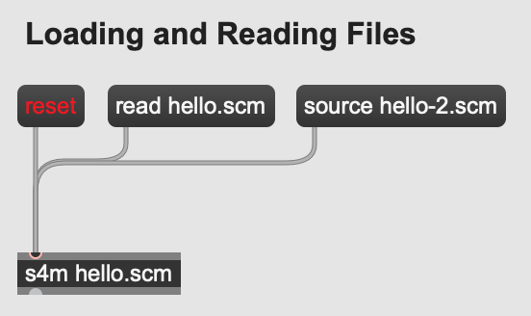
File I/O
Loading a main file from the object
Load other files additively
Read and write to/from the local file system directly

Slide 53
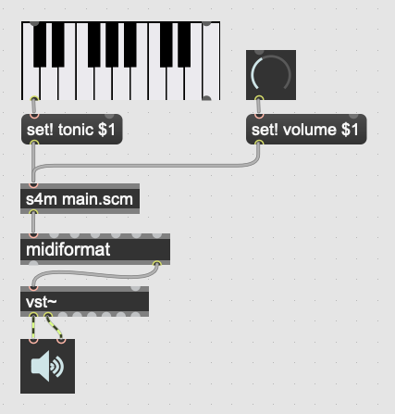
Evaluate messages as code
Max and Scheme syntax compatibility
No need to write callbacks to interact with interpreter

Slide 54
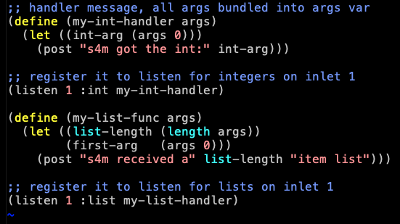
Receive messages as callbacks
Helpful when we don’t control messages (OSC, etc.)
Flexible registration and conversion system

Slide 55
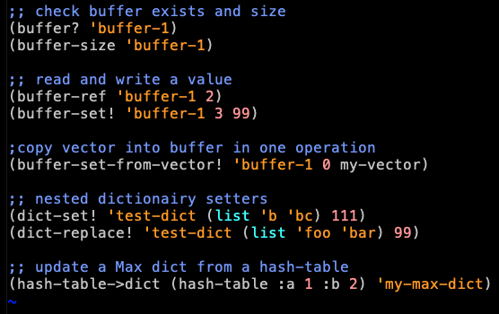
Max data integrations
Buffer, table, and dictionary API
Recursive conversions
Fast copy options

Slide 56
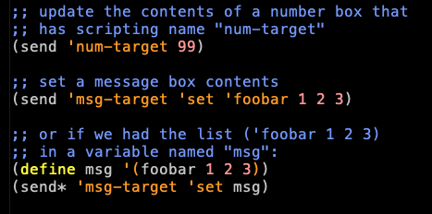
Sending Max messages
Send messages without cables
Enables use as orchestrator
Enables patcher scripting
Enables live-coding

Slide 57
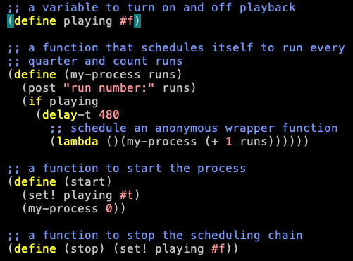
Scheduling Events
Scheduling anonymous functions
Runs in scheduler thread, accurate!
Supports using milliseconds, beats, quantized beats, transport integration

Slide 58
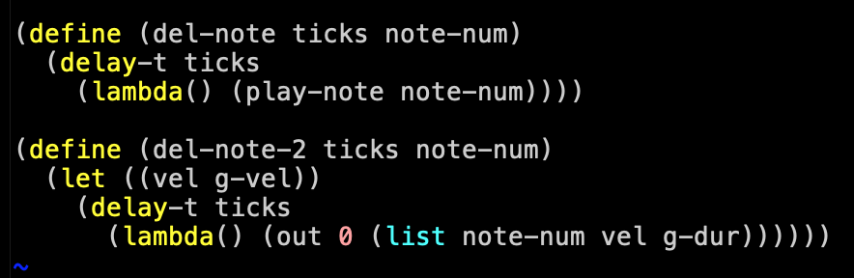
Scheduling and Closures
By using Scheme’s lexically scoped closures, we can schedule functions that use data as it is at scheduling time, or as it will be at execution time.

Slide 59
Conclusion

Slide 60
What has worked well

Slide 61
What has worked well
Performance and stability is suitable for real-world use

Slide 62
What has worked well
Performance and stability is suitable for real-world use
Integration with commercial tools works very well

Slide 63
What has worked well
Performance and stability is suitable for real-world use
Integration with commercial tools works very well
Scheme and Lisp are great for music

Slide 64
What has worked well
Performance and stability is suitable for real-world use
Integration with commercial tools works very well
Scheme and Lisp are great for music
Interactive development is awesome!

Slide 65
Current Limitations

Slide 66
Current Limitations
Realtime limits from garbage collector pauses

Slide 67
Current Limitations
Realtime limits from garbage collector pauses
Currently a memory leak bug for certain scenarios

Slide 68
Current Limitations
Realtime limits from garbage collector pauses
Currently a memory leak bug for certain scenarios
Does not run in audio thread (or more than one thread)

Slide 69
Future Work

Slide 70
Future Work
Integrate with the Bach Project (computer assisted composition in Max)

Slide 71
Future Work
Integrate with the Bach Project (computer assisted composition in Max)
Work on realtime-appropriate garbage collection

Slide 72
Future Work
Integrate with the Bach Project (computer assisted composition in Max)
Work on realtime-appropriate garbage collection
Make a version that runs in the audio thread

Slide 73
Project Pages
GitHub (main page): https://github.com/iainctduncan/scheme-for-max
Documentation: https://iainctduncan.github.io/scheme-for-max-docs/
YouTube channel:
https://www.youtube.com/c/MusicwithLisp

