Slide 1


Open Refine for Humanities
Lucia Michielin
Edinburgh University
L.Michielin@sms.ed.ac.uk

Slide 2

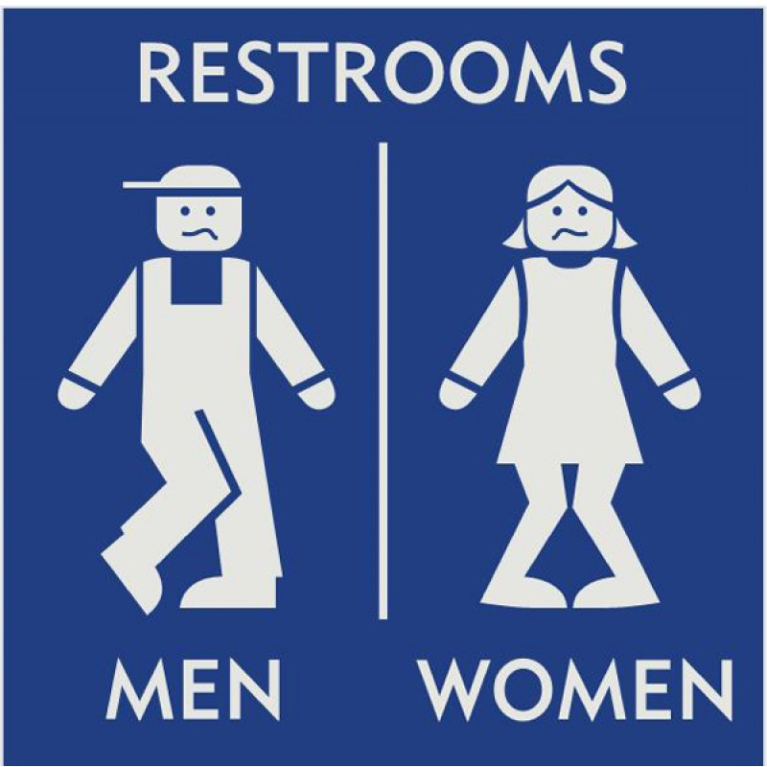

Before starting …some practical info
Coffee break
Restrooms
Stickers

Slide 3
Plan of the Workshop
1. Introduction
2. Working with OpenRefine
3. Filtering and Sorting with OpenRefine
4. Examining Numbers in OpenRefine
5. Scripts from OpenRefine
6. Exporting and Saving Data from OpenRefine
7. Other Resources in OpenRefine

Slide 4
What is it?
1. Introduction
OpenRefine is a standalone open source desktop application for data clean up and transformation to other formats, the activity known as data wrangling.
It is a Java program hence you operate it through your browser but you don’t need to be online.
Works with large-ish datasets (100,000 rows). Does not scale to many millions. (yet).
More information on the software in here.

Slide 5
Why Using Open Refine?
1. Introduction
Helps you dealing with your data (most of all when they start be a lot).
All action within the software are tracked and easily reversible.
You must save your work to a new file; OpenRefine does not modify your original dataset.
Data is often very messy, and this tool saves a lot of time on cleaning (spearing a lot of time).
Data cleaning steps can be saved and applied to multiple files.
It makes clustering easy to do and understand.
Large and helpful community online.

Slide 6
Sticker time!!!
1. Introduction

Slide 7

2. Working with OpenRefine
Questions
How can we bring our data into OpenRefine?
How can we sort and summarize our data?
How can we find and correct errors in our raw data?
Objectives
Create a new OpenRefine project from a CSV file.
Recall what facets are and how they are used to sort and summarize data.
Recall what clustering is and how it is applied to group and edit typos.
Manipulate data using previous steps with undo/redo.
Employ drop-downs to split values from one column into multiple columns.
Employ drop-downs to remove white spaces from cells.

Slide 8

2. Working with OpenRefine
Creating a Project
(Start looking at your data)
More information in here
Main supported files:
TSV
CSV
*SV
Excel (XLS, XLSX)
JSON
XML
RDF as XML

Slide 9
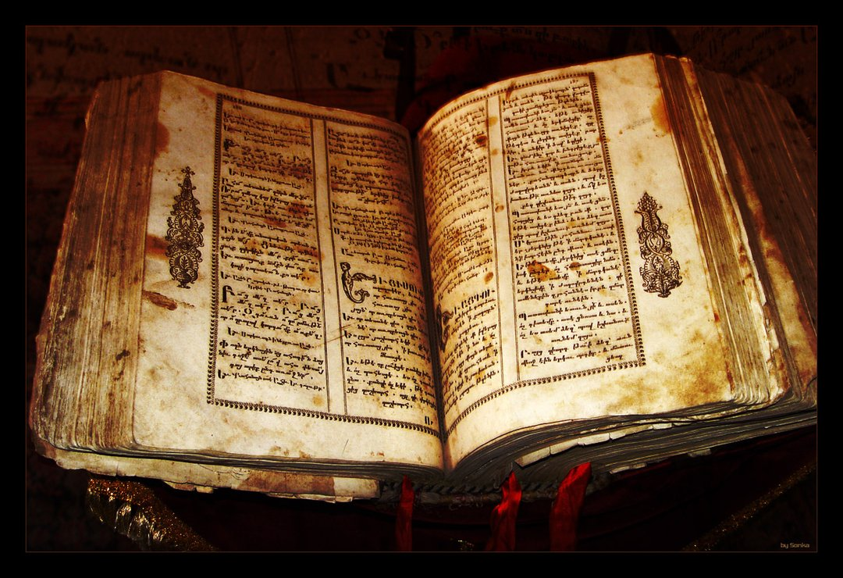
2. Working with OpenRefine
Our Dataset
Real Dataset extract from the Text Creation Partnership
It is a time-series for the texts collected and encoded by the Text Creation Partnership
The file we are going to work with is a CSV file recording a series of information about books encoded in the project
Real dataset messed up for this excersice

Slide 10

2. Working with OpenRefine
Data Faceting
(Exploring data by applying multiple filters)
Seeing the big picture of your data
Filtering down to just the subset of rows that you want to change in bulk.

Slide 11
2. Working with OpenRefine
Exercise: 1
Using faceting, find out how many years are represented in the catalogue.
Is the column formatted as Number, Date, or Text?
Which years have the most and least observations?

Slide 12

Clustering (Finding groups of different values that might be the same thing)
2. Working with OpenRefine
Edit and control typos and different style of representing the same concept (e.g. Elizabeth the first, Elisabeth 1, Elisabeth I…)
More on clustering

Slide 13


2. Working with OpenRefine
Split
(Subdividing the information)
More on Splitting
Exercise: 2
Try to change the name of the second new column to “Author”. How can you correct the problem you encounter?

Slide 14


2. Working with OpenRefine
Undo / Redo
(Control your steps)
Trim Leading and Trailing Whitespace
(Remove blank characters from the beginning and end)

Slide 15
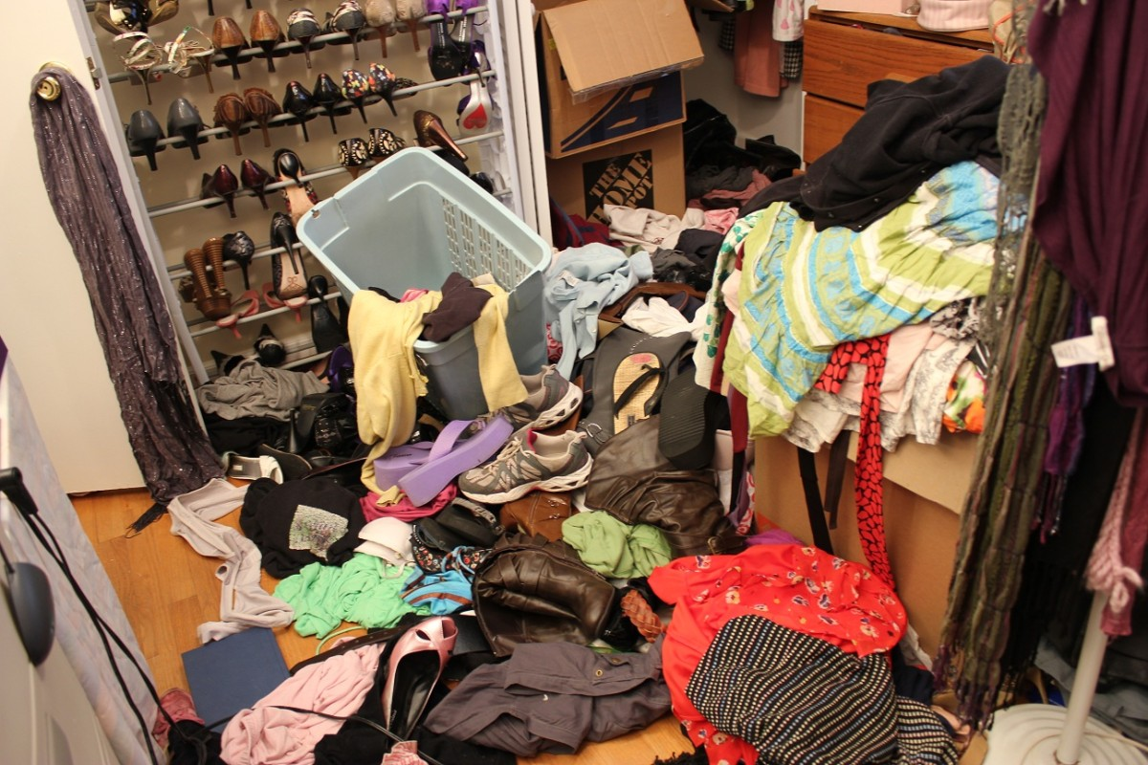
3. Filtering and Sorting with OpenRefine
Questions
How can we select only a subset of our data to work with?
How can we sort our data?
Objectives
Filter to a subset of rows by text filter or include/exclude.
Sort table by a column.
Sort by multiple columns.
Tidying Up your Data!

Slide 16
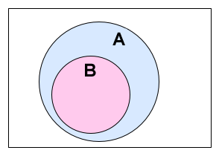

3. Filtering and Sorting with OpenRefine
Exercise 1
Filtering
(Working on a subset)
How would you restrict this to one of the author selected?

Slide 17
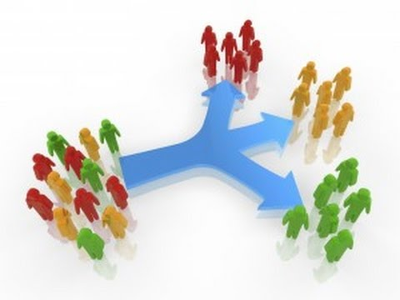
3. Filtering and Sorting with OpenRefine
Sorting Data
(Single column and multiple column)
Exercise 3
You might like to look for trends in your data by Page length of collection across years.
How do you sort your data by year?
How would you do this differently if you were instead trying to see all of your entries in chronological order?

Slide 18
3. Filtering and Sorting with OpenRefine
Sorting Data
(Single column and multiple column)
Exercise 4
Sort by Date, Author and Pages in some order.
Be creative: try sorting as numbers or text, and in reverse order (largest to smallest or z to a).
Use > Sort > Remove sort to remove the sort on the second of three columns. Notice how that changes the order.

Slide 19

4. Examining Numbers in OpenRefine
Questions
Objectives
Transform a text column into a number column.
Identify and modify non-numeric values in a column using facets.
Use scatterplot facet to examine relationships among columns.
How can we convert a column from one data type to another?
How can we visualize relationships among columns?

Slide 20
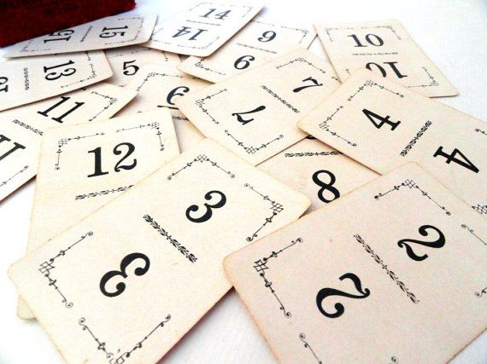
4. Examining Numbers in OpenRefine
Exercise 1:
Transform 3 columns from text data to number data? What happen to the columns that are not numbers?
Exercise 2:
What happen when we have mixed data?

Slide 21
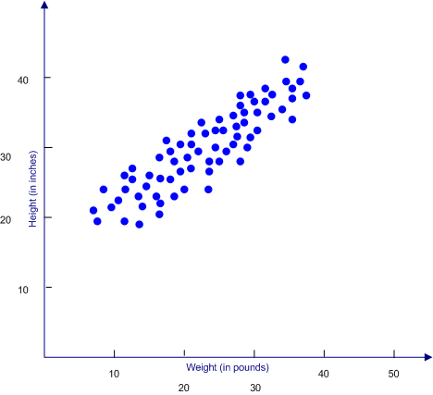
Scatterplot Facet
4. Examining Numbers in OpenRefine
Exercise 3:
Examine the scatterplots overall. Do the patterns make sense?
Why does the scatterplot for VID vs Date have the pattern it does?
3. Click in the scatterplot facet in the left margin and drag to highlight a rectangle. What happen to the data?
4. Redo the Text Filter on Author to show only the entries including the letters Arch. What happen to the scatterplot?

Slide 22

5. Scripts from OpenRefine
Questions
How can we document the data-cleaning steps we’ve applied to our data?
How can we apply these steps to additional data sets?
Objectives
Describe how OpenRefine generates JSON code.
Demonstrate ability to export JSON code from OpenRefine.
Save JSON code from an analysis.
Apply saved JSON code to an analysis.

Slide 23
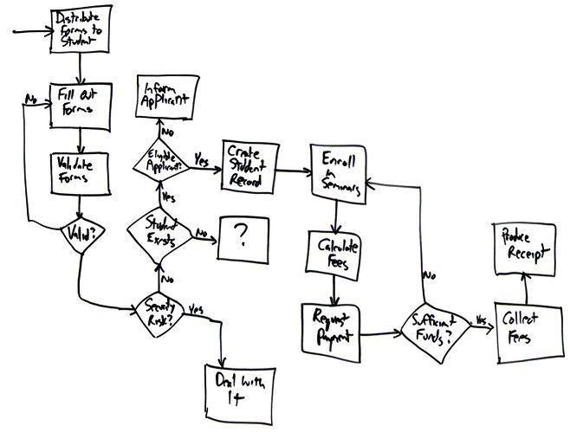
Saving the cleaning flowchart
5. Scripts from OpenRefine
As you conduct your data cleaning and preliminary analysis, Open Refine saves every change you make to the dataset. These changes are saved in a format known as JSON (JavaScript Object Notation). You can export this JSON script and apply it to other data files.

Slide 24


6. Exporting and Saving Data from OpenRefine
Questions
How can we save and export our cleaned data from OpenRefine?
Objectives
Save an OpenRefine project.
Export cleaned data from an OpenRefine project.

Slide 25

7. Other Resources in OpenRefine
Questions
What other resources are available for working with OpenRefine?
Objectives
Understand that there are many online resources available for more information on OpenRefine.
Identify other resources about OpenRefine

Slide 26
7. Other Resources in OpenRefine
OpenRefine web site
OpenRefine Documentation for Users
OpenRefine documentation Wiki site
Using OpenRefine book by Ruben Verborgh, Max De Wilde and Aniket Sawant
OpenRefine history from Wikipedia
Grateful Data is a fun sight with many resources devoted to OpenRefine, including a nice tutorial.
Margaret Heller shows how she uses OpenRefine for Measuring and Counting Impact in Repositories.
Intersect Course Resources has Jared Berghold’s Cleaning & Exploring your data with Open Refine (scroll down page to find).
Enipedia OpenRefine Tutorial

Slide 27

Any Question?

